Slide 1





Feminist Translation
Gu Dongfang
Jiang Fengyi
2020.11.30

Slide 2
1
Background
2
Contents
Feminist Translation Theory
3
Application of Feminist Translation Theory
4
Limitations

Slide 3
1. Background

Slide 4




Background
Feminism
In the 1970s:
The second wave of feminism
Feminism + Translation

Slide 5
2. Feminist Translation
Theory

Slide 6
Feminist Translation Theory
Two
Four
Eliminating Discrimination
one
Equal Relationship
Translator’s
Subjectivity
Three
Five
Translation
is a political act.
Emphasis on Rebellion

Slide 7

Feminist Translation Theory
One: The Subjectivity of the Translator
1.Women Visible
2.Overthrowing the dominant status of men.

Slide 8
Feminist Translation Theory
Two: Eliminating Discrimination
Identify and Criticize
Explore
Shake discrimination

Slide 9
Feminist Translation Theory
Three: Equal Relationship
“master-servant relationship”
“Equal Relationship”

Slide 10
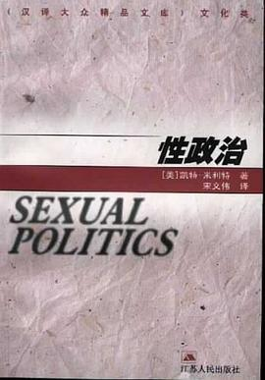
Feminist Translation Theory
Four: A Political Act
The act of translating in a feminist manner is inherently political. It can be said to be a political speech act.

Slide 11
Feminist Translation Theory
Five: Emphasis on Rebellion
Original Text = Men
No absolute fidelity.
Target Text = Women

Slide 12

3. Application of Feminist
Translation Theory

Slide 13

3. Application of Feminist Translation Theory
——The Old Man and Sea Translated by Zhang Ailing
Addition
Example 1: And pain does not matter to a man.
疼痛是不碍事，并不伤人。
Example 2: Let him think I am more than man than I am and I will be so.
让他想着我是个胜过我的人，我就会超过自己。
Notes:
有没有具体的例子

Slide 14
3. Application of Feminist Translation Theory
Preface and Footnotes
Feminist translators often use a preface to explain the main idea of the original work, the purpose of their own selection and translation, and to outline their own translation strategies.

Slide 15
3. Application of Feminist Translation Theory
Hijacking or Misappropriation
Example：
All the time the male had stayed with her…He had stayed so close that the old man was man was afraid…
它离她那样近，老人很怕它会……

Slide 16
4.Limitations

Slide 17
Criticisms of feminist translation theory
Over-emphasis on the Translator’s Intervention
Over-emphasis on the Influence of Sexual Difference upon Translation
3. Over-emphasis on the Manipulation over Language

Slide 18
References
https://www.ipl.org/essay/The-Feminist-Translation-Theory-FKX5QX7ESCFR
2) Criticisms on the Feminist Translation Theory Outside the Feminism. Proceedings of the 2nd. Gu Yingying, International Conference on Humanities Education and Social Sciences (ICHESS 2019), 2019.
3) 袁媛.张爱玲《老人与海》译本中女性主义翻译策略的运用[J].青年文学家,2016(36):116.
4) 浅谈女性主义翻译理论[J].考试周刊，2013（88）.

Slide 19



Thanks for Listening!
Gu Dongfang
Jiang Jengyi

