Slide 1


Global Impact Of Chinese Language
-Chinese fever-

Slide 2







Why does the Chinese language have a global impact?
"Chinese fever" and the Reasons
Contents:
Situation of “Chinese fever” in America 21st Century
How to define the importance and influence of a language?
How to increase?

Slide 3

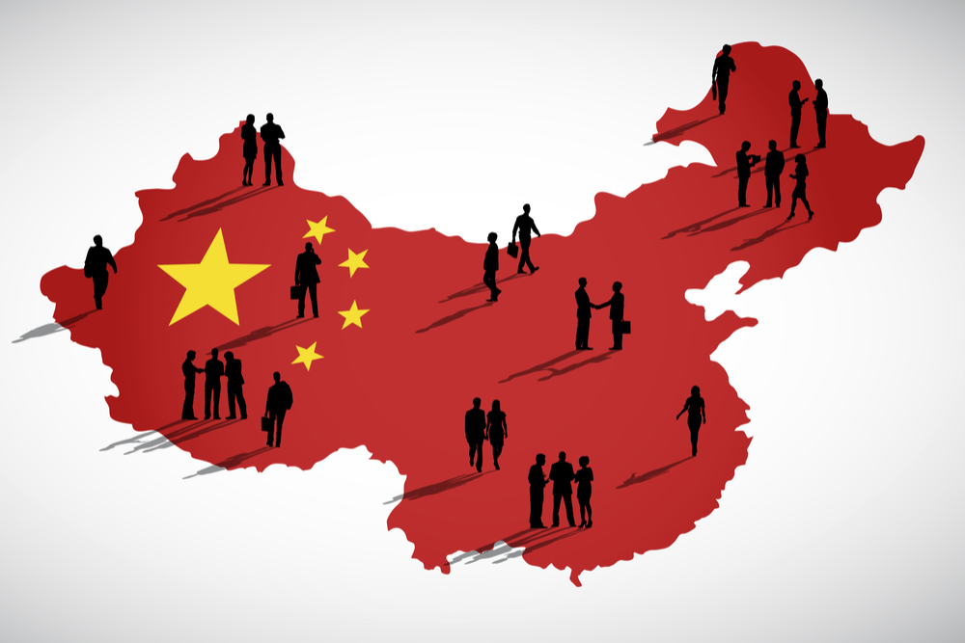


Why does the Chinese language have a global impact?
PART.01
Chinese is the most spoken language in the world with over an estimated billion people in China and various other parts of the world speaking it. China as a country is growing by leaps and bounds as a world power and shows no sign of slowing down.
In terms of education has been shown that Chinese has become a popular choice as a second language among college students in many countries. Surpassing the previous favorite that includes Spanish, French, and German languages.

Slide 4

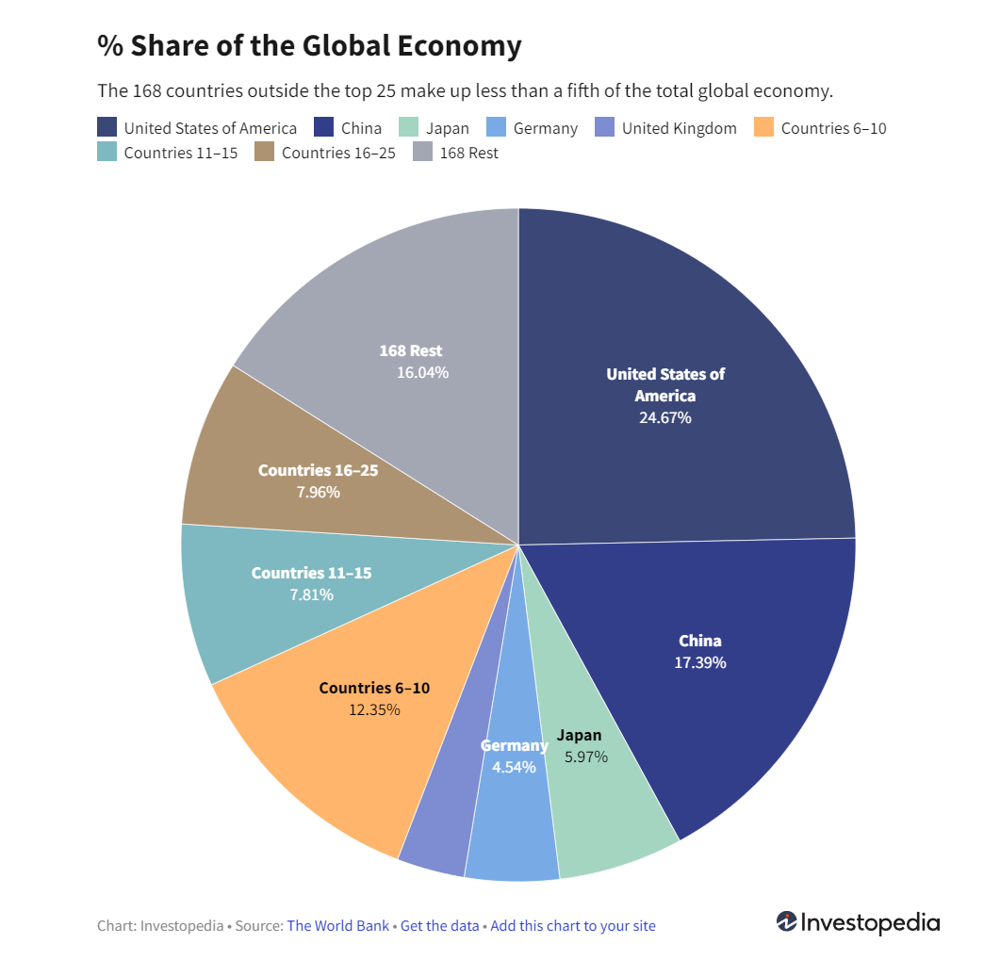
PART.01
continue
Chinese is becoming one of the most important languages when it comes to operating an international business. The Chinese market is the biggest growing market even in this economic downturn.
Expertise in Chinese has grown increasingly important to the overall global economy and many business owners are looking to break into this international market. Any business in the twenty-first century will be trying to do business in China and in doing so will require Chinese speakers to negotiate agreements and develop these trade deals.

Slide 5


“Chinese fever” and the Reasons
PART.02
What is “Chinese fever” or “Mandarin fever” ？
Is the rise of learning Chinese traditional culture and language. During the 21st century, many scholars who studied ancient Chinese literature called for and encouraged them to learn traditional Chinese culture and not forget its roots.
As a result, these scholars carried out propaganda with different influences in different ways. Arousing the passion of the people to re-learn traditional Chinese culture, until becoming a phenomenon of Chinese culture fever and Chinese fever.
“Time Magazine”(American news magazine) expounded its viewpoint on the importance of learning about China. Up till now, learning Chinese has become a hot issue that people have pursued and concentrated on and mandarin fever can be said to become a global issue.

Slide 6



PART.02
continue
The Reasons for the “Chinese fever”
1. Rapid rising and continuously developed China
2. Swiftly developed economy and daily growing comprehensive national strength have attracted the eyeball of the whole world
3. The vigorously developing country with infinite potential has produced infinite hope and incessant illusion among people from all over the world Most importantly, “mandarin fever” has reflected the forecast and anticipation of the world in the future of China.
4. Longstanding ancient culture and square characters with peculiar charm contain profound connotations and are highlighted with attractive glory Chinese characters are the intermediary of Chinese inheritance and the ancient and beautiful Chinese characters are the carrier of Chinese culture and are the attestation of Chinese culture

Slide 7


Situation of “Chinese fever” in America 21st Century
The Chinese culture has seeped into American society. Chinese food has seen a severe climb in popularity. Immigration helps to integrate Chinese cuisine into American culture.
Chinese language class enrollments are increasing rapidly as well. With the growing economy of China, classes in the language are skyrocketing,
PART.03
Interview: Reasons for foreign students to learn Chinese
Student,
Dori Samet, 15, is from Israel. "If I were to start my own business China would be the ideal place," he said.
Alex Kozakov, 14, already speaks Russian fluently and hopes to become a diplomat. "If you want to be a diplomat, Chinese is very useful," Kozakov said.
With China's growing international influence, learning Chinese has become a popular trend in the United States. The United States Council on the teaching of foreign languages estimates has more students study Chinese has been ten times more than the original.

Slide 8

How to define the importance and influence of a language?
PART.04
1. Language, like money, is a currency and a tool. Money simplifies economic transactions,
A language widely used in the world, widely used by many people to contact and Exchange messages, and has a large number of data messages to support. If a language can provide a large amount of data and literature, it can also help to enhance its international hub position and influence.
2. Scholars at MIT and Harvard measure the influence of a language based on international information hubs.
They use data to measure the frequency of language use worldwide. Three channels include translated books, Wikipedia, and Twitter, an online social platform that covers both traditional and electronic information.
3. The study also found a positive relationship between the influence of a language and the number of celebrities who speak it as their mother tongue.
In other words, the more influential a language is, the more prominent people use it as their mother tongue.

Slide 9




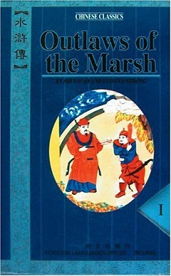



PART.05
How to increase?
If China wants to enhance the International influence of Mandarin and Chinese and hopes that Chinese can provide complementary and benign interaction with economic development, the simplest answer is to translate a large number of foreign documents into Chinese, translate more Chinese documents into multiple languages, and allow and encourage the use of global common platforms to increase the links between Chinese and other languages, thus enhancing the pivotal position of Chinese.

Slide 10
Reference:
Caleb Silver.(2022). The Top 25 Economies in the World
https://www.investopedia.com/insights/worlds-top-economies/
“Chinese Cultural Fever”.(2021), from
https://en.wikipedia.org/wiki/Chinese_Cultural_Feve
Sin Yee Koh.(2020). “Mandarin Fever” and Chinese Language-learning in Brunei’s Middle Schools: Discrepant Discourses, Multifaceted Realities and Institutional Barriers
Wu yuci.(2021).Analysis of the International Influence of Chinese (汉语的国际影响力分析)

Slide 11



感谢观看
Thank you

