Slide 1
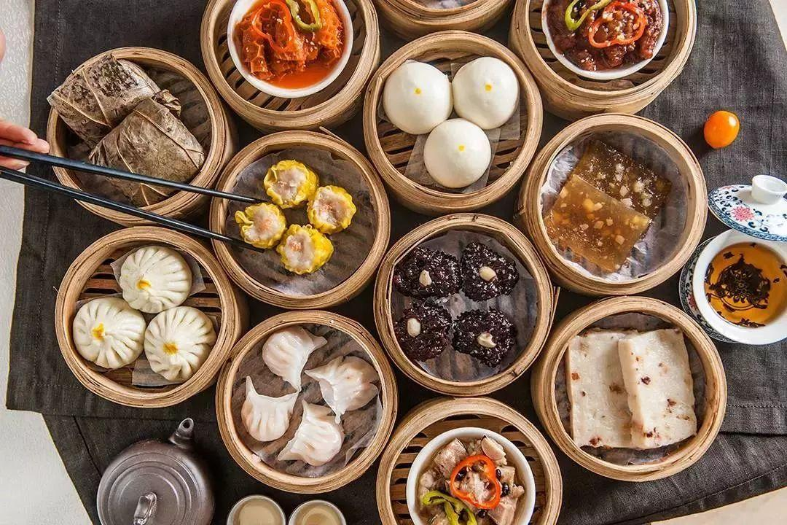
Guangdong Morning Tea Presenter: Yuan Xiaolin

Slide 2
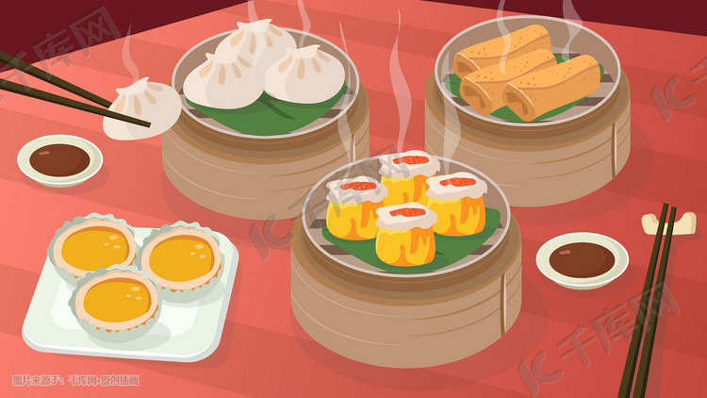
Guangdong Morning Tea 饮茶
a symbol of Cantonese culture
It is significant to Cantonese people
leisure gathering business negotiation

Slide 3
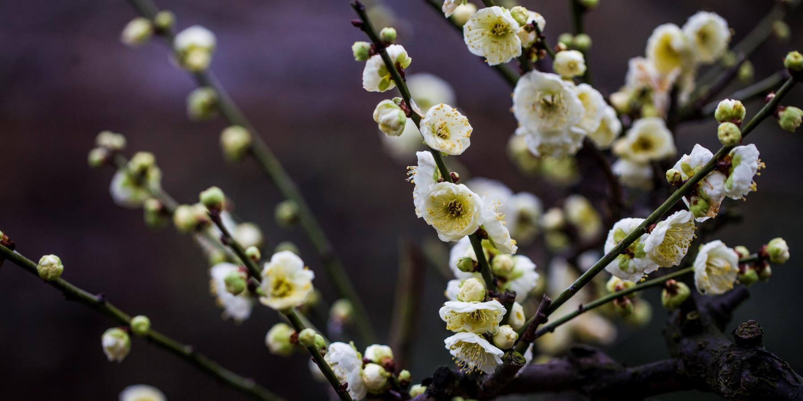
CONTENT
Dishes in Guangdong Morning Tea
Habit
Part one
Part two
Development
Etiquette
Part three
Part four

Slide 4
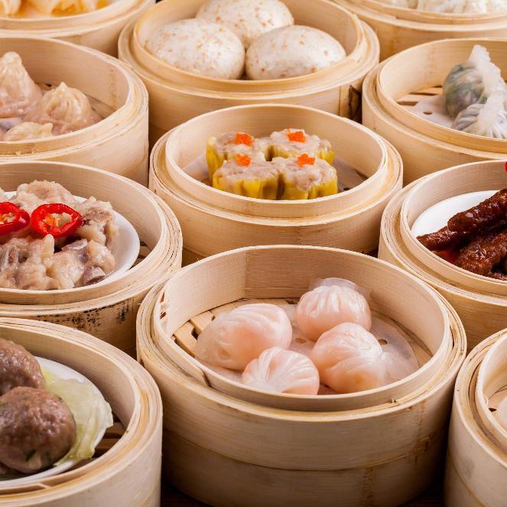
01
Dishes in Guangdong Morning Tea
Part one
How many kinds of dishes are mentioned in the video?

Slide 5
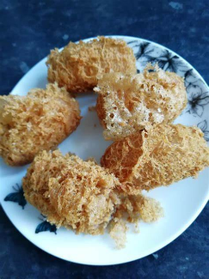
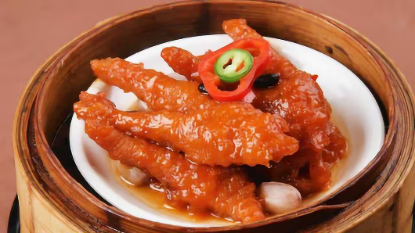
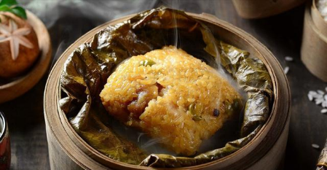
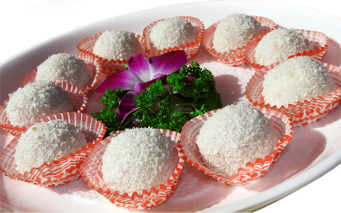
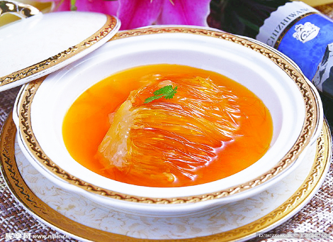
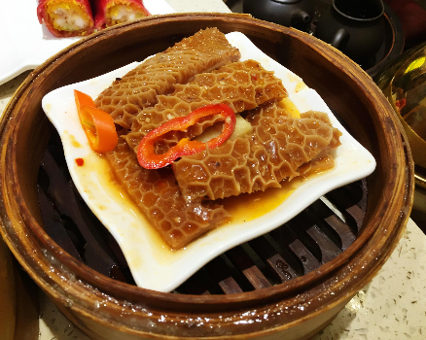
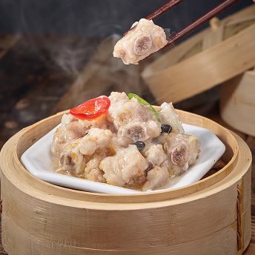
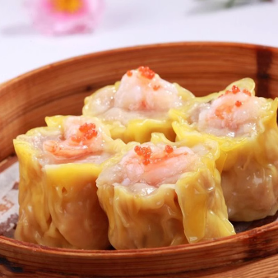
How many kinds of dishes are mentioned in the video?
8
Glutinous Rice Chicken
Glutinous rice dumplings/
Glutinous Paste
taro croquette
Chicken Claw
Bao Chi
Ox Tripe
ribs
Shao-Mai/Siu Mai

Slide 6
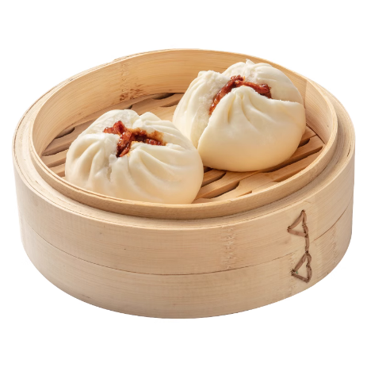
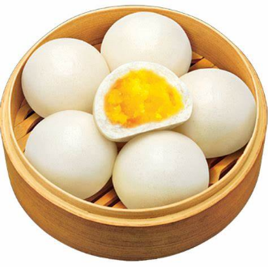
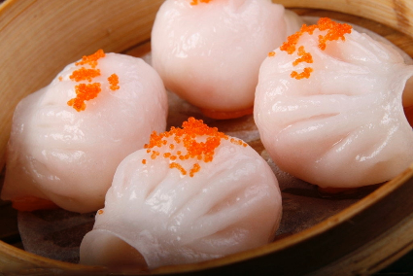
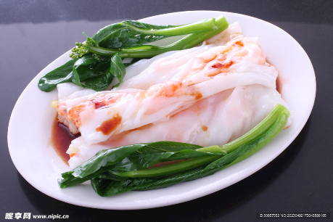
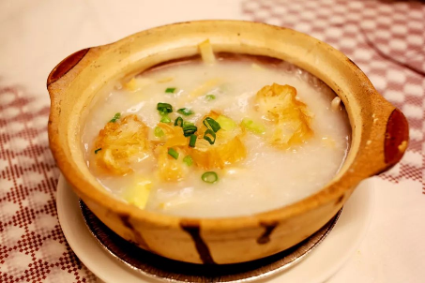
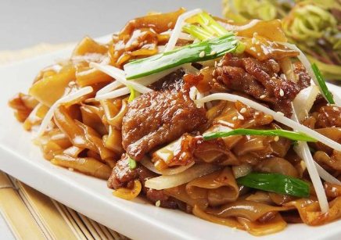
Shrimp dumplings
Barbecue pork bun
Cream Custard Bun
Rice noodle rolls
Sampan Congee/Tingzai porridge
Stir-Fried Rice Noodles with Beef/
Beef Chow Fun

Slide 7
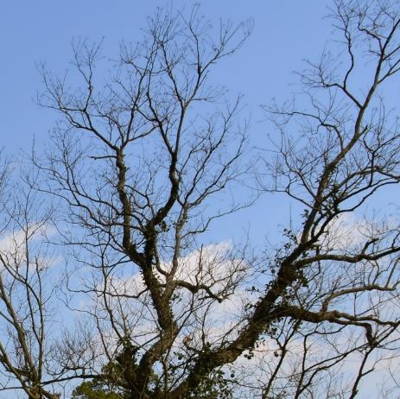
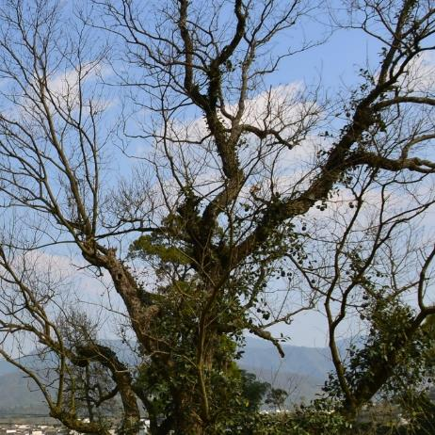
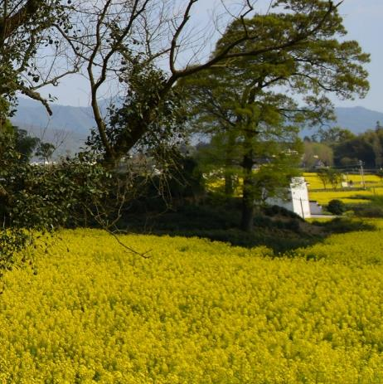
02
Habit
Part two

Slide 8
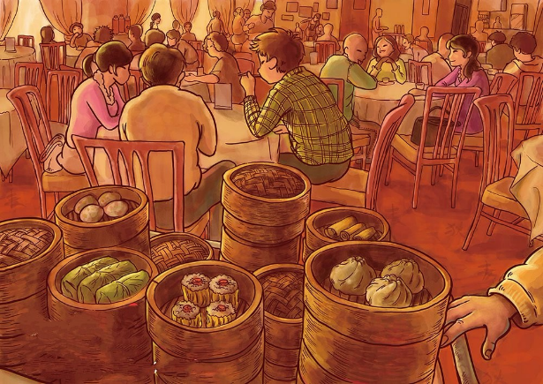
The timing
Some people especially old people choose to have morning tea early mainly to talk with friends.
Some people choose to have morning tea at around lunch time to have breakfast and lunch together.

Slide 9
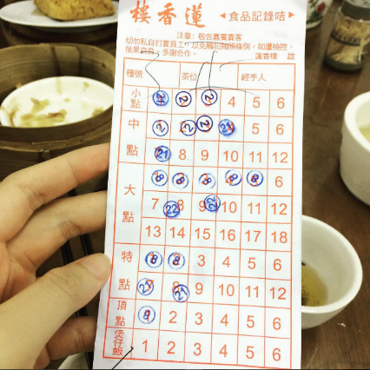
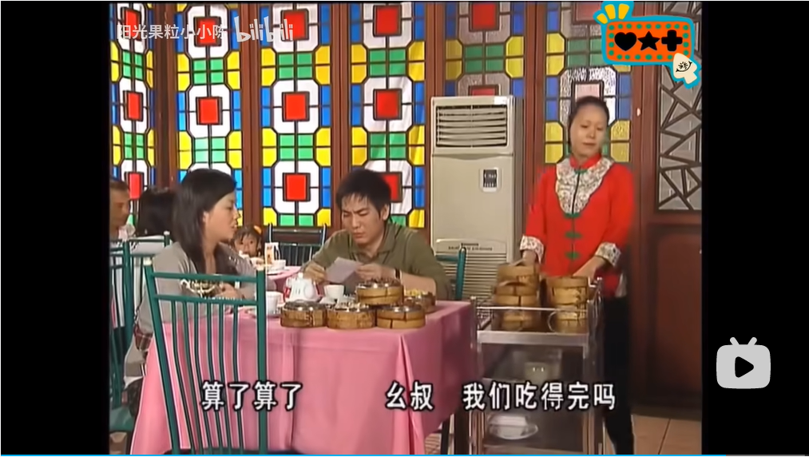
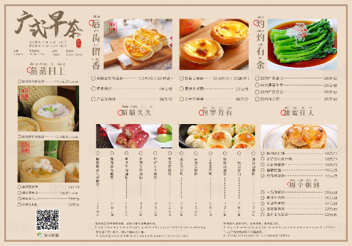
Types of ordering
Use a menu
Use a card
Tick the dishes you want and give the menu to the waiter.
Take the dishes you want from a handcart and then the waiter will stamp on the card.
Or you can go to the order area, choose what you want and give the card to the waiter, then he will deliver the dishes and the card to your table.

Slide 10
03
Etiquette
Part three

Slide 11
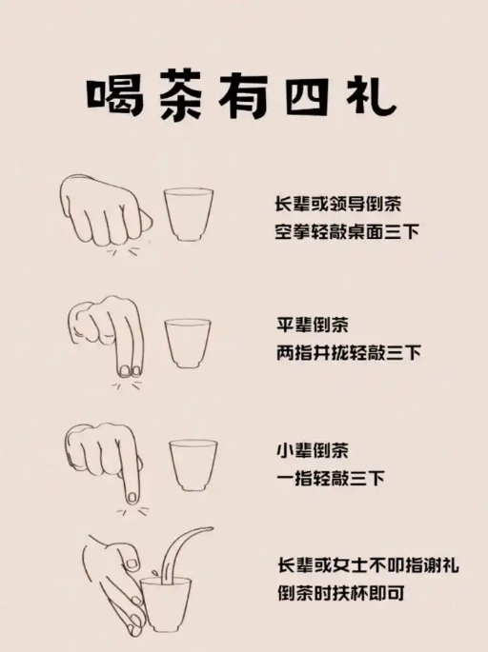
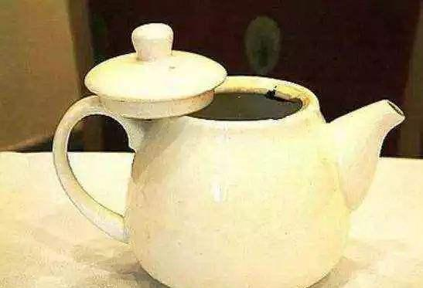
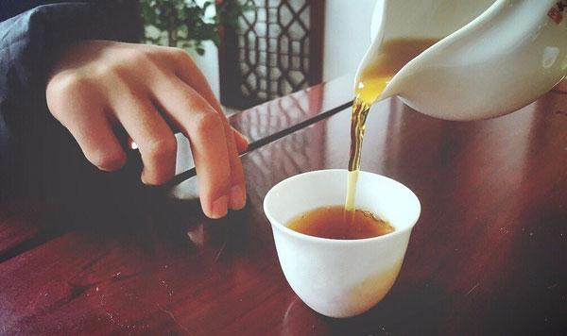
If no water is left in your teapot, you can lift the teapot lid and put it beside to let the waiter know.
If others pour tea for you, you can tap your fingers or knock your hand on the table to express your thanks.

Slide 12
The origin of “叩手礼”
In Qing Dynasty, the emperor Qianlong and his officials went to Jiangnan.
In a teahouse, Qianlong poured tea for his officials.
According to the etiquette system, officials should kowtow to the emperor.
But they didn’t want others to know their social status.
So the official tapped his fingers on the table in place of the kowtow ceremony to show his respect to the emperor.

Slide 13
04
Development
Part four

Slide 14
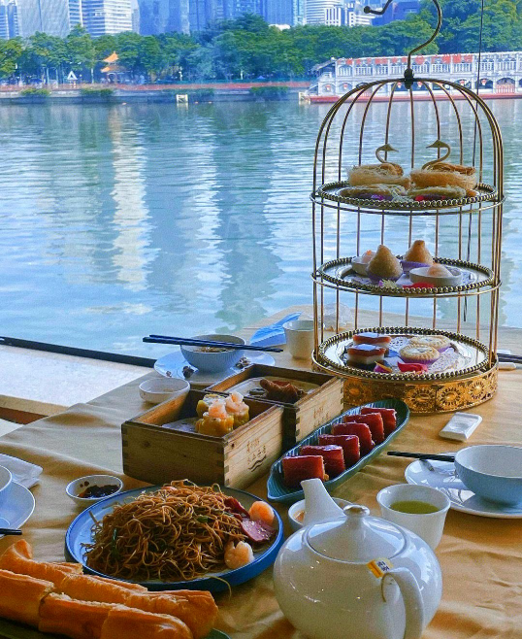
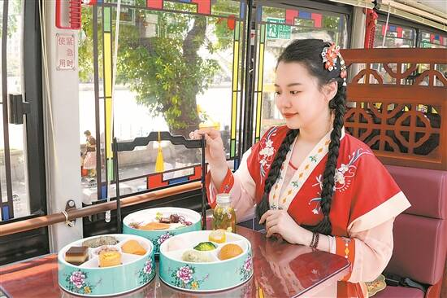
Morning tea bus
Morning tea boat

Slide 15
Thanks for your listening.

