Slide 1



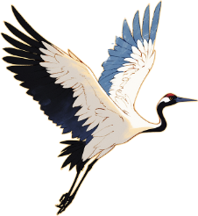






Jiangxi Gan Opera
Wang Xinyu
2025.3.21

Slide 2

catalogue
Origins and significance of Gan Opera
Features of Gan Opera
Themes of Gan Opera Plays
Modern development of Gan Opera

Slide 3
01
Origins and significance of Gan Opera
————————————————————

Slide 4

Origins and Early Development
Fusion of Local and Migrant Traditions
Survival Through Dynasties
Patronage and Growth
At the turn of the century,Gan Opera was born in Southern Jiangxi.It integrated local folk arts with the traditions of relocated opera troupes,such as the lively charm of Gan Nan Caicha Opera and the solemnity of the Huiban troupes.At that time,Gan Opera was mainly characterized by the“Yiyang Tune,”whose high-pitched and stirring vocal style originated from the shamanistic songs in folk sacrificial ceremonies,reflecting the ancient people’s awe and reverence for nature and deities.
During the Ming and Qing dynasties,Gan Opera underwent several cultural transformations but remained deeply rooted in the folk culture.In the Ming dynasty,as opera flourished,Gan Opera absorbed the delicate performance style of Kunqu Opera.In the Qing dynasty,Gan Opera developed both in the imperial court and among the common people,becoming an essential form of performance for court celebrations and folk festivals.It witnessed the prosperity and evolution of Chinese opera.
The generous patronage of Qingyang merchants provided Gan Opera with stable financial support,enabling its rapid development during the Ming and Qing dynasties,with a rich repertoire and highly skilled performers.The prosperity of Gan Opera in this period was also due to its close integration with religious ceremonies,making it an essential part of folk sacrificial and blessing activities.

Slide 5
02
Features of Gan Opera
————————————————————

Slide 6
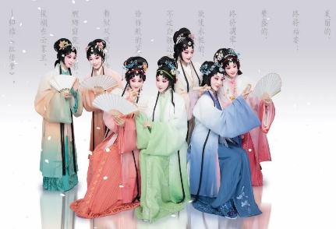
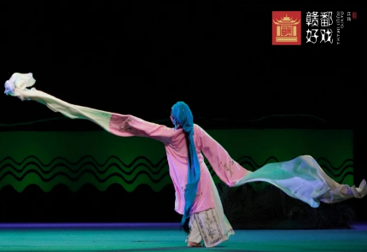
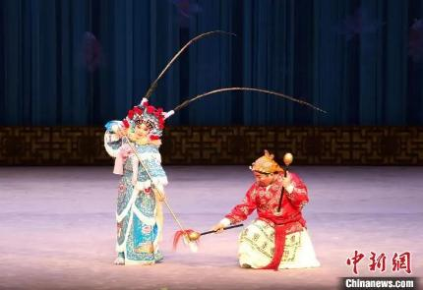
The Art of Performance
Music and Singing
Acrobatics and Action
Characteristics of “Gao Qiang” (High-Pitched Tunes)
Use of Traditional Instruments
Physical Performances on Stage
Costumes and Makeup
Symbolism of Colors and Patterns in Costumes
Meanings of Facial Makeup Colors

Slide 7
03
Themes of
Gan Opera Plays
————————————————————

Slide 8

Historical Dramas
Stories of Emperors and Generals
There are many Gan Opera plays that feature emperors and generals from ancient Chinese history as protagonists,such as"Farewell My Concubine"and"Changbanpo,"which showcase their bravery and wisdom.These plays not only have high artistic value but also,through vivid performances,convey the essence of ancient Chinese history and culture to the audience.
Legends of Historical Figures
Gan Opera also tells many legendary stories of historical figures,such as"Su Wu Herding Sheep"and"Yue Fei Resisting the Jurchens,"which highlight their noble character and patriotic spirit.Through vivid performances,these plays enable the audience to gain a deeper understanding of the deeds and spiritual essence of these historical figures in ancient China.
Reflections of Historical Events
Many Gan Opera plays reflect significant historical events in ancient China,such as"The Burning of Books and Burying of Scholars"and"The Battle of Red Cliffs."Through the form of drama,these plays depict the grandeur and solemnity of these events.Not only do they possess high artistic value,but they also convey the essence of ancient Chinese history and culture to the audience through vivid performances,enabling viewers to gain a deeper understanding of ancient Chinese history.

Slide 9
04
Modern development of Gan Opera
————————————————————

Slide 10
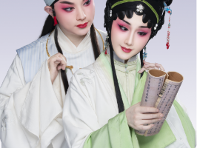
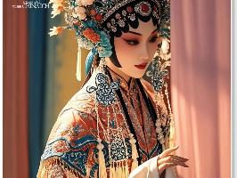
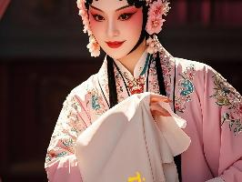
New Audiences and Markets
Attracting Younger Generations
Expanding International Reach
Collaborations with Modern Media

Slide 11
Thank you

