Slide 1
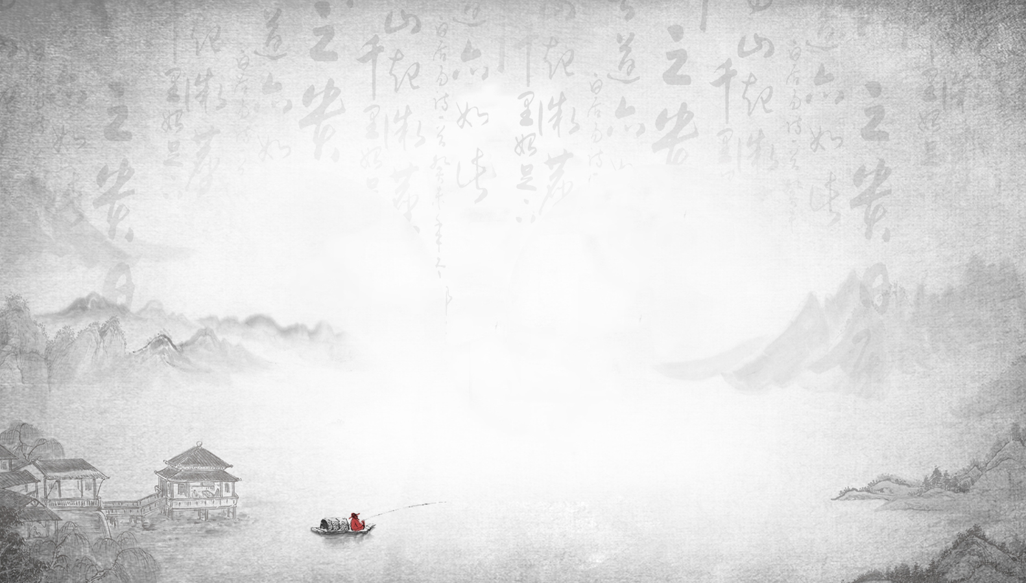

江 雪
Fishing in Snow
Lei Fangyuan(雷方圆） Guan Qinqing(管钦清）
Notes:
大侠素材铺 https://dxpu.taobao.com

Slide 2



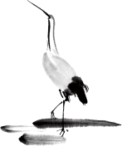
Contents
A Brief Introduction of Fishing in Snow
Translation Appreciation and Comparison
Translation Strategies of Poetry

Slide 3
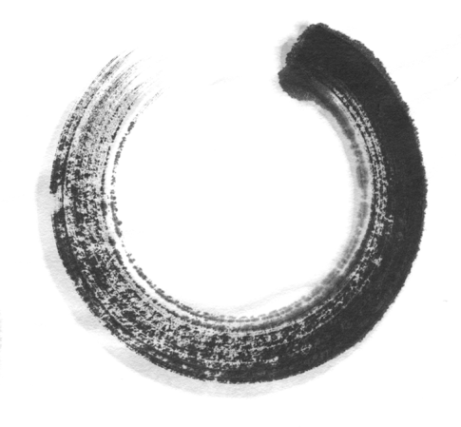
One
A Brief Introduction of
Fishing in Snow

Slide 4
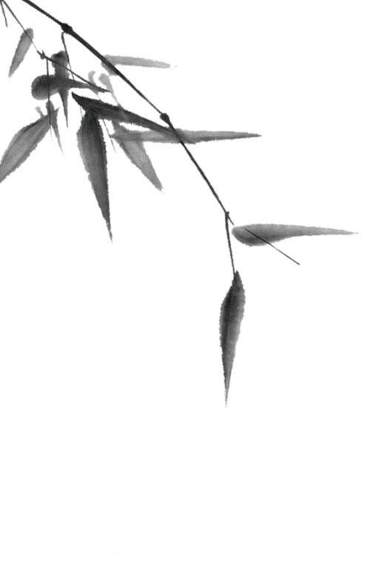

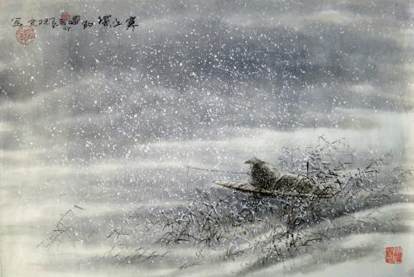
A Brief Introduction of Fishing in Snow
《江雪》这首五言绝句作于诗人谪居永州期间。当时柳宗元被贬到永州,由于仕途遭受挫折,他在精神上受到很大打击。这首诗体现的就是他借助对隐居山水的渔翁的歌咏,排遣自己在政治上失意的苦闷和压抑,寄托自己清高孤傲的情怀。
The five-character quatrain River in Snow was written during the poet Liu Zongyuan's exile in Yongzhou. Due to the setbacks in his career, he suffered from a great mental blow. This poem，in line with the description of the fisherman who lives in seclusion,dispels Liu's political frustration and depression, and entrusts his great priggish and lonely spirit.

Slide 5

A Brief Introduction of Fishing in Snow
江 雪
千山鸟飞绝，
万径人踪灭。
孤舟蓑笠翁，
独钓寒江雪。

Slide 6
Two
Translation Appreciation and Comparison

Slide 7
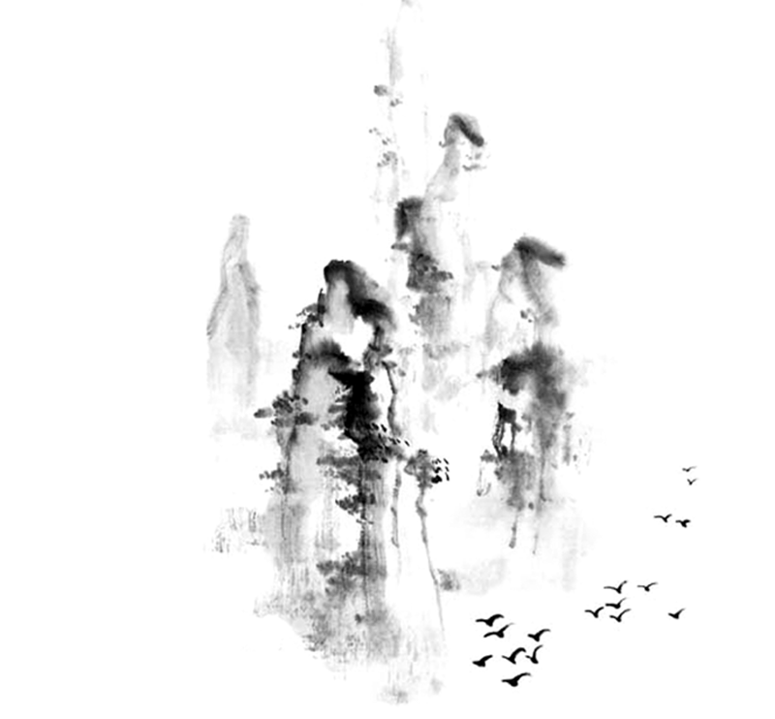
Translation Comparison and Appreciation
Fishing in Snow
From hill to hill no bird in flight ;
From path to path no man in sight.
A lonely fisherman afloat,
Is fishing snow in lonely boat.
《汉英对照唐诗三百首》, 2000:55 ^{[1]}

Slide 8
Translation Comparison and Appreciation
River Snow
These thousand peaks cut off the flight of birds,
On all the trails, human tracks are gone.
A single boat-coat——hat——an old man,
Alone fishing chill river snow.
Gary Snyder, 转引自Weinberger, 2003:139^{[2]}

Slide 9
Translation Comparison and Appreciation
River Snow
A thousand peaks:no more birds in flight,
Ten thousand paths:all trace of people gone.
In a lone boat, rain cloak and hat of reeds,
An old man’s fishing the cold river snow.
David Hinton, 转引自Weinberger, 2003 ^{[3]}

Slide 10
Translation Comparison and Appreciation
River Snow
A hundred mountains and no bird,
A thousand paths without a footprint,
A little boat, a bamboo cloak,
An old man fishing in the cold river-snow.
Witter Bynner, 1929:550^{[4]}

Slide 11
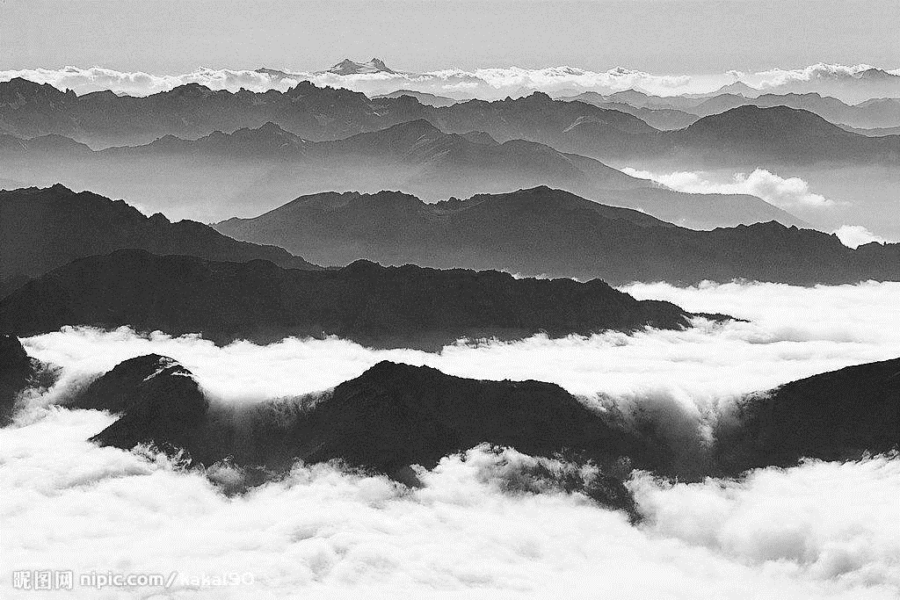
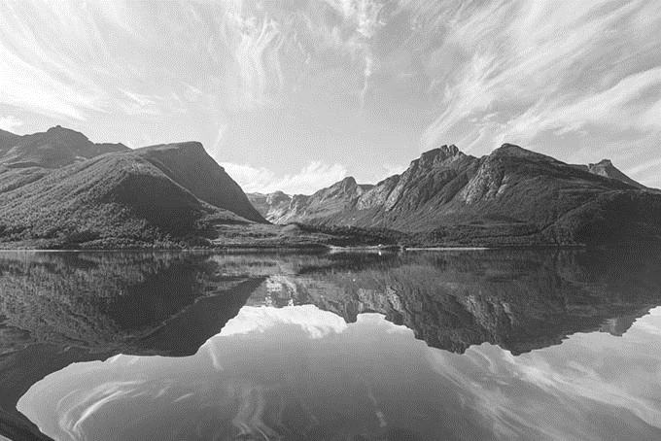
诗名赏析
诗名：江雪
译文一
译文二
Fishing in Snow
River Snow

Slide 12
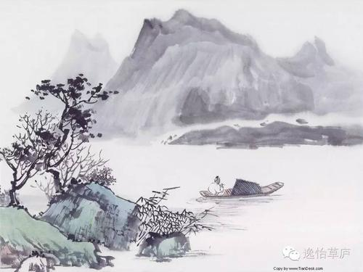
原诗：千山鸟飞绝,万径人踪灭。
译文1：hill
译文2: peaks
译文3: peaks
译文4: mountains

Slide 13

原诗：千山鸟飞绝,万径人踪灭。
From hill to hill no bird in flight ;
From path to path no man in sight.
译文一
A hundred mountains and no bird;
A thousand paths without a footprint.
译文四

Slide 14

原诗：千山鸟飞绝,万径人踪灭。
译文一:
From hill to hill no bird in flight ;
From path to path no man in sight.
译文二:
These thousand peaks cut off the flight of birds,
On all the trails, human tracks are gone.

Slide 15

原诗：孤舟蓑笠翁,独钓寒江雪。
译文1:lonely
译文2:single
译文3:lone
译文4:little

Slide 16
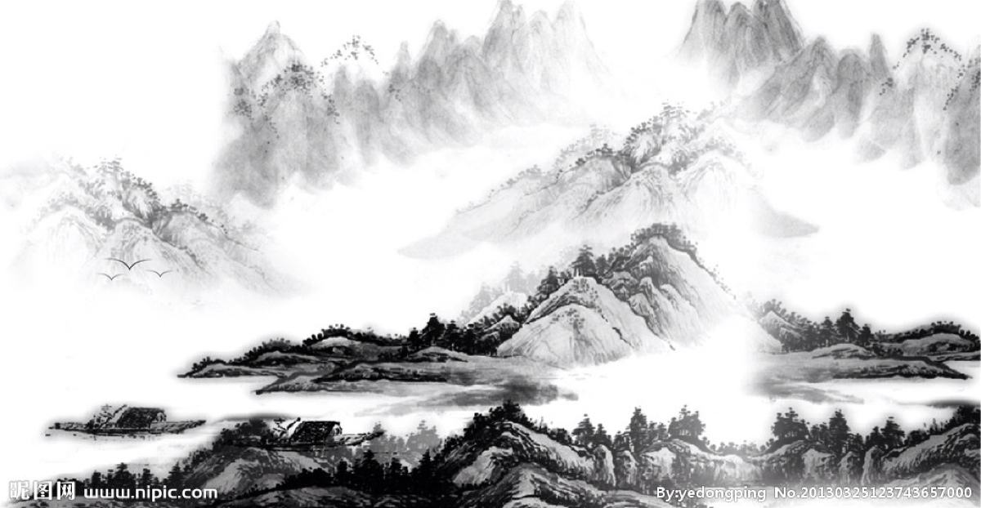
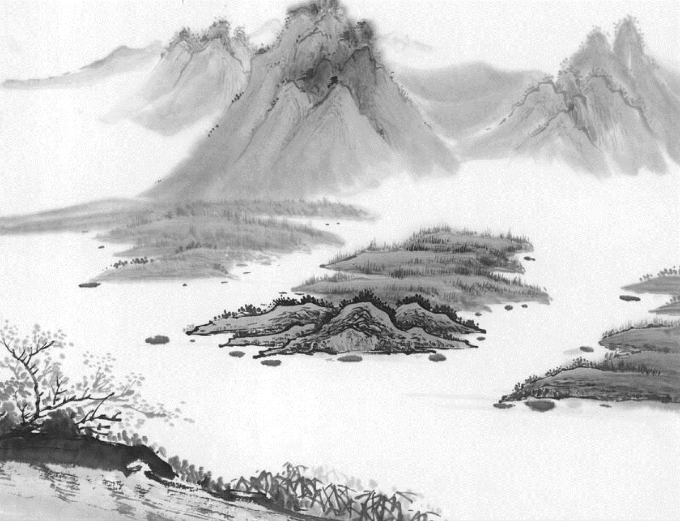
原诗：孤舟蓑笠翁,独钓寒江雪。
蓑笠翁
译文一：fisherman
译文二：A single boat—boat—hat—an old man
译文三：In a lone boat,rain cloak and hat of reeds
译文四：A little boat, a bamboo cloak

Slide 17

原诗：孤舟蓑笠翁,独钓寒江雪。
壹
译文一
贰
译文二
Is fishing snow in a lonely boat.
Alone fishing chill river snow.
叁
译文三
肆
译文四
An old man’s fishing the cold river snow.
An old man fishing in the cold river-snow.

Slide 18
Three
Translation Strategies of Poetry

Slide 19

Translation Strategies of Poetry
直译法
Literal Translation
散文翻译法
Poetry into Prose
无韵诗翻译法
Blank Verse
——————————————————————————————————
音位翻译法
Phonemic Translation
韵律翻译法
Metrical
Translation
谐韵翻译法
Rhyme
解释和拟作
Interpretation and Imitation
《当代美国翻译理论》,2001:68^{【5】}
2020-11-16
Chinese Languages and Cultures
12

Slide 20

Bibliography
[1] 许渊冲.汉英对照唐诗三百首[M].北京:高等教育出版社, 2000.
[2] 马红军.从文学翻译到翻译文学[M].上海:上海译文出版社, 2006.
[3] Weinberger, Eliot.The New Directions Anthology of Classical Chinese Poetry[Z].New York:New
Directions, 2003.
[4] Witter Bynner&K iang Kang-hu.The Jade Mountain:A Chinese Anthology, Being Three Hundred Poems of the T'ang Dynasty[Z].New York:Alfred A.Knope, 1929.
[5]郭建中.当代美国翻译理论[M].湖北:湖北教育出版社，2001.
[6]常青.从 《江雪 》的英译诗谈诗歌翻译的策略[J].辽宁：鞍山师范学院学报,2008.

Slide 21
Thank
you !
Notes:
大侠素材铺 淘宝店：https://dxpu.taobao.com/

