Slide 1









Early Literary Examples
Translations by Lin Shu
林纾先生(1852-1924)的文学翻译
Xu Pengfei & Xiao Yining

Slide 2



Content
1.Historical background.
2.Introduction of Lin Shu.
3.Lin Shu's translations.
4.Excerpt appreciation
5.Evaluation

Slide 3


1.Historical background

Slide 4

“俄北瞰，英西睽，法南瞬，日东耽，处四强邻之中而为国，岌岌哉！”
To save this old country, people started to learn from Western countries.
Patriots like Lin Zexu, Wei Yuan, Yan Fu...
Demand for translation increased.
Translation schools were established.
Lots of good translators emerged.

Slide 5
2.Introduction of Lin Shu

Slide 6
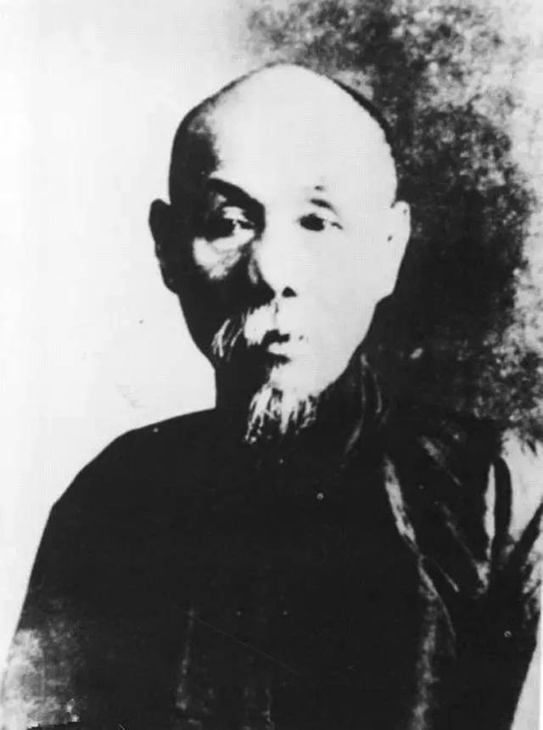

He is a great but controversial translator.
He deeply studied Chinese literature.
He didn't know any foreign languages but he translated over 200 works.
His translations cover works from English, American, Russian, Greek, Japanese, Spanish and so on.
He is highly grounded as “king of translation”, but he is also criticized by generations.
林纾，字琴南

Slide 7



Cooperation
王寿昌、魏易、王庆骥、王庆通
“耳受手追，声已笔止。”
Classical Style
韩愈、司马迁

Slide 8
3.Lin Shu's translation

Slide 9
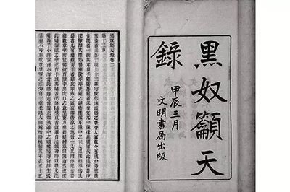
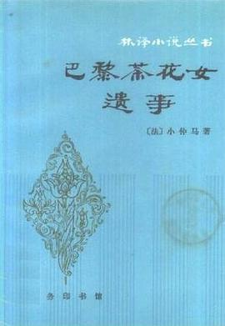
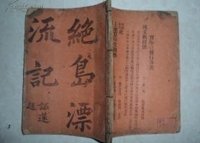
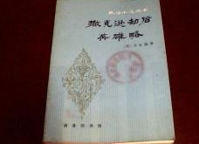
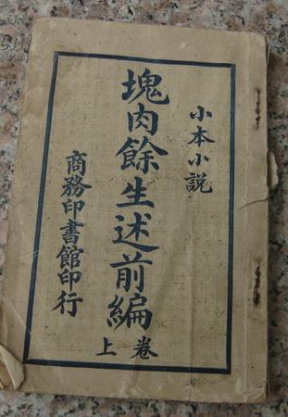
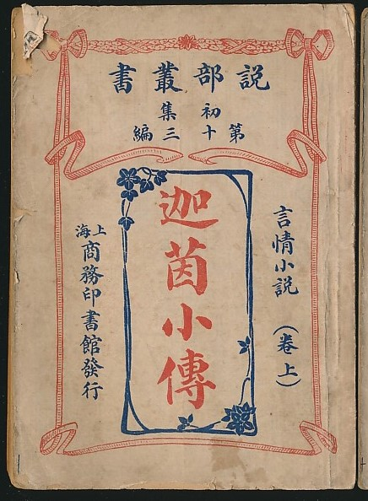
His main works——林译小说
《黑奴吁天录》1905
（Uncle Tom's Cabin)
《茶花女遗事》1895
（La dame aux camélias）
王寿昌
《鲁宾逊漂流记》1905
（Robinson Crusoe)
《撒克逊劫后英雄略》1905
（Ivanhoe）
《块肉余生述》1908
（David Copperfield)
《迦茵小传》1905
（Joan Haste)

Slide 10

His other translation
《吟边燕语》（1903）
《伊索寓言》（1903）
《利俾瑟战血馀腥记》（1904）
《埃斯兰情侠传》（1905）
《英孝子火山报仇录》（1905）
《雾中人》（1906）
《海外轩渠录》（1906）
《拊掌录》（1907）
《滑稽外史》（1907）
《孤星泪》（1907）
《贼史》（1908）
《不如归》（1908）
《脂粉议员》（1909）
《古鬼遗金记》（1912）
《离恨天》（1913）
《哀吹录》（1915）
《鹰梯小豪杰》（1916）
《社会声影录》（1917）
《现身说法》（1918）
《铁匣头颅》（1919）
《赂史》（1920）
《马妒》（1921）
《魔侠传》（1922）
《情天补恨录》（1924）

Slide 11
4.Excerpt Appreciation

Slide 12


Marguerite is still conscious of what goes on around her, and she suffers in body, mind and heart. Big tears trickle down her cheeks so thin and pale that you would never recognize the face of her whom you loved so much, if you could see her. She has made me promise to write you when she can no longer write, and I write before her. She turns her eyes toward me, but she no longer sees me; her eyes are already veiled by coming of death; yet she smiles, and all her thoughts, all her soul are yours, I am sure. Every time the door opens her eyes brighten, and she thinks you are going to coming in; then when she sees that it is not you, her face resumes its sorrowful expression a cold sweat breaks out over it, and her cheek-bones flush．
马克弥留中尚略觉双泪渍颊上，颊已瘦损，附骨色如死灰。君苟见之，并不识为向日意中人也。马克既不能书，属余书之，而目光恒注余笔端，时时微笑。想其心肝，并在君左右。时见开门，辄张目视以为君入; 审其非是，睫又旋和。汗发如沸渖，触之冰凉如水，两颧已深紫如蕴血。

Slide 13
5.Evaluation

Slide 14

Creation Rewriting Domestication Free translation
Advantages:Fluid and graceful translation
High readability
Vivid language
Expressiveness√
Disadvantages:Mistranslations and omissions
（1.Fast translation
2.Interpreters' mistakes
3.Personal taste.)
Faithfulness×

Slide 15

“Customs officer and smuggler”
译才并世数严林，百部虔初救世心. ——康有为
“则谓吾华有国度耶？无国度耶？观哲而治与友书，
意谓无国之人，虽文明者亦施我以野蛮之礼，则异日吾华为奴张本，不即基于此乎？……则吾书虽俚浅，亦足为振作志气，爱国保种之一助，海内有识君子，或不斥为过当之言乎？”——林纾
大凡文字务求怪异之人，必系邪僻之士。文体既坏，士风因之。夫叙事述理，中国自有通用名词，何必拾人牙慧。又若外国文法，或虚实字义倒装，或叙说繁复曲折，令人费解，亦所当戒。——张之洞

Slide 16

“Customs officer and smuggler”
As above we can see, translation in the way of foreignization did not get the approvement of the government.
Undoubtedly, Lin Shu is a patiot who seeks to convey new thoughts to save China. However, people and government in late Qing dynasty were still immersed in old tradition and resisted to accept new cultural forms.
To understand and evaluate Lin Shu, we should not only analyze his translation behavior and results, but also to study his translation purpose and background.
He has made many achievements in the field of translation, which has provided basis for future studies. He made great contributions to cultural communication and largely broadened people's horizons in that era.

Slide 17
Thank You!
Have a nice day (๑•̀ㅂ•́)و✧

