Slide 1
The Beef Board Noodle
汇报人: 郑珊
2025年11月20日

Slide 2
目录
Overview of Hebei Beef Board Noodle
Origin、Development and Spread
01
02
CONTENTS
Process of making
cultural value extension
03
04

Slide 3
Overview of Hebei Beef Board Noodle
01

Slide 4
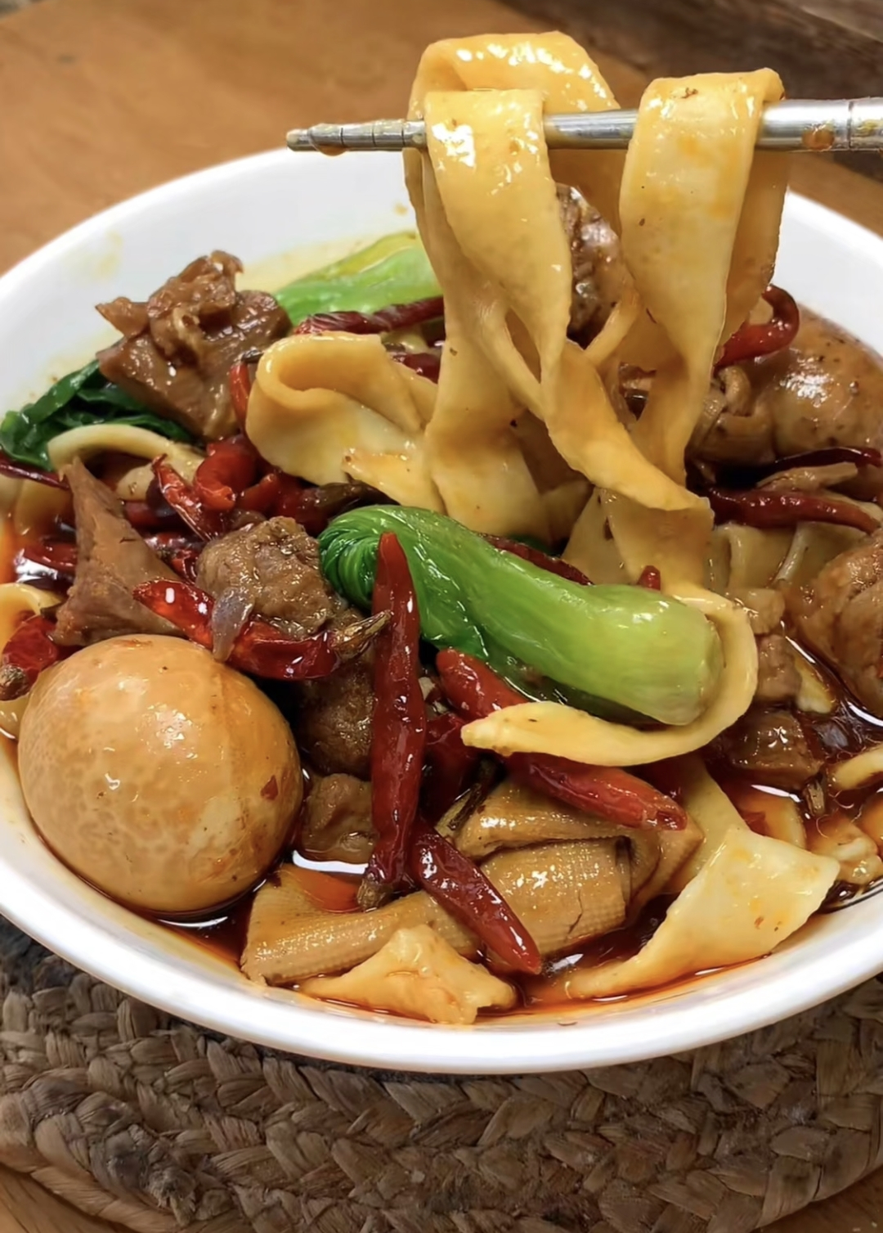
Overview of Hebei Beef Board Noodle
Shijiazhuang Beef Noodle Soup is a traditional dish with local characteristics, renowned for its rich beef broth and chewy, smooth noodles.

Slide 5
Origin、Development and Spread
02

Slide 6
Origin、Development and Spread
Origin
Development
Spread
in the late 20th
century,noodle artisans from Anhui brought
their techniques to Shijiazhuang.
in the 1990s,Shijiazhuang Beef Noodle Soup gained widespread popularity
Today,Shijiazhuang Beef Noodle became Hebei’s signature dishes.

Slide 7
Process of making
03

Slide 8
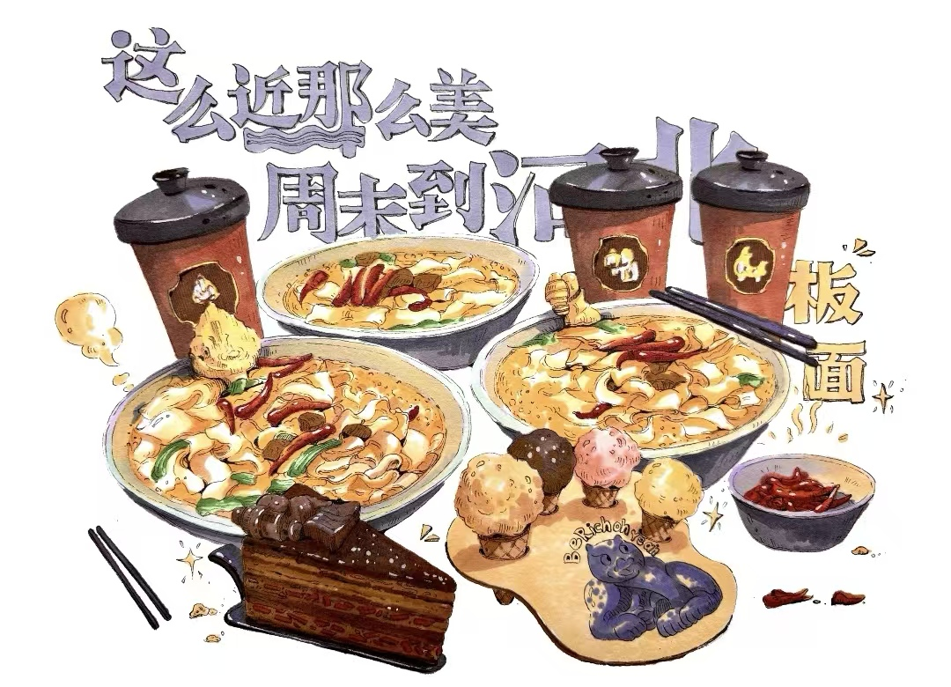
The process of making Shijiazhuang Beef Noodle Soup
1.Noodle Preparation
2.Broth Preparation
3.Beef Stewing
4.Seasoning

Slide 9
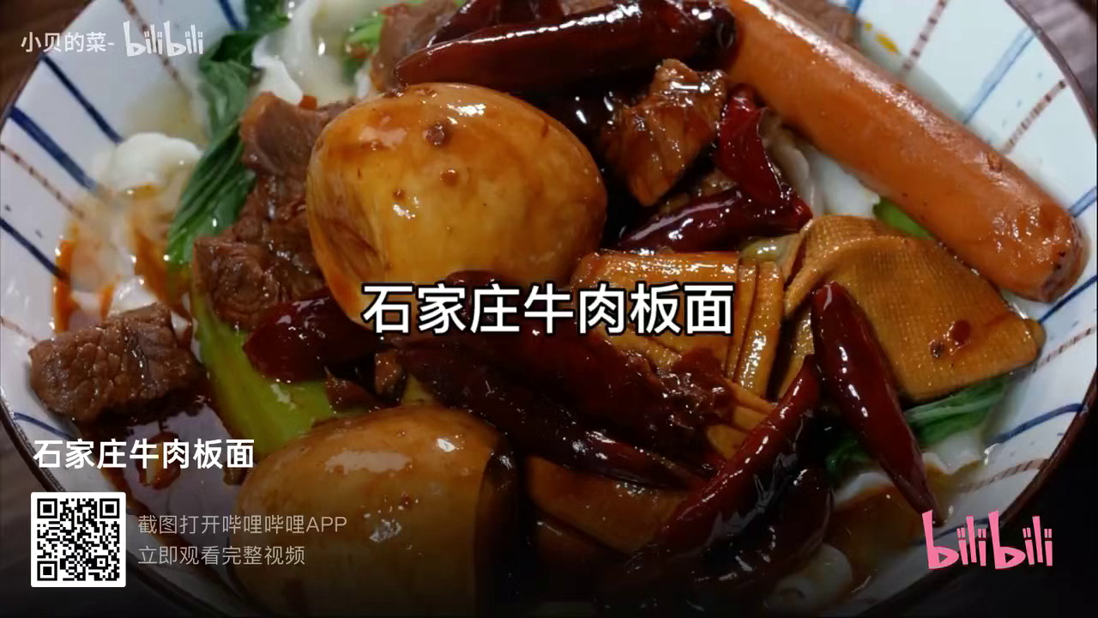
Process of Making

Slide 10
cultural value extension
04

Slide 11
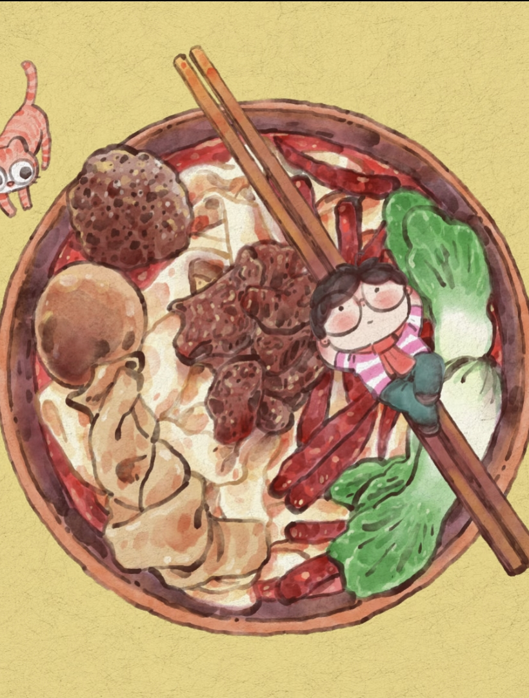
cultural value extension
cultural symbol
family warmth
local identity and profound regional sentiment
reunion and care; a bowl of hot noodles brings comfort to both body and mind.
inheritance of craftsmanship
philosophy of diet
authentic original flavor
The art of handmade noodles has been handed down through generations.

Slide 12
Thanks!

