Slide 1
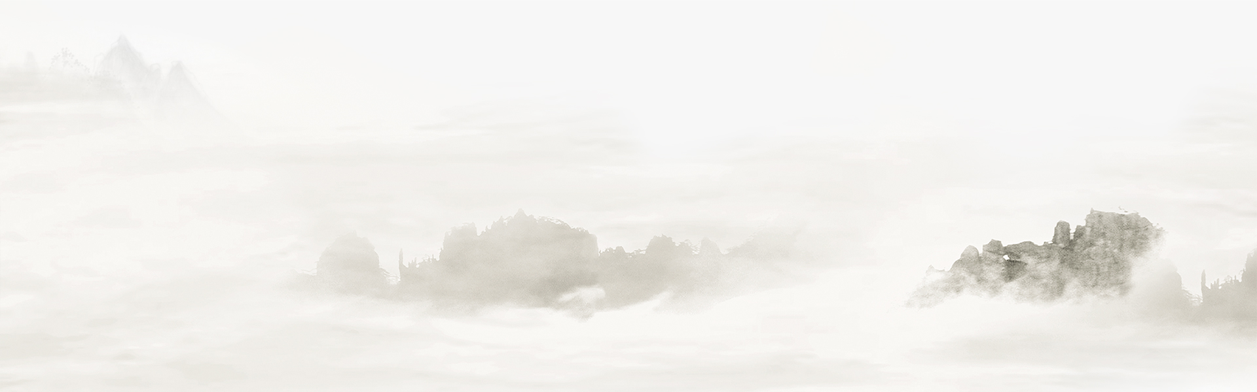
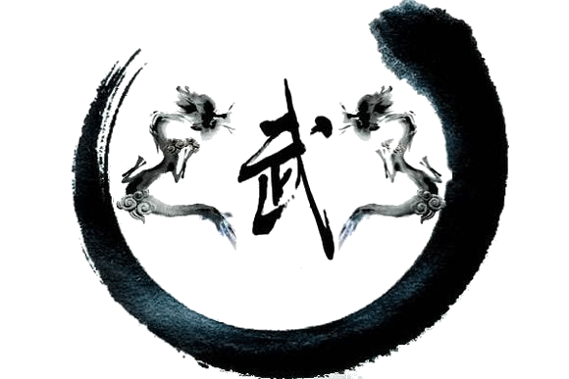

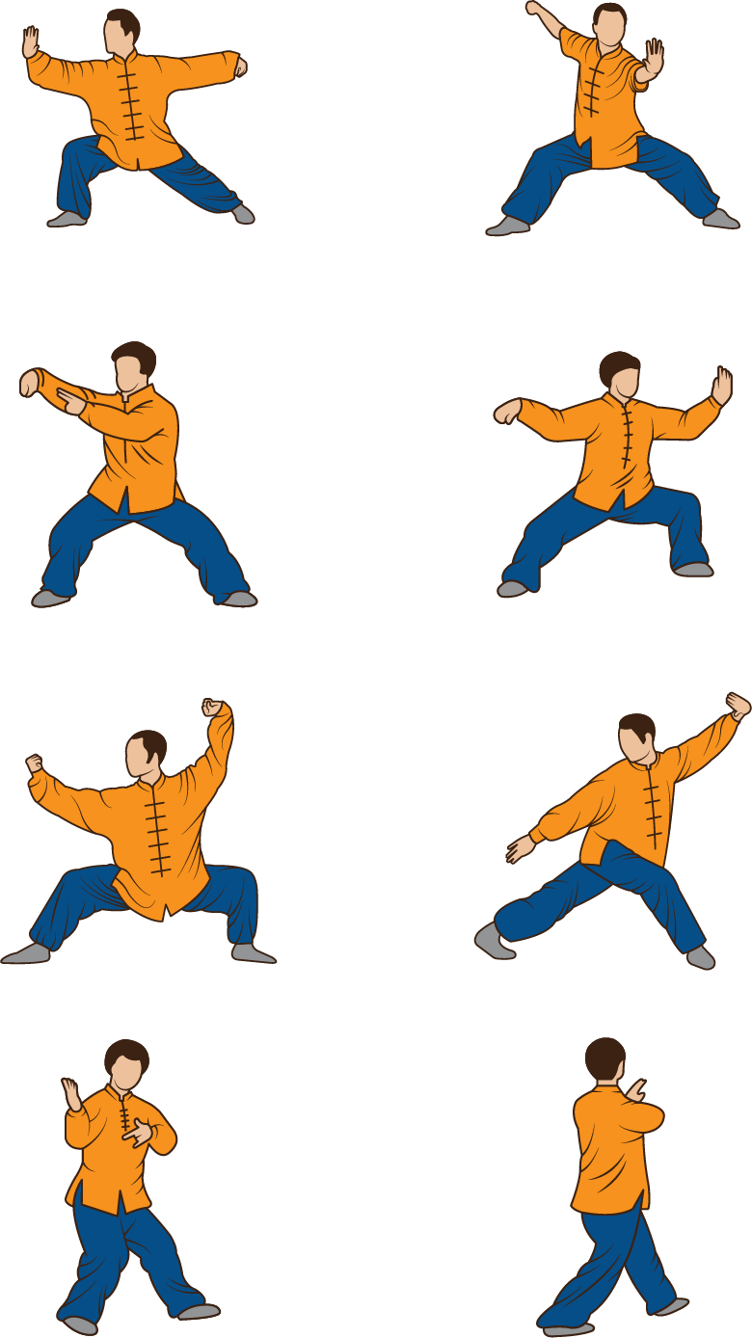
中华文化
Wushu
Martial Art

Slide 2
中华文化
Content
Chapter One：Essence Of Wushu
Chapter Two: Embodiments of Wushu
Chapter Three:Benefits of Wushu

Slide 3

Chapter One：Essence Of Wushu

Slide 4
Martial arts has a history of thousands of years. It was a skill originally used to improve one's physical fitness, strengthen one's body and protect the country. However, with the continuous and deep integration of Chinese traditional culture with it, it has long evolved into not being used to proactively provoke wars and bully the weak but having strength and the ability to win without fighting.

Slide 5
The Chinese idiom “止戈为武”：“止”means stop and “戈”means battle.
—To end or avoid battle，not to cause it.

Slide 6
Chapter Two: Embodiments of Wushu

Slide 7
After World War II，competitions of sports are used to eliminate the anger of the people all over the world，which leads the martial arts to the sport field and development.

Slide 8
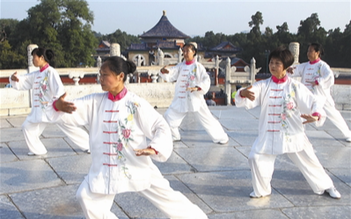
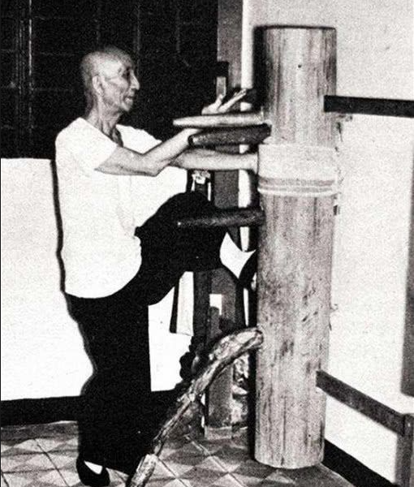
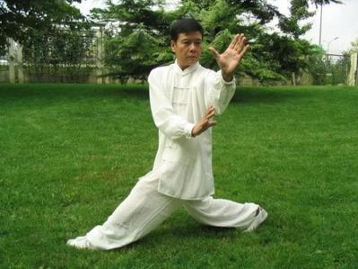
Modern Types of Boxing：
Shadow Boxing——太极拳
Yongchun Fist——咏春拳
Eight Diagram Shadowboxing——八卦掌

Slide 9
Chapter Three:Benefits of Wushu

Slide 10
As is known to all，our bodies are controlled by our mind.If we cannot fully control our bodies,it means our brains do not function well.Martial ars,as a way to strenthen the flow of our blood and calmness of our spirit,aims to improve the way our brains think and work along with its improvising.

Slide 11
For another,martial arts is not only a practical skill,but a symbol of cultural cultivation.A healthy body and a clean face with high spirit relects the active attitude of a society,which has tremendous value about the resilience of a nation.

Slide 12
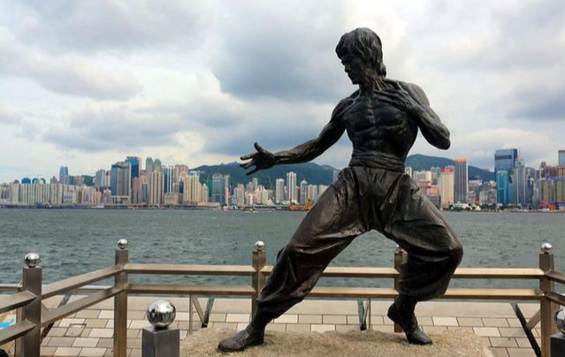
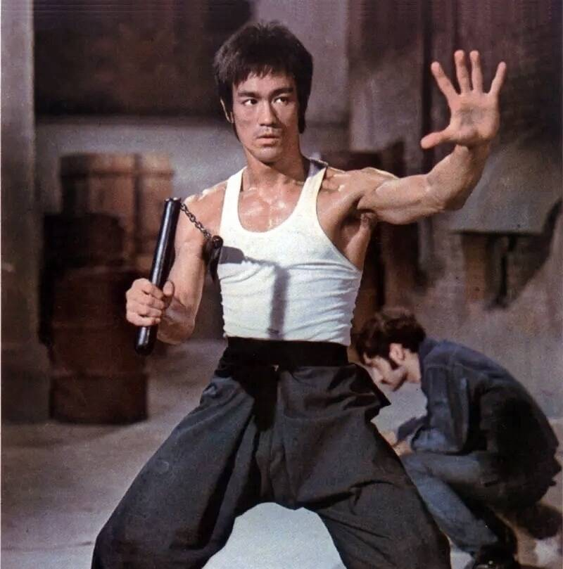
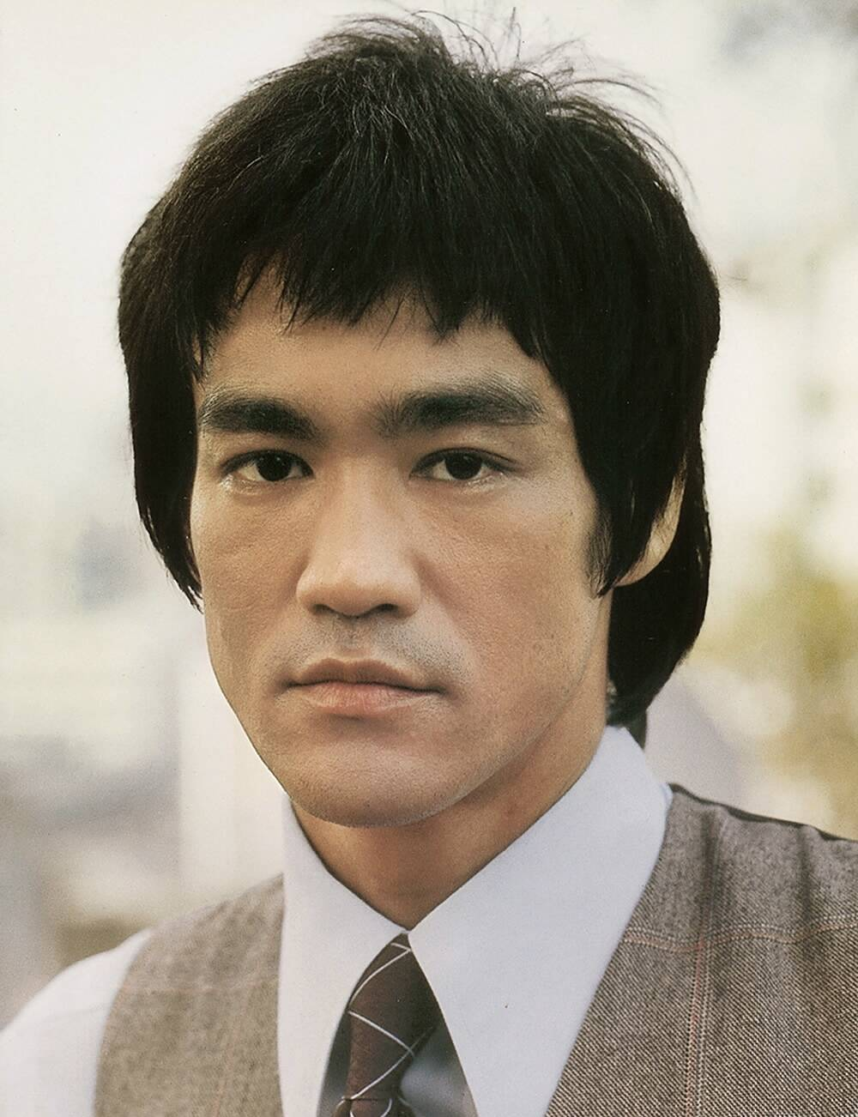
Bruce Lee——李小龙
The world’s well-known Kungfu master
Empty your mind and focus entirely on yourself. Be like water，my friend.
—放空身心，专注自我。朋友，要像水一样。

Slide 13
中华文化
Thanks for watching！

