Slide 1
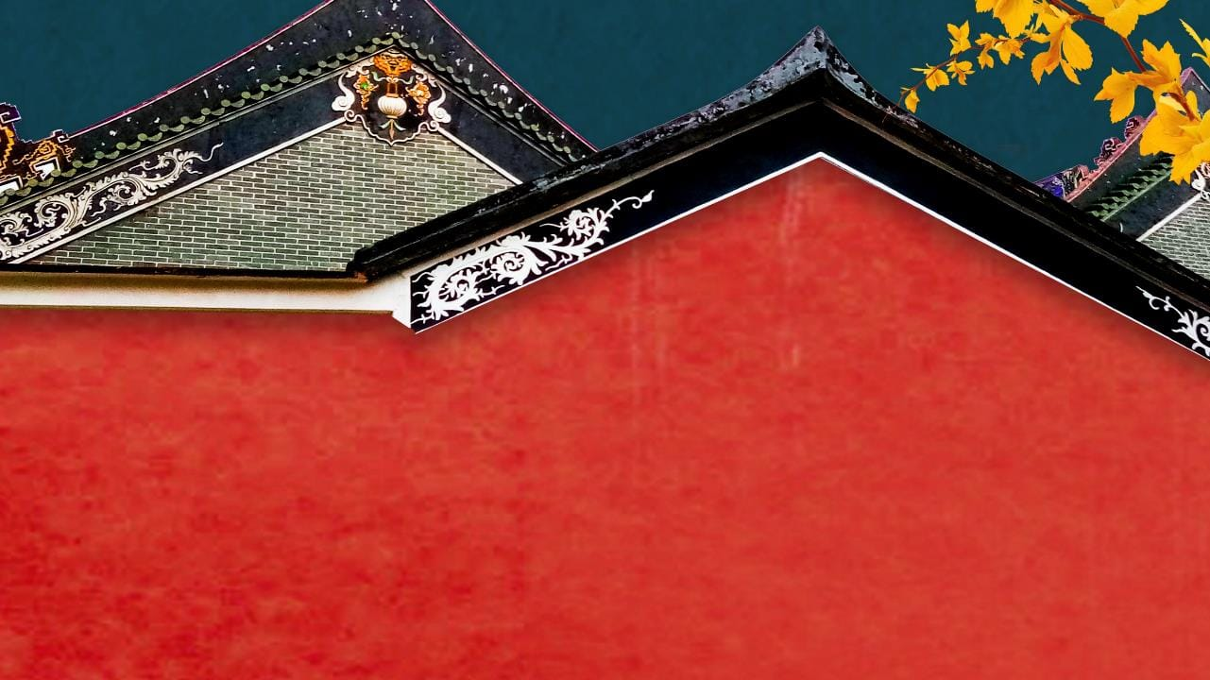
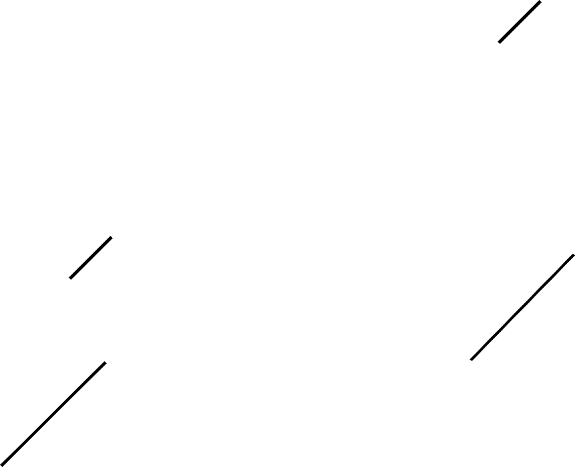

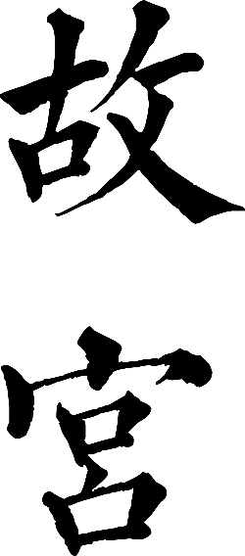

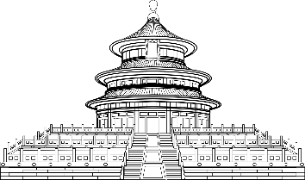

7, Mar, 2022 Betty

Slide 2
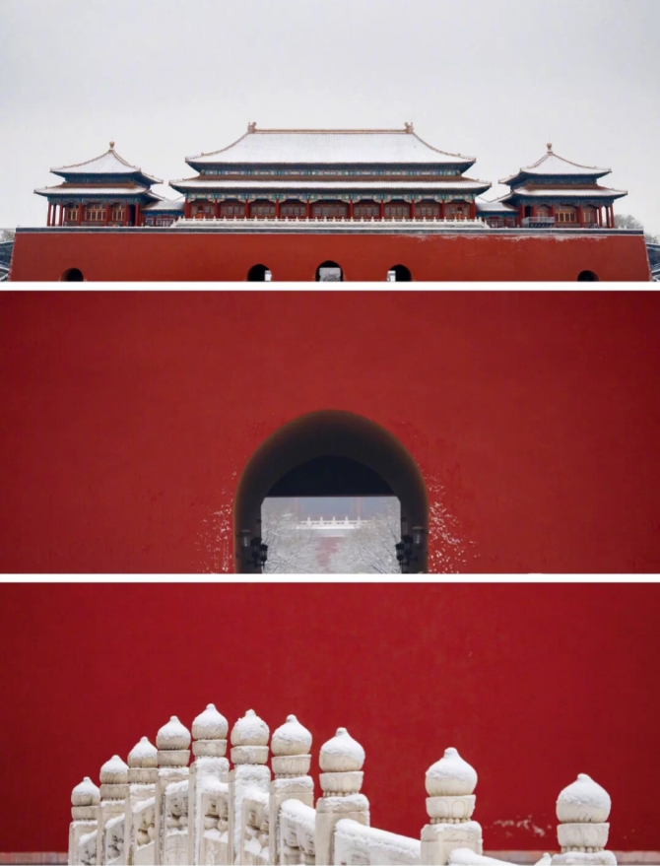
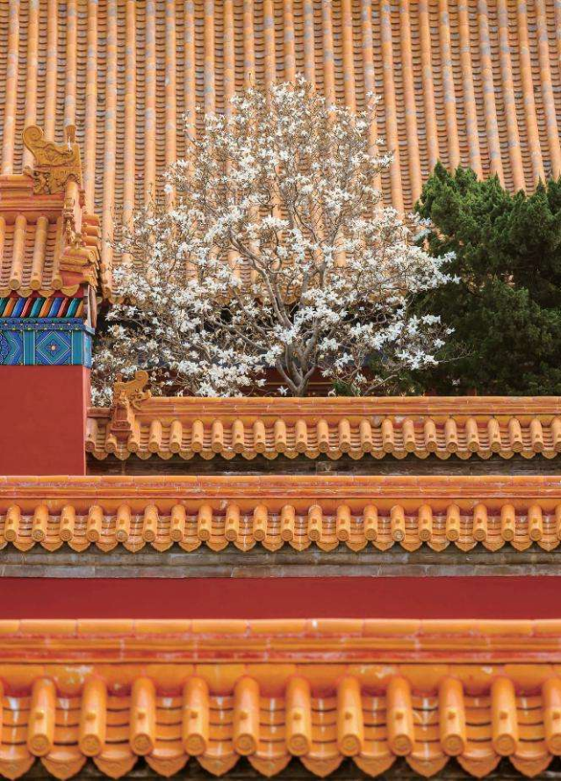

Slide 3
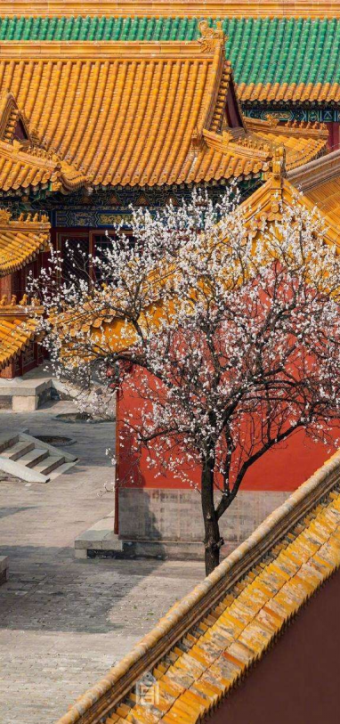
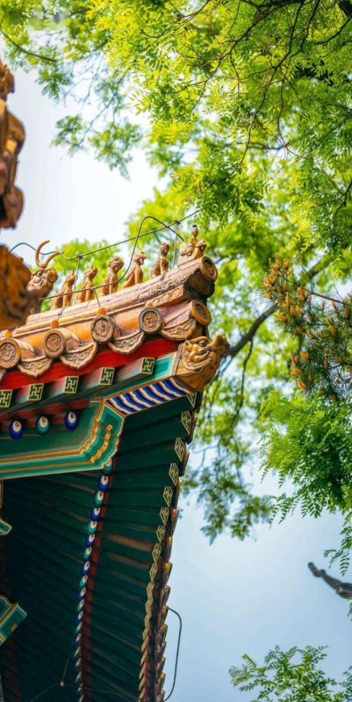
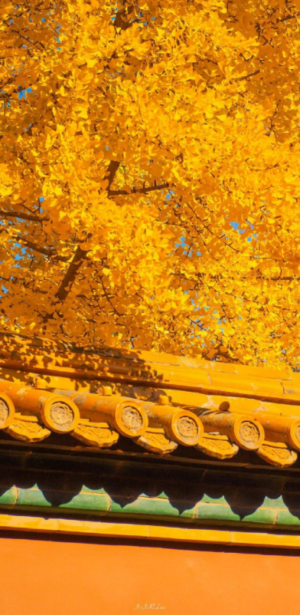
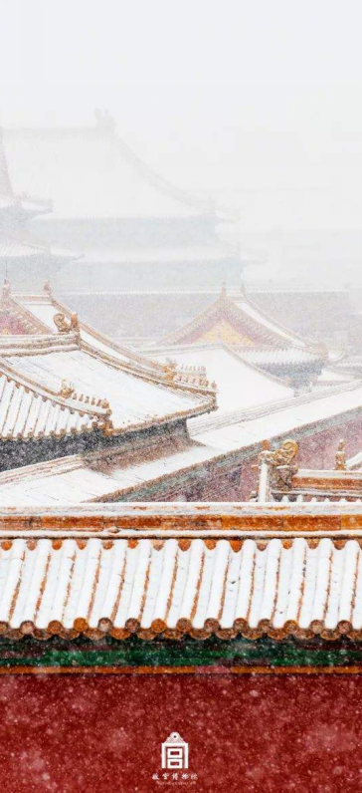

Slide 4
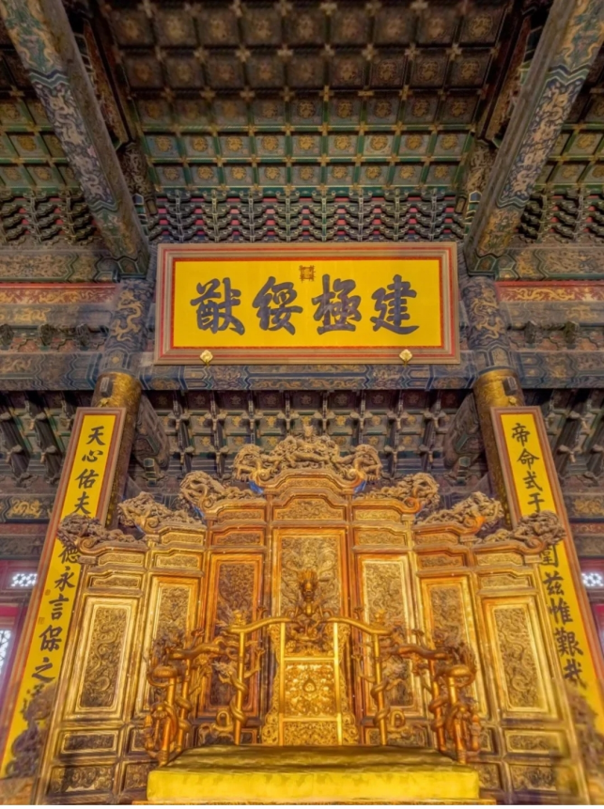

Slide 5
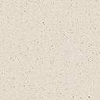
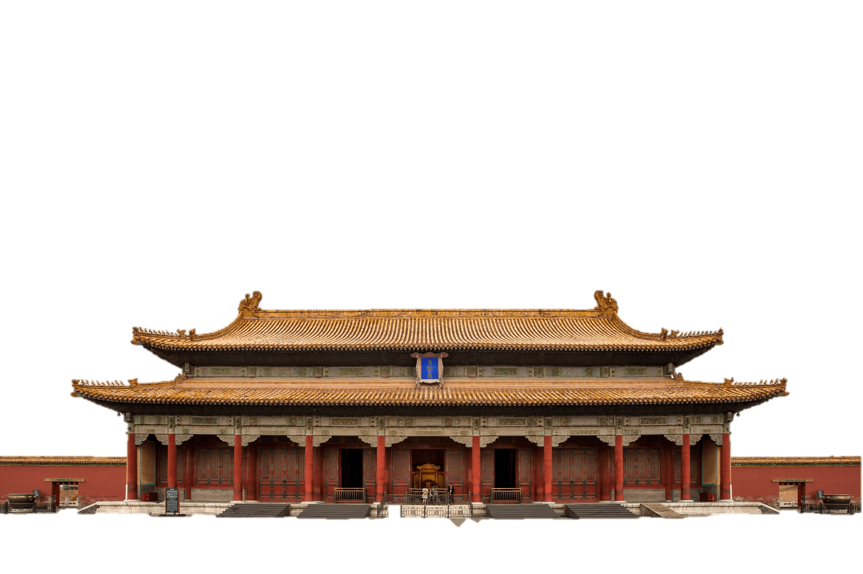
CONTENTS
1. Name
2. History
3. Layout
4. Crafts

Slide 6

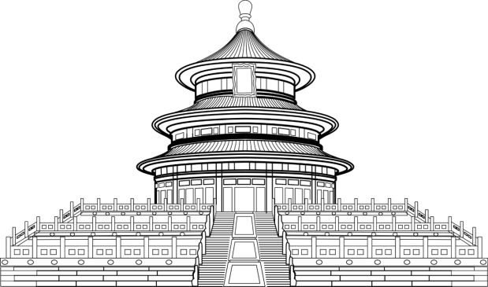




Name

Slide 7
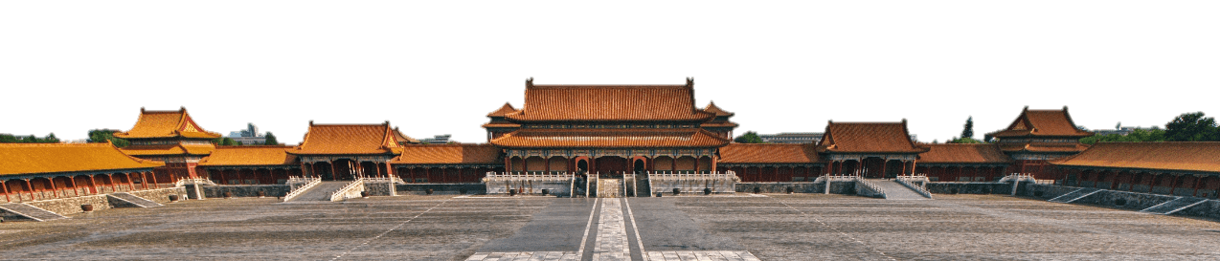
Name
The Forbidden City is the translation of the Chinese name Zijin Cheng which first formally appeared in the period of Jia Jing. The name embodies Chinese philosophy and majesty of imperial power. Zi, or “purple”, refers to the North Star which in ancient China was called Ziwei Star. It shows the concept of “harmony between man and nature”. Jin represents the supreme power and status of the royal family. No one could enter or leave the palace without the emperor's permission. Cheng means city, and as its name suggests, the palace is a micro-city in its own right.

Slide 8
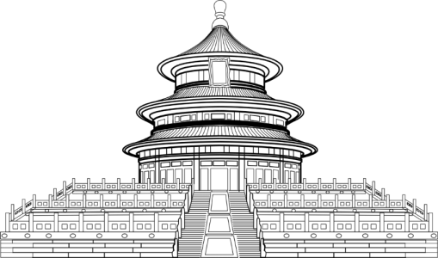
Name
Gugong, or the Former Palace
The Forbidden City
In 1925, the government of the Republic of China declared the establishment of the Palace Museum.

Slide 9
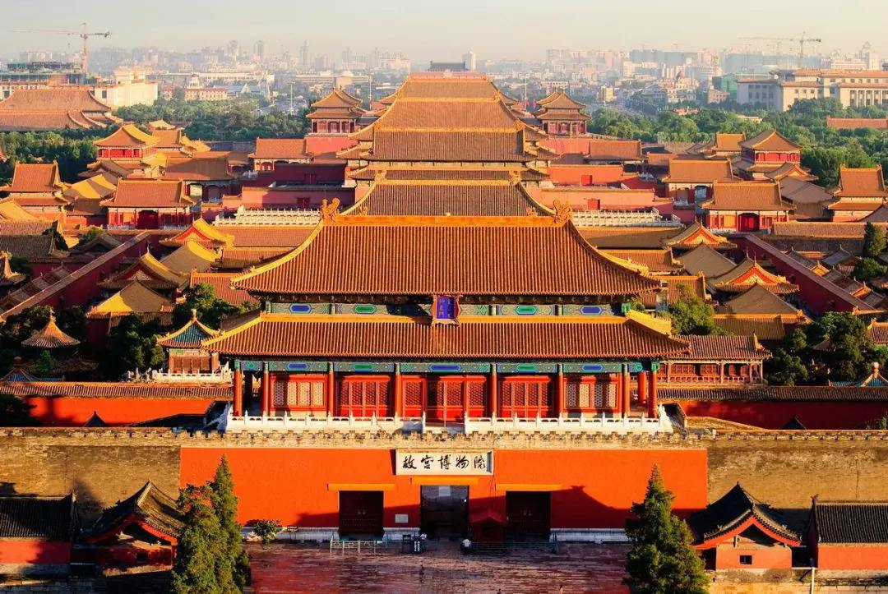

Slide 10
History

Slide 11
History
The Forbidden City was built from 1406 to 1420 on the orders of Zhu Di, Emperor Yongle, Ming Dynasty. Zhu Di, an ambitious and insightful seignior（藩王）, seized the throne from his nephew in Nanjing. In order to consolidate his imperial power and protect the kingdom from the underlying threat of the troops of the former Yuan Dynasty, he decided to move the capital from Nanjing to Beijing, which was once his fief（封地）.
After its completion in 1420, the Forbidden City was home to 24 emperors, their families and servants during the Ming (1368–1644) and the Qing (1644–1911) dynasties.
The last occupant of the Palace, Puyi, was expelled when the precinct was transformed into the Palace Museum in 1925. Since then, though it was not an imperial precinct anymore, it remained one of the most important cultural heritage sites, welcoming visitors from all over the world.

Slide 12
Layout

Slide 13
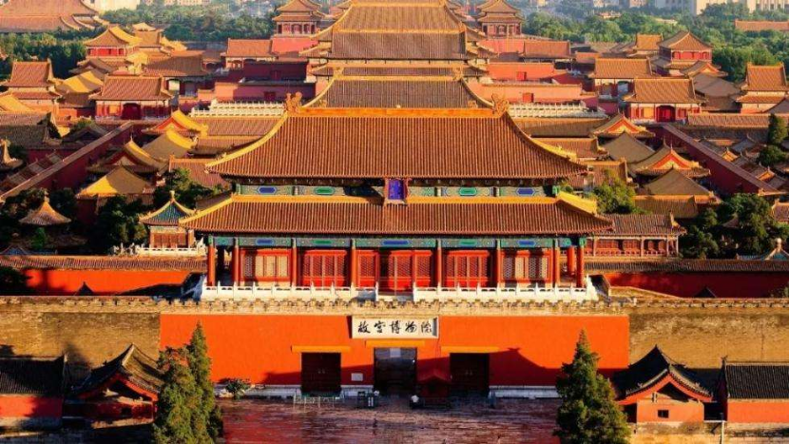
Layout
The Forbidden City is a palace complex in Dongcheng District, Beijing, China, with a total area of 720,000 square meters. It is composed of more than 70 palace compounds including more than 9,000 rooms. The Forbidden City lies in the center of Beijing's central axis. It is a rectangle, symmetric in its layout, encircled by 10-meter-high walls and a 52-meter-wide moat (护城河）.

Slide 14
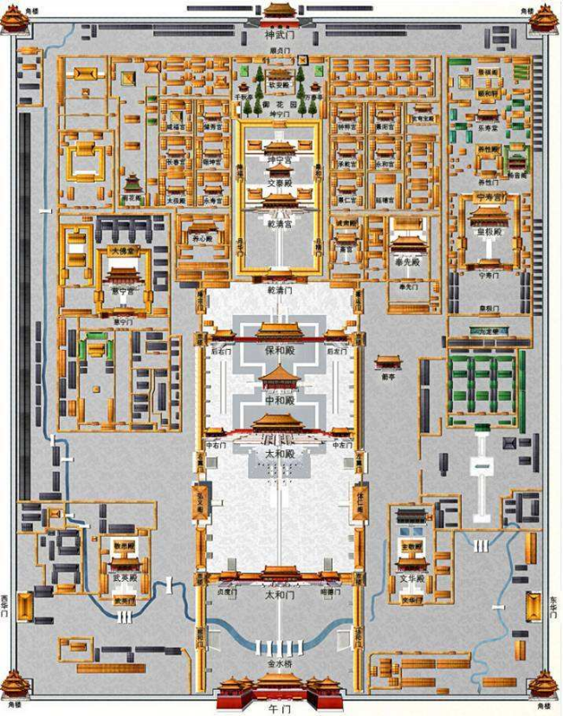
The Forbidden City is divided into two parts, the Outer Court（外朝） and Inner Court（内廷）. The Outer Court is the place where the emperor deals with political affairs. There are mainly three halls: the Hall of Supreme Harmony(太和殿）, the Hall of Central Harmony（中和殿）, and the Hall of Preserving Harmony（保和殿）.
The Inner Court or the Back Palace includes the northern sections, and is the residence of the emperor and his family, and is used for day-to-day affairs of state. The Inner Court takes Palace of Heavenly Purity（乾清宫）, the Hall of Union（交泰宫） and Palace of Earthly Tranquility（坤宁宫） as its center with six palaces in the east and six palaces in the west（东、西六宫）.

Slide 15
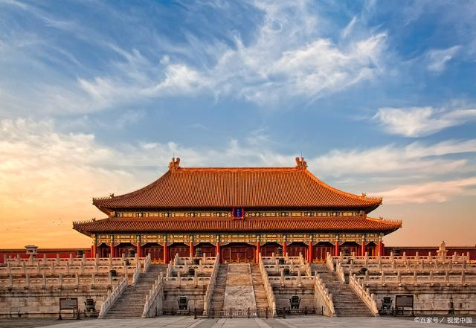
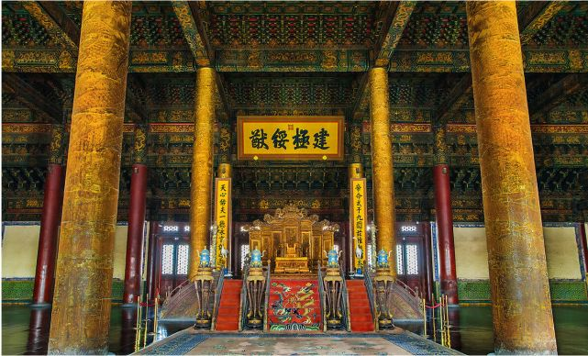
The Hall of Supreme Harmony, standing atop a three-tiered marble terrace, is the heart of the immense Forbidden City palace complex, the most dignified building. The 35.5 meters high hall has a double-layered roof which represents the highest construction rank in the whole empire and thus is exclusively for the emperor. Covering a floor area of 2,377 square meters, the grand hall is the largest wooden structure in the world. In the palace stands the emperor's Dragon Throne. It is surrounded by six huge golden pillars, engraved with dragons representing the supreme dignities and power of the Emperor.

Slide 16
Crafts

Slide 17
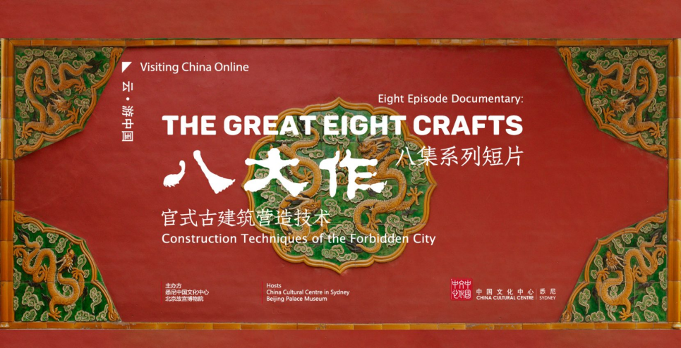
Ancient Chinese architecture is an important component of the world architectural system. During its long development, it gradually formed into a style that featured earthwork（土作） combining masonry（石作）, scaffolding（搭材作）, carpentry（木作）, tilework（瓦作）, paint and lacquer（油作）, decorative painting（彩画作）, and papering（裱糊作）, which are called the “Eight Great Crafts” in the industry. In 2008, “Official Ancient Architecture Construction Skills”（官式古建筑营造技艺） was included in the national intangible cultural heritage.

Slide 18
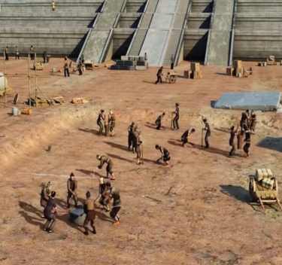
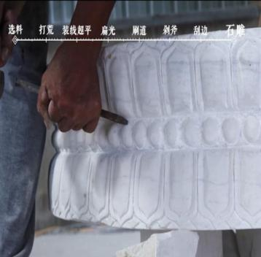
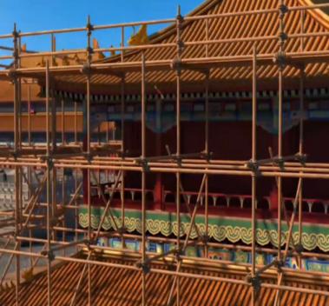
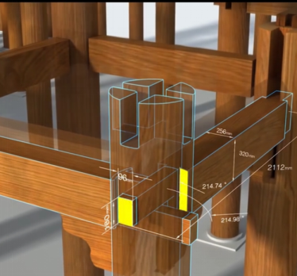
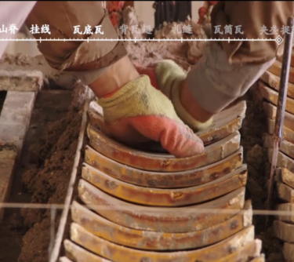
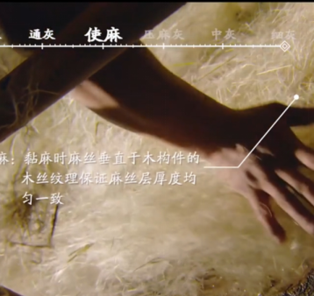
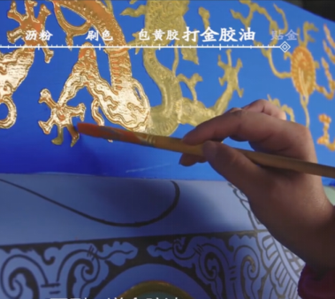
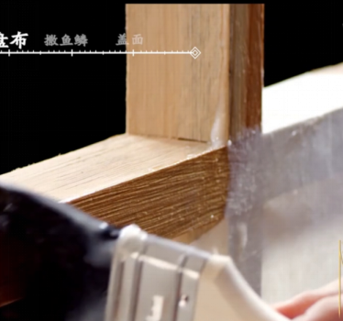
earthwork（土作）
masonry（石作）
scaffolding（搭材作）
carpentry（木作）
tilework（瓦作）
paint and lacquer（油作）
decorative painting（彩画作）
papering（裱糊作）

Slide 19
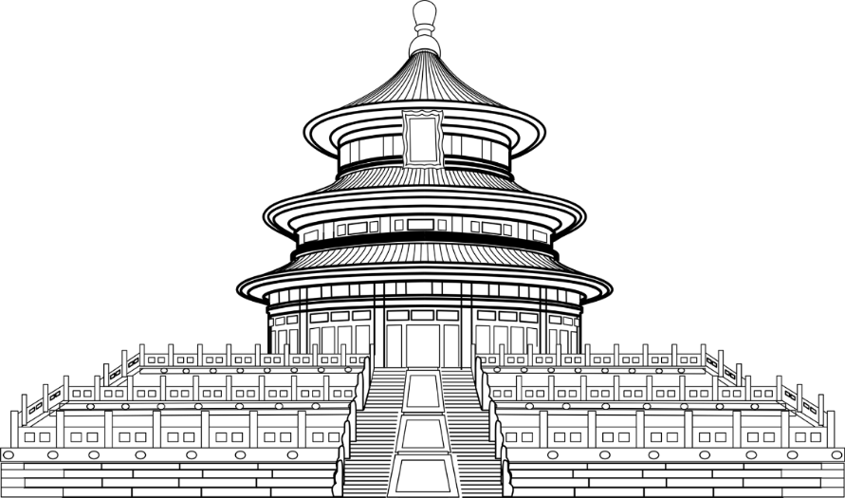
7, Mar, 2022 Betty
Thanks!

