Slide 1
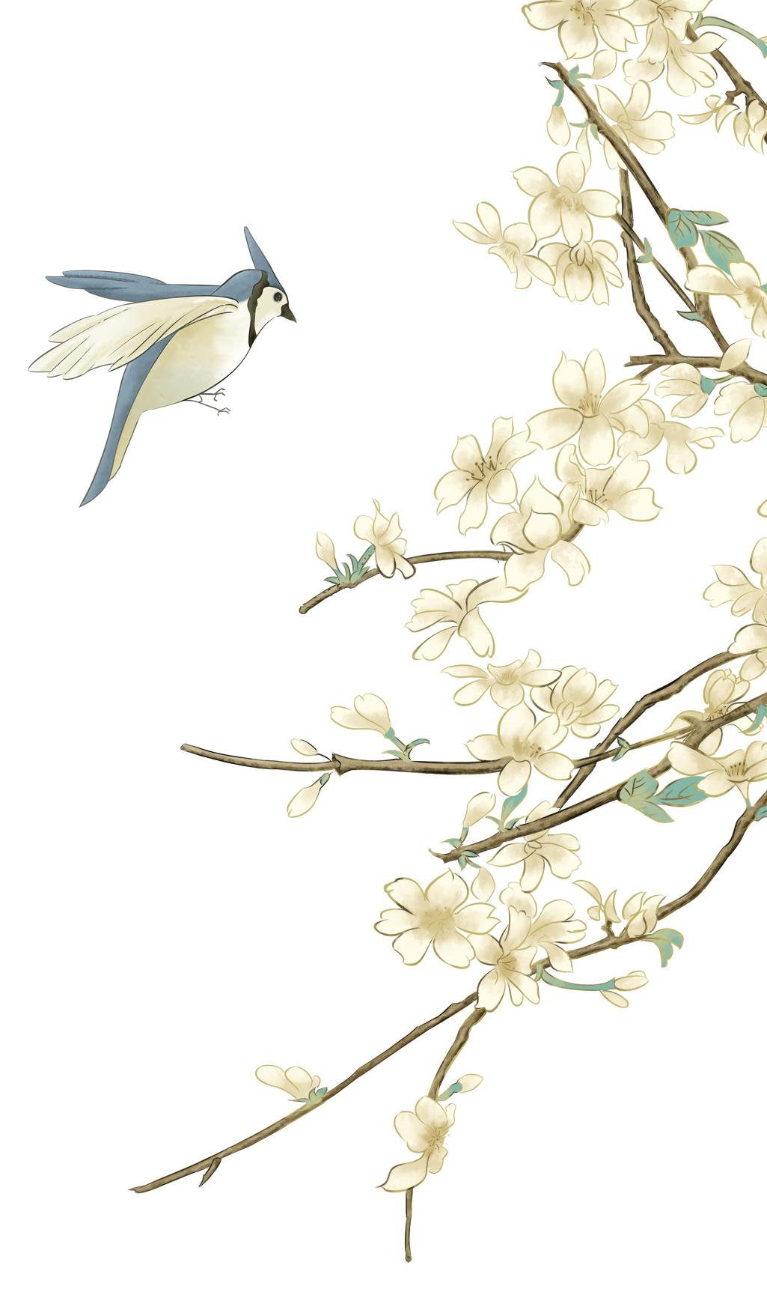
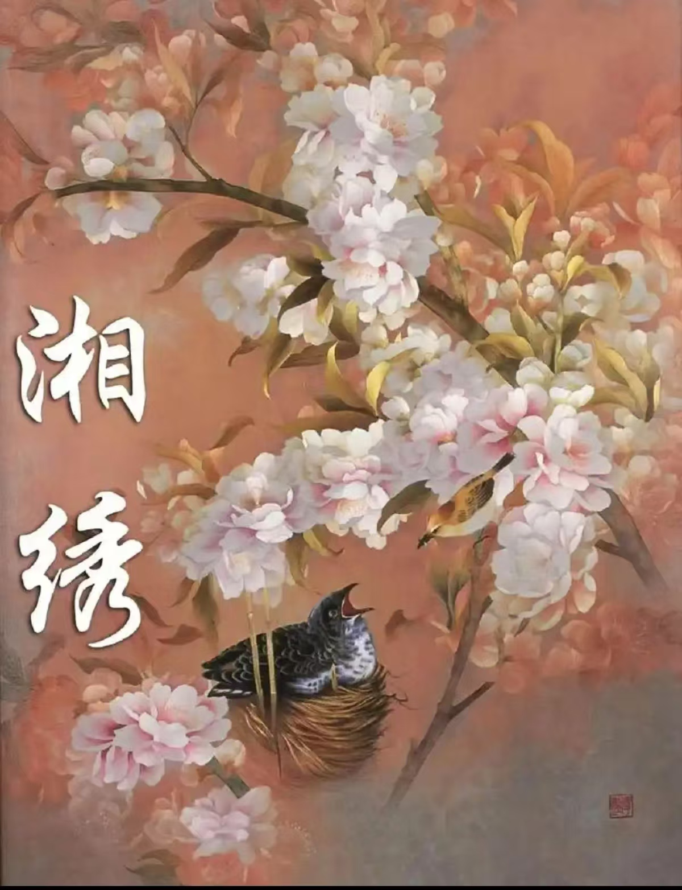
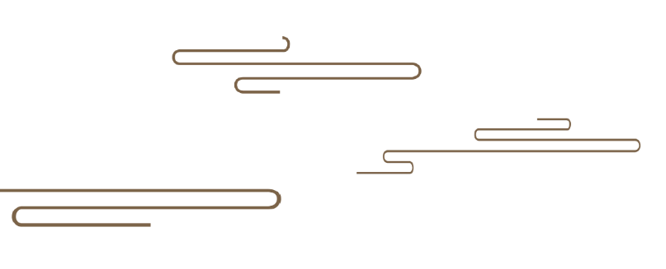
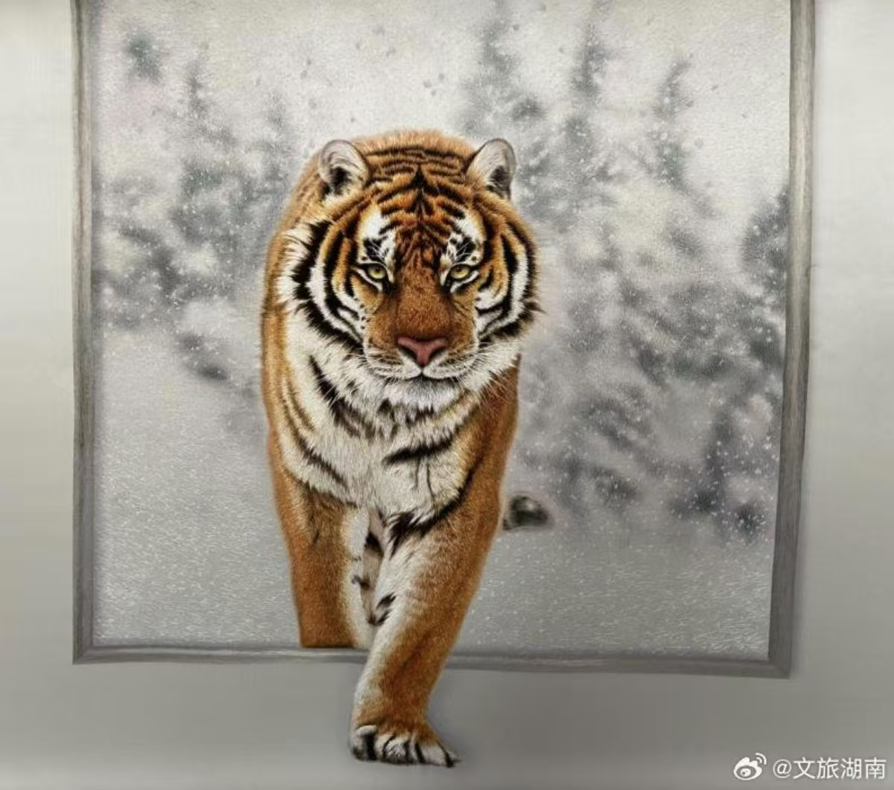

You seem to smell the scents of them when seeing the flowers in Xiang embroidery.(绣花能生香）
The Beauty of Hunan Embroidery
You may see it running when watching the tiger in Xiang embroidery.
（绣虎能奔跑）
古典国风
By Zhang Huifang, student number: 202470081626

Slide 2
Content
壹
贰
叁
肆
Introduction
Changes of Topics
Development of Stitches
Inheritance and Development

Slide 3
壹
Introduction
Xiang embroidery, also known as Hunan embroidery, is a time-hornored intangible cultural heritage in China. With more than 2000 years of history, Xiang embroidery has embraced rich Chinese cultural and artistic values, especially Chu culture, becoming a symbol of Hunan Province.

Slide 4
贰
Changes of Topics

Slide 5
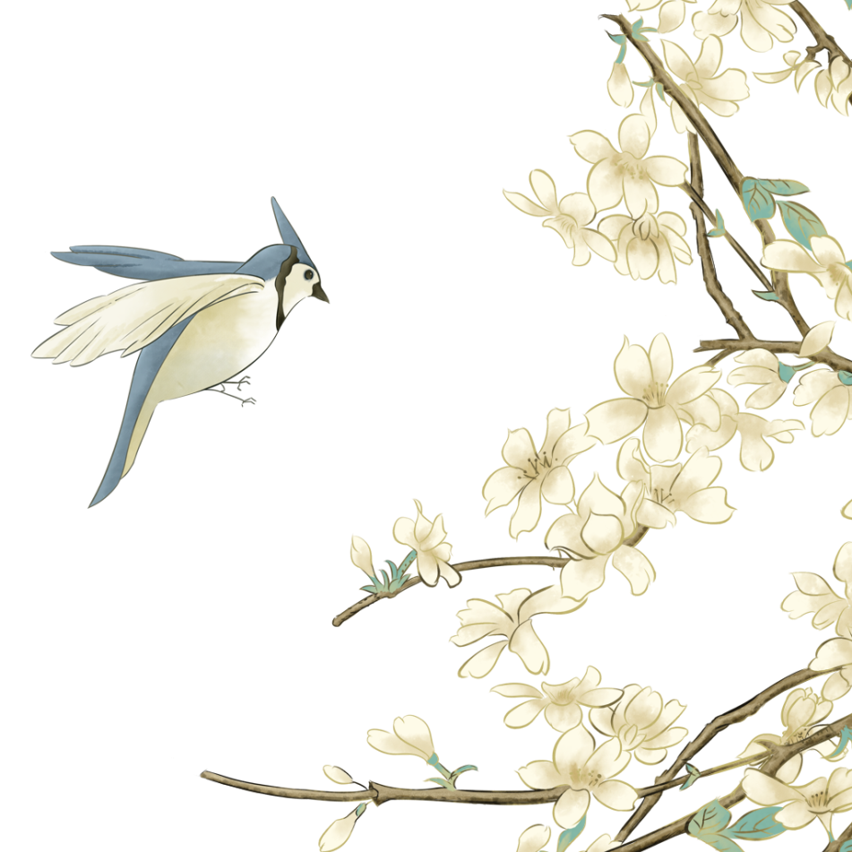
The Development of Topicss in Hunan Embroidery has gone through Multiple Stages.
Modern Period
Introduction of Western Elements in China:
European - style buildings and Western figures
History scenes : social changes and daily life at that time, making Hunan embroidery more in tune with the times.
Contemporary Period
Diversification:
Contemporary Hunan embroidery themes cover various fields including traditional culture, modern art, science and technology, and daily life.
Traditional Period:
Early Focus on Nature and Mythology: flowers, birds, fish, and insects "Dragon and Phoenix Presenting Auspiciousness"
Addition of Characters and Religion in the Ming and Qing Dynasties:
images of Guanyin and Arhats, reflecting the religious culture of the time and people's spiritual beliefs.

Slide 6
叁
Development of Stitches

Slide 7
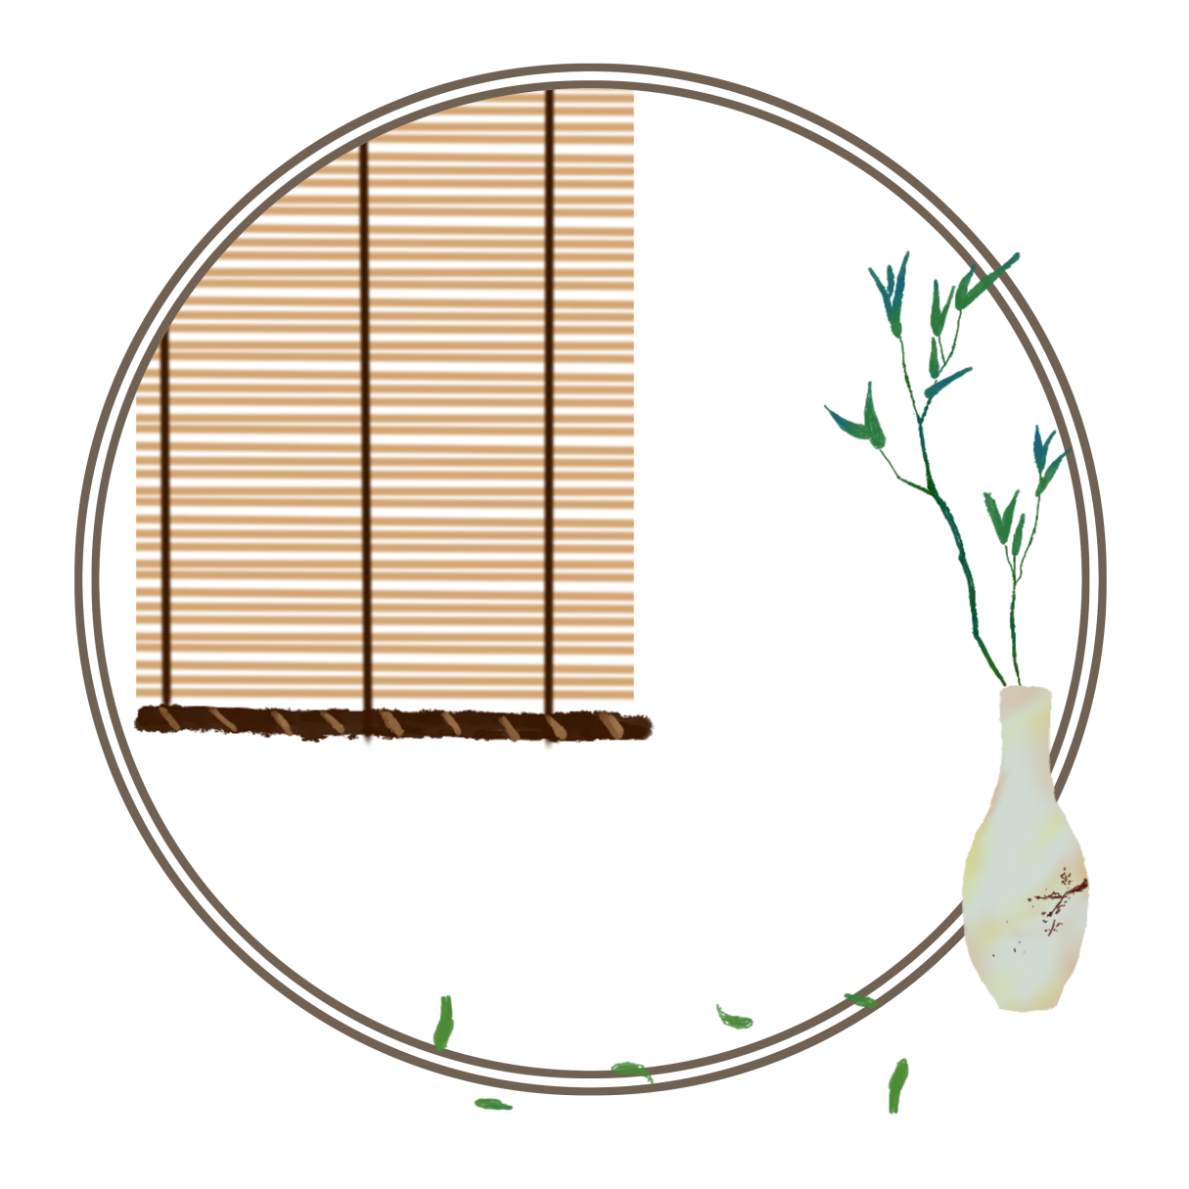
Development of Stitches
Completion of the Stitch System in the Ming and Qing Dynasties:
For example, the blending stitch could make the color transition natural by blending different colored threads. The hyena hair stitch could vividly show the texture and shape of animal hair.
Formation Period of Traditional Stitches
Emergence of Simple Early Stitches: plain - stitch being the main one. It was used to outline patterns and fill in colors. Later, loose - stitch gradually emerged. By using loose stitches, it could show the light, shade, and texture of objects.

Slide 8
Development of Stitches
Contemporary Development
With the help of computer - aided design and embroidery machines, traditional stitches are digitally simulated and innovated. Some new combinations of stitches and embroidery methods are developed, improving production efficiency and the stability of the quality of embroidered works.
Modern Times
Hunan embroidery stitches began to integrate the techniques of other embroidery types and painting. Attempts were made to incorporate the principles of light, shadow, and perspective from Western paintings into Hunan embroidery.

Slide 9
肆
Inheritance and Development

Slide 10
Inheritance and Development
Challenges
Talent Shortage:
The learning process of Hunan embroidery techniques is time - consuming and difficult.
Fierce Market Competition:
The competition from machine - embroidered products and other embroidery types has impacted the market share and brand image of Hunan embroidery.
Lack of Cultural Awareness:
In the fast - paced modern life, some young people have insufficient awareness and interest in traditional handicrafts like Hunan embroidery.
古典国风

Slide 11
Inheritance and Development
Development Strategies
Talent Cultivation:
Strengthen cooperation with educational institutions, improve the talent cultivation system...
Innovative Development:
Continuously innovate in themes, stitches, materials, etc., strengthen the integration with modern design concepts and technologies...
Brand Protection:
Raise brand protection awareness, crack down on counterfeiting and shoddy products, and enhance the cultural influence ...
古典国风

Slide 12
Thank You for Listening!
古典国风

