Slide 1

中国文化基础
Foundation of Chinese Cultures for Bachelor Students of Translation Studies
湖南师范大学 2021年3月3日-2021年6月16日
中国文化基础 周三第七和第八节课14:30-16:10，
上课地点：在线
助教：刘廷阳 Liu Tingyang, wiki 助教：陈柯汝 Chen Keru
吴漠汀特聘教授 Distinguished Professor Dr. Martin Woesler
湖南师范大学外国学院 Foreign Studies College, Hunan Normal University

Slide 2
Session 4 第四周
Session Overview 本节概览
Preparation:
Check: Have you read the 3 texts, made the homework?
3 Students: Have you prepared and uploaded ppt?
Explanations:
Changes in class: NEW: We hear the presentation and take the quizzes immediately after the presentations. – one platform
Honglou meng translation: Can you translate without having learned translation theories? Own experiences. What has the Honglou meng to do with Chinese culture?

Slide 3
Session 4 第四周
What kind of elements of Chinese culture can we learn from Honglou Meng? (http://scrumblr.ca/hlm)

Slide 4
Session 4 第四周
What kind of Chinese culture can we learn from Honglou Meng?
Cuisine, ancestor worship, festivals, family relations, love relations, policy of courtesans and second wife, honor, crimes, murders, courtesy, politeness, court culture, fashion, interior design of houses, education system: private family schools, opera scenes, actors, philosophy: Confucianism, Daoism, Buddhism, society: beggars, drunkyards, fights, civil servants, police-like forces, noblemen, robbers, monks & nuns, temples, poverty and wealth, superstition, woodoo, foreign goods and people in Qing dynasty, relation to sexuality, legal culture, yamen, trials, poetry, childhood, gossip and rumors, state exams, role of merchants, giving to the poor, social unrest, indirectness,

Slide 5
Session 4 第四周
My experience as a freshman 本科生
Hard life (400 Yuan => living in cellar room of dormitory, having to earn living through writing)
Through own impression (bad and shortened translation) => need for better translation
Poor knowledge of language
No training in translation studies/theory
Learning the hard way
Found tools
Asked experts

Slide 6
Session 4 第四周
What can we learn from translating HLM as 2019级本科生？

Slide 7
Session 4 第四周
What can we learn from translating HLM as 2019级本科生？
Learning through practice
Team work
Learning from corrections of fellow students
Trying to derive theories / strategies from practice: communicative translation? Cultural equivalence?

Slide 8
Session 4 第四周
Hitlist of Chinese cultural phenomena: This semesters‘ schedule
Order | Date | Topic | Chapter | Points | Popularity
1 | 10.03.2021 | Beverages: Milk Tea | 21 | 474 | 79%
2 | 10.03.2021 | Traditional Cuisine: Eight Major Cuisines in China | 28 | 468 | 78%
3 | 10.03.2021 | Beverages: Tea | 20 | 451 | 75%
4 | 17.03.2021 | Architecture: Architecture and Gardens, The Forbidden City | 36 | 433 | 72%
5 | 17.03.2021 | Traditional Festivals | 2 | 432 | 72%
6 | 17.03.2021 | Aesthetic ideals and social customs: The Four Most Handsome Men in Ancient China | 108 | 427 | 71%
7 | 24.03.2021 | Traditional Cuisine: Four Distinct Regional Cuisines | 24 | 423 | 71%
8 | 24.03.2021 | Education: Historical Figures, The Four Talented Women of Ancient China | 119 | 417 | 70%
9 | 24.03.2021 | Traditional Cuisine: Two Famous Dishes | 26 | 415 | 69%
10 | 31.03.2021 | Aesthetic ideals and social customs: Chinese Marriage Customs | 110 | 409 | 68%
11 | 31.03.2021 | Music and instruments: Pipa | 95 | 406 | 68%
12 | 31.03.2021 | Traditional Cuisine: The Art of Chinese Cooking | 25 | 404 | 67%
13 | 07.04.2021 | Silk and porcelain: Celadon and Celadon Song 《青花瓷》歌词 | 31 | 401 | 67%
14 | 07.04.2021 | Traditional Cuisine: Chinese Dining Etiquette | 23 | 396 | 66%
15 | 07.04.2021 | Facial Make-up: Cosmetics, Traditional Chinese Make-Up | 98 | 395 | 66%
16 | 14.04.2021 | Garden Culture: The Summer Palace | 41 | 385 | 64%
17 | 14.04.2021 | Money culture: The tradition of Red Envelope and Lucky Money | 106 | 384 | 64%
18 | 14.04.2021 | Stage entertainment: Crosstalk 相声 | 99 | 383 | 64%
19 | 21.04.2021 | Architecture | 35 | 377 | 63%
20 | 21.04.2021 | Music and instruments: Guzheng | 94 | 375 | 63%
21 | 21.04.2021 | Chinese Astrology: Twelve Animals of the Chinese Zodiac | 71 | 372 | 62%
22 | 28.04.2021 | Ancient literature: Four Folk Stories of Ancient China | 49 | 371 | 62%
23 | 28.04.2021 | Ancient literature: Chinese Classical Fairy Tales | 50 | 369 | 62%
24 | 28.04.2021 | Chinese language: Chinese Dialects | 45 | 368 | 61%
25 | 05.05.2021 | Animals: Panda | 128 | 366 | 61%
26 | 05.05.2021 | Facial Make-up: Face Changing in Sichuan Opera | 97 | 365 | 61%
27 | 05.05.2021 | Chinese Mythology: Huli-jing | 73 | 364 | 61%
28 | 12.05.2021 | Traditional Crafts: Folk Art - Chinese Paper-cutting | 19 | 364 | 61%
29 | 12.05.2021 | Science and Technology: Douyin (Tik Tok) | 8 | 362 | 60%
30 | 12.05.2021 | Chinese clothing / interieur: Chinese clothing | 112 | 361 | 60%
31 | 19.05.2021 | Facial Make-up | 96 | 360 | 60%
32 | 19.05.2021 | Beverages: The Liquor Culture of Ancient China | 22 | 357 | 60%
33 | 19.05.2021 | Premodern literature: Tang and Song (2 texts) | 51 | 357 | 60%
34 | 26.05.2021 | Chinese Medicine: The Development of Chinese Medicine | 68 | 356 | 59%
35 | 26.05.2021 | Modern and Contemporary Literature: Qian Zhongshu (Ch'ien Chung-shu) | 56 | 349 | 58%
36 | 26.05.2021 | Body movement performance: Traditional Chinese Dance | 103 | 346 | 58%
37 | 02.06.2021 | Chinese Astrology: Calendar, The 24 Solar Terms | 72 | 346 | 58%
38 | 02.06.2021 | Stage entertainment: Shadow Play | 100 | 344 | 57%
39 | 02.06.2021 | Chinese Astrology: Chinese Astrology | 70 | 338 | 56%
40 | 09.06.2021 | Chinese Writing: Chinese Characters | 9 | 336 | 56%
41 | 09.06.2021 | Landscapes and tourism: Landscape, Five Famous Mountains | 122 | 333 | 56%
42 | 09.06.2021 | Traditional Crafts: Carving | 17 | 326 | 54%
43 | 16.06.2021 | Landscapes and tourism: Tourism, Nanjing-An Ancient Capital of Six Dynasties | 126 | 319 | 53%
44 | 16.06.2021 | Garden Culture: Qingming Riverside Landscspe Garden | 42 | 317 | 53%
45 | 16.06.2021 | Traditional Crafts: Handcraft - Chinese Knots | 18 | 317 | 53%
46 |  | Fine Arts: Painting | 32 | 316 | 53%
47 |  | Chinese clothing / interieur: Cheongsam | 113 | 312 | 52%
48 |  | Silk Road - by land and by sea: Zhang Qian and the Silk Road | 89 | 309 | 52%
49 |  | Money culture: Currency, Jiaozi (A Paper Currency in Northern Song Dynasty) | 105 | 308 | 51%
50 |  | Beijing Opera: Actor Mei Lanfang | 61 | 306 | 51%
51 |  | Education: Ancient Chinese Education | 116 | 305 | 51%
52 |  | Chinese language | 44 | 304 | 51%
53 |  | Traditional Crafts: Embroidery | 14 | 304 | 51%
54 |  | Chinese Mythology: Gods and Immortals | 74 | 303 | 51%
55 |  | Chinese Writing: Calligraphy | 11 | 302 | 50%
56 |  | Landscapes and tourism: The Ancient Tea Horse Road | 123 | 300 | 50%
57 |  | Traditional Festivals: Spring Festival Couplets | 3 | 299 | 50%
58 |  | Premodern literature: Li Bai's 李白 《长干行》 and its translations | 52 | 297 | 50%
59 |  | Chinese Medicine: Acupuncture and Moxibustion | 67 | 296 | 49%
60 |  | Silk and porcelain: Silk | 29 | 296 | 49%
61 |  | Science and Technology: China's Four New Inventions | 7 | 294 | 49%
62 |  | Stage entertainment: Chinese cinema (dramas and movies) and its popularity and affection in Vietnam | 101 | 294 | 49%
63 |  | Games: Go 围棋 | 107 | 291 | 49%
64 |  | Premodern literature: Strange Stories from a Chinese Studio | 54 | 289 | 48%
65 |  | Religions: Daoism | 76 | 288 | 48%
66 |  | Science and Technology: Ancient Science and Technology | 5 | 286 | 48%
67 |  | Architecture: Bridges | 39 | 284 | 47%
68 |  | Education: Yuelu Academy (One of the Four Most Prestigious Academies) | 117 | 283 | 47%
69 |  | Landscapes and tourism: Mogao Grottoes | 124 | 283 | 47%
70 |  | Silk Road - by land and by sea: Zheng He and the Maritime Silk Road | 90 | 283 | 47%
71 |  | Ancient literature: Classical Literature | 46 | 281 | 47%
72 |  | Army and weapons: Chinese Ancient Weapons | 121 | 281 | 47%
73 |  | Aesthetic ideals and social customs: Habits, Ways of Contacting | 109 | 279 | 47%
74 |  | Architecture: Three Great Towers in China | 38 | 275 | 46%
75 |  | Fine Arts: Seal-cutting | 33 | 275 | 46%
76 |  | Silk Road - by land and by sea: Zheng He's Voyages | 91 | 275 | 46%
77 |  | Garden Culture: Gardens | 40 | 274 | 46%
78 |  | Chinese Medicine: Diagnosis and Pharmacology | 66 | 273 | 46%
79 |  | Beijing Opera | 60 | 272 | 45%
80 |  | Chinese Writing: Chinese Characters and Scripts | 10 | 272 | 45%
81 |  | Premodern literature: China's Four Great Classical Novels | 53 | 270 | 45%
82 |  | Chinese clothing / interieur: The Folding Screen | 115 | 267 | 45%
83 |  | Ancient literature: Chinese Mythology | 48 | 265 | 44%
84 |  | Chinese Medicine: Zhang Zhongjing | 69 | 264 | 44%
85 |  | Landscapes and tourism: Four State-Level Cultural Relics | 125 | 263 | 44%
86 |  | Martial Arts: Qigong | 64 | 262 | 44%
87 |  | Architecture: Four Great Pavilions | 37 | 261 | 44%
88 |  | Religions: Buddhism | 75 | 260 | 43%
89 |  | Traditional Cuisine: Chopsticks | 27 | 260 | 43%
90 |  | Westernization: The Eastward Spread of Western Learning | 92 | 260 | 43%
91 |  | Body movement performance: Chinese Lion Dancing | 104 | 259 | 43%
92 |  | Body movement performance: Stilts | 102 | 259 | 43%
93 |  | Science and Technology: Compass | 6 | 259 | 43%
94 |  | Chinese Writing: The Evolution of Calligraphy | 12 | 258 | 43%
95 |  | Chinese Writing: Ancient Writing and Painting Tool, Writing Brush | 13 | 255 | 43%
96 |  | Garden Culture: Bonsai (Penjing) | 43 | 253 | 42%
97 |  | Traditional Crafts: Lacquerware | 16 | 247 | 41%
98 |  | Chinese clothing / interieur: Batik | 114 | 242 | 40%
99 |  | Confucianism: Confucian Culture | 81 | 237 | 40%
100 |  | Westernization: The Westernization Movement | 93 | 236 | 39%
101 |  | Modern and Contemporary Literature: Novels | 57 | 234 | 39%
102 |  | Modern and Contemporary Literature: Literature, Science Fiction, and Fantasy | 59 | 233 | 39%
103 |  | Ancient literature: Yue Fu | 47 | 231 | 39%
104 |  | Modern and Contemporary Literature: Modern Literature | 55 | 231 | 39%
105 |  | Education: The Nine-Grade Official Selection System in Wei, Jin, Southern and Northern Dynasties | 118 | 229 | 38%
106 |  | Confucianism: Four Main Philosophic Schools | 79 | 226 | 38%
107 |  | Philosophical Schools (Daoism, Buddhism, Legalism): Classical Philosophy - Reading Tao Te Ching | 85 | 225 | 38%
108 |  | Minority cultures: Lisu People and Daogan Festival of Lisu Ethnic Minority | 111 | 219 | 37%
109 |  | Landscapes and tourism: Four Buddhist Shrines | 127 | 213 | 36%
110 |  | Beijing Opera: Beijing Opera Acrobatics | 62 | 211 | 35%
111 |  | Confucianism: Classical Philosophy - Confucius and Confucianism | 80 | 211 | 35%
112 |  | Martial Arts: Wushu | 63 | 211 | 35%
113 |  | Army and weapons: Terracotta Army | 120 | 210 | 35%
114 |  | Fine Arts: Bada Shanren and Qi Baishi | 34 | 210 | 35%
115 |  | Martial Arts: Huo Yuanjia | 65 | 210 | 35%
116 |  | Modern and Contemporary Literature: Contemporary Literature | 58 | 209 | 35%
117 |  | Philosophical Schools (Daoism, Buddhism, Legalism): Classical Philosophy - Daoism | 84 | 204 | 34%
118 |  | Traditional Festivals: Lattice on Ancient Chinese Windows | 4 | 203 | 34%
119 |  | Silk and porcelain: Porcelain | 30 | 197 | 33%
120 |  | Philosophical Schools (Daoism, Buddhism, Legalism): Legalism | 88 | 196 | 33%
121 |  | Confucianism: Chinese Traditional Culture-Five Constant Virtues | 83 | 195 | 33%
122 |  | Traditional Crafts: Cloisonne | 15 | 194 | 32%
123 |  | Religions: Christianity | 78 | 176 | 29%
124 |  | Religions: Islam | 77 | 171 | 29%
125 |  | Confucianism: Classical Philosophy - Reading The Analects | 82 | 170 | 28%
126 |  | Philosophical Schools (Daoism, Buddhism, Legalism): Classical Philosophy - Reading The Importance of Living | 87 | 168 | 28%
127 |  | Philosophical Schools (Daoism, Buddhism, Legalism): Classical Philosophy - Reading The Sutra of Hui-neng | 86 | 154 | 26%

Slide 9
Session 4 第四周
Order | Date | Topic | Chapter | Points | Popularity
25 | 05.05.2021 | Animals: Panda | 128 | 366 | 61%
26 | 05.05.2021 | Facial Make-up: Face Changing in Sichuan Opera | 97 | 365 | 61%
27 | 05.05.2021 | Chinese Mythology: Huli-jing | 73 | 364 | 61%
28 | 12.05.2021 | Traditional Crafts: Folk Art - Chinese Paper-cutting | 19 | 364 | 61%
29 | 12.05.2021 | Science and Technology: Douyin (Tik Tok) | 8 | 362 | 60%
30 | 12.05.2021 | Chinese clothing / interieur: Chinese clothing | 112 | 361 | 60%
31 | 19.05.2021 | Facial Make-up | 96 | 360 | 60%
32 | 19.05.2021 | Beverages: The Liquor Culture of Ancient China | 22 | 357 | 60%
33 | 19.05.2021 | Premodern literature: Tang and Song (2 texts) | 51 | 357 | 60%
34 | 26.05.2021 | Chinese Medicine: The Development of Chinese Medicine | 68 | 356 | 59%
35 | 26.05.2021 | Modern and Contemporary Literature: Qian Zhongshu (Ch'ien Chung-shu) | 56 | 349 | 58%
36 | 26.05.2021 | Body movement performance: Traditional Chinese Dance | 103 | 346 | 58%
37 | 02.06.2021 | Chinese Astrology: Calendar, The 24 Solar Terms | 72 | 346 | 58%
38 | 02.06.2021 | Stage entertainment: Shadow Play | 100 | 344 | 57%
39 | 02.06.2021 | Chinese Astrology: Chinese Astrology | 70 | 338 | 56%
40 | 09.06.2021 | Chinese Writing: Chinese Characters | 9 | 336 | 56%
41 | 09.06.2021 | Landscapes and tourism: Landscape, Five Famous Mountains | 122 | 333 | 56%
42 | 09.06.2021 | Traditional Crafts: Carving | 17 | 326 | 54%
43 | 16.06.2021 | Landscapes and tourism: Tourism, Nanjing-An Ancient Capital of Six Dynasties | 126 | 319 | 53%
44 | 16.06.2021 | Garden Culture: Qingming Riverside Landscspe Garden | 42 | 317 | 53%
45 | 16.06.2021 | Traditional Crafts: Handcraft - Chinese Knots | 18 | 317 | 53%
46 |  | Fine Arts: Painting | 32 | 316 | 53%
47 |  | Chinese clothing / interieur: Cheongsam | 113 | 312 | 52%
48 |  | Silk Road - by land and by sea: Zhang Qian and the Silk Road | 89 | 309 | 52%
49 |  | Money culture: Currency, Jiaozi (A Paper Currency in Northern Song Dynasty) | 105 | 308 | 51%
50 |  | Beijing Opera: Actor Mei Lanfang | 61 | 306 | 51%
51 |  | Education: Ancient Chinese Education | 116 | 305 | 51%
52 |  | Chinese language | 44 | 304 | 51%
53 |  | Traditional Crafts: Embroidery | 14 | 304 | 51%
54 |  | Chinese Mythology: Gods and Immortals | 74 | 303 | 51%
55 |  | Chinese Writing: Calligraphy | 11 | 302 | 50%
56 |  | Landscapes and tourism: The Ancient Tea Horse Road | 123 | 300 | 50%
57 |  | Traditional Festivals: Spring Festival Couplets | 3 | 299 | 50%
58 |  | Premodern literature: Li Bai's 李白 《长干行》 and its translations | 52 | 297 | 50%
59 |  | Chinese Medicine: Acupuncture and Moxibustion | 67 | 296 | 49%
60 |  | Silk and porcelain: Silk | 29 | 296 | 49%
61 |  | Science and Technology: China's Four New Inventions | 7 | 294 | 49%
62 |  | Stage entertainment: Chinese cinema (dramas and movies) and its popularity and affection in Vietnam | 101 | 294 | 49%
63 |  | Games: Go 围棋 | 107 | 291 | 49%
64 |  | Premodern literature: Strange Stories from a Chinese Studio | 54 | 289 | 48%
65 |  | Religions: Daoism | 76 | 288 | 48%
66 |  | Science and Technology: Ancient Science and Technology | 5 | 286 | 48%
67 |  | Architecture: Bridges | 39 | 284 | 47%
68 |  | Education: Yuelu Academy (One of the Four Most Prestigious Academies) | 117 | 283 | 47%
69 |  | Landscapes and tourism: Mogao Grottoes | 124 | 283 | 47%
70 |  | Silk Road - by land and by sea: Zheng He and the Maritime Silk Road | 90 | 283 | 47%
71 |  | Ancient literature: Classical Literature | 46 | 281 | 47%
72 |  | Army and weapons: Chinese Ancient Weapons | 121 | 281 | 47%
73 |  | Aesthetic ideals and social customs: Habits, Ways of Contacting | 109 | 279 | 47%
74 |  | Architecture: Three Great Towers in China | 38 | 275 | 46%
75 |  | Fine Arts: Seal-cutting | 33 | 275 | 46%
76 |  | Silk Road - by land and by sea: Zheng He's Voyages | 91 | 275 | 46%
77 |  | Garden Culture: Gardens | 40 | 274 | 46%
78 |  | Chinese Medicine: Diagnosis and Pharmacology | 66 | 273 | 46%
79 |  | Beijing Opera | 60 | 272 | 45%
80 |  | Chinese Writing: Chinese Characters and Scripts | 10 | 272 | 45%
81 |  | Premodern literature: China's Four Great Classical Novels | 53 | 270 | 45%
82 |  | Chinese clothing / interieur: The Folding Screen | 115 | 267 | 45%
83 |  | Ancient literature: Chinese Mythology | 48 | 265 | 44%
84 |  | Chinese Medicine: Zhang Zhongjing | 69 | 264 | 44%
85 |  | Landscapes and tourism: Four State-Level Cultural Relics | 125 | 263 | 44%
86 |  | Martial Arts: Qigong | 64 | 262 | 44%
87 |  | Architecture: Four Great Pavilions | 37 | 261 | 44%
88 |  | Religions: Buddhism | 75 | 260 | 43%
89 |  | Traditional Cuisine: Chopsticks | 27 | 260 | 43%
90 |  | Westernization: The Eastward Spread of Western Learning | 92 | 260 | 43%
91 |  | Body movement performance: Chinese Lion Dancing | 104 | 259 | 43%
92 |  | Body movement performance: Stilts | 102 | 259 | 43%
93 |  | Science and Technology: Compass | 6 | 259 | 43%
94 |  | Chinese Writing: The Evolution of Calligraphy | 12 | 258 | 43%
95 |  | Chinese Writing: Ancient Writing and Painting Tool, Writing Brush | 13 | 255 | 43%
96 |  | Garden Culture: Bonsai (Penjing) | 43 | 253 | 42%
97 |  | Traditional Crafts: Lacquerware | 16 | 247 | 41%
98 |  | Chinese clothing / interieur: Batik | 114 | 242 | 40%
99 |  | Confucianism: Confucian Culture | 81 | 237 | 40%
100 |  | Westernization: The Westernization Movement | 93 | 236 | 39%
101 |  | Modern and Contemporary Literature: Novels | 57 | 234 | 39%
102 |  | Modern and Contemporary Literature: Literature, Science Fiction, and Fantasy | 59 | 233 | 39%
103 |  | Ancient literature: Yue Fu | 47 | 231 | 39%
104 |  | Modern and Contemporary Literature: Modern Literature | 55 | 231 | 39%
105 |  | Education: The Nine-Grade Official Selection System in Wei, Jin, Southern and Northern Dynasties | 118 | 229 | 38%
106 |  | Confucianism: Four Main Philosophic Schools | 79 | 226 | 38%
107 |  | Philosophical Schools (Daoism, Buddhism, Legalism): Classical Philosophy - Reading Tao Te Ching | 85 | 225 | 38%
108 |  | Minority cultures: Lisu People and Daogan Festival of Lisu Ethnic Minority | 111 | 219 | 37%
109 |  | Landscapes and tourism: Four Buddhist Shrines | 127 | 213 | 36%
110 |  | Beijing Opera: Beijing Opera Acrobatics | 62 | 211 | 35%
111 |  | Confucianism: Classical Philosophy - Confucius and Confucianism | 80 | 211 | 35%
112 |  | Martial Arts: Wushu | 63 | 211 | 35%
113 |  | Army and weapons: Terracotta Army | 120 | 210 | 35%
114 |  | Fine Arts: Bada Shanren and Qi Baishi | 34 | 210 | 35%
115 |  | Martial Arts: Huo Yuanjia | 65 | 210 | 35%
116 |  | Modern and Contemporary Literature: Contemporary Literature | 58 | 209 | 35%
117 |  | Philosophical Schools (Daoism, Buddhism, Legalism): Classical Philosophy - Daoism | 84 | 204 | 34%
118 |  | Traditional Festivals: Lattice on Ancient Chinese Windows | 4 | 203 | 34%
119 |  | Silk and porcelain: Porcelain | 30 | 197 | 33%
120 |  | Philosophical Schools (Daoism, Buddhism, Legalism): Legalism | 88 | 196 | 33%
121 |  | Confucianism: Chinese Traditional Culture-Five Constant Virtues | 83 | 195 | 33%
122 |  | Traditional Crafts: Cloisonne | 15 | 194 | 32%
123 |  | Religions: Christianity | 78 | 176 | 29%
124 |  | Religions: Islam | 77 | 171 | 29%
125 |  | Confucianism: Classical Philosophy - Reading The Analects | 82 | 170 | 28%
126 |  | Philosophical Schools (Daoism, Buddhism, Legalism): Classical Philosophy - Reading The Importance of Living | 87 | 168 | 28%
127 |  | Philosophical Schools (Daoism, Buddhism, Legalism): Classical Philosophy - Reading The Sutra of Hui-neng | 86 | 154 | 26%

Slide 10
Session 4 第四周
Four Distinct Regional Cuisines by王子涵 https://ks.wjx.top/vj/tUEq5AW.aspx
Historical Figures, Four Women by袁静 https://ks.wjx.top/vm/YhIAxyb.aspx
Two Famous Dishes刘廷阳 https://ks.wjx.top/vm/ek295PA.aspx

Slide 11
Unit 5
Cuisine

Slide 12
Questions Concerning Section A
Distinct Regional Cuisine
1. What are the 4 most popular regional cuisines of China?
2. What school of China’s culinary art is perhaps the most popular? What is it famous for?
3. What dishes are typical of Sichuan cuisine?
4. What do you know about Pock-marked Wife’s Bean Curd?
5. What are the characteristics of Shangdong Cuisine?

Slide 13
6. Why are small amounts of cooking oil used in Shangdong Cuisine?
7. What do you know about Beijing Roast Duck and Confucius Family Dishes?
8.Why must Guangdong dishes be lightly seasoned? What Guangdong dishes can you name?
9. What is the greatest characteristic of Huaiyang cuisine? What Huaiyang dishes can you name?
10. What other schools of China’s culinary art do you know?

Slide 14
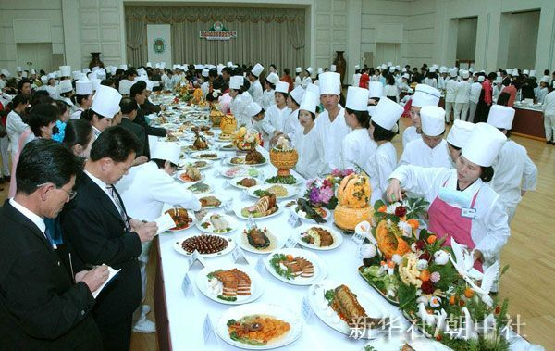
A culinary art competition

Slide 15
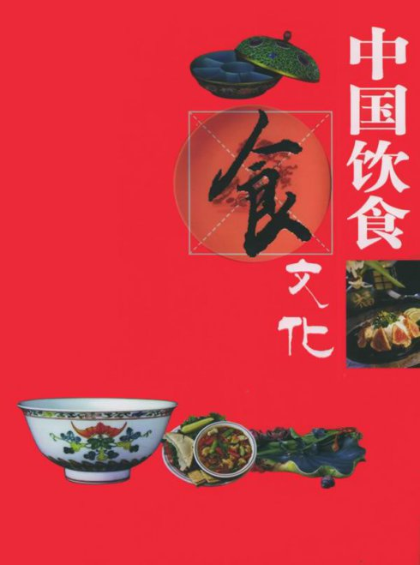
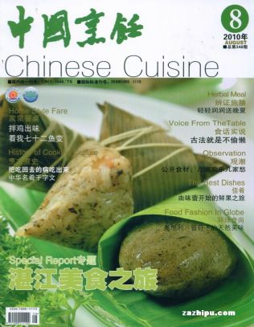
Chinese cuisine

Slide 16
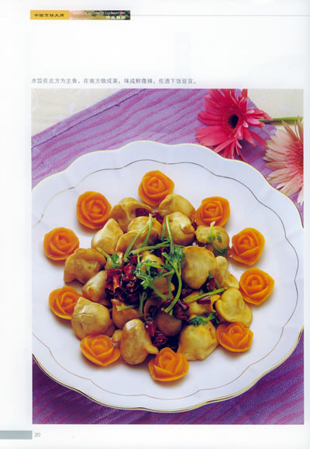
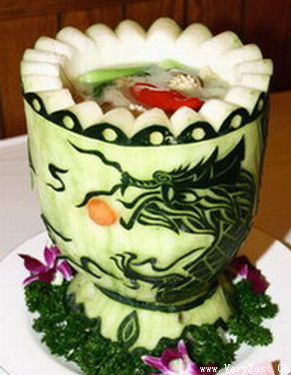
Chinese cuisine as art of cooking

Slide 17
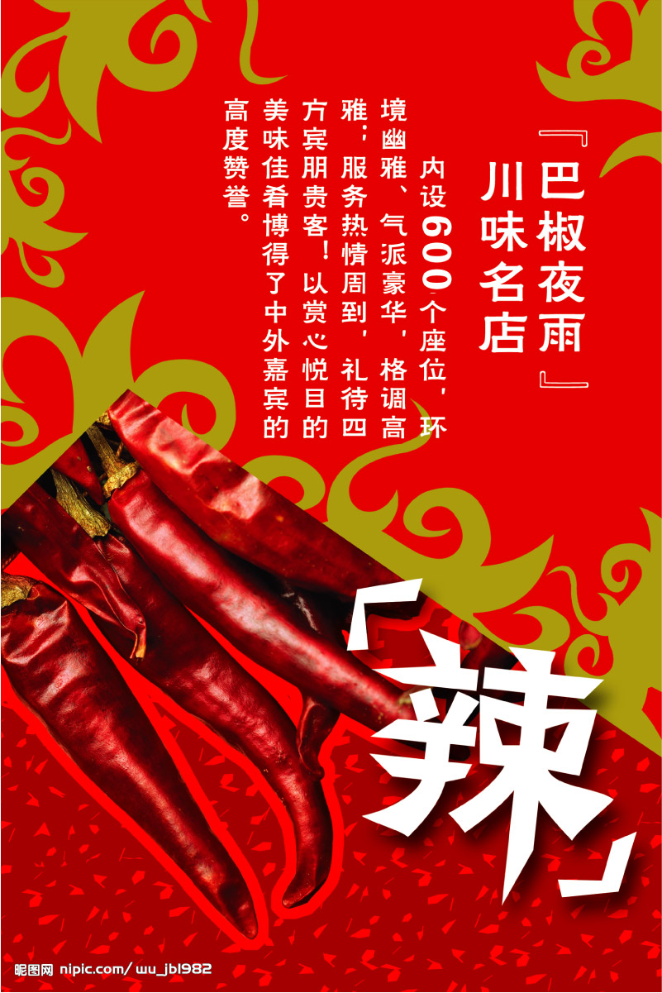
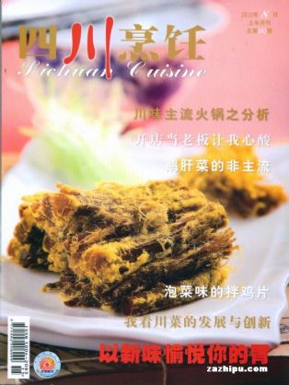
Magazine and poster

Slide 18
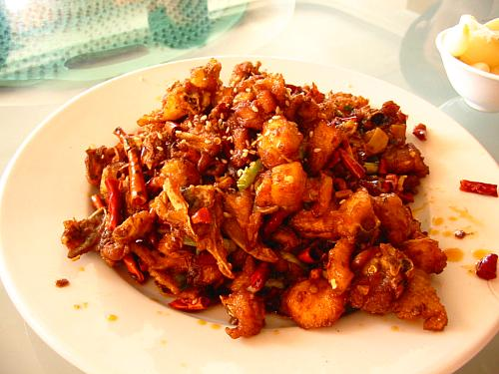
川菜之
麻
辣
鸡
丁

Slide 19
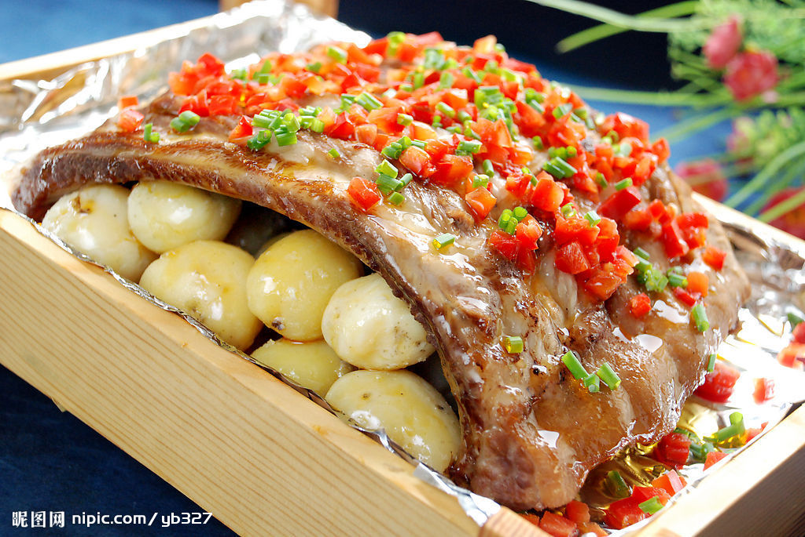
川菜之 排骨飞虹

Slide 20
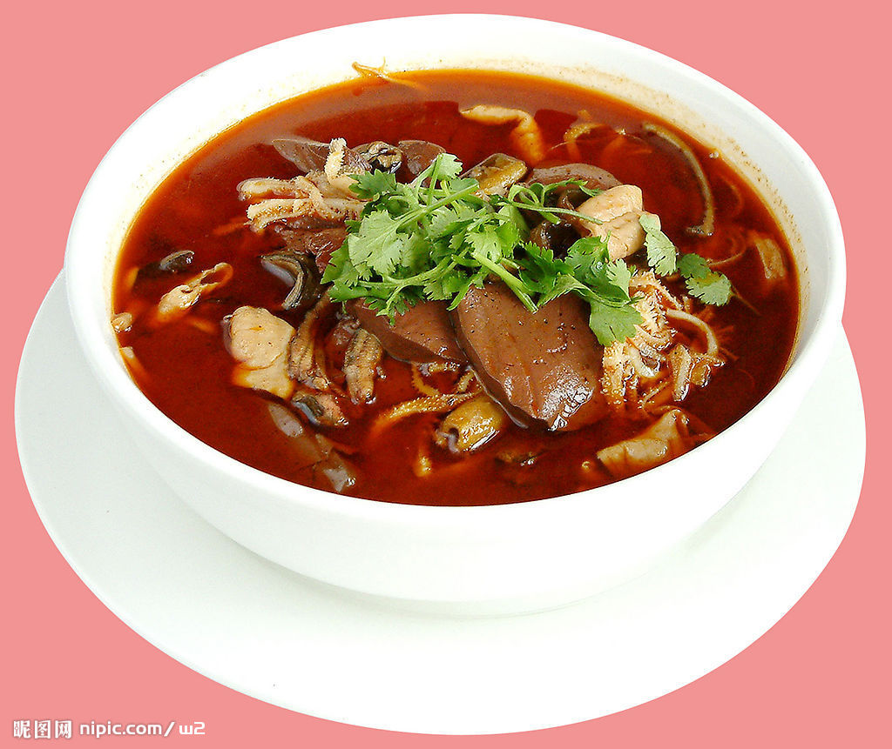
川菜之
毛血旺

Slide 21
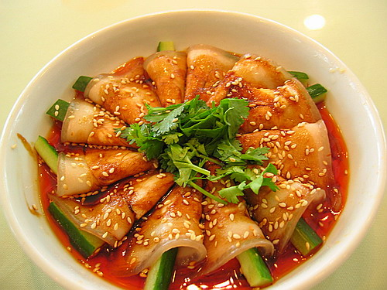
川菜之
麻辣肉片

Slide 22
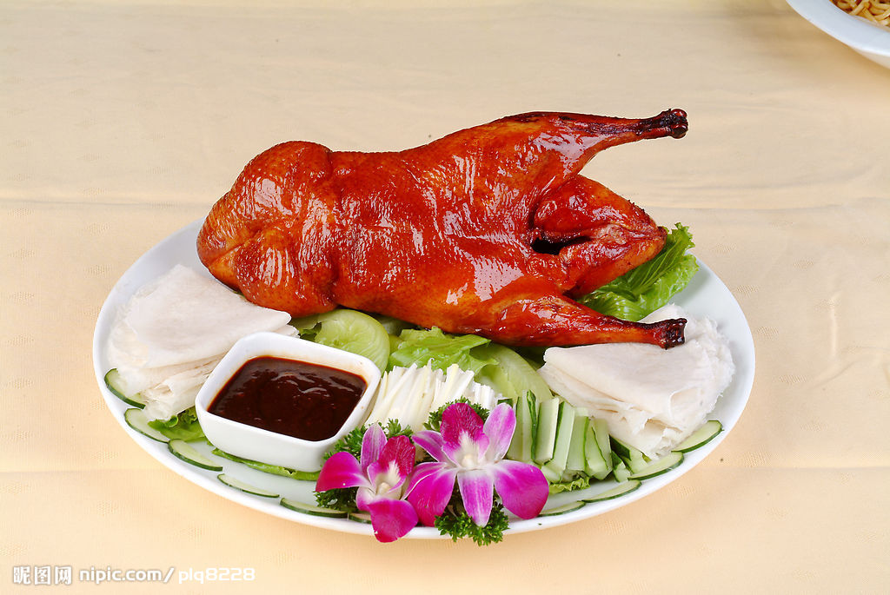
鲁菜之 北京烤鸭

Slide 23
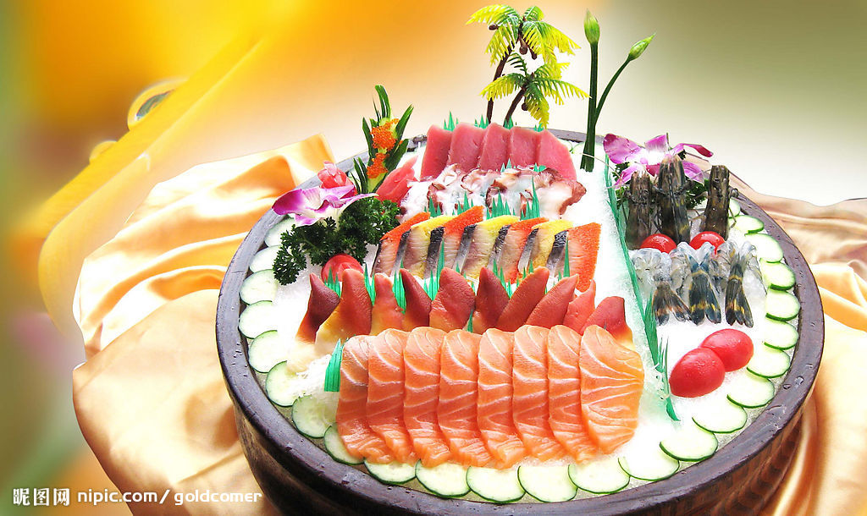
粤菜之 生鱼片

Slide 24
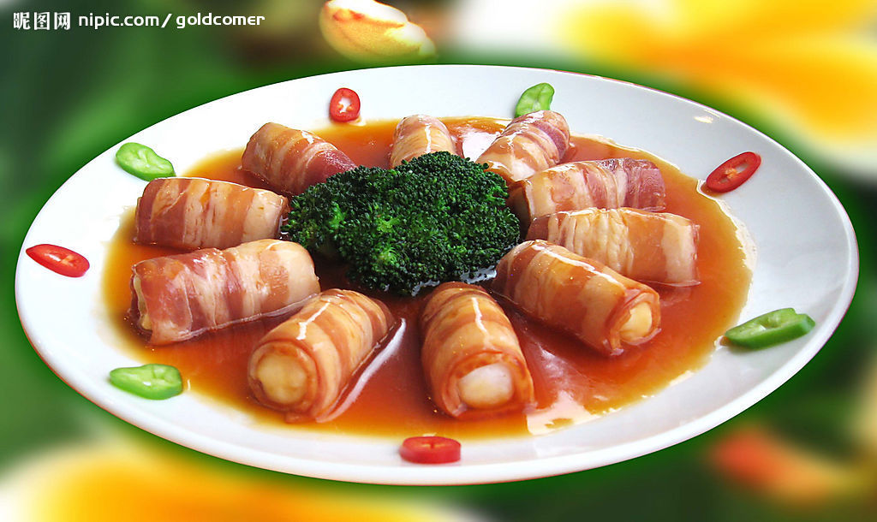
粤菜之 鱼丸肉卷

Slide 25
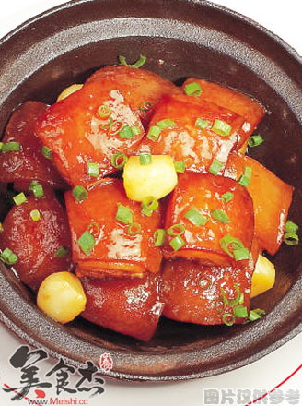
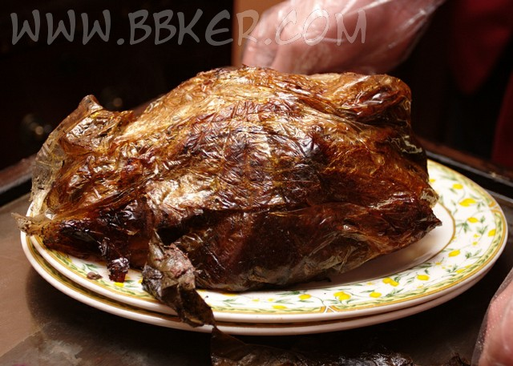
淮扬菜之 Beggar’s Chicken & Dongpo Pork

Slide 26
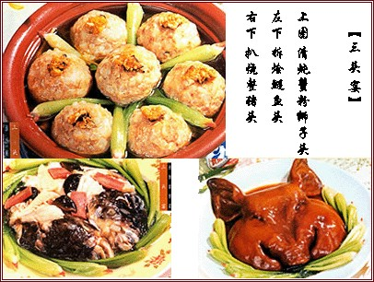
淮扬菜之 三头宴

Slide 27
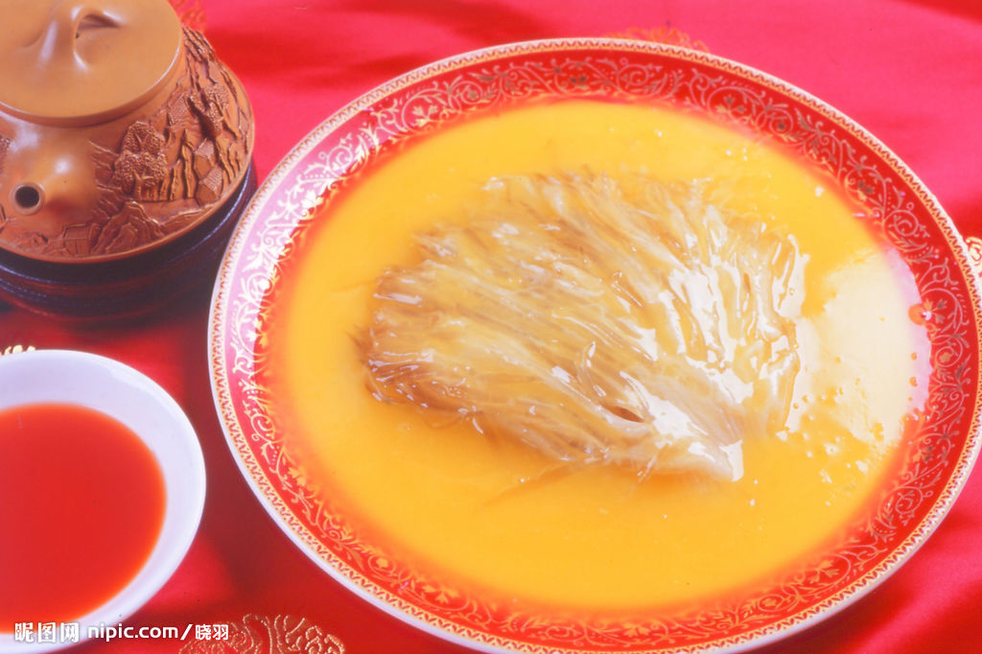
淮扬菜之 ？

Slide 28
Questions Concerning Section B.
The Art of Chinese Cooking
1. What differences are there between Chinese cuisine and Western cuisine?
2. What else is emphasized in Chinese cuisine besides the function of food satisfying the stomach?
3. What do you know about the choice of raw materials?
4. What do you know about the combination of main ingredients and auxiliary materials?
5. What do you know about the art of food cutting?
6. What do you know about the art of cooking Dongpo Braised Pork?

Slide 29
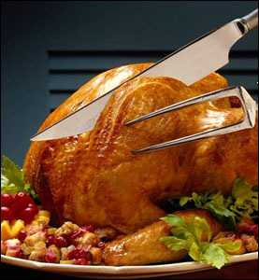
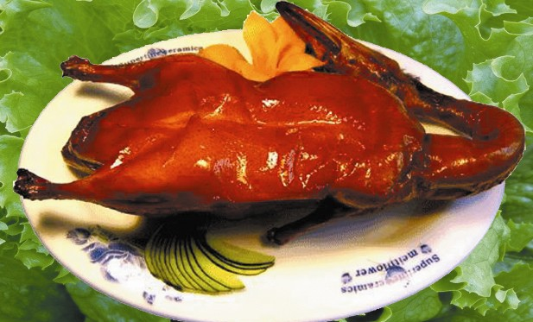
C. 2 Famous Dishes
Beijing Roast Duck

Slide 30
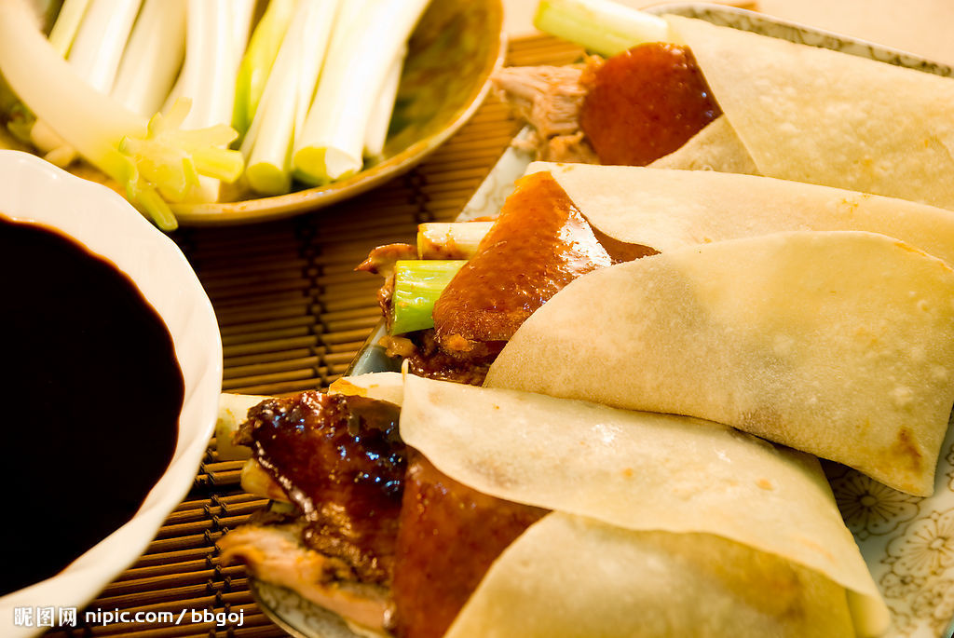
Beijing Roast Duck

Slide 31
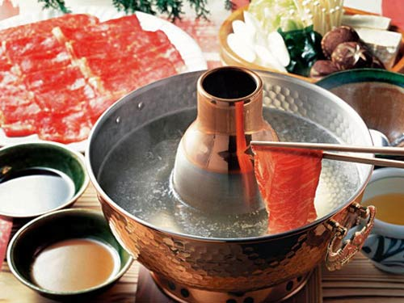
中国名菜之
羊肉火锅

Slide 32
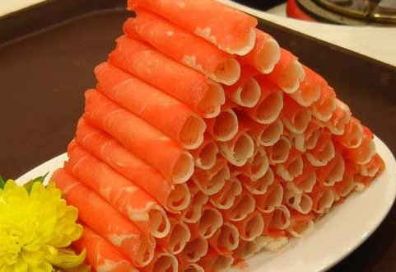
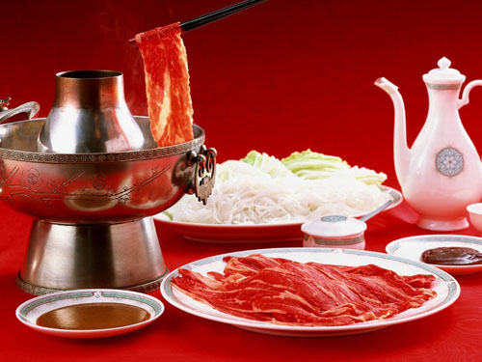
中国名菜之
涮羊肉

Slide 33
北京涮羊肉
据考证，我国南北朝时期已有火锅了，不过那时的火锅形状和质料并不像现在的铜质炭火锅，涮的肉也不像现在这样单一，有鸡、鱼、猪肉等。唐宋时的诗词中，不乏对火锅的吟诵。清代火锅已盛行，据载，嘉靖元年（1796），太上皇乾隆设的著名“千叟宴”，主菜就是涮羊肉。此宴用火锅多达1550多个，规模之大可以想见。第一家正式经营涮羊肉的店家，是开业于咸丰四年（1854）的前门外正阳楼。1914年，河北人丁德山开东来顺涮羊肉店。

Slide 34
乾隆做太上皇的第一年，为了庆祝国泰民安，在这个大殿里举行了一次别开生面的盛大宴会——“千叟宴”。这是清朝历史上规模最大、耗资最多、参加人数也最多的宴会。参加宴会的老叟有3000多人，故名。其实，清代一共举行过四次“千叟宴”，都是在康乾盛世时期，康熙和乾隆各有两次。这次宴会是在冬天举行的，天气很冷，而年岁最大的老人已经106岁了，乾隆怕把老人们冻坏了，不知吃什么好。这时，和绅提出吃火锅，又暖和又热闹。于是历史上最后一次“千叟宴”吃的就是火锅，这些老人们一边饮酒一边作诗，场面非常壮观。

Slide 35
Questions Concerning Section D.
Chopsticks
1. What do you know about the history of chopsticks?
2. What scientific principle does the use of chopsticks illustrate?
3. Why did fishermen prefer the character for chopsticks 筷 than 箸?
4. What manners of using chopsticks are considered bad in China?
5. How should we use chopsticks?
6. Do you know any story concerning chopsticks?
7. Is the use of chopsticks a good physical exercise?

Slide 36
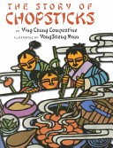
The author, Ying Chang Compestine, offers facts about the history of chopsticks, describes good table manners in a Confucian context, and gives a simple recipe for a dish served at the wedding feast. Xuan's illustrations, boldly colored cut-paper designs, are abstract enough to suggest the "high and far-off times" of this modern tale, yet lively enough to engage viewers. This story is rooted in Chinese culture and offers Americans an authentic glimpse of its traditions.

Slide 37
The Story of Chopsticks
Long ago, when all Chinese people ate with their hands, Keai (Quick), the youngest of three boys, was never fast enough to grab some nourishment before his brothers. In desperation, he pulled two sticks from the kindling pile and used them to spear chunks of hot food. His family members immediately copied the tools and named them Keai zi (quick ones) after him. When they were invited to a wedding banquet, the brothers, wielding their sticks, gobbled up the delicious, festive dishes. The village children caught on quickly, but the elders had to consider whether using the new implements conflicted with established etiquette.

Slide 38
筷子的故事
美国前总统尼克松在中国的欢迎宴会上也使用了筷子。他刚离桌，一名外国外交人员就抓起他的筷子，作为历史纪念。
《竹箸诗》云：“殷勤问竹箸，甘苦尔先尝；滋味他人好，尔空来去忙” 。古人之箸，多是竹木型，当然也有铜箸、铁箸、金箸、银箸、玉箸和象牙箸等。千年过去，筷子的形状、种类并无太大变化。使用最广的还是竹木筷子。筷子兼有多种功能，中国选手在国际乒坛多次囊括全部金牌，西人谓这是筷子练就的童子功。
“借箸代筹”：楚汉相争，郦食其建议刘邦分封战国时的六国后代，以争取多数贵族的支持。张良坚决反对，从食案上抓起一把筷子，提出一条理由就摆出一根筷子；他从八个方面力驳郦食其主张的危害，使刘邦收回成命，避免了割据分裂，成就了汉朝四百年的统一大业。

Slide 39
中国的筷子前圆后方，这种款式最早见于明朝，是当时理学盛行的一个见证，是“天圆地方”思想在筷子上的运用。日本的筷子比中国的筷子短，头是尖的。据说吃鱼比较方便，刺、肉容易分离。韩国的筷子是不绣钢和银制的，是两根扁扁细细的金属条，前后宽度一致。韩国人多食盖浇饭，用匙搅拌后舀着吃，筷子只用来夹泡菜之类，所以筷子居匙之后。
日本有家公司生产精密的光学仪器，他们的器材可用在航天飞机和脑外科显微镜上。招募新人时，这个公司先要通过画自画像和做飞机模型两关，最后把应聘者带到吃鱼的店子，看他怎样用筷子吃鱼。就算前两关过了，吃鱼不利索的，也会被淘汰，因为筷子的使用反映了一个人手脑的精细度。
从筷子可以看出中、日、韩三国国民性的差异。日本人比中国人更习惯、更擅长于精细化；中国人“讲究实用”，生活较随意，能用就好，不做进一步的探究，不在乎具体的细节和程度。日本人对这种‘模糊性’是生来就抵触的，他们一定要把筷子头弄细，这样就是米粒也能夹得起来。

Slide 40
Topics for discussion
1. Do you know any story or legend concerning Chinese cuisine?
2. What role does the use of chopsticks play in Chinese cuisine?
3. What differences are there between Chinese cuisine and Western cuisine?

Slide 41
See you next time!

Slide 42
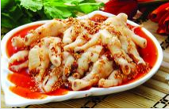
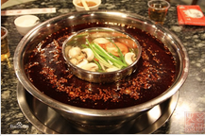
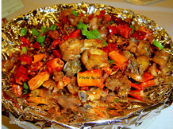
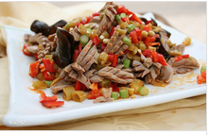
What school of China’s culinary art is perhaps the most popular? What is it famous for?

Slide 43
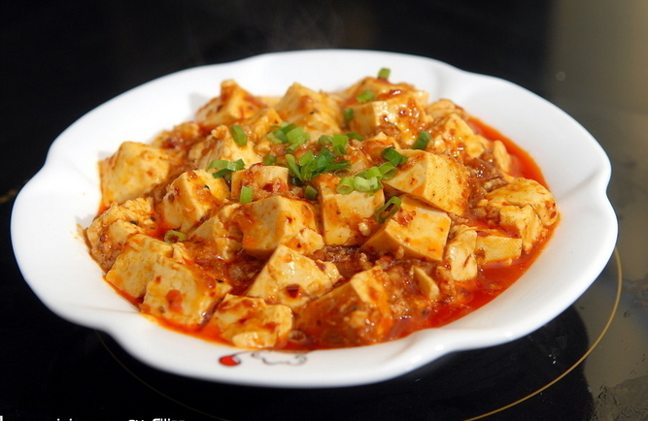
What do you know about Pock-marked Wife’s Bean Curd?

Slide 44
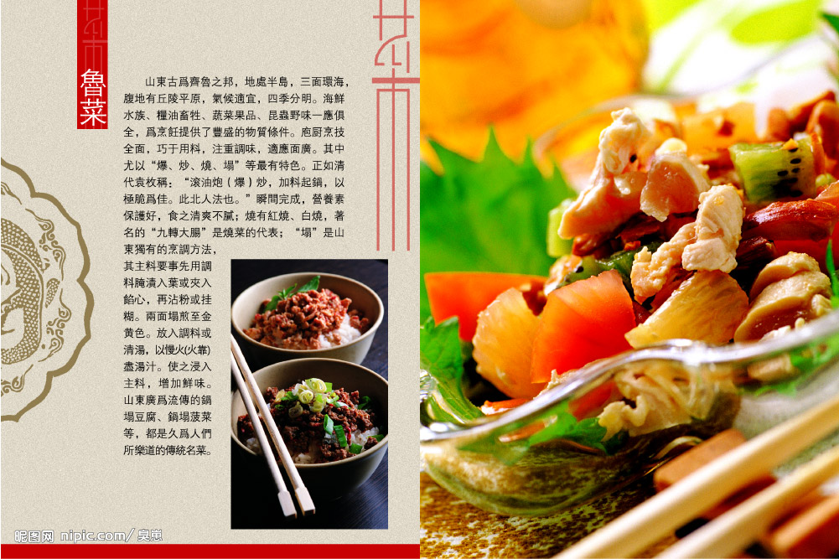
What are the characteristics of Shangdong Cuisine?

Slide 45
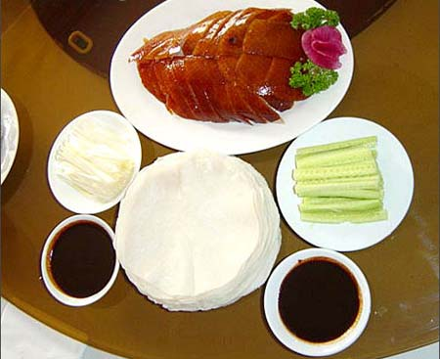
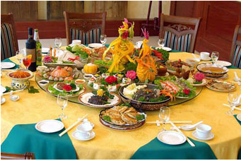
What do you know about Beijing Roast Duck and Confucius Family Dishes?

Slide 46
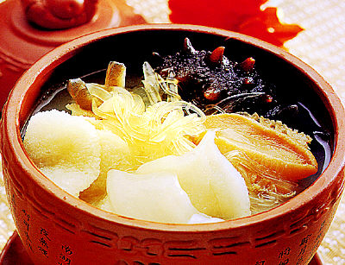
Why must Guangdong dishes be lightly seasoned? What Guangdong dishes can you name?
粤菜之 海参鲍鱼汤

Slide 47
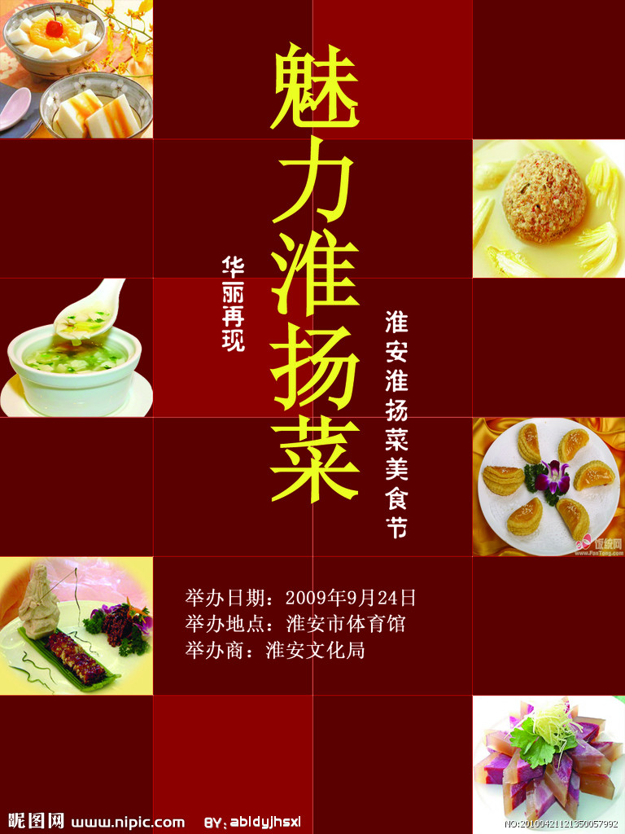
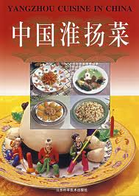
What is the greatest characteristic of Huaiyang cuisine? What Huaiyang dishes can you name?

Slide 48
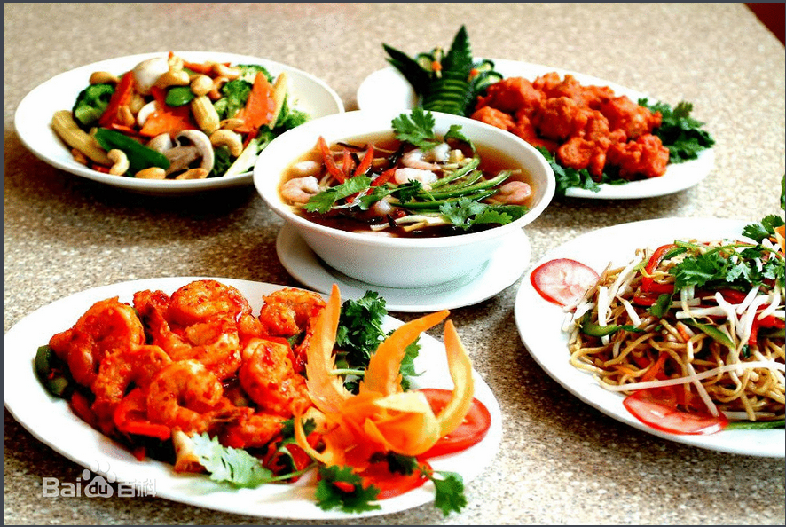
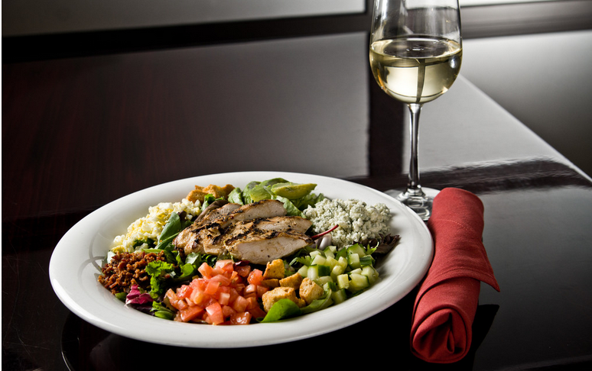
What differences are there between Chinese cuisine and Western cuisine?

Slide 49
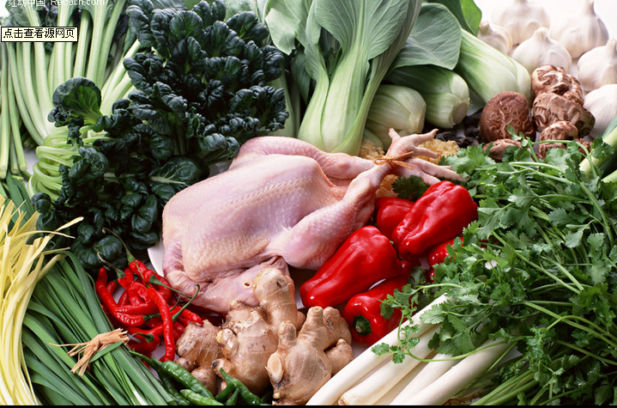
What do you know about the choice of raw materials?

Slide 50
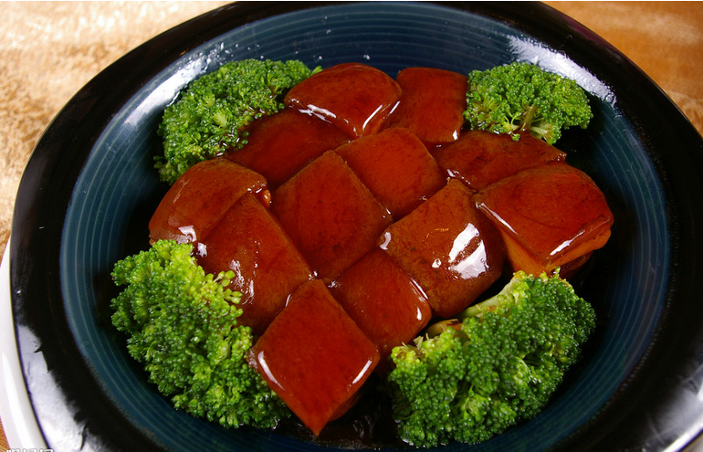
What do you know about the art of cooking Dongpo Braised Pork?

Slide 51
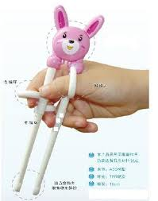
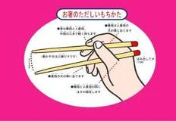
What scientific principle does the use of chopsticks illustrate?

Slide 52
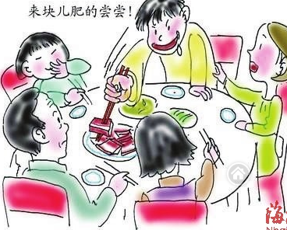
What manners of using chopsticks are considered bad in China?

Slide 53
Preparation for next week
Please prepare the three topics for session 5 (March 31, 2021):
Aesthetic ideals and social customs: Chinese Marriage Customs杜心语
Music and instruments: Pipa 刘卓凡 ...
Traditional Cuisine: The Art of Chinese Cooking戴沐雨

Slide 54
Always here for you!
随时为你们服务
Professor Dr. Martin Woesler
吴漠汀
湖南师范大学特聘教授，博士导师
Office / 办公室: 外国语学院406
国际汉学中心308
Phone / 电话: (150) 1138 8818
(德国+49 178 2073538)
Email / 电子邮件: wmt@hunnu.edu.cn

Slide 55
Thank You

