Slide 1

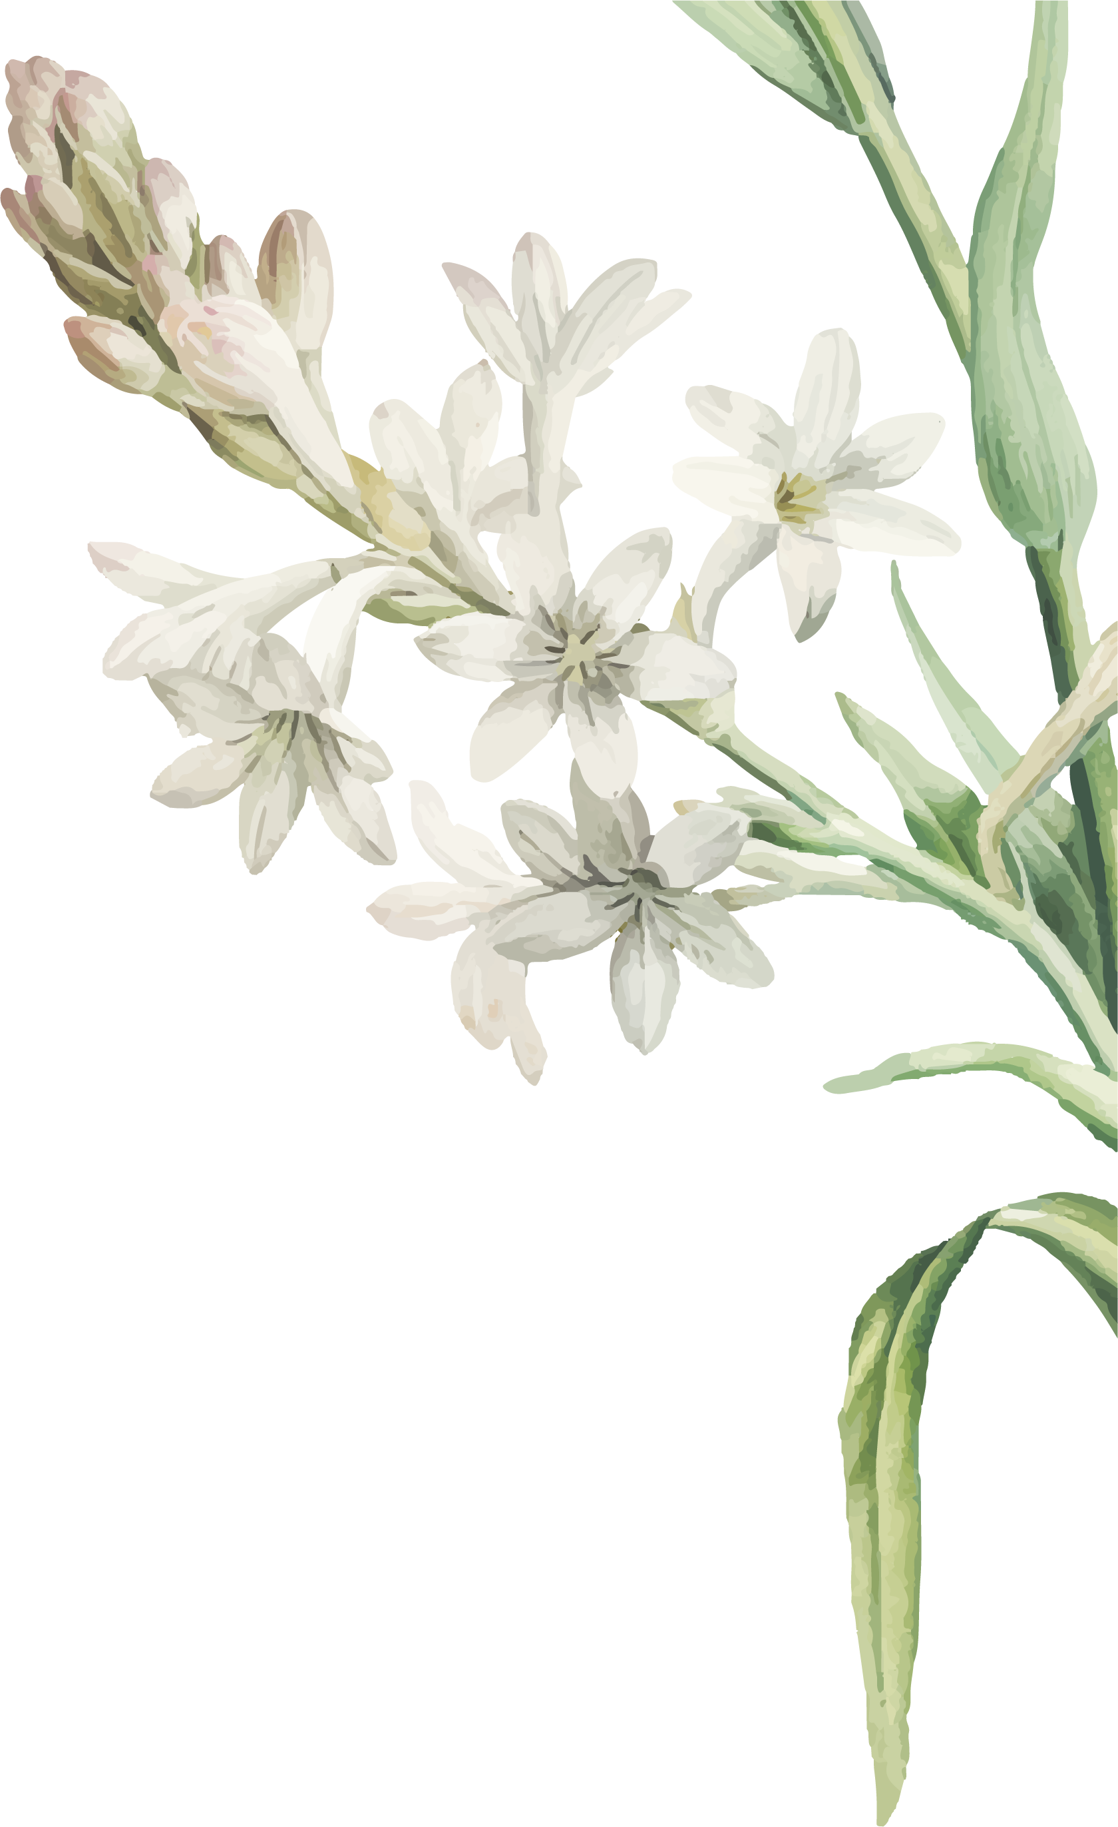
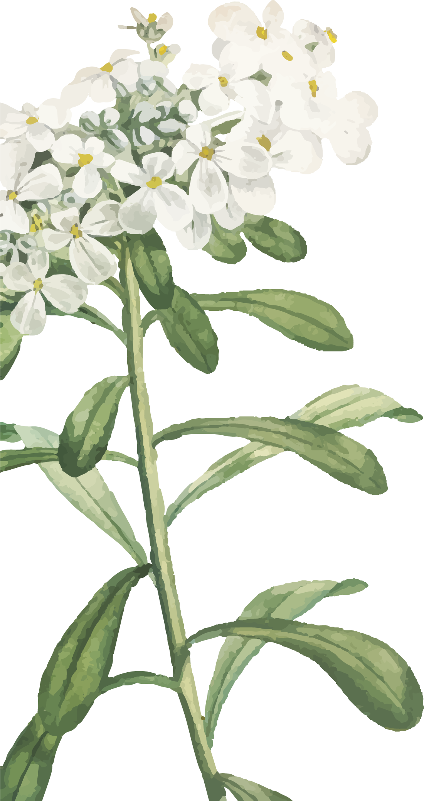
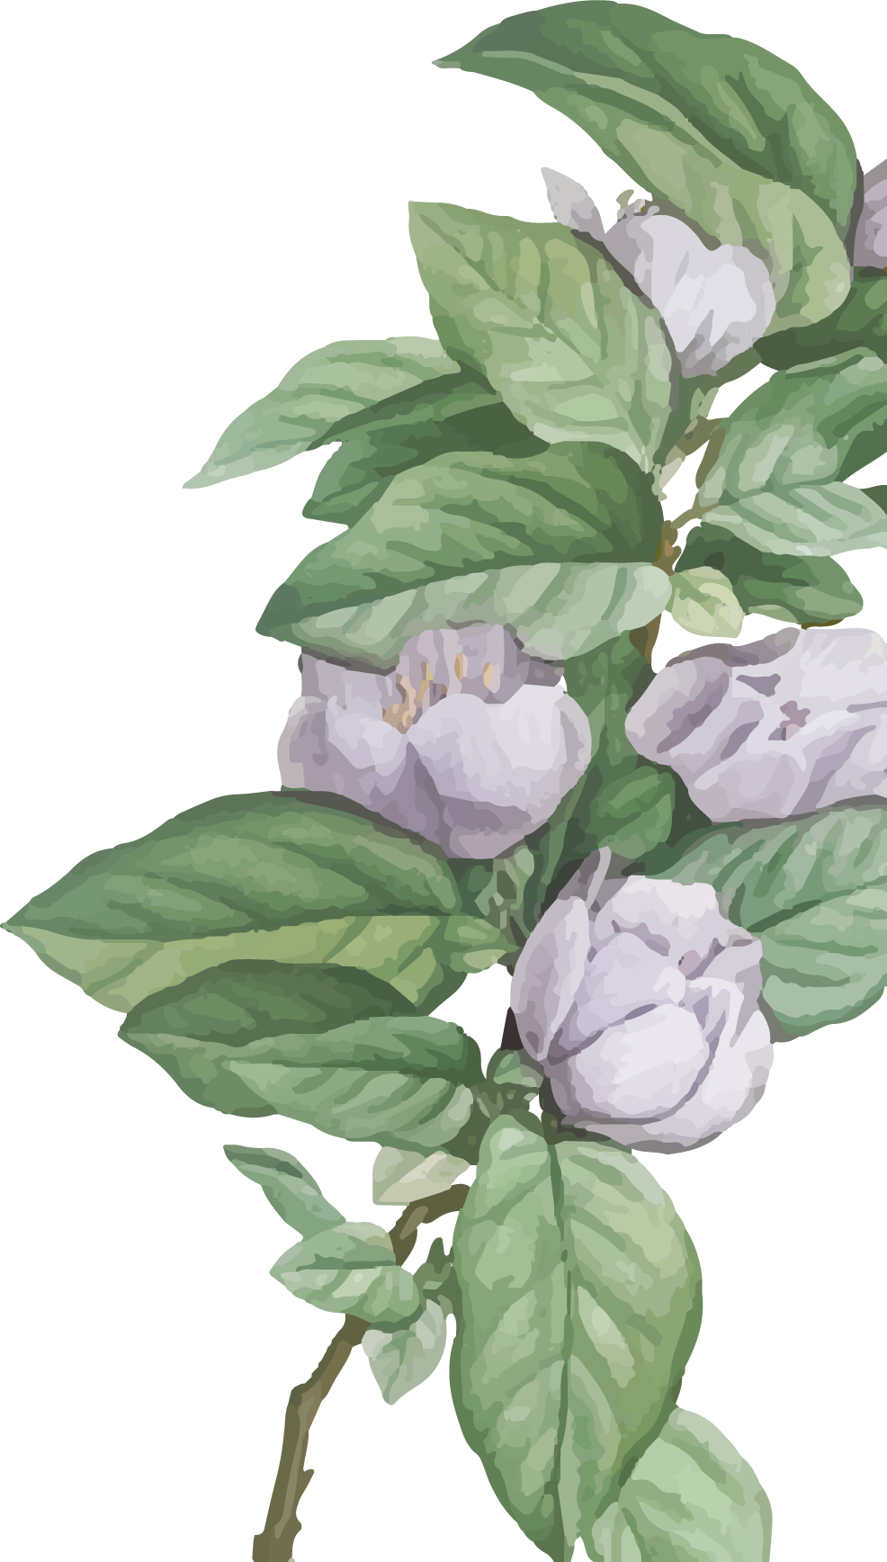

中国方言
Chinese Dialect
喻鑫众

Slide 2
01
A. Brief introduction of Chinese dialects
目录
02
B. Hunan dialect
CONTENTS
03
C. Cantonese

Slide 3
01
Brief introduction
of
Chinese dialects

Slide 4

dialect
方言
In Europe，“dialect” is a linguistic concept subordinating under the concept of “language”..
“the form of a language that is spoken in one area with grammar, words and pronunciation that may be different from other forms of the same language”
pronunciation + vocabulary + grammar

Slide 5
The word is originated from《輶轩使者绝代语释别国方言》by 杨雄in Han dynasty.
So方言was a very vague word only meant the language spoken in a place at that time.
方=地方
言=语言

Slide 6
Missionaries often used the word方言 to refer to the languages spoken throughout China.
19th cen.
Chinese scholars began to consciously discuss the relationship between dialects and Mandarin.
end of 19th cen.

Slide 7
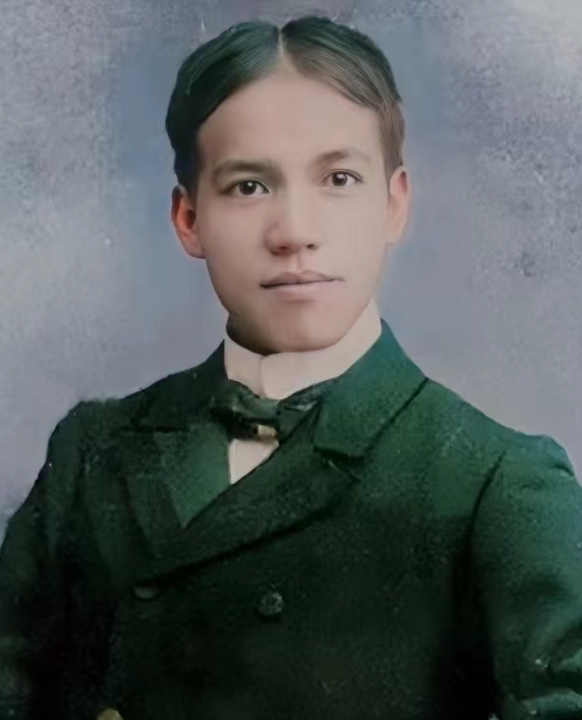
近今考族类者，必以言语为基。
环观全球万国，以同一民族而其言语厖杂，沟绝不能相通，则未有中国人若也。闽粤不必论，即吴、越、湘、鄂、齐、燕，莫不各有其方言，非互相迁就，则相对不能交一言也。

Slide 8
Missionaries often used the word方言 to refer to the languages spoken throughout China.
19th cen.
Chinese scholars began to consciously discuss the relationship between dialects and Mandarin.
end of 19th cen.
In 1932, the National government officially announced the establishment of 新国音 as 国语.
1932

Slide 9

foundation of PRC
Mandarin was renamed as Putonghua.

Slide 10
国务院《关于当前语言文字工作的请示》
推广普通话工作方针由50年代确定的“大力提倡、重点推行、逐步普及”调整为“大力推行、积极普及、逐步提高”。

Slide 11
foundation of PRC
Mandarin was renamed as Putonghua.
Mandarin became dominant in China.
21st cen.
Mandarin became too dominant in China...

Slide 12
对方言应多加关注、适当保护。从政策、舆论、措施等各方面尽可能为方言的存在与发展创造有利条件提供更多空间并尽力延缓濒危方言的消亡及时纪录、妥善保存其珍贵资料。

Slide 13
foundation of PRC
Mandarin was renamed as Putonghua.
Mandarin became dominant in China.
21st cen.
Mandarin became too dominant in China...
And the government started to do so many efforts to protect dialects.
now

Slide 14
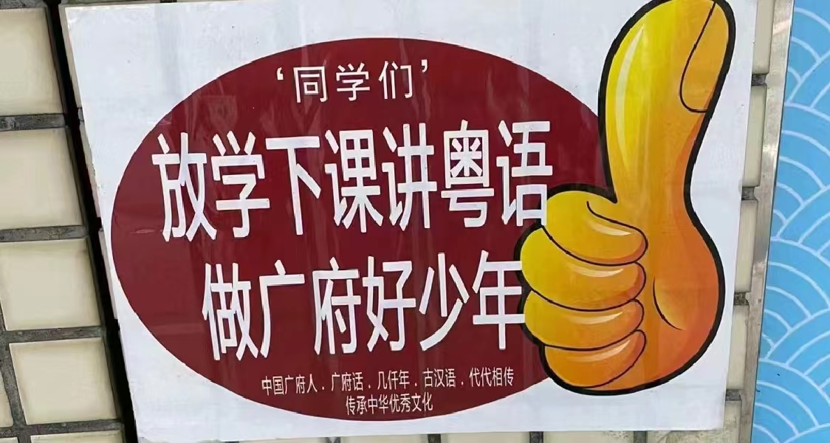
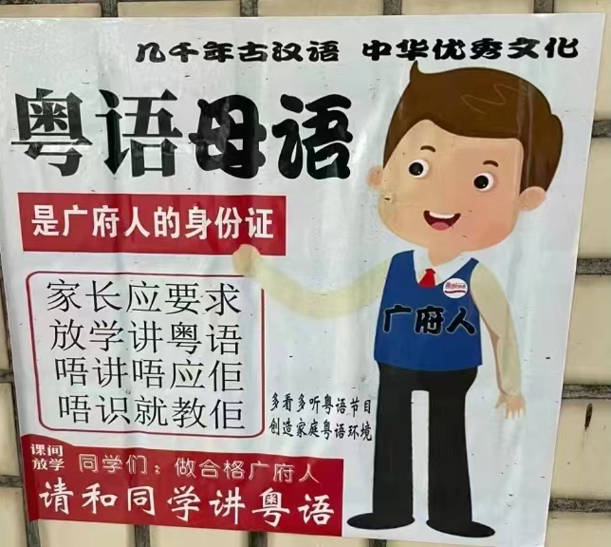

Slide 15
02
Hunan
Dialects

Slide 16
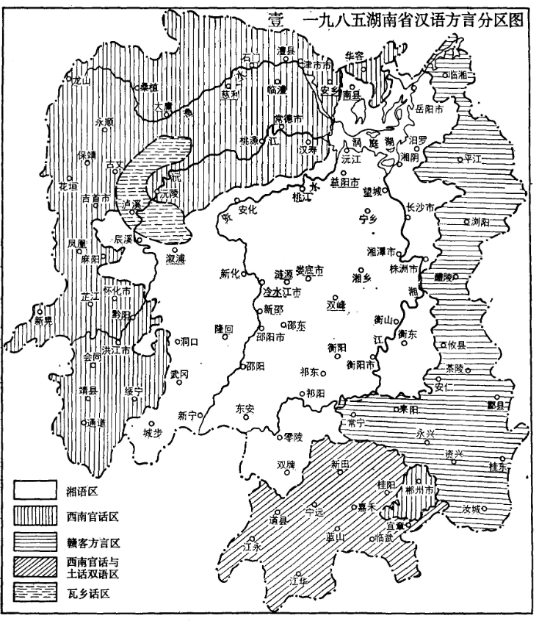

Slide 17
Changsha Dialect & Ningxiang Dialect
Changsha Dialect
Ningxiang Dialect
Changsha Dialect almost lost all the “zh ch sh”
Ningxiang Dialects maintains many “zh ch sh”

Slide 18
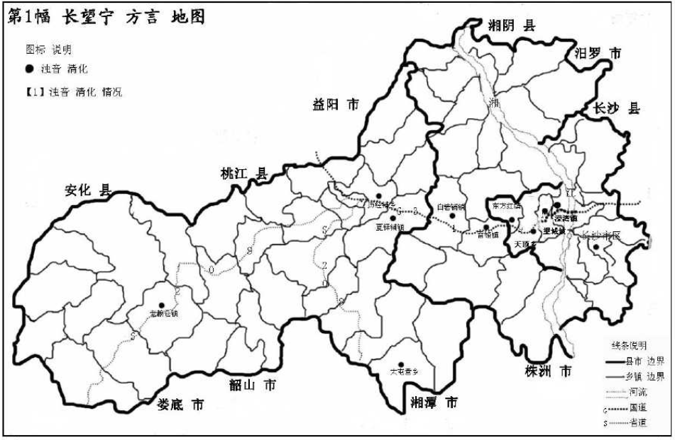

Slide 19
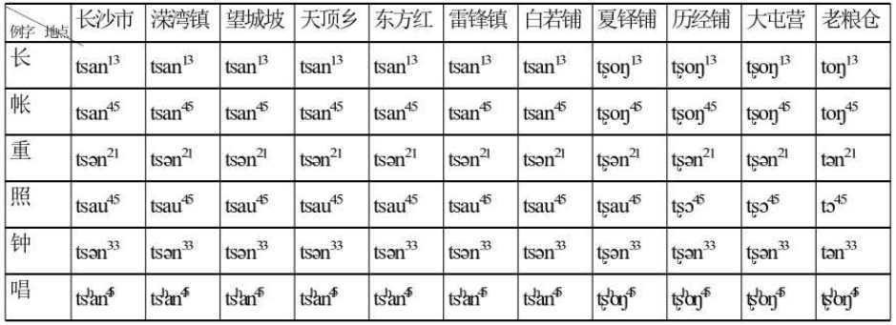

Slide 20
Changsha Dialect & Ningxiang Dialect
Changsha Dialect
Ningxiang Dialect
Changsha Dialect almost lost all the “zh ch sh”
Ningxiang Dialects maintains many “zh ch sh”
“man” means the youngest kid in Changsha.
“man” means the dear kid in Ningxiang.
“Bie” is offensive in Changsha.
“Bie” is to show love in Ningxiang.

Slide 21
03
Cantonese

Slide 22
Cantonese
Yueyu, or Cantonese, Guangdong dialect, is commonly known as "baihua"(白话). Cantonese is the mother tongue of the Guangfu nationality, an important carrier of the Guangfu culture of the Han nationality.
冇
喺

Slide 23
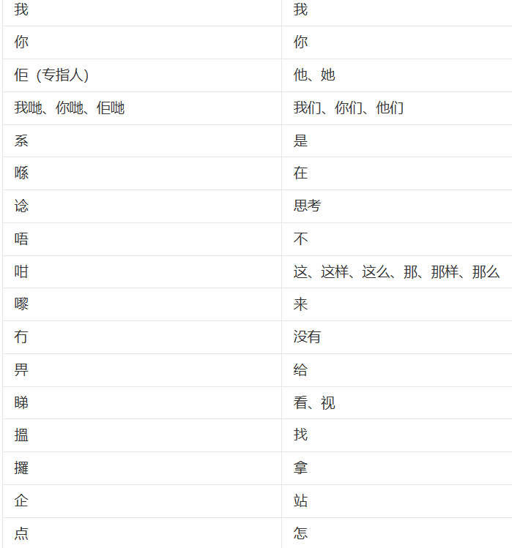
Cantonese

Slide 24
Cantonese & English
datai
打领带
sidodim
士多店

Slide 25
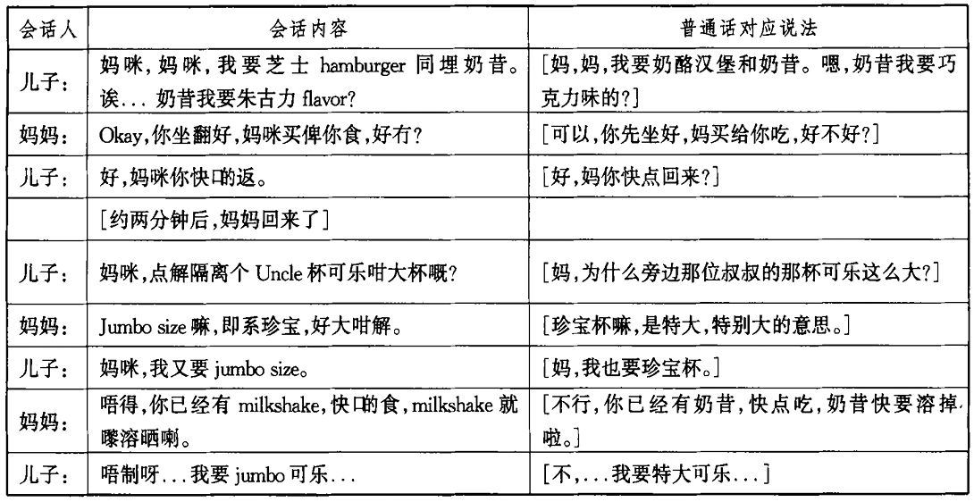
Cantonese & English

Slide 26
04
reflections

Slide 27
谢
观
谢
看
THANKS

