Slide 1


REPORTING
Interesting Things about Hot Pot
Xiao Yixuan/Yuki
2024-10-24

Slide 2

REPORTING
The Charm of Hot Pot
History of Hot Pot
Hot Pot Fans in the Royal Family
目录
CATALOGUE

Slide 3


REPORTING
01
The Charm of Hot Pot
火锅的魅力

Slide 4
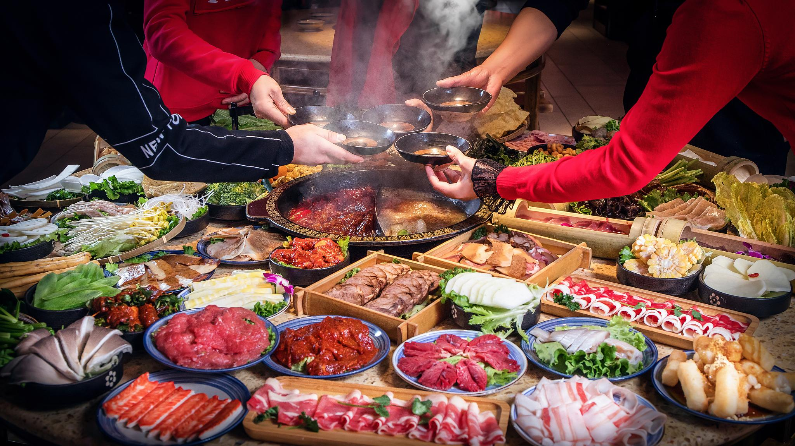
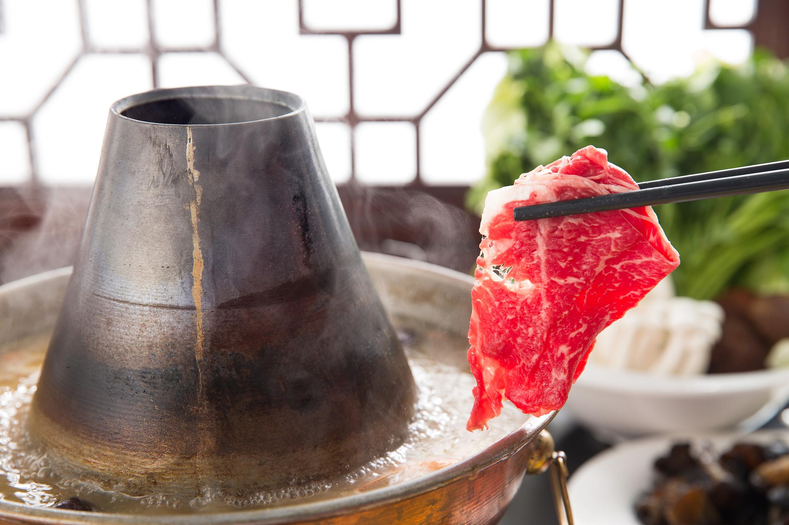
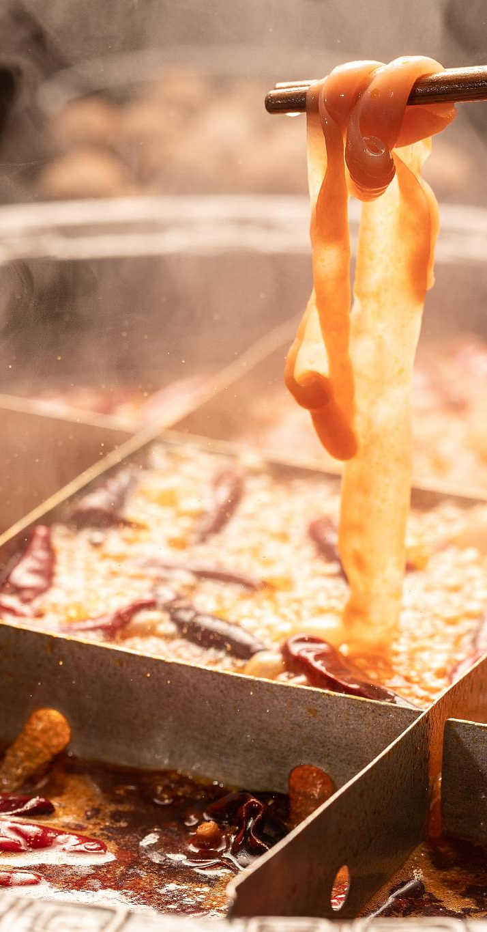
The Charm of Hot Pot 火锅的魅力
The Charm of Hot Pot
When it comes to hot pot, many people start to image large slices of fatty beef and a thick, flavorful pot base. Especially when the weather is getting colder, a hot pot can be a wonderful experience to relax the body and mind.
Hot pot has been popular since ancient times
Hot pot is not a modern cuisine; long, long ago, the ancients began to eat and enjoy hot pot.

Slide 5
REPORTING
02
How long has hot pot
been around?
火锅的历史有多长？

Slide 6
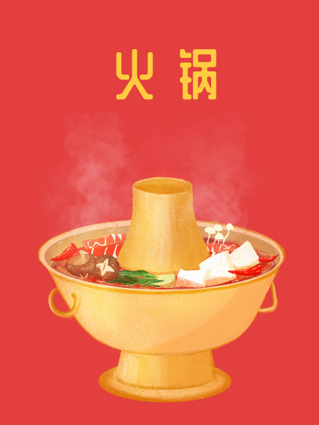
Origin of Hot Pot 火锅的起源
How long do you think hot pot has a history?
a. 1000 years ago
b. 500 years ago
c. 100 years ago
d. 2000 years ago.

Slide 7
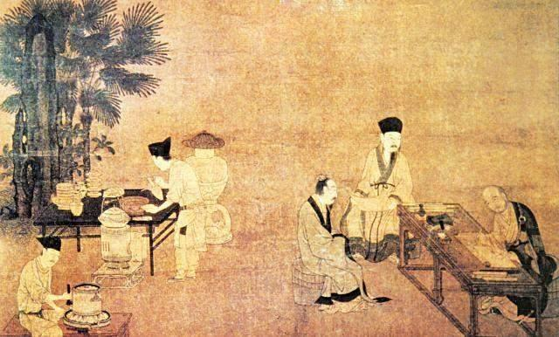
Origin of Hot Pot 火锅的起源
Warring States Period 战国时期说
Hot pot existed during the Warring States period, and the ancients used clay pots as pots, and this method is considered to be an ancient way of cooking.
Han Dynasty 汉代说
Hot pot began in the Han Dynasty, and the excavated hot pot from the tomb of Marquis Haihun of the Western Han Dynasty shows that hot pot has a history of more than 2,000 years in China.

Slide 8
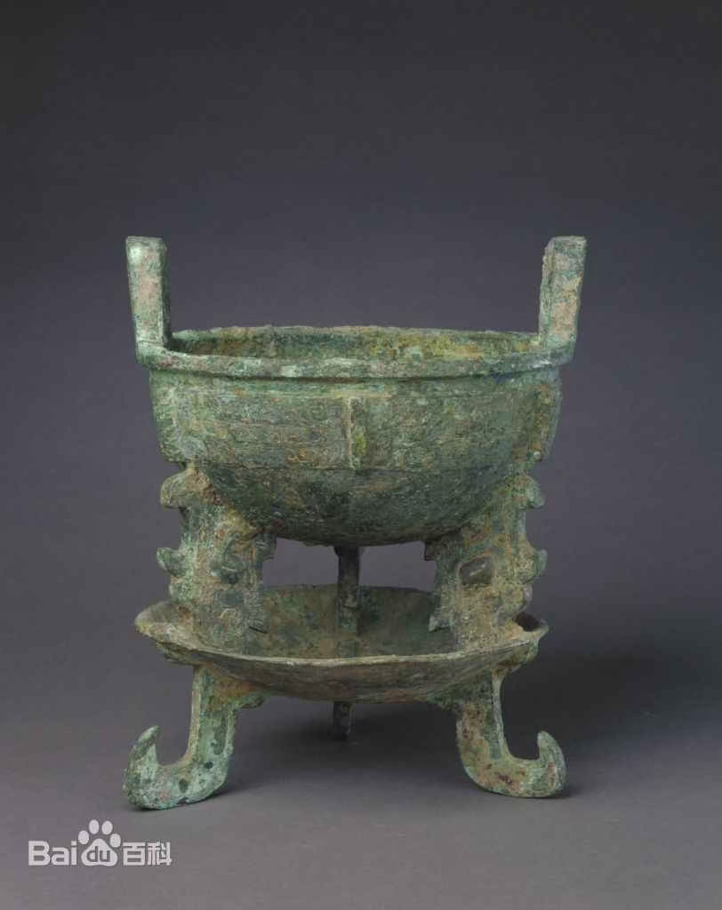
Hot Pot Relics 火锅文物
the Ding with Tray from the Western Zhou Dynasty
西周（前1046～前771年）
collected by the Palace Museum.
Below is a tray for charcoal fire.
This is basically like a hot pot.
👈故宫博物院收藏的西周有盘鼎

Slide 9
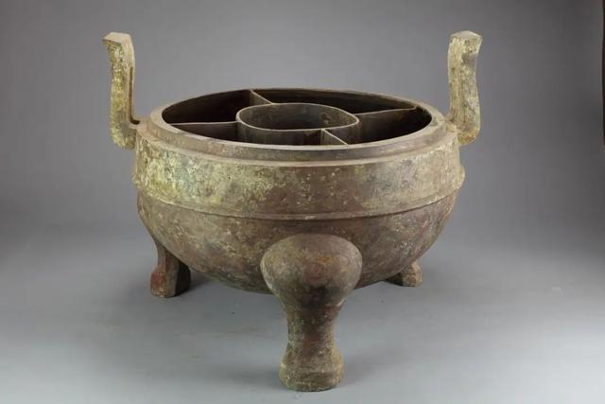
Hot Pot Relics 火锅文物
Divided Hotpot of Western Han Dynasty 西汉分格鼎
The mandarin duck hot pot commonly used by modern people has already taken shape in the old ancestor. Liu Fei, the King of Jiangdu in the Western Han Dynasty, had a compartmentalized tripod unearthed from his tomb, which can be regarded as the first person of compartmentalized hot pot.

Slide 10
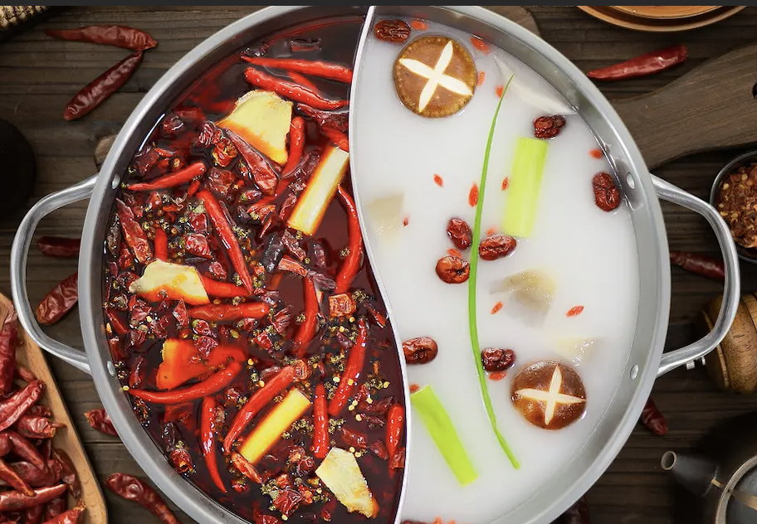
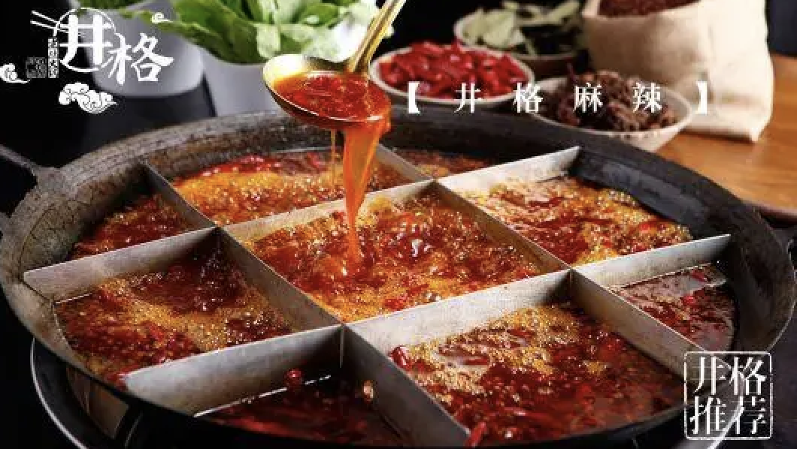
Hot Pot Relics 火锅文物
西汉分格鼎
Divided Hotpot of Western Han Dynasty
鸳鸯火锅
Yuan-yang pot (spicy and non-spicy divided pot)
井格火锅
The grid hot pot

Slide 11
Hot Pot Relics 火锅文物
Divided Hotpot of Western Han Dynasty 西汉分格鼎
The mandarin duck hot pot commonly used by modern people has already taken shape in the old ancestor. Liu Fei, the King of Jiangdu in the Western Han Dynasty, had a compartmentalized tripod unearthed from his tomb, which can be regarded as the first person of compartmentalized hot pot.

Slide 12
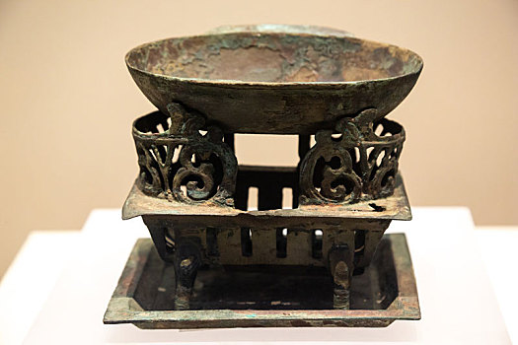
Hot Pot Relics 火锅文物
the Bronze Dyeing Furnace of the Western Han Dynasty.
西周（前1046～前771年）
What is this container used for?
a. noodles 面条
b. hot wine 热酒
c. dipping sauce 蘸料
d. appetizers 前菜
👈西汉青铜染炉

Slide 13
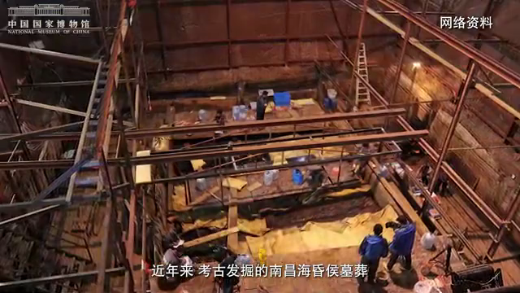

Slide 14
Hot Pot Relics 火锅文物
the Bronze Dyeing Furnace of the Western Han Dynasty.
西周（前1046～前771年）
・In ancient times, seasonings were called "dyeing".
・Compared to us, people in the Western Han Dynasty were much more particular. Not only was the food hot, but even the dipping sauce had to be hot.
・This thing in the picture is not for boiling meat, but for heating dipping sauce.
👈西汉青铜染炉

Slide 15
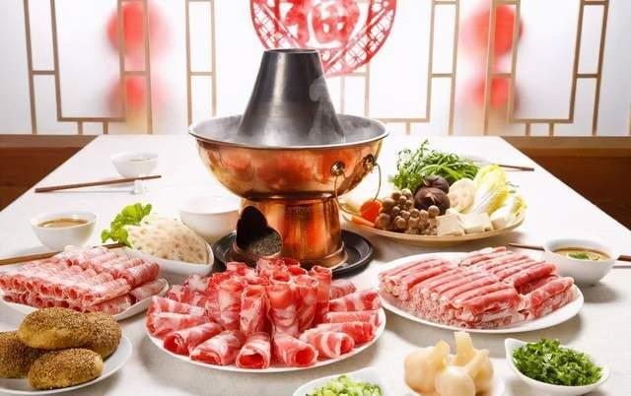
Ancient name for hot pot
a. Suan-suan pot 涮涮锅
b. Warm pot 温锅
c. Antique soup古董羹
d.Shabu shabu 呷哺呷哺
Guess what the ancient name of hot pot was?

Slide 16
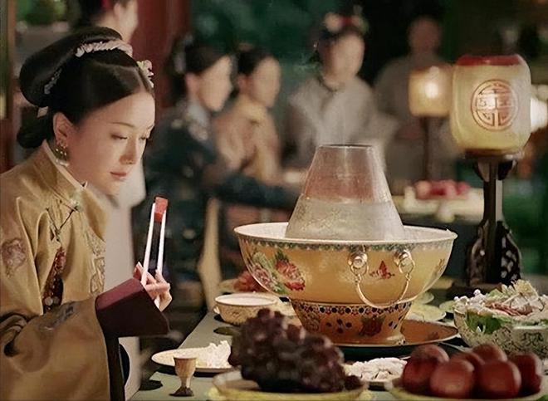
Ancient name for hot pot
The correct answer to the ancient name for hot pot is “antique soup”, which comes from the “gurgling” sound made by adding vegetables and other ingredients to the hot pot.
The correct answer is C
Antique soup
古董羹
古董=咕咚
gudong=gudong

Slide 17
REPORTING
03
Hot Pot Fans in the Royal Family
皇室中的火锅迷

Slide 18
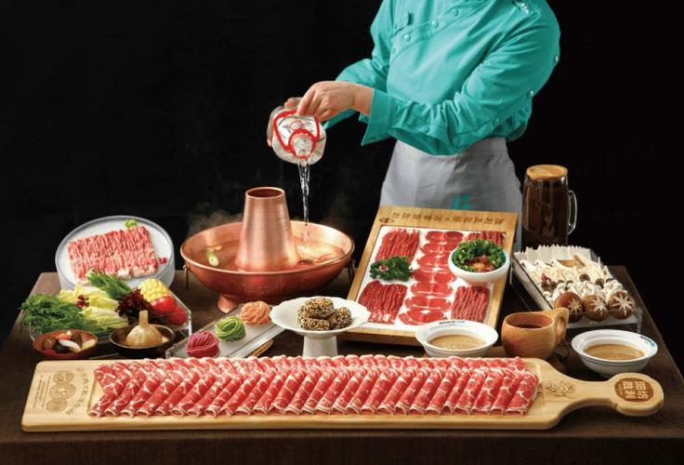
Who invented lamb hot pot? 羊肉火锅是谁发明的？

Slide 19
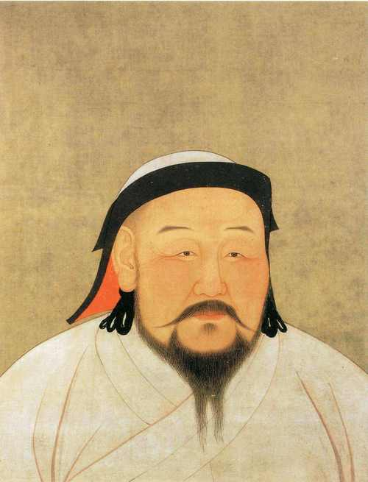
Who invented lamb hot pot? 羊肉火锅是谁发明的？
Kublai Khan and lamb Hot Pot
01
Kublai Khan, hegemon of the Mongol Empire, conquered many acountries and his chef invented lamb Hot Pot.
Kublai Khan named the lamb ‘Shuan Yang Rou’(Shabu Shabu)
02
He was hungry in winter and wanted to eat lamb, the chef innovated thin slices for shabu-shabu; Kublai gave it the name ‘Shuan Yang Rou’, and it became the grand finale of the celebratory feast.

Slide 20
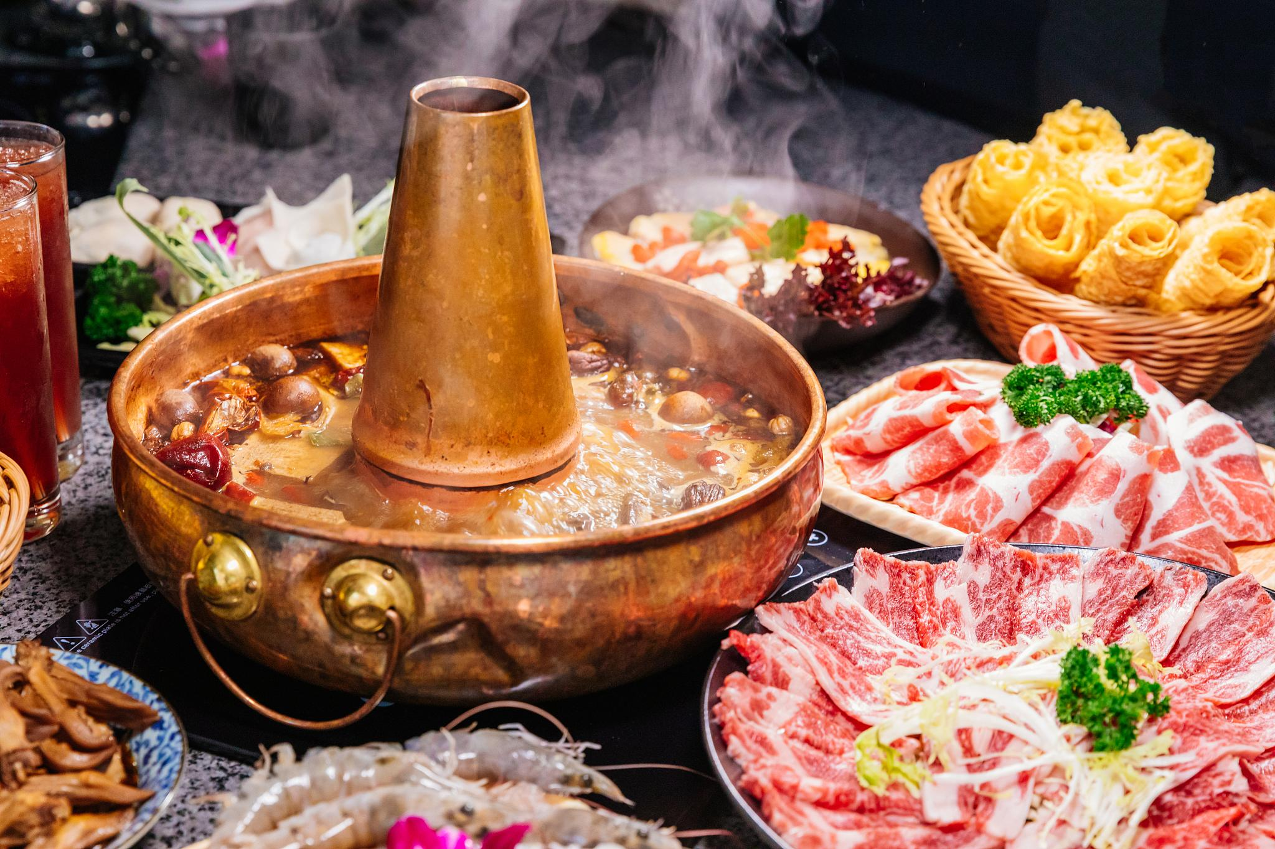
Hot Pot Fans in the Royal Family
皇室中的火锅迷
Who among the emperors of the Qing Dynasty was an avid fan of hot pot?
A. Kang xi B. Qian long
C. Yong zheng D. Shun zhi

Slide 21
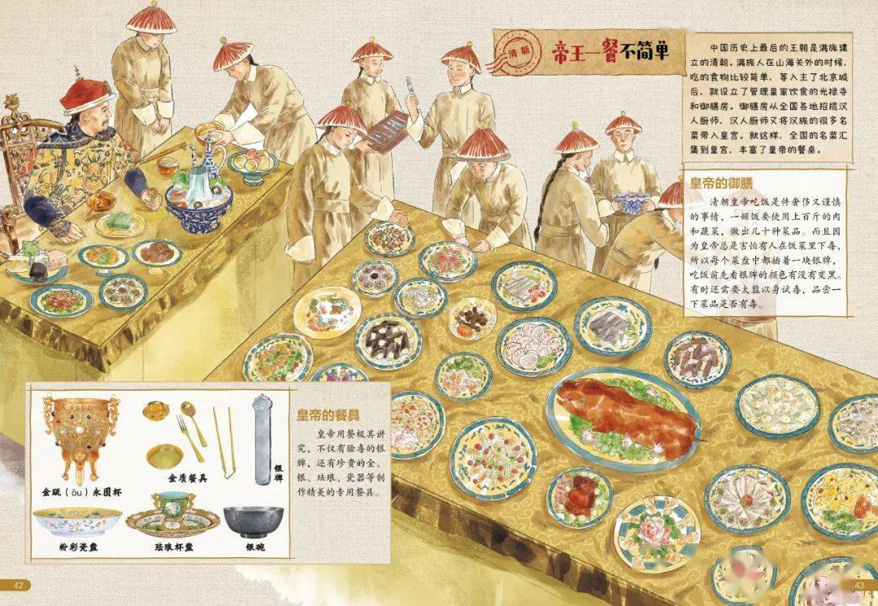
Hot Pot Fans in the Royal Family
皇室中的火锅迷
The correct answer is B. Qianlong

Slide 22
The avid fan of hot pot ——Emperor Qianlong
The record of his imperial meals
01
Qianlong started eating hot pot from breakfast.
According to records, from August 16th to September 16th in the 44th year of Qianlong, there were 23 kinds of hot pots served 66 times.
乾隆三十年正月十六
早膳第一个菜：燕窝红白鸭子南鲜热锅
当天晚膳第一个菜：燕窝鸭子热锅
乾隆三十年正月十七日
早膳第一个菜：燕窝肥鸡鱼脍
晚膳第一个菜：野鸡热锅
乾隆三十年正月十八日
早膳第一个菜：炒鸡大炒肉炖酸菜热锅
晚膳第一个菜：莲子八宝鸭子热锅。

Slide 23
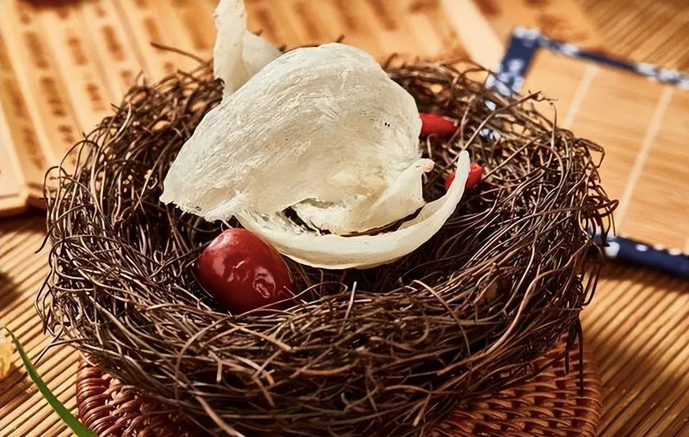
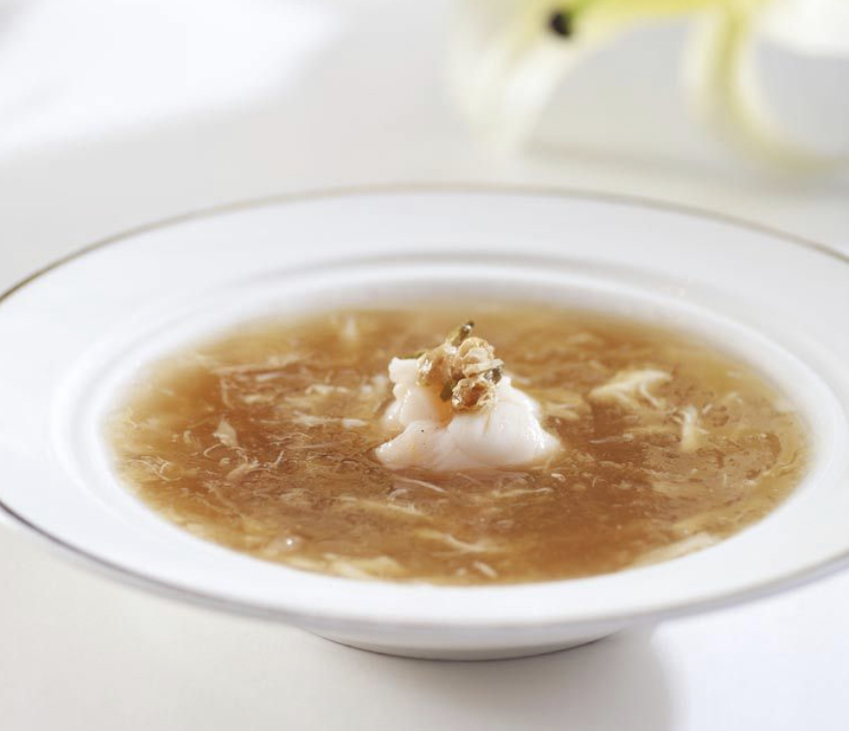
The avid fan of hot pot ——Emperor Qianlong
01
The record of his imperial meals
乾隆三十年正月十六
早膳第一个菜：燕窝红白鸭子南鲜热锅
当天晚膳第一个菜：燕窝鸭子热锅
乾隆三十年正月十七日
早膳第一个菜：燕窝肥鸡鱼脍
晚膳第一个菜：野鸡热锅
乾隆三十年正月十八日
早膳第一个菜：炒鸡大炒肉炖酸菜热锅
晚膳第一个菜：莲子八宝鸭子热锅。

Slide 24
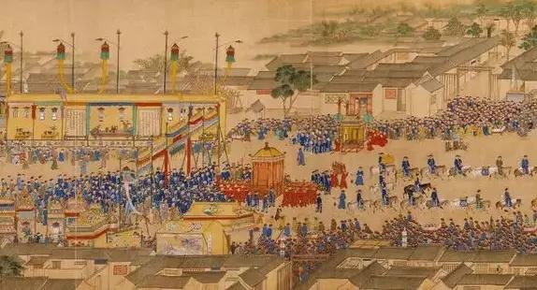
The avid fan of hot pot ——Emperor Qianlong
The Thousand Elders Banquet 千叟宴
02

Slide 25
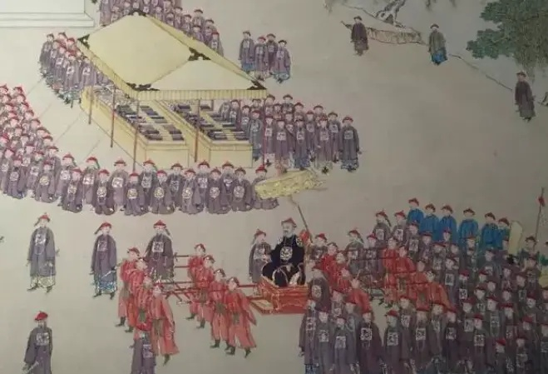
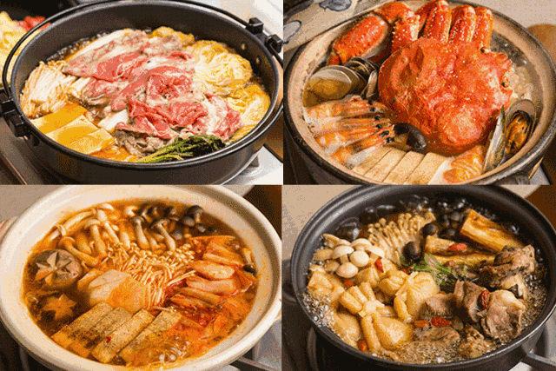
The avid fan of hot pot ——Emperor Qianlong
The Thousand Elders Banquet 千叟宴
02

Slide 26

REPORTING
THANKS
感谢聆听

