Slide 1
CHINESE TANGYUAN
Wen Xi 文茜

Slide 2
TABLE OF CONTENTS
01
02
03
04
Introduction
History
International
Influences
Geographical
Differences

Slide 3
01
INTRODUCTION

Slide 4
TANGYUAN INTRODUCTION
Glutinous Rice Crust
Filling
It's usually the original flavor, but you can also add vegetable juice to change the color and taste
Sweet Fillings： Black Sesame、Crushed Peanuts、Red Bean Paste、Lotus Seed Paste
Salty Fillings： Minced Meat、Mushroom、Cabbage
Soup Bases
Red Bean soup
Black sesame soup
Ginger and rock sugar
Fermented glutinous rice (醪糟，酒酿)
Sweet Osmanthus and rock sugar

Slide 5
02
HISTOTY

Slide 6
Tangyuan History
Tangyuan first appeared in the Song Dynasty, when the novel food was popular everywhere. With glutinous rice balls wrapped with fruit filling, it tastes very sweet and delicious.

Slide 7
Tangyuan History
Later, because of its round shape, it gradually became a traditional food during the Lantern Festival, symbolizing togetherness and completeness, this dish is also served at weddings, family reunions, Chinese New Year, and the Dongzhi Festival. People eat it for good luck and hopes of filling their life with sweetness and joy.

Slide 8
03
Geographical
Differences

Slide 9
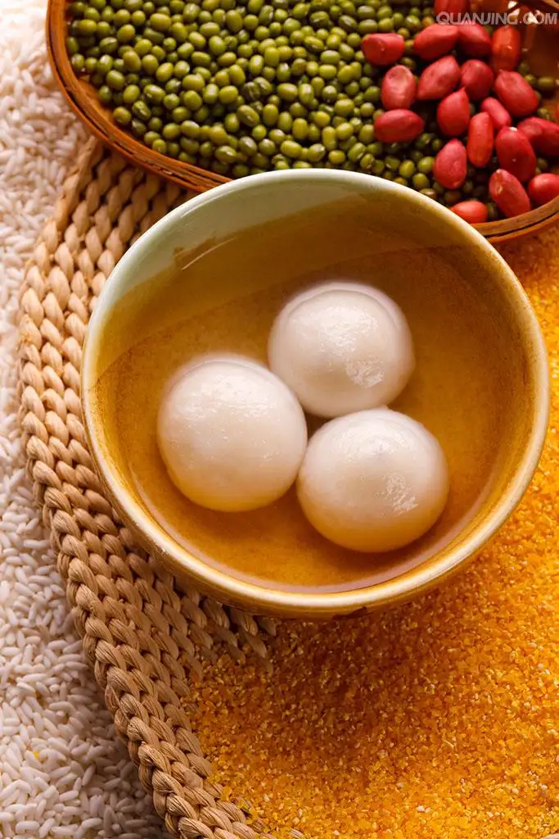
South VS North
South | North
Tangyuan | Yuanxiao
Mix the flour and the water first | Dip the fillings in water and roll it in glutinous rice flour
Sweet & Salty | Sweet
Boiling it | Boiling & Frying

Slide 10
Sweet OR Salty？
100%
0%
Sweet Tangyuan
Slaty Tangyuan

Slide 11
04
International
Influences

Slide 12
International Influences
As the Chinese dessert spread to other regions of Asia, a variety of renditions emerged from different cultures.
Japan
Thailand
Daifuku mochi
Bua loi
Malaysia
Indonesia
Buah Melaka
Wedang Ronde

Slide 13
THANK YOU!
Your suggestions are warmly welcome！

