Slide 1

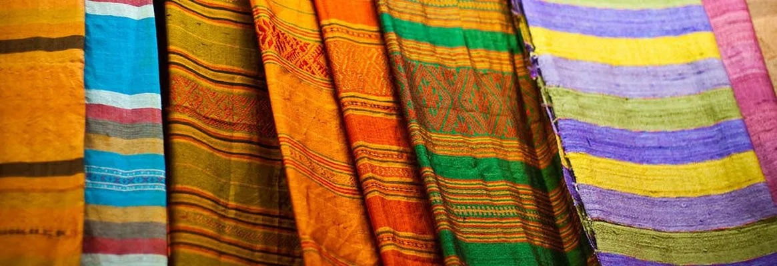


Silk
-by Zhang Yinliu Wu Qiong

Slide 2


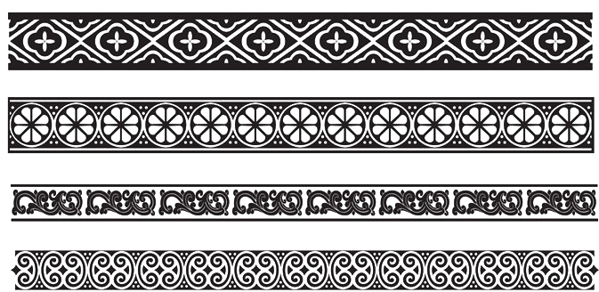
CONTENTS
Introduction to Silk
Silk Road
Translation skills

Slide 3
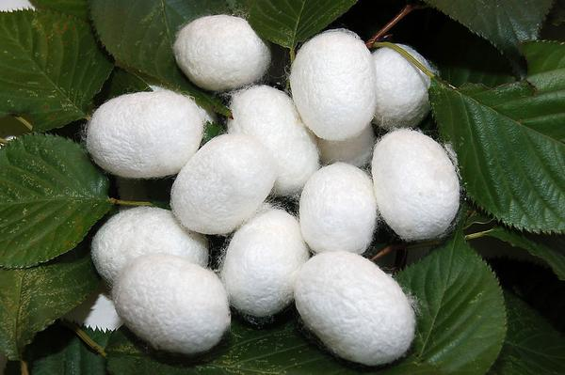

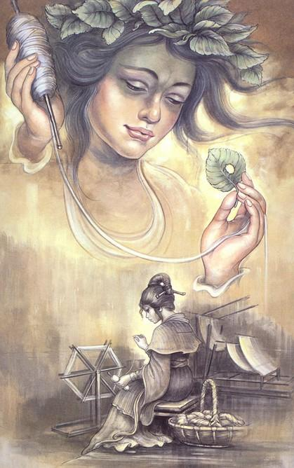
Definition of Silk
a fibric made from the fine threads produced by silkworm cocoons
Deprivation of Silk
Lei Zu, Huang Emperor's wife (嫘祖）
existed before the middle of the 3rd millennium BC.
Silk Country

Slide 4
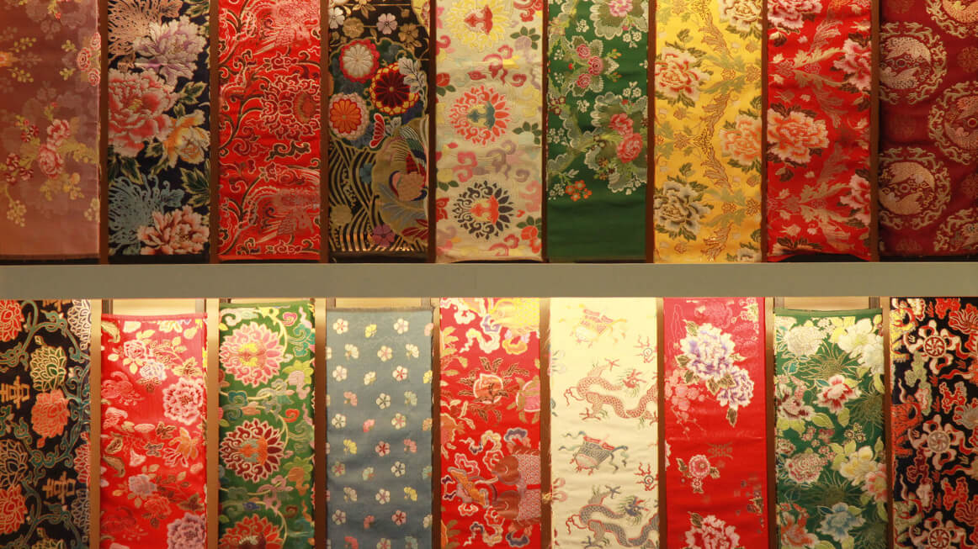
Three Best Known Brocades
Nanjing Broacde (Yun Jin) in Nanjing, Jiangsu Province
Song Brocade（Song Jin) in Hangzhou, Zhejiang Province
Sichuan Brocade (Shu Jin）in Chengdu, Sichuan Province

Slide 5
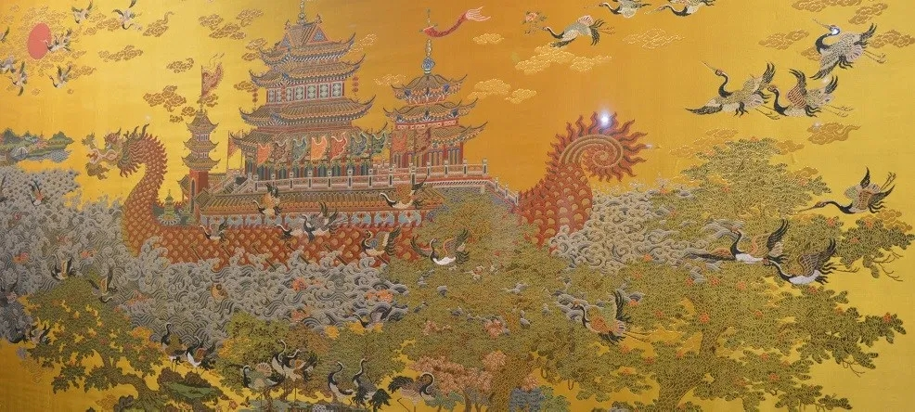
Nanjing Brocade
Originated in Nanjing, Jiangsu Province
Known as Yun Jin( Cloud Brocade) because it is as beautiful as the clouds at sunset
Listed as an intangible cultural heritage of humanity in 2009.
Represents the highest achievement of Chinese silk weaving technology.
gold and silver threads

Slide 6
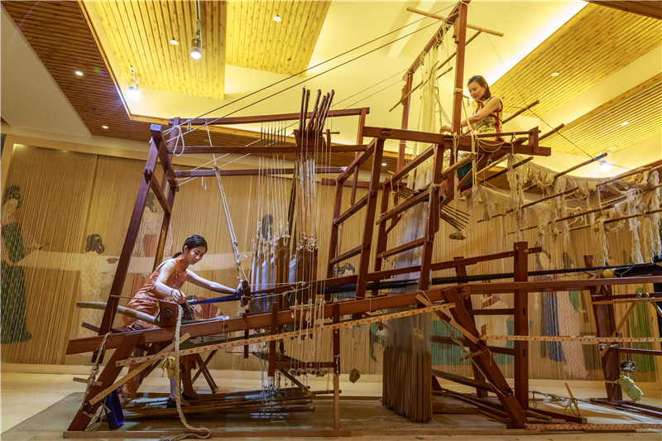
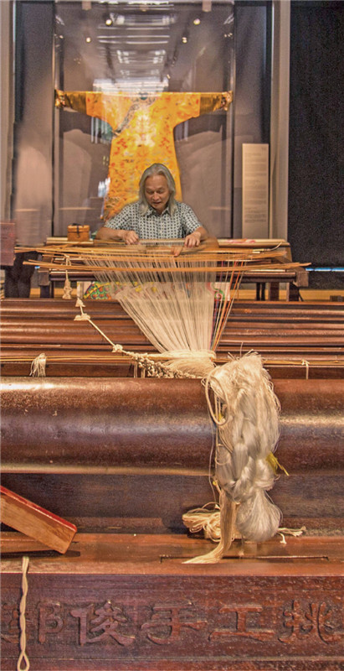
Weaving Nanjing brocade

Slide 7


Ancient silk road
Maritime silk road

Slide 8
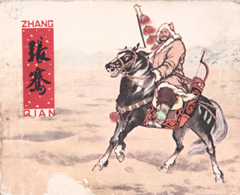
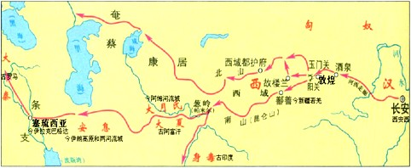
张骞两次出使西域
Zhang Qian went on a mission to the western regions .
最长路线:长安—鄯善—葱岭—塞琉西亚
途经国家：大宛，康居，大月氏，大夏，安息等

Slide 9
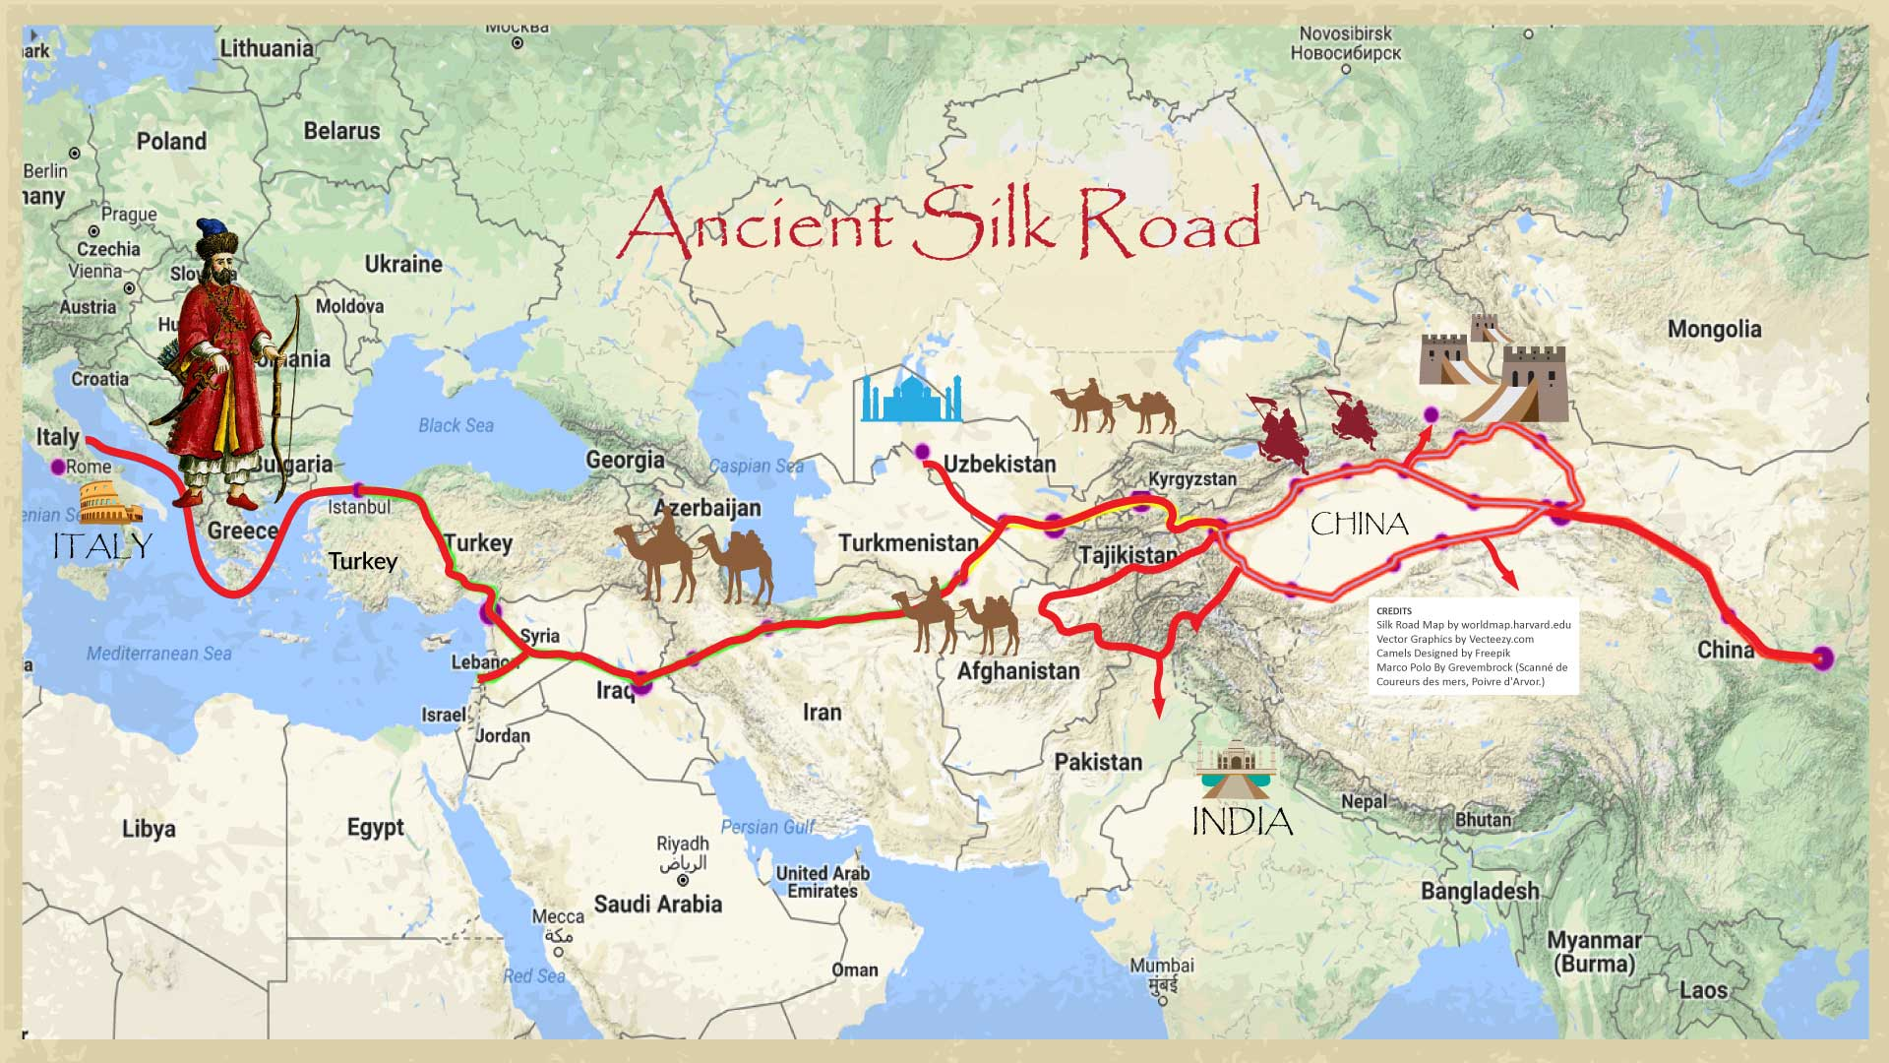
Later, the silk road developed and stretched from Changan (the capital of Han Dynasty, Xian today), pass through Tajikstan, Afghanistan, Iran, Iraq, Syria, Turkey, to Italy(Rome).

Slide 10
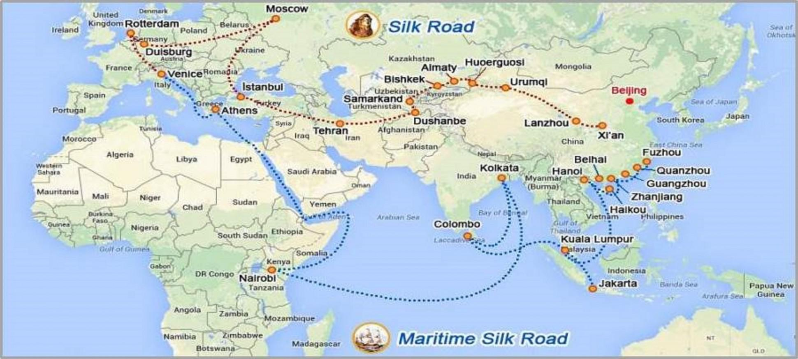
Maritime Silk Road
1. It is also known as Maritime Spice Road
2. There are two routes: China East Sea Route and China South Sea Route

Slide 11
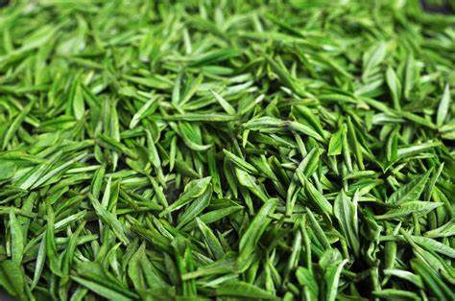
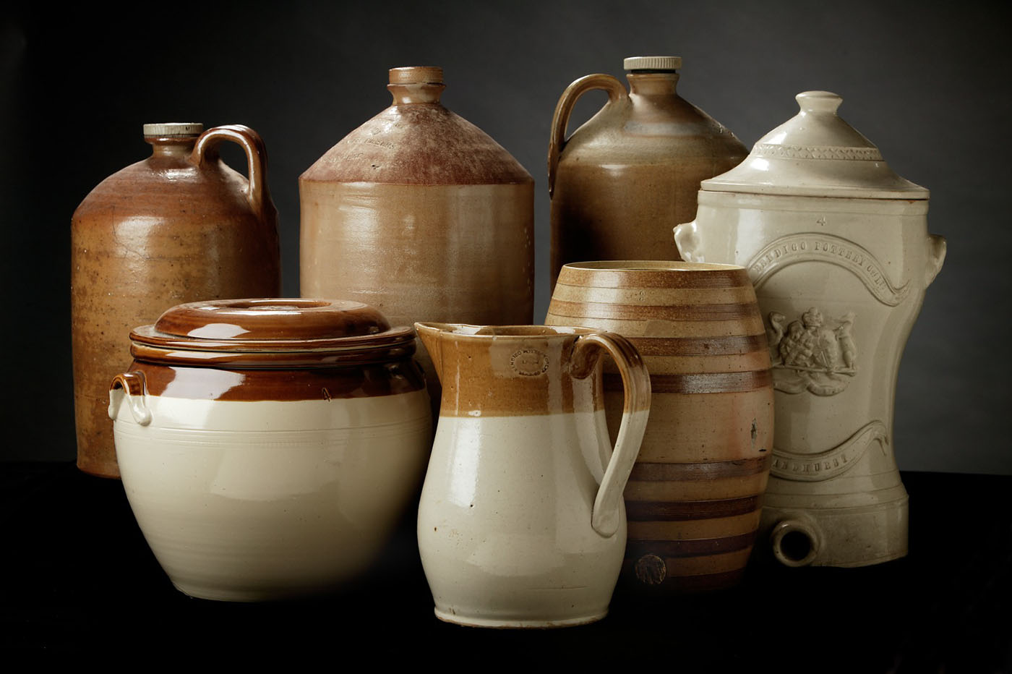
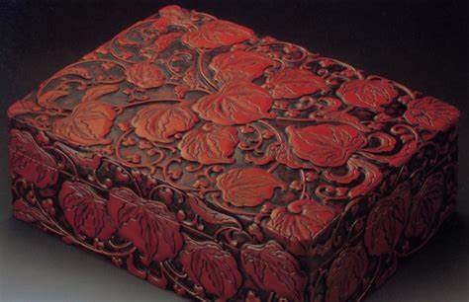
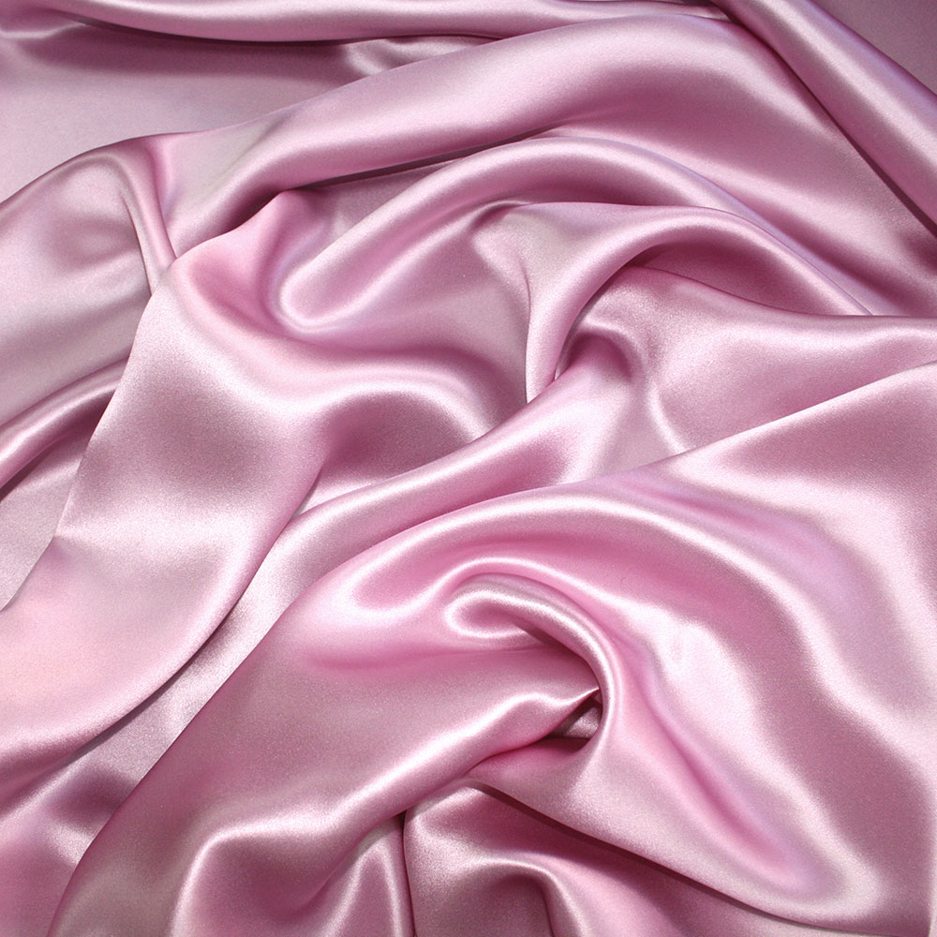
tea
pottery
lacquerware
silk
Chian
China
Western regions

Slide 12
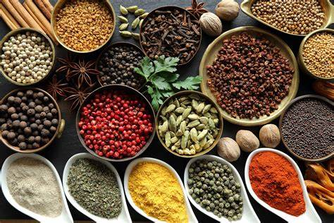
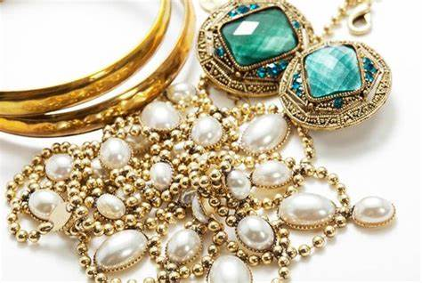
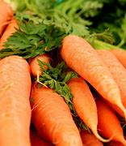

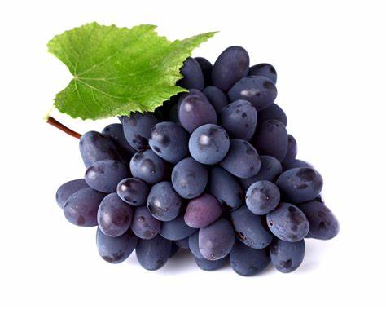
spice
jewery
carrots
medicine
grapes
China

Slide 13
Translation Skills
1. Amplification增译
例如：汉武帝派张骞出使西域，以首都长安为起点。
Translation 1: Wu Emperor of Han Dynasty appointed Zhang Qian to the western regions, departing from Changan.
Translation 2: Wu Emperor of Han Dynasty appointed Zhang Qian as an emissary to the western regions, departing from Changan, the capital of Han Dynasty.

Slide 14

Thank You!

