Slide 1
6th Century Chinese Literature

Slide 2
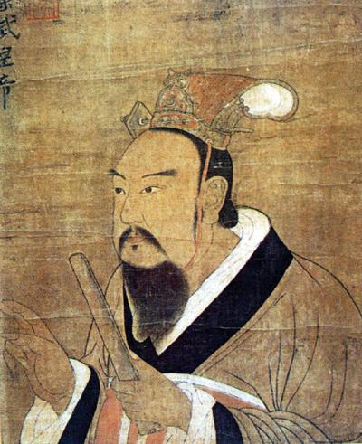
Emperor Wu of the Liang Dynasty
-He is probably the most important figures in 6th century southern Chinese Literature.
-Not because of his writings but what he did to usher in a new age of literature.
-He restored the Imperial Academy
-"According to the History of the Sui, In the past admission to the Imperial Academy was limited to noble scions. The Emperor [Wu of the Liang] desired to acquire young talents, and so the five academies all let in gifted students of humble origin, and there was no enrollment limit" (250).
-This ended up having a big impact on upward social mobility.

Slide 3
Emperor Wu (Continued)
-"Emperor Wu was the central figure in the rich and diverse cultural landscape of the first half of the sixth century. It was his grand vision for the empire that made the Liang dynasty in many ways a cultural and intellectual pinnacle in pre-Tang China. His tireless devotion to literary and scholarly undertakings went far beyond any of his imperial predecessors, both in terms of his personal involvement and in terms of the imperial sponsorship of various large-scale cultural projects" (251).
-Wu himself was a literary figure.
-At one point he had a collection of his own works which was 120 scrolls, unfortunately the scrolls are now lost.

Slide 4
Ren Fang and Shen Yue
-These two were also prominent figures in the 6th century southern literary atmosphere
-"Neither had come from the most elite families "252).
-They took part in a large amount of promotion and patronage of writers in the area. Most Liang dynasty man had in fact been appraised by them at some point or another.
- They also promoted people from more humble origins.
- They even promoted the brothers Doa Gai and Doa Qia whose father we employed transporting human waste.

Slide 5
Literary Criticism
-"The Liang witnessed the first full development of literary criticism in Chinese history" (257).
-Liu Xie's Literary Mind and the Carving of Dragons was an important work in the field of LIterary Criticism.
-Literary Mind consists of fifty chapters and reflects on various literary genres and basic literary concepts.
-He makes the claim that literature is an extension of the Confucian Classics and literary criticism is as valuable as commentaries on the classics.

Slide 6
Excerpt from Literary Mind and the Carving of the Dragon
-"Human beings are the flower of the elements: in fact, they are the mind of Heaven and Earth. When mind came into being, language was established; and with the establishment of language, pattern became manifest. This is the natural course of things, the Way" (Liu Xie 344).
-"Long ago someone said that a person's body might be on thee rivers and lakes, yet his mind could remain by the palace towers or Wei. This is what is meant by spirit thought. And spirit does indeed go far in the thought that occurs in writing. When we silently concentrate, thought may reach a thousand years in the past; and when the face stirs quietly, the eyes can see thousands of miles. When we sing, the sounds of pearls and jade come forth; right before our eyelashes the colors of clouds in the wind unfurl. This is something achieved by the basic principle of thought (Liu Xie 346).

Slide 7
Palace-style poetry
-Palace-style poetry also surfaced in the sixth century
-This style was revolutionary to the Chinese world of poetry
-"palace style poetry is concerned with particularly on both temporal and spatial levels, as it attempts to present things as observed in libing moments. This poetry is also intensely visual, in thee sense not so much of 'pictorial images' as of what and how to see; it is characterized by a focused and illuminating look at the minutest details of physical reality.

Slide 8
Change in fu poetry
Fu also underwent a big change in this age as writers like Xiao Gang and Xiao Yu created poems that are referred to as the poeticization of fu.

Slide 9
The fall of the South
The South eventually fell after a string of different rulers usurped the throne. This led to many Southern writers making their way to the NOrthern parts of China which resulted in a "fusion" of the northern and southern cultures. Part of this fall was documented by Shen Jiong while he made his way back into his native city:
Still apprehensive about the northern cavalry.
I am ever wary of encountering barbarian troops.
Only large trees remain in the empty village;
deserted towns are left with crumbling city walls.
None of my old friends is around;
all my new acquaintances have different names.
A hundred years, thirty thousand days in all,
this heart-wrenching sorrow in each and every one of them.

