Slide 1




Chinese Bossy Fictions and Micro-drama
汇报人：张梅容

Slide 2

The Origin & Definition
The Evolution & Personality
The Reason for Popularity

Slide 3


Chapter 01
The Origin & Definition

Slide 4



What is Chinese “Bosses”?
Origin
Chinese romance novels on different websites
Feature
conforming to contemporary Chinese social culture and the expectations of women
Core Traits
elite, powerful, authoritarian and only treat you in a unique way

Slide 5

Chapter 02
The Evolution & Personality

Slide 6


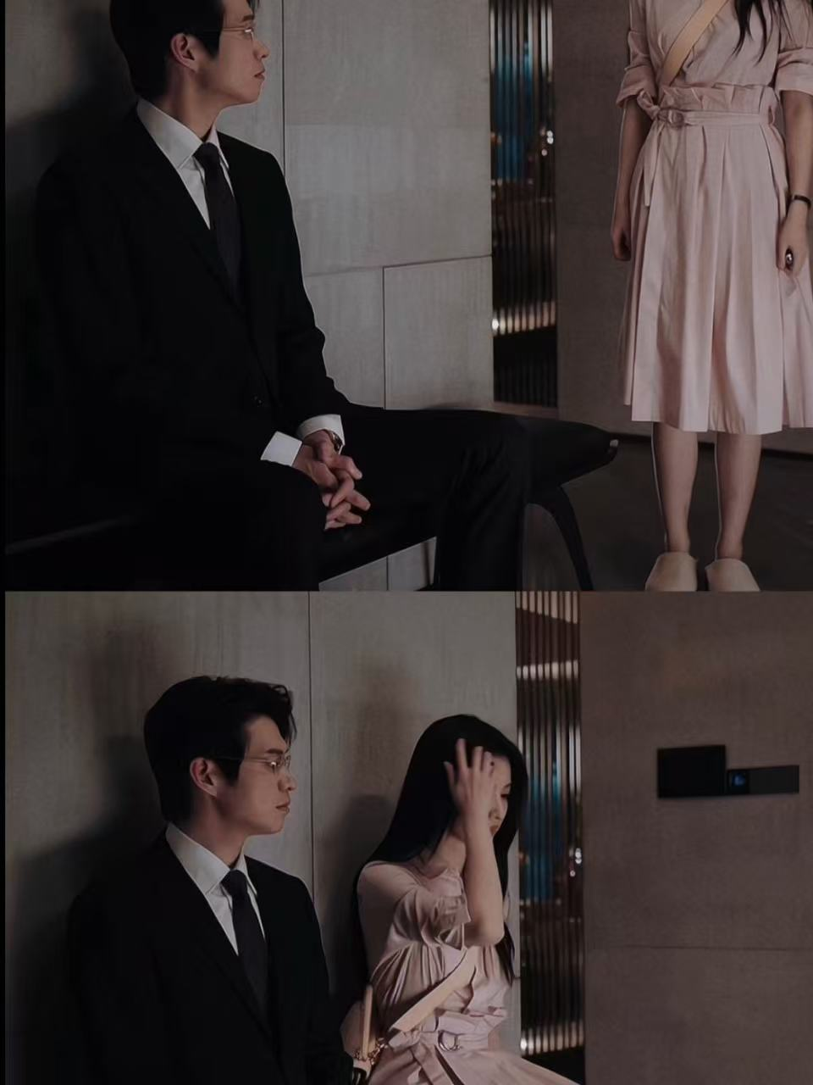
The Evolution of Chinese Bossy Images
- From Violence to Respect
( violent love)
( sweet affection)
(mutual respect)
1.0: The Classic
2.0: The Evoled
3.0: The Contemporary
forced love and irritable temper
cold exterior, warm heart
and silent sacrifices
strong boundaries collaborative partner
From “He is strong, so I am safe” to “He respects me, so I remain myself”

Slide 7

Chapter 03
The Reason for its Popularity

Slide 8
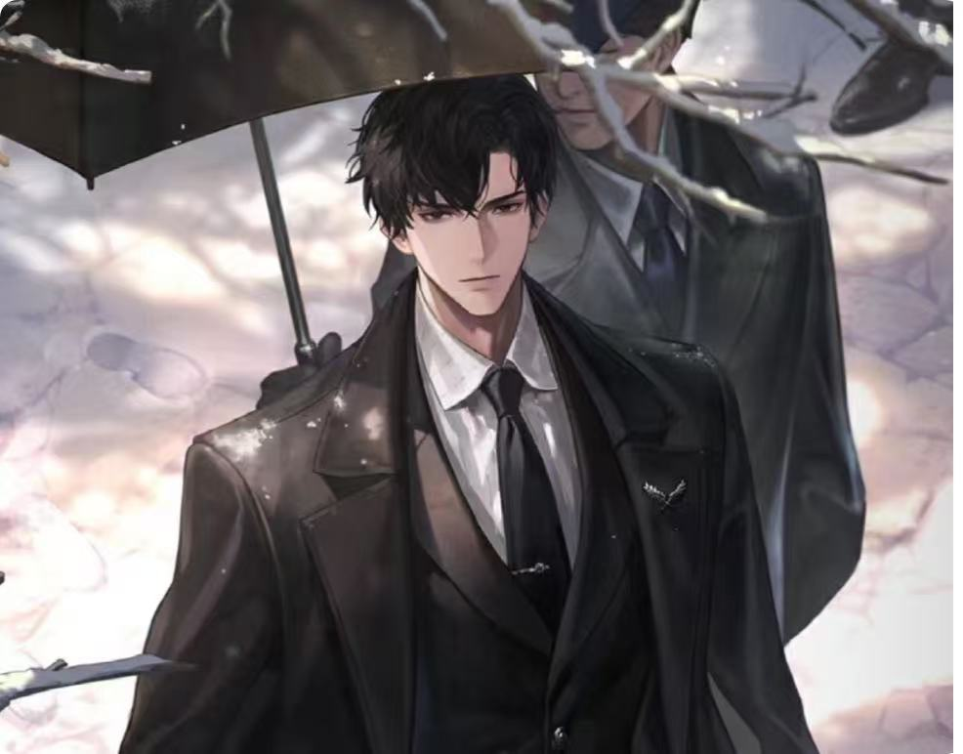
Why does it go viral?
The Psychology Behind the Passion
Desire for Security
offers the fantasy of "absolute protection" and "exclusive favor," acting as an harbor against anxiety .
Reflection of Feminism
mirrors the longing for independence and understanding. The CEO morphs from a conqueror to a guardian and partner.
Demand for Emotional Value
Micro-dramas deliver high-emotion spikes in sixty seconds, offering efficient wish-fulfilment for the audience.

Slide 9

The Future: What Are We Truly Consuming?
Future Trends
Characters will diversify and professionalize
The core appeal will shift to mutual respect and spiritual compatibility
Bossy-micro drama in foreign version successfully capture a
large number of foreign audiences
Ultimately, we consume not merely the dominance, but a simple longing—
to be firmly chosen in an overwhelmingly complex world.

Slide 10


文字参考：百度百科，中国文化课本2025版
图片来源：小红书，微博，百度百科

