Slide 1
Aesthetic ideals and social customs The Four Most Handsome Men in Ancient China
1. Pan An
2. Wei Jie
3. Song Yu
4. King Lanling

Slide 2
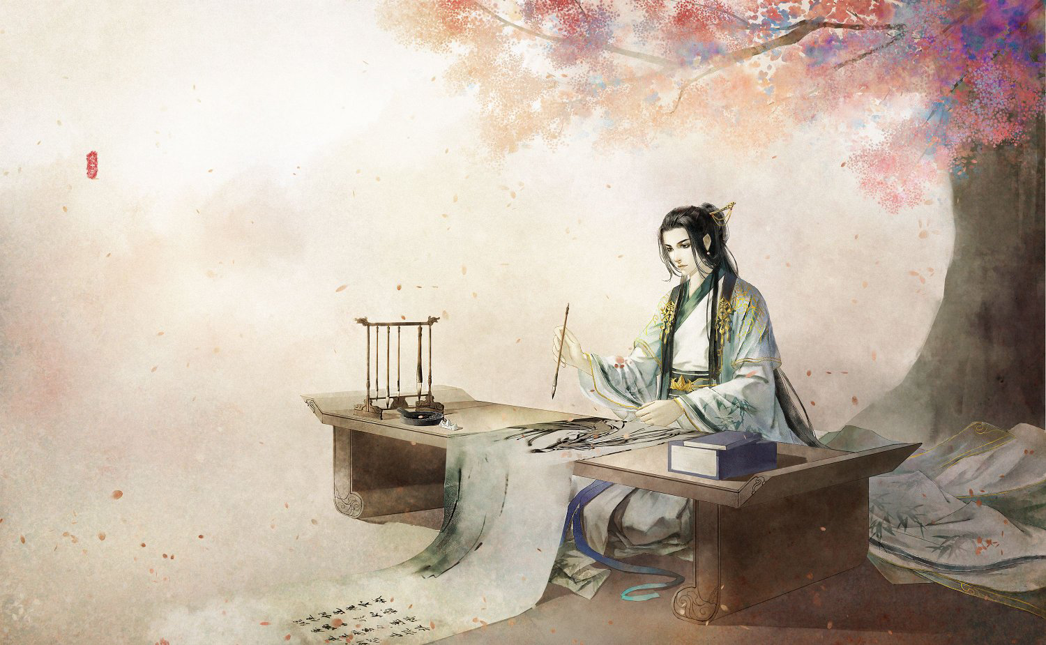
Pan An
Now we can describe a man's beauty :
his appearance is hansome as Pan An.
Actually he is a writer in the
Western Jin Dynasty.

Slide 3
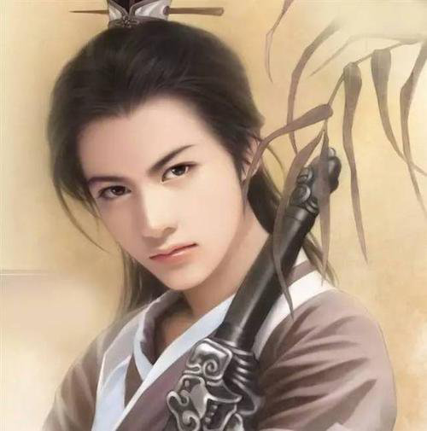
When he goes out, there are always countless women coming to watch.
We all know that ancient women were implicit and reserved, but many women still threw fruit on Pan an's carriage to express their love.
This gave birth to an idiom: throw fruit to fulfill a carriage.

Slide 4
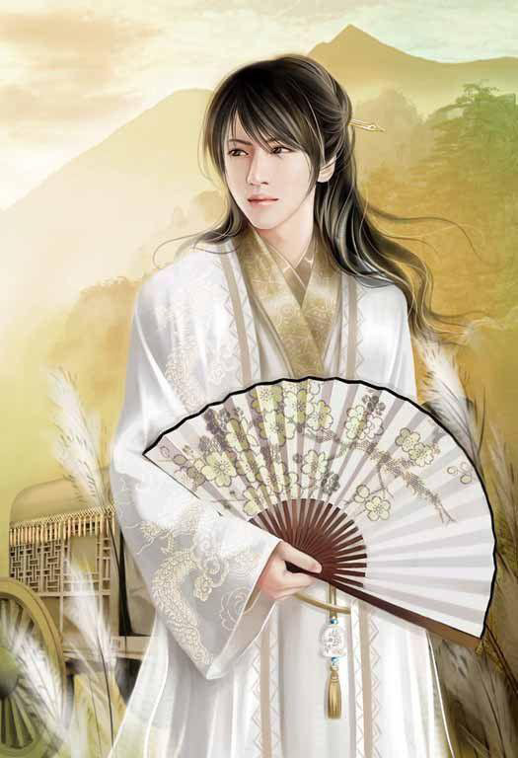
Wei Jie
Wei Jie was born in a famous nobility. His physical condition was very poor, and his skin was white and smooth, so he was compared to a jade man. He had unique views on affairs, but he was indifferent to fame and wealth. The emperor had asked him to be an official for many times, but he refused.

Slide 5
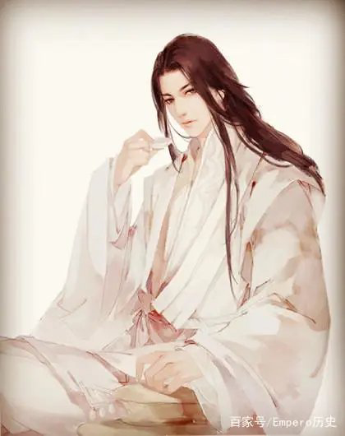
Song Yu
There is such an allusion in history that a minister named Dengtuzi disliked him and complained to the king of Chu that Song Yu was so good-looking that if the concubines saw him, they would admire him soon.

Slide 6
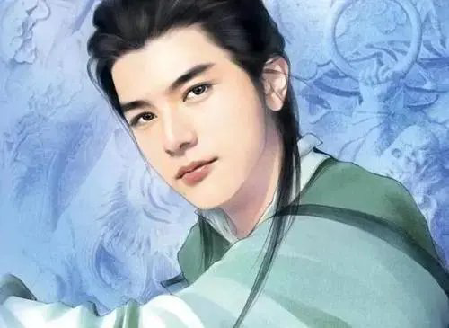
Song Yu argued that there was a very beautiful woman in his hometown and didn't like him after staying with him for three years.
Dengtuzi's words made everyone think he was a lecher, and Dengtuzi became the pronoun of a lecher
Song Yu also made great contributions to Ci and Fu after Qu Yuan.

Slide 7
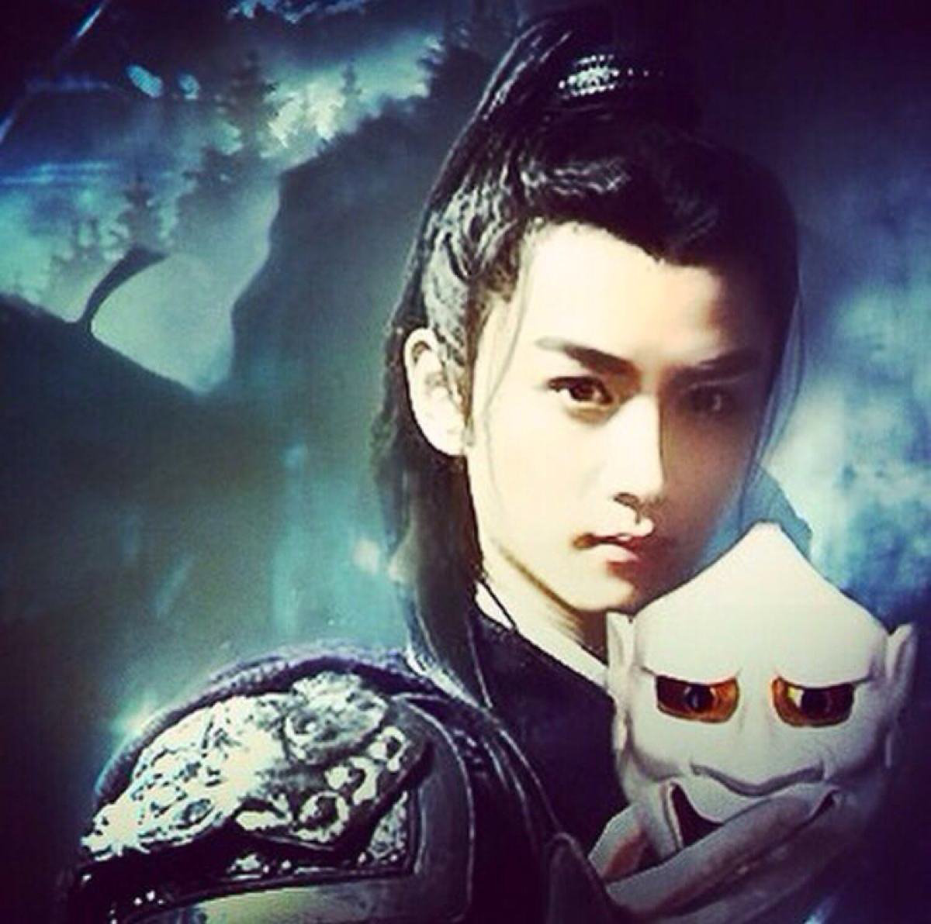
King Lanling
Formerly named Gao Changgong, was a general of the Northern Qi Dynasty. He was the only man of good character in the royal family at that time. It is said that because of his delicate appearance, he has to wear a mask to frighten the enemy every time.

Slide 8
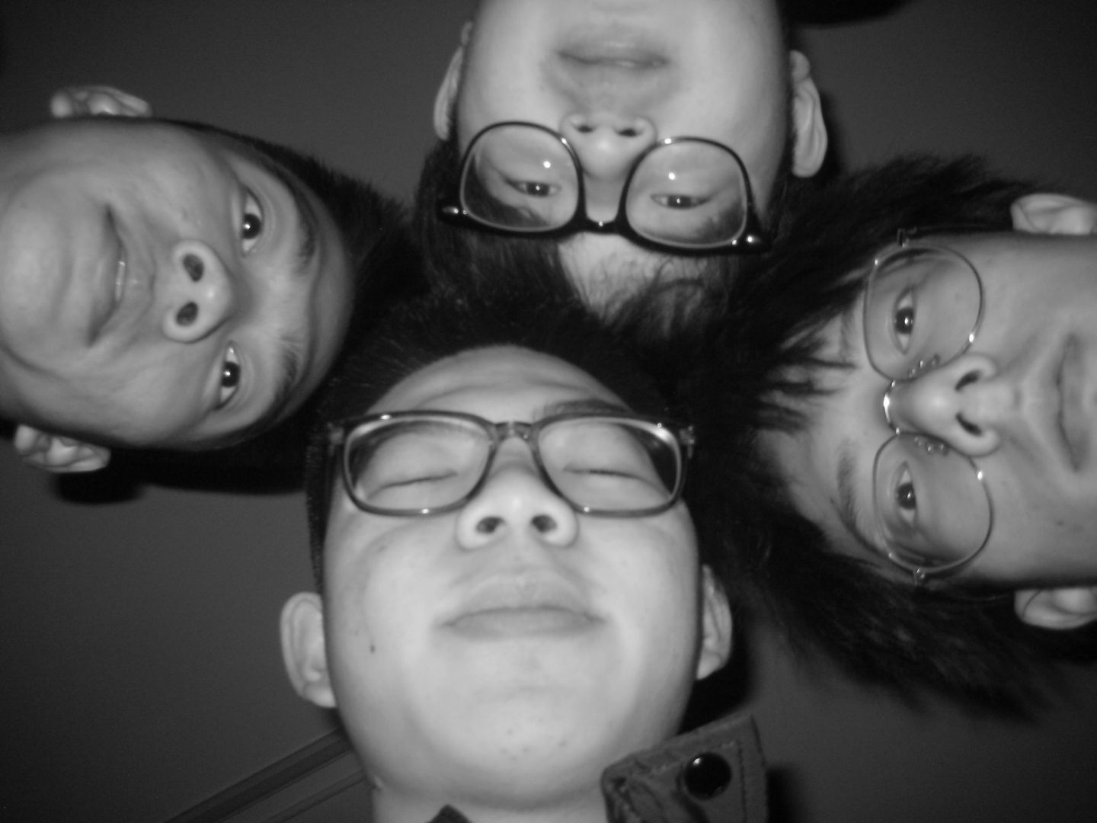
Summary
talent
appearance
characteristic
strategy

Slide 9
Among the four most handsome men, almost all of them are men with talent and beauty who are regarded as perfect.
They may be well-educated, or they may be brave, or they may be noble. Perfect looks are their advantage, but not all of them.
Thank you！

