Slide 1
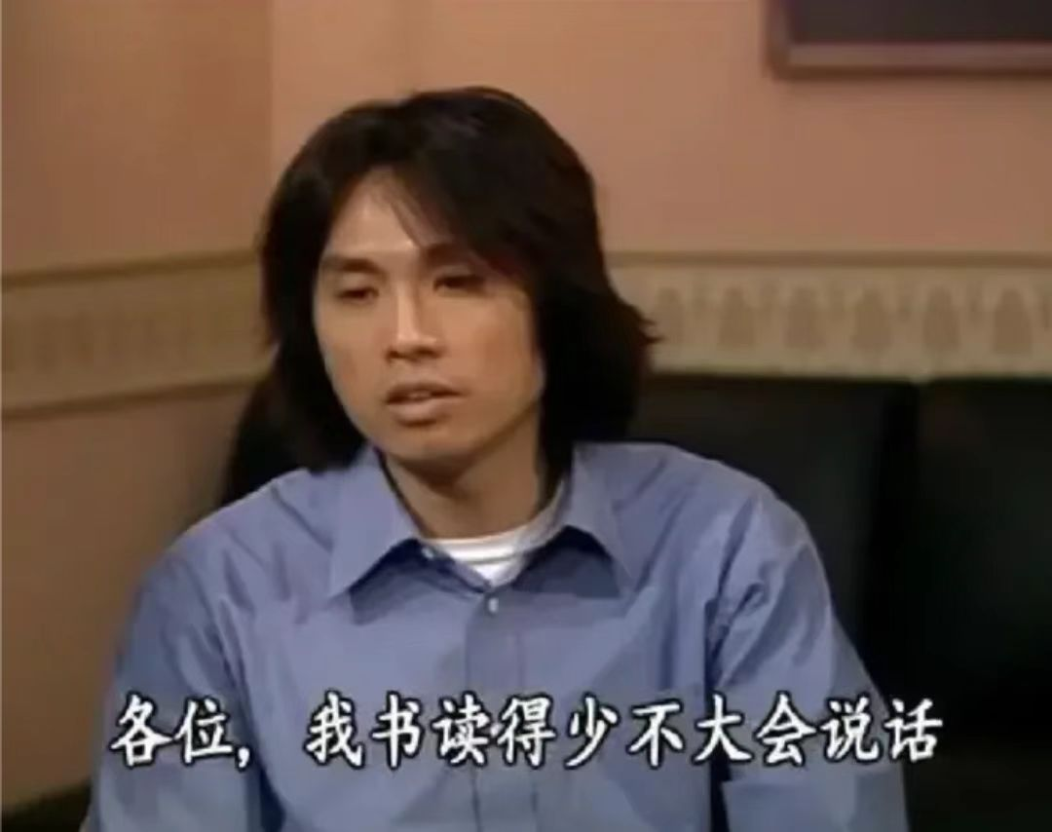
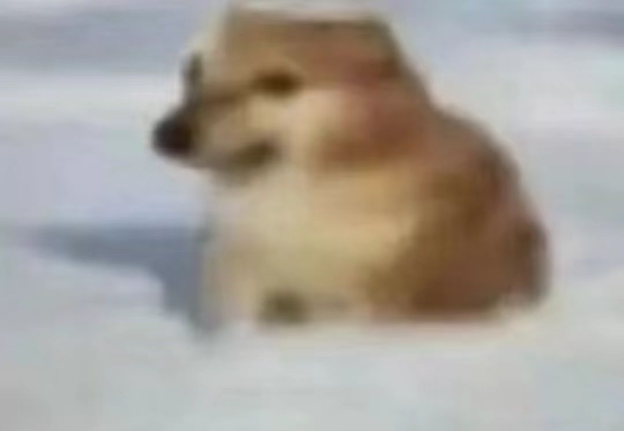
Xiangxi Ganshi
Presenter: You-Know-Who
Roseeeeeeeeeeeeeeeeeeeeeeeeeeeeeeeee

Slide 2
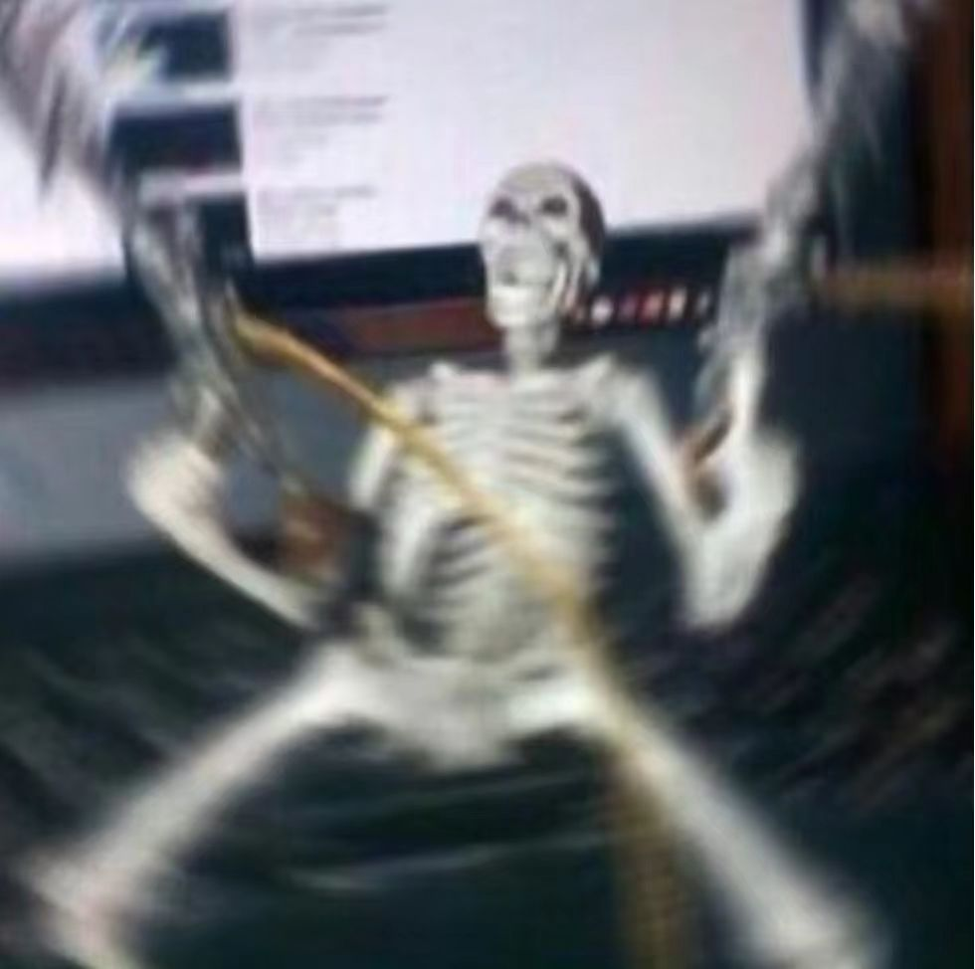
Main Points
A. Background
B. Its Relationship with Xiangxi Witchcrafts
C. Different Ways of Corpse Driving
D. “PPP”(Preparations, Practice and Perform)
E. Three “NO”（“三不赶”）
F. Historical and Cultural Analysis of Xiangxi Witchcrafts(Brief)
G. ? Time
H. Maybe a Little Observations on the Topic of “Death”
I. Conclusion

Slide 3
Background
Xiangxi(Xiangxi Tujia and Miao Autonomous Prefecture) is located in mountainous regions characterized by high elevations and steep terrains, which created natural barriers tha affect migration, trade routes and agricultural practices. Residents struggled to make their life and turned to other job opportunities beyond the reach of their villages(the same for outsiders). In the context, Death elsewhere induced the demand for “Corpse Driving”.
During the Sino-Japanese War (1931–45), Hunan was the scene of bitter fighting between 1939 and 1941. For soliders and fighters, they need to “go home”.
Another speculation: Smugglers, the cultivation of tobacco in Yunnan and Guizhou regions;

Slide 4
Its Relationship with Xiangxi Witchcrafts
One of Miao Witchcraft, with the use of Chenzhou Spell
classified into the branch of medicine(Zhuyou), Maoshan茅山术的祝由科
Maoshan: a mysterious Taoist sect
Zhuyou: flexibly incorporate and critique the variety of ritual therapies into orthodox practice（简单来说，就是靠心理疗法不靠药物，有点像现在的心理医生）
Not only in Xiangxi, but also in Sichuan province

Slide 5
Different Ways of Corpse Driving
One body at a time背尸（入门级别）
Two bodies at a time with stretcher台式
Corpse Driving(regular)赶尸
Corpse Driving(alive)赶活尸--First, with the consent of the subjects (who are not completely brain dead), let them drink specific drugs, and help them go back home with their desperate will of returning to hometown.

Slide 6
“PPP”(Preparations, Practice and Perform)
Preparations:
1. Dead Body Preservation: herbal medicine use(to temporarily preserve human remains to forestall decomposition/prevent the cadaver from animal bites)
2. Remove the internal organs of human bodies, replace the “original ones” with straw or materials soaked with preservative elements(the head will be the only part remained during the process, the limbs as well as head can be kept and the body is removed in some special cases); weight-lifting
3. Low temperature environment(hidden caves for “restoring” the corpse)
4. Inhibitor for bodies undergoing putrefaction: cinnabar from Chenzhou, Xiangxi(also found in Spain); Seal
5. Tools: 阴锣、师刀、号角、令牌、罗盘、圣杯、三清铃铛

Slide 7
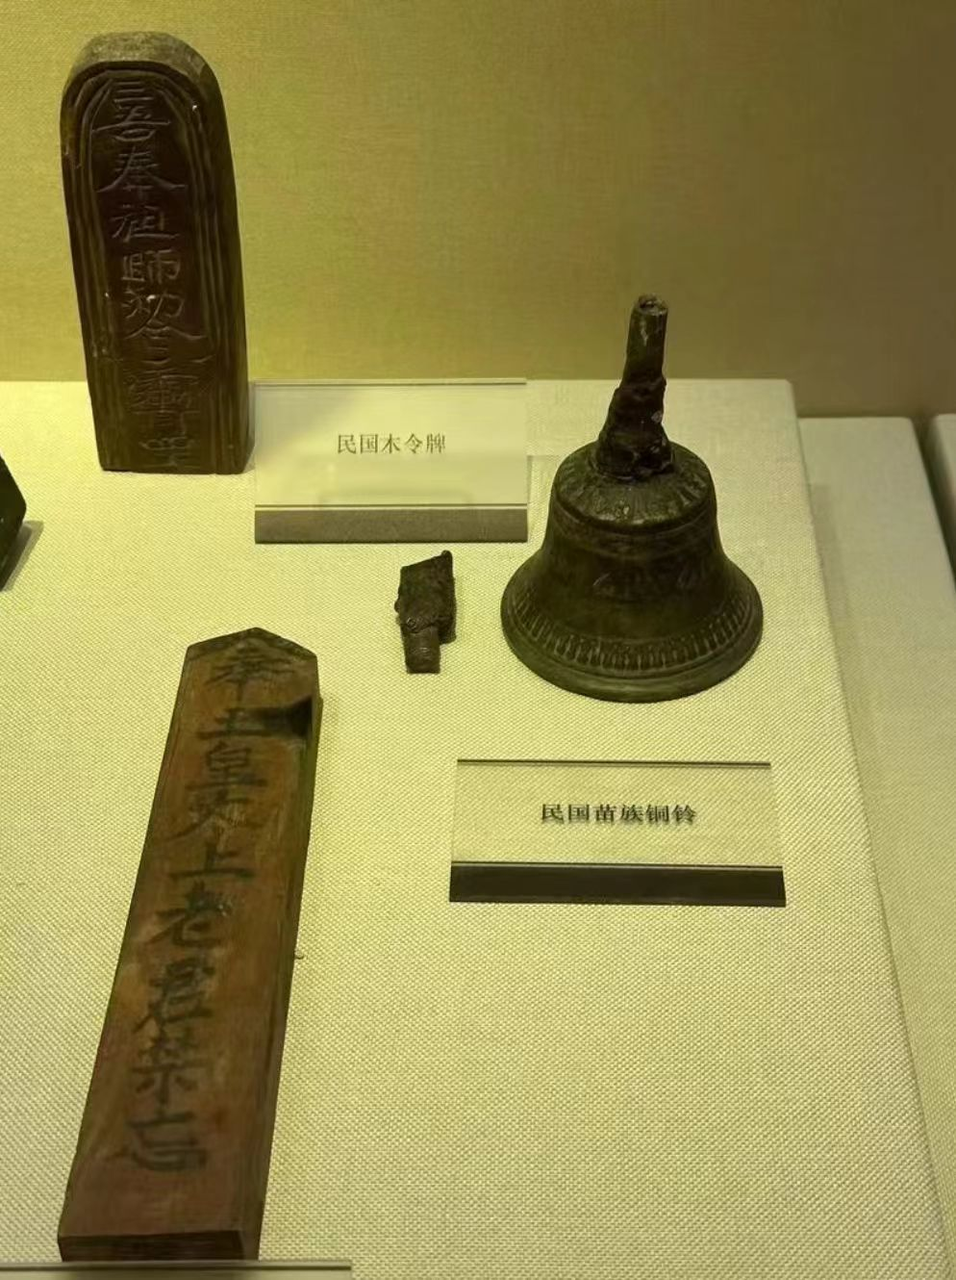
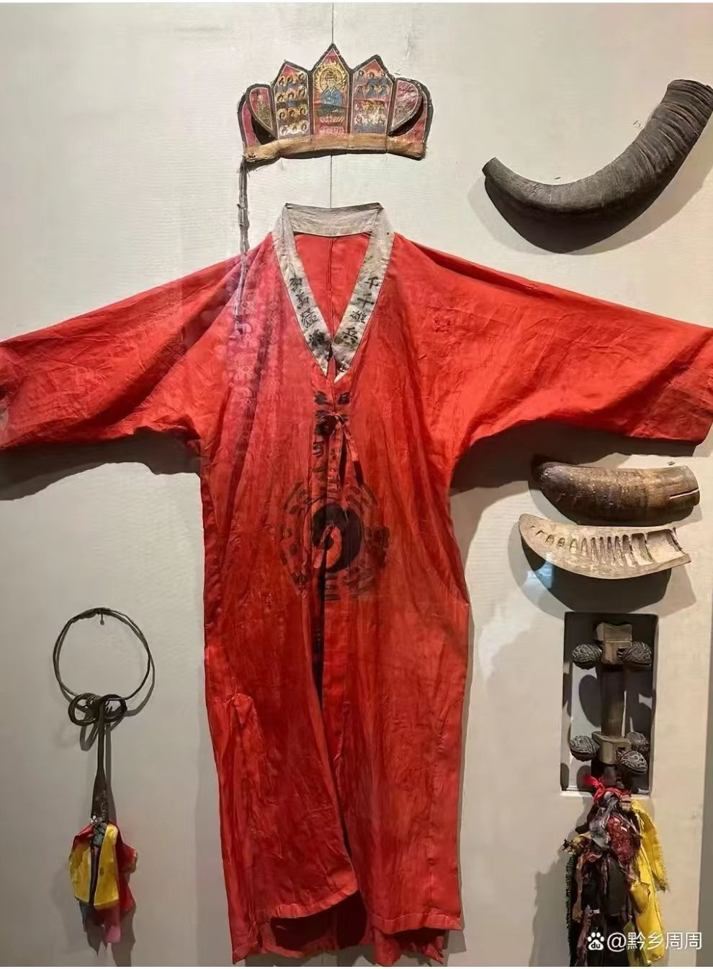

Slide 8
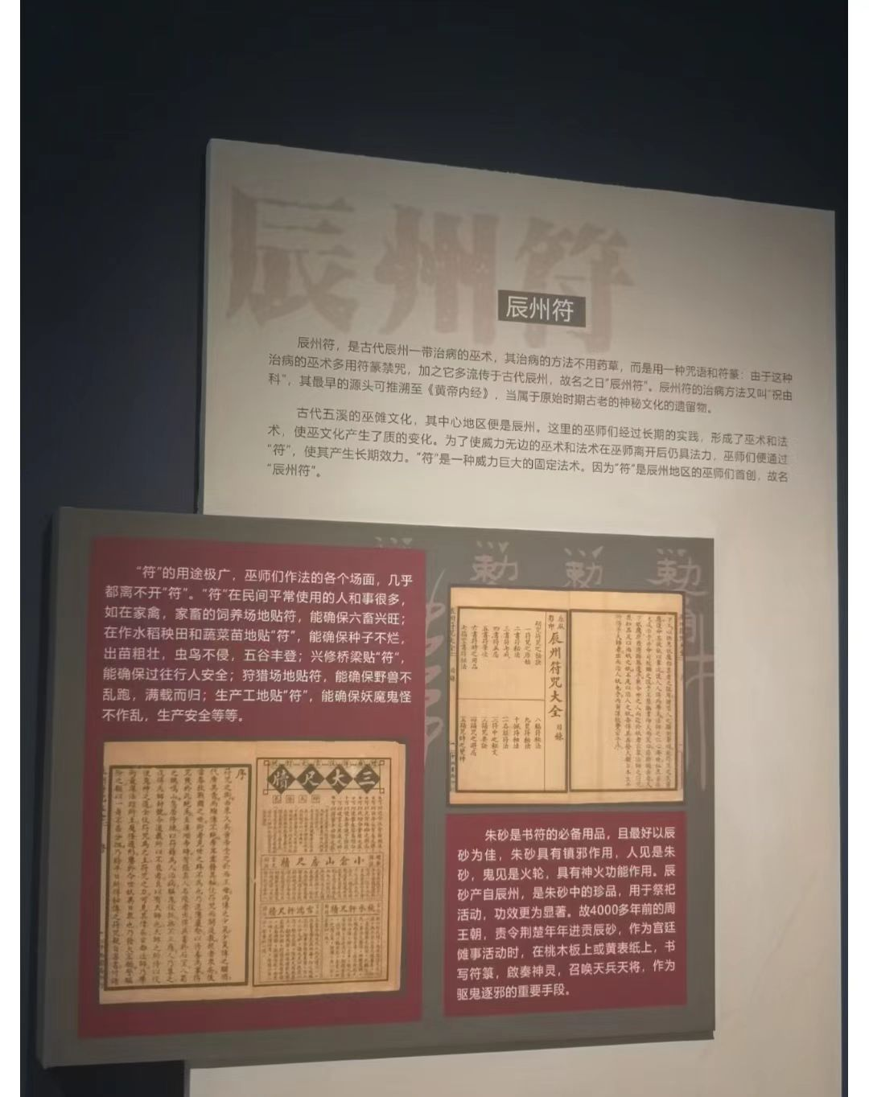
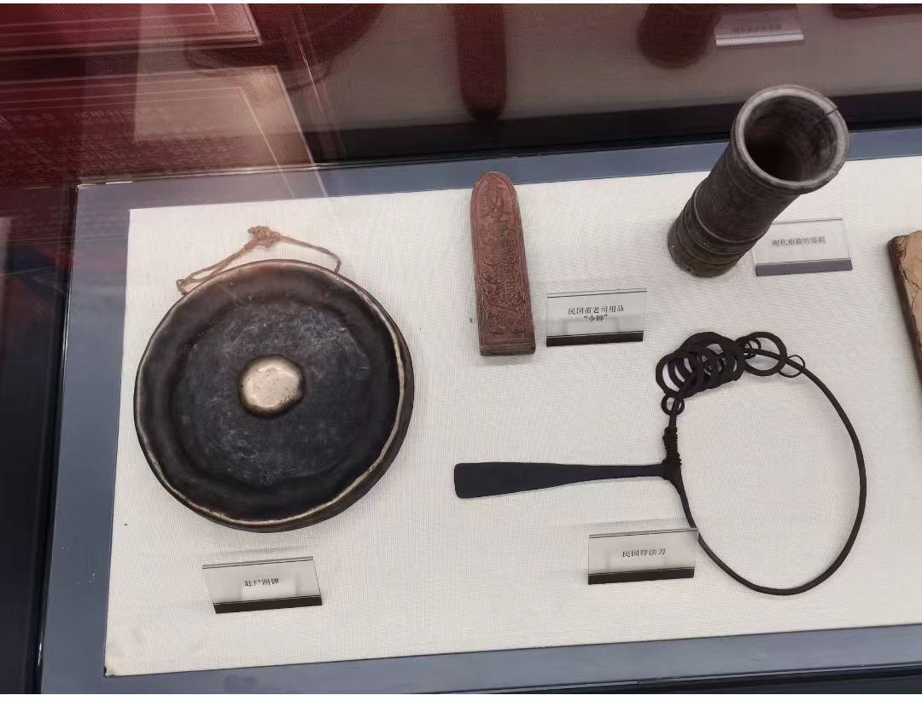

Slide 9
*Comparison:
MUMMIFICATION
1. The brain and internal organs were removed and placed into canopic jars.
2. The heart was left inside of the body because the Ancient Egyptians believed the heart controlled all thoughts, memories and intelligence.
3. The body was covered in a salty substance called Natron then left to dry out for 40 days.
4. The body was then filled with saw dust to lessen the limp and lifeless appearance.
5. The body was then bathed in wine andspices, wrapped in linen and left for anadditional 30 days.
6. Once mummified, the bodies were placed in a mummy case, then in a coffin and then in asarcophagus.
Modern Embalming
Arterial embalming
Cavity embalming
Hypodermic embalming
Surface embalming

Slide 10
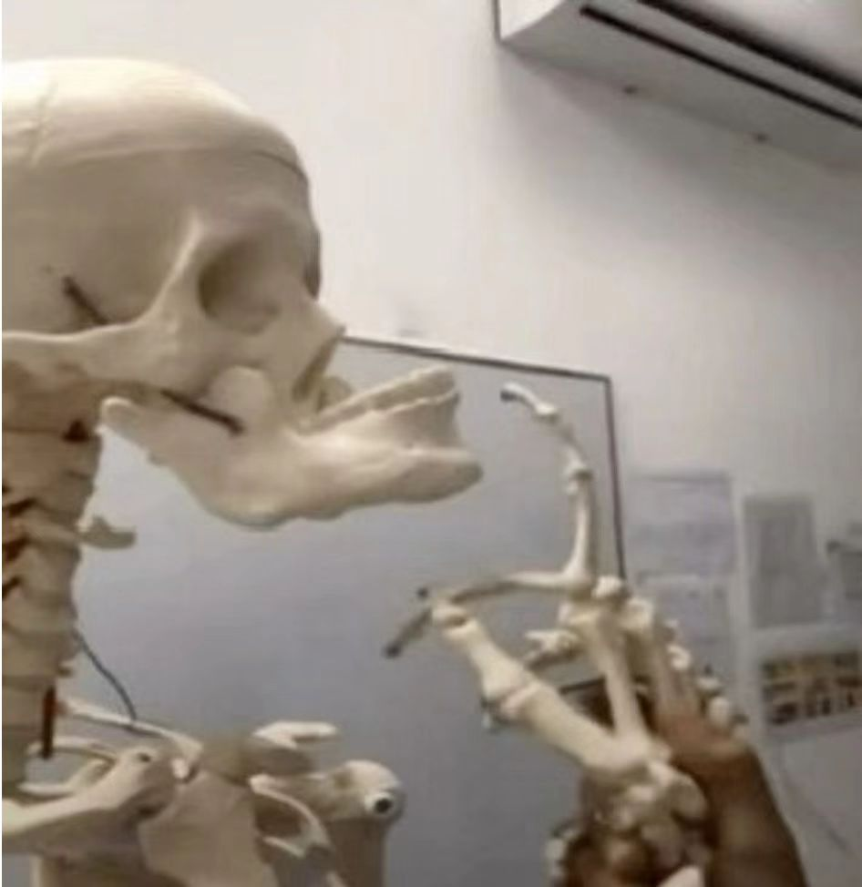
Practice
Three trials:
1. Courage--Go to the mountain at night to get a sycamore leaf
2. Physical Ability(carrying heavy loads)
3. Self-cognition
Principles of Apprentice
1. Brave
2. Good Physical Condition
3. Perhaps Ugly
4. Accurate Sense of Direction(Night/Foggy Weather)

Slide 11
Perform
1. Two people, the master and the apprentice, take turns to carry the body, or carry the body on themselves.
2. A Group of People: one for offering illumination, one for leading the team(throwing Chinese paper money, ringing the bell), one for transporting the bodies(with grip of the bamboo poles), one for driving wild animals(shaking the bamboo poles for pretending the bodies as alive, frightening people away)
点灯人（负责照明）；引尸人员（撒纸钱、摇铃招魂，引导队伍前行）；伏尸人（控制竹竿，实际抬尸体）；赶尸人（持鞭驱赶野狗，摇动竹竿使尸体看起来有生命力，吓退行人；

Slide 12
Three “NO” & Other Parts Involved in Relevant Culture of Corpse Driving in Xiangxi
白天不赶 腐尸不赶 不信不赶
No corpse driving in the daytime
No corpse driving for overdecomposed bodies
No corpse driving for those who have no confidence in the practice
Other Parts Involved in Relevant Culture of Corpse Driving in Xiangxi
道
法
术

Slide 13
Historical and Cultural Analysis of Xiangxi Witchcrafts(Brief)
Animism(an integrated belief in China. It is propagated by two major religions, Buddhism and Taoism, which believe that everything is interconnected within the sacred cosmos and infused with spiritual energy). This spiritual essence is often referred to as a “spirit” or “life force.”
The rugged landscapes, mountains, hills and steep slopes make it difficult for successive development of productive relations in Xiangxi, there came the emphasize of a deep connection with the natural world, and this connection is often expressed through rituals and practices that honour spirits or deities associated with various aspects of nature.

Slide 14
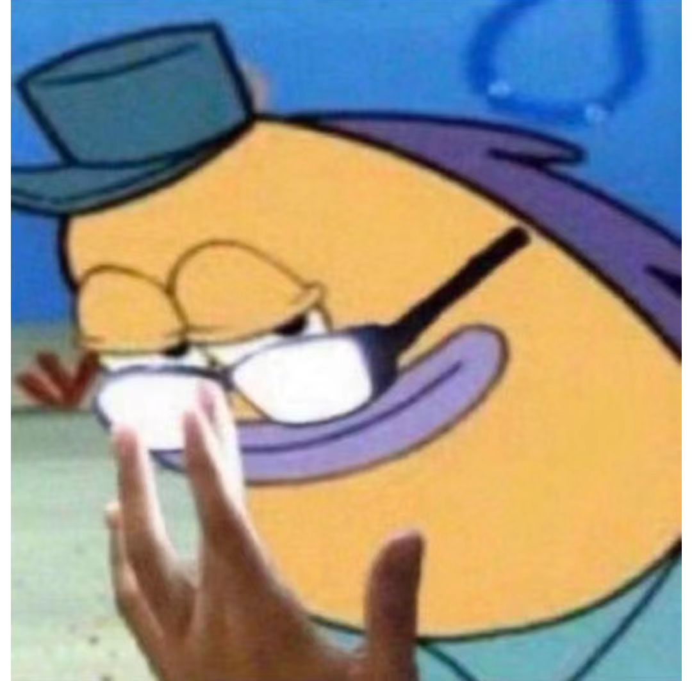
？Time
1. Sour--What is its relationship with Xiangxi witchcrafts?
2. Sweet--Name the three “NO” mentioned before
3. Bitter--Tell us the three “labor principles”
4. Spicy--Tell us all the different ways of corpse driving(elaborated in the PPT)
5. Salty--What’s the difference between “法” and “术“？
6. “YOU-KNOW-WHAT”--What is the belief underpining the process(Miao Myth&Culture)?

Slide 15

Maybe a Little Observations on the Topic of “Death”
Time Permitted, we’ll see.

Slide 16
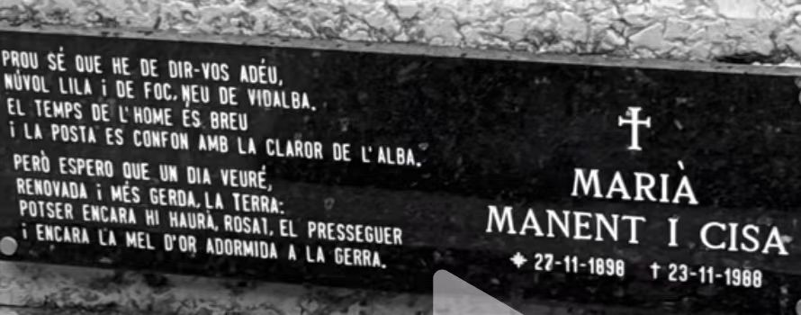
Conclusion
生的终止不过一场死亡，死的意义不过在于重生或永眠，死亡不是失去生命，而是走出时间。--余华《活着》
我们的民族忌讳死亡，华夏大地虽不出产鸵鸟，但我们秉承了这种动物的精神。帝王将相们寻找长生不老之药，以为可以逃脱自然的法则。小小百姓有许多言语禁忌，他们天真地认为不谈死亡，死亡就会扭过脸，给我们一个光滑的后背。--毕淑敏《精华本》
Snow is falling, falling in that lonely churchyard where Michael Furey lays buried. Falling faintly through the universe, and faintly falling, like the descent of their last end, upon all the living and the dead, which they reared and lived in.--The Dead

Slide 17
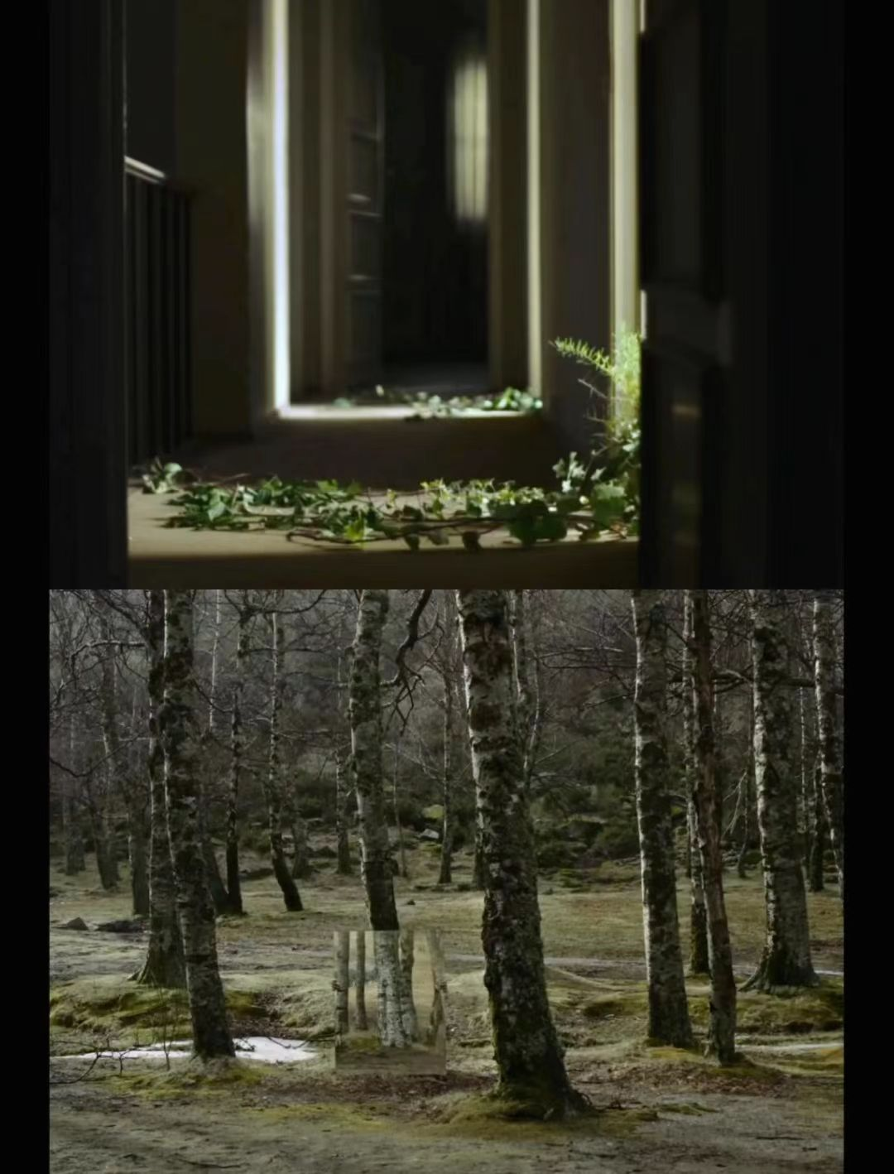
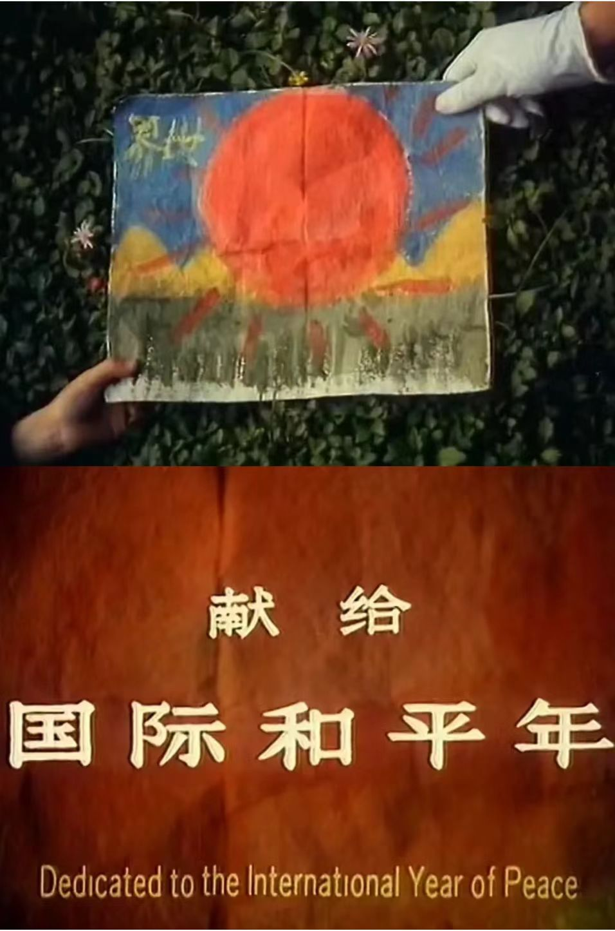
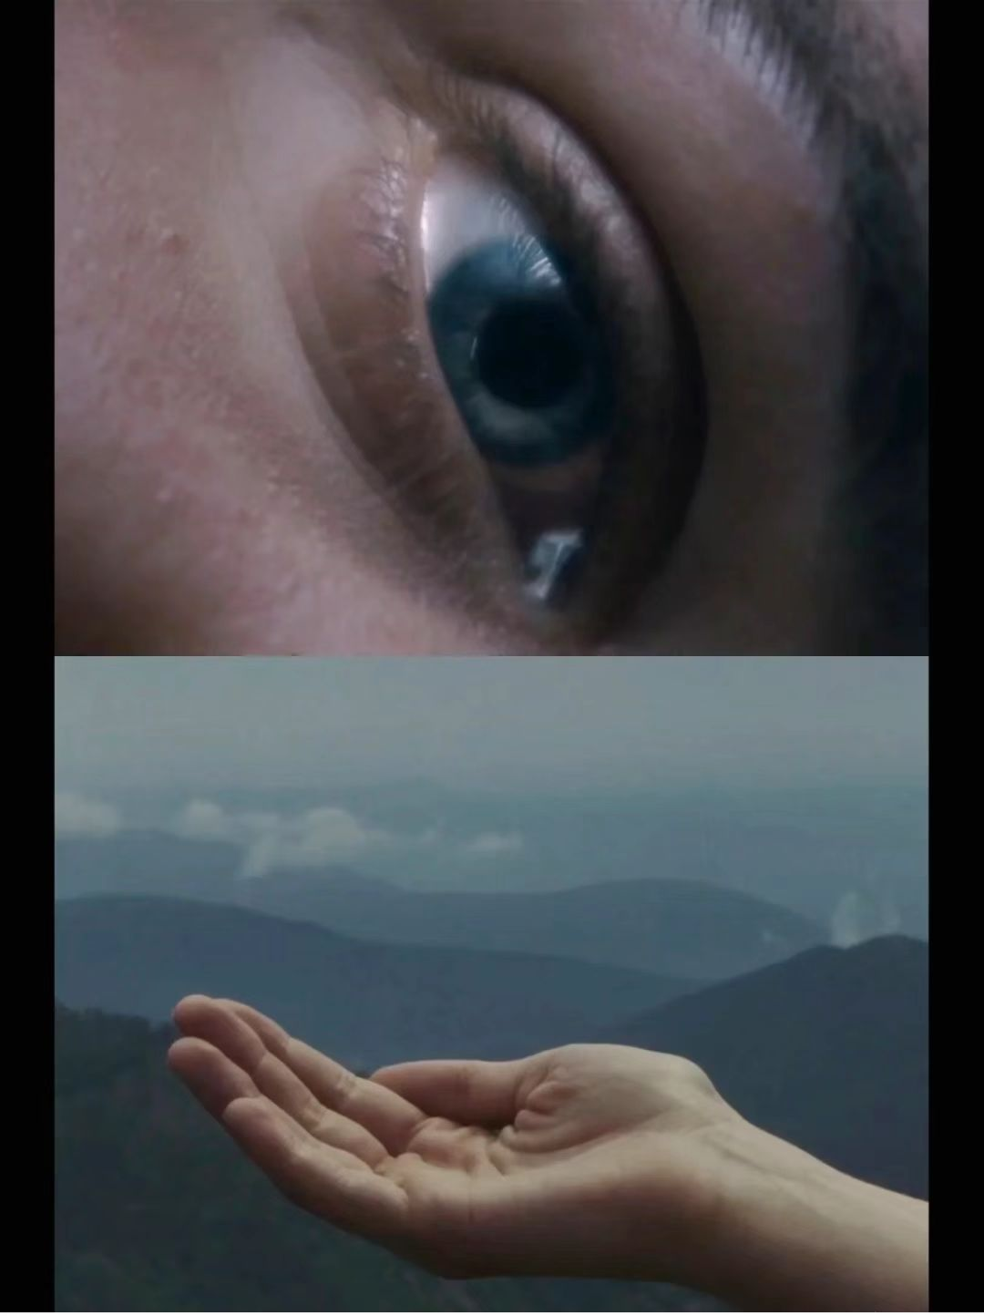

Slide 18
References:
[1] 梁谞."解密湘西赶尸". 2014年07月民俗非遗研讨会论文集. Ed. 2014, 20-21.
[2] 李子皿. 巫风骀荡大湘西——浅析湘西巫术文化及历史成因[J]. 戏剧之家, 2014, (15): 260-261.
[3] 陆群. 神秘的湘西赶尸[J]. 文史博览, 2007, (05): 56-59.
[4] 张达玮. 湘西赶尸的宗教与伦理意蕴——兼论原始信仰作为人的存在方式[J]. 黔南民族师范学院学报, 2016, 36(04): 18-22.
[5] 赵玉燕. 旅游吸引物符号建构的人类学解析——以“神秘湘西”、“神秘文化”为例[J]. 广西民族研究, 2011, (02): 184-189.
Movies & Inspiration of videos:
《魔窟中的幻想》/《鸟类变形记》
河马往事”写了一辈子湘西，沈从文怎么记录湘西赶尸的？”/江寻千“湘西赶尸，改了这么久终于可以发出来了”

Slide 19
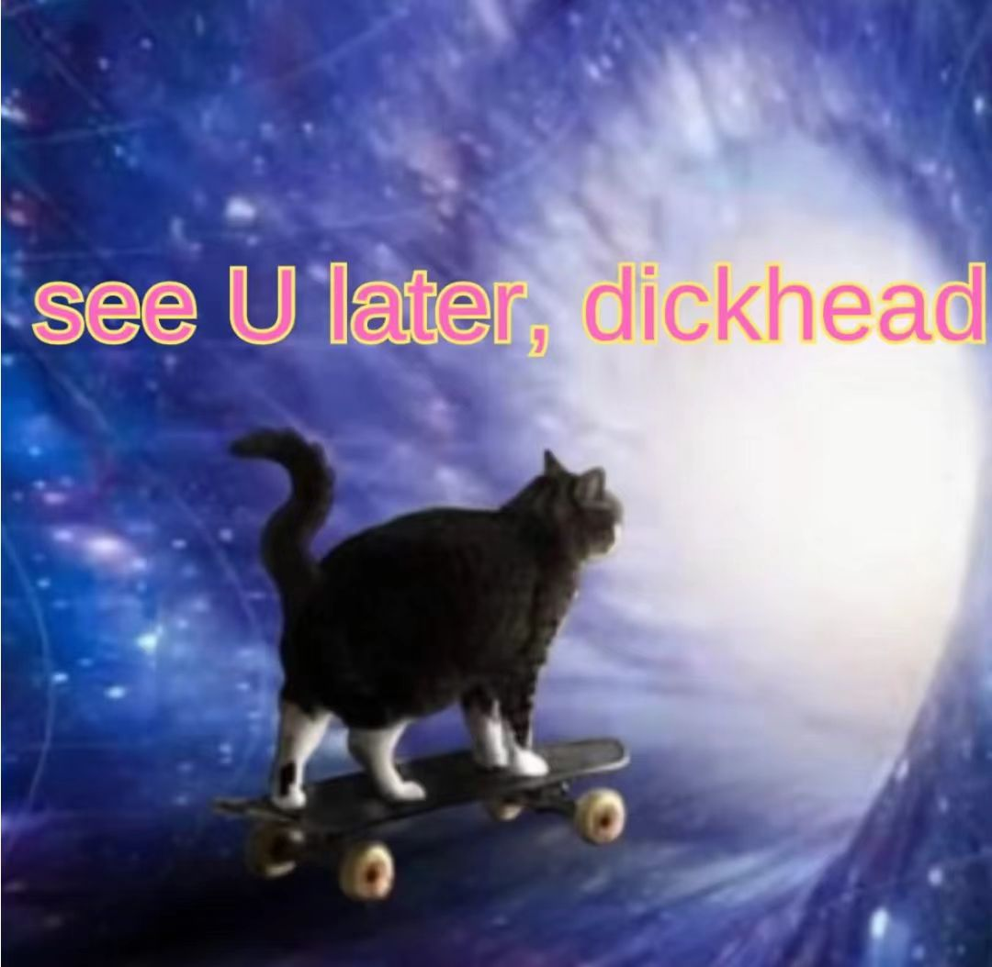
Thanks For Your Join!!!!!

