Slide 1
Nida's Functional Equivalence Theory
Group members: 康灵凤 莫南

Slide 2
CONTENTS
01
The Introduction of Eugene A. Nida
02
The Content and Development of the Theory
03
The Application and Practical Significance of the Theory
04
The Limitations of the Theory

Slide 3
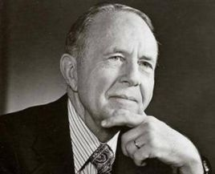
01
The Introduction of Eugene A. Nida
Mastered many languages and investigated more than 100 languages.
Obtained Ph.D. degree in linguistics at University of Michigan.
Engaged in Bible translation.
Worked for translation department of American Bible Society.
Published over 200 theses and about 40 works and about 20 works of them are about language and translation.
Wrote Toward a Science of Translating, The Theory and Practice of Translation.
Eugene A. Nida (1914-2011)
An American linguist and translation theorist.

Slide 4
02
The Content and Development of the Theory
Definition
Dynamic equivalence is therefore to be defined in terms of the degree to which the receptors of the message in the receptor language respond to it in substantially the same manner as the receptors in the source language. (Nida, 2004: 24)
“就是译文读者对译文所做出的反应与原文读者所做出的反映基本一致”
Due to people's misunderstanding of dynamic equivalence, Nida changed dynamic equivalence into functional equivalence. Both of them have little difference.
Emphasis: the functional equivalence of information instead of the direct formal equivalence in translation.
所谓功能对等，就是说翻译时不求文字，表面的死板对应，而要在两种语言之间达成功能上的对等要求，在意义和风格上都贴近原作。

Slide 5
Four Aspects of Functional Equivalence Theory
Lexical equivalence
Syntactic equivalence
Textual equivalence
Stylistic equivalence
Two Kinds of Equivalence in the 1990s
Maximal Equivalence
The target readers can understand and appreciate the translation in the same way as the original readers. It's the ideal state pursued by translators.
Minimal Equivalence
The target readers should be able to understand the translation and then can imagine how the original readers understand and appreciate the original text.

Slide 6
03
The Application and Practical Significance of the Theory
Lexical equivalence
Lexical equivalence simply means that the meaning of a word in the source language can match the meaning of the word in the target language.
Example 1:But a violent hand pulled away a chair and the cushions fell down. (Maugham, Of Human Bondage)
张柏然译：但是一只有力的手猛地拖开靠背椅, 软垫纷纷跌落在地。
Syntactic equivalence
It is required that the sentence structure of the source language should be equal to that of the target language, which is called syntactic equivalence.
Example 2: “I do not cough for my own amusement.” (Austen, Pride and Prejudice)
李继宏译：“你们以为我想咳啊？难道咳嗽好玩吗？”
王佐良译：“我又不是故意咳着玩儿”

Slide 7
Textual equivalence
Textual equivalence means that translators can not only analyze the language itself in discourse analysis and translation, but also properly embody the same meaning and function of the source language in the target language.
Stylistic equivalence
Equivalence of Alliteration Style
Example 3: “Good Heaven! Brighton, and a whole campful of soldiers, to us, who have been overset already by one poor regiment of militia, and the 19 monthly balls of Meryton.” (Austen, Pride and Prejudice)
李继宏译：“天哪！梅里顿才不过是一团民兵，每个月开一次舞会，已经弄得我们全部乱了套，要是到了布莱顿，遇到一整个兵营的士兵，那还得了啊。”
......

Slide 8
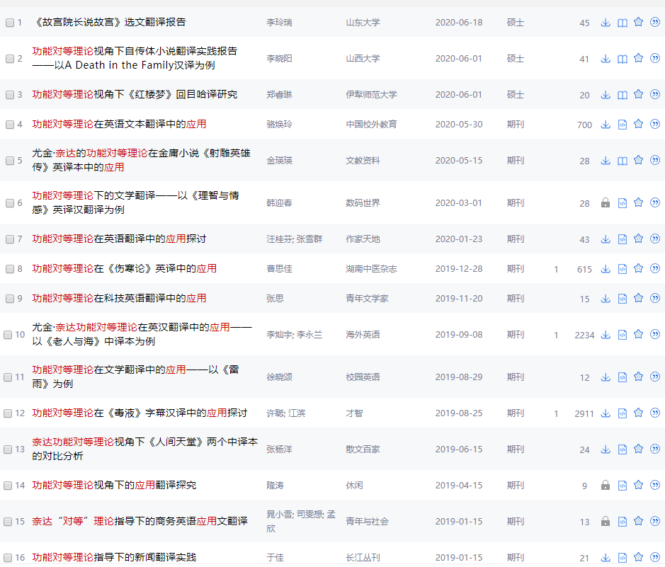
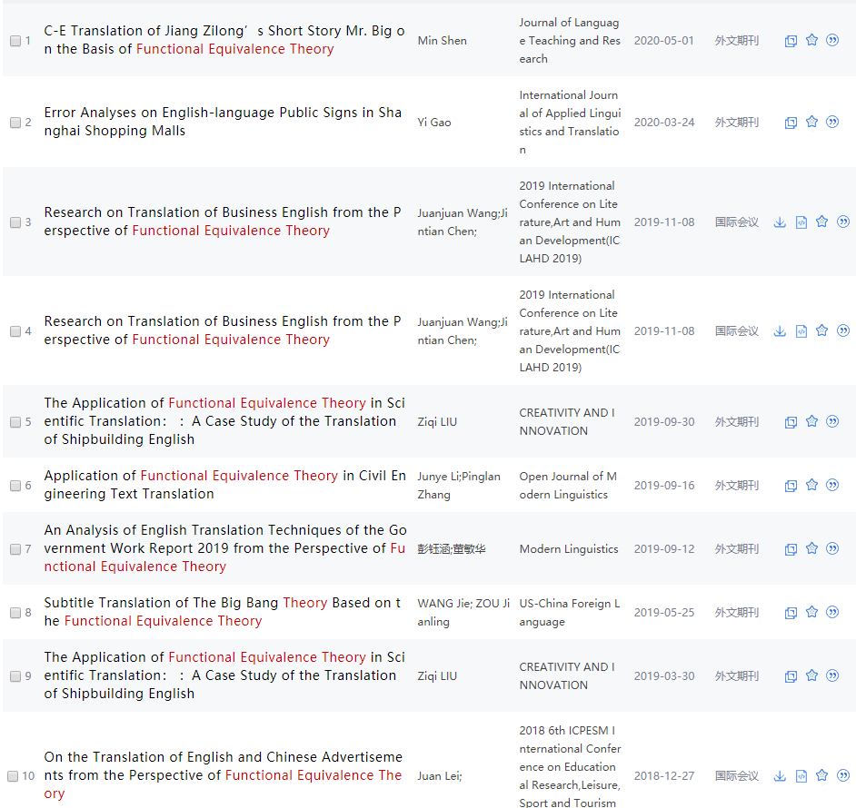
It challenges the past translation theories which are mainly about empiricism.
It introduces theories such as aesthetics, communication into the translation field.
It addresses the long-standing debate over literal translation and free tranlsation.
......

Slide 9
04
The Limitations of the Theory
Functional equivalence ignores the individuality and particularity of language.
individualism and “个人主义” in Chinese are two different things.
The theory of equivalence ignores cultural differences between different languages.
“雨后春笋” and “grow like mushroom”
The equivalence theory ignores the original form and discourse diversity.
translations of technology, history and philosophy
......

Slide 10
Bibliography
Austen, Jane. Pride and Prejudice[M]. New York: Dover Publications, 2009.
Nida, Eugene. The Theory and Practice of Translation[M]. Leiden: E. J. Brill, 1982.
胡菊花.辩证反思奈达的“功能对等”理论[J].长春理工大学学报(高教版),2009,4(05):134-136.
刘雪莲.从奈达的功能对等理论来看《傲慢与偏见》的翻译[J].兰州教育学院学报,2010,26(04):136-137+148.
石锡书,杜平.辩证地看待奈达的“功能对等”理论[J].四川教育学院学报,2004(07):69-71.
杨司桂.浅析奈达的“功能对等”理论[J].河北广播电视大学学报,2007(01):68-71.
赵丹丹.浅论奈达的功能对等理论[J].文学教育(中),2011(03):54-55.
Networking Linking
https://wenku.baidu.com/view/62f8b2acaff8941ea76e58fafab069dc51224702.html?fr=search_income2
https://wenku.baidu.com/view/39116e0502020740be1e9b32.html
https://baike.so.com/doc/6183661-6396909.html

Slide 11
Thanks for watching and listening!

