Slide 1
Skopos Theory
——王轩
肖双玲
By Wang Xuan,
Xiao Shuangling

Slide 2
Definition
Three purposes
Three main rules
Application
Merits and criticisms

Slide 3
Definition
Skopos is a Greek word defined as "purpose". It is a technical term, coined by Hans Vermeer, that represents the aim of a translation.
In 1984 K. Reiss and H.J.Vermeer co-authored “Foundation for a General Theory of Translation”, which formulated “skopos” theory principles.
Skopos theory focuses on the purpose of the translation, which determines the methods and strategies of translating, which are employed to produce functionally adequate result.
That is to say, it centers on the purpose of the translation and the function that TT (Target Text)will fulfill in the target culture, which may not be necessarily the same as the purpose of ST(Source Text) in the source culture.

Slide 4
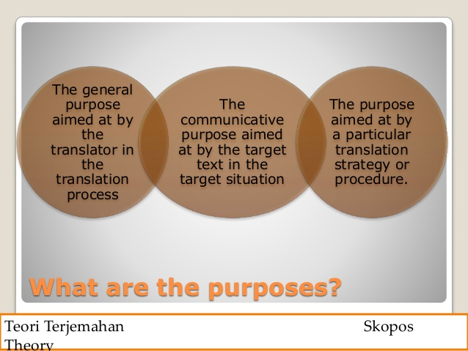
Three purposes:
general, communicative, and strategic purposes.

Slide 5
The Skopos rule
The Coherence rule
The Fidelity rule
Three main rules of Skopos Theory

Slide 6
The Skopos rule
  The first rule to obey in the process of translation is the purpose of an overall translational action, which can also be interpreted as “the end justifies the means”.
  As defined by Vermeer and translated by Nord, the Skopos rule states: each text is produced for a given purpose and should serve this purpose.

Slide 7
The Fidelity rule
This is a further principle, also known as the “inter-textual coherence” by Reiss and Vermeer in 1984.
The fidelity rule states that there must be coherence between the translated version and the source text.
Attention!!!
  While this rule is highly similar to the ‘faithfulness’ aspect in previous equivalence translation theories, it is different from ‘faithfulness’.
  ‘faithfulness’ is static and unchanging, it necessitates the maximum equivalence possible. While ‘fidelity’ is dynamic; the extent of faithfulness depends on the purpose of the text and the understanding of the source text by the translator.

Slide 8
The Coherence rule
  The second rule, the Coherence rule, imposes on translators the requirement that any target text should make sense according to the target culture of the target language so that the receivers can make sense of it.
  As quoted from Nord, this rule states: a translation should be acceptable in a sense that it is coherent with the receivers’ situation.

Slide 9
Application
旅游翻译（尤其是营销、推广性质的翻译）有很强的针对性和目的性，翻译要求能直接达到预期的反映，为达到此目的，删减和改译及其常见。
如：这里三千奇峰拔地而起，形态各异，有的似玉柱神鞭，立地顶天；有的像铜墙铁壁，巍然而立；有的如晃板垒卵，摇摇欲坠；有的如盆景古董，玲珑剔透……神奇而真实，迷离又实在，不是艺术创造胜似艺术创造，令人叹为观止。
3000 crags rise in various shapes-----pillars, columns, walls, shaky egg stacks and pottedlandscapes—conjuring up fantastic and unforgettable images.
译文着眼于预期功能，摒弃了汉语的行文形式，删减掉有悖英语读者阅读习惯的内容，采取符合读者习惯的表达方式，有效地传达出了原作意图。

Slide 10
Benifits
  Streamlining the complications derived from translators and clients
  Providing translators with an explicit guideline discussed with the client
  Establishing new statuses of the source and target text
  Promoting innovations

Slide 11
Criticism
  Posing additional pressure and responsibilities on the translator to seek an adequate translation strategy
  Oversimplifying the linguistic situation of a text and thus posing some difficulty in surveying contexts comprehensively
  Bringing about inconsistences

Slide 12
Thanks for watching.

