Slide 1

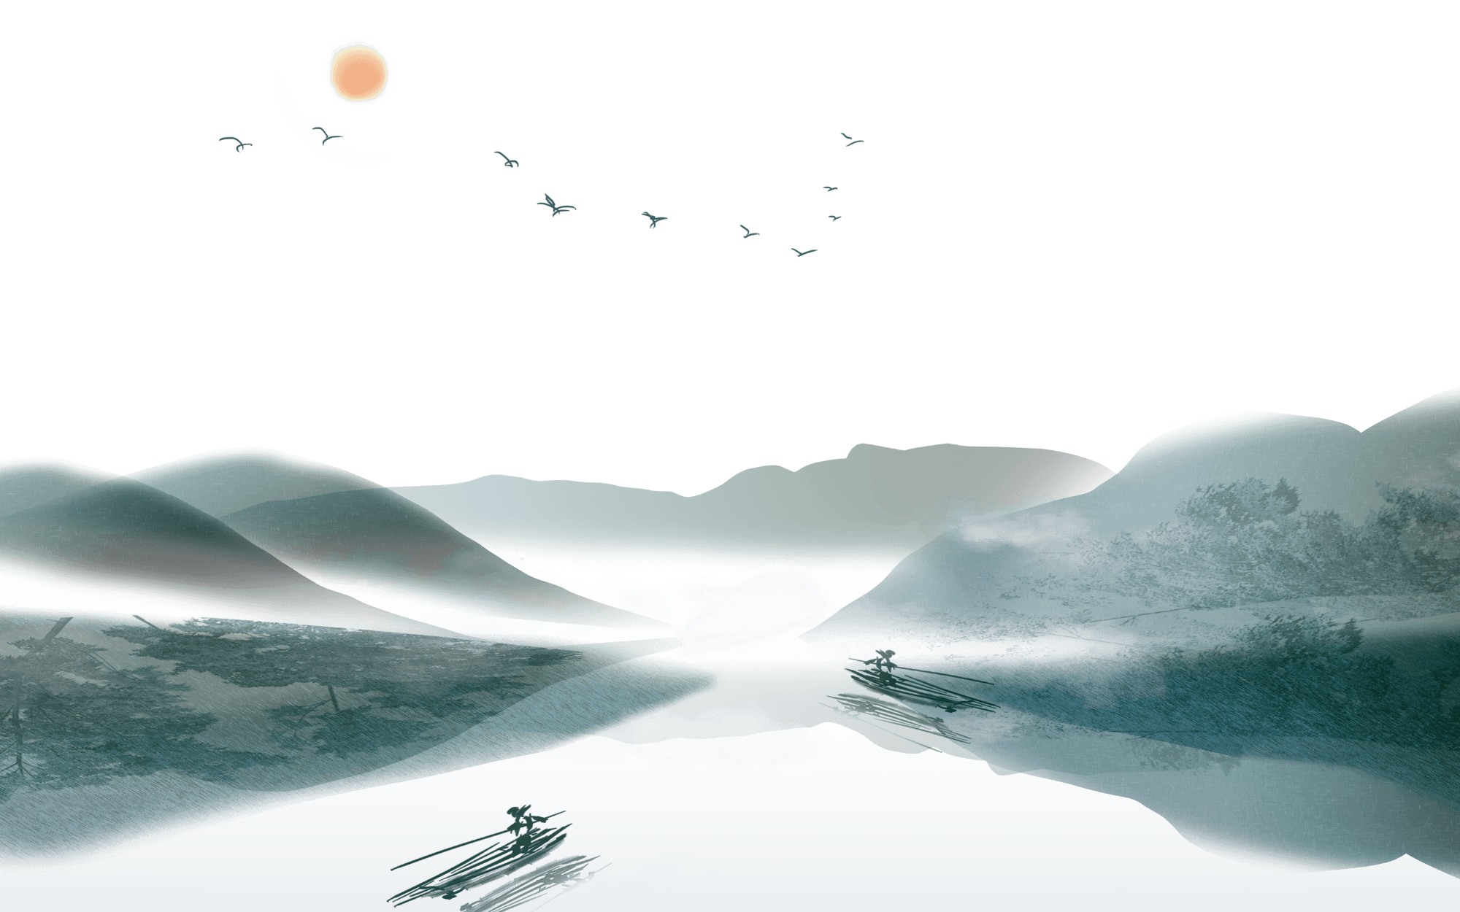

Chinese Mythology
Liu Shuangying

Slide 2

Two parts
Three main characters
Water war

Slide 3
Part one: Three main characters

Slide 4


Three main characters
伏羲
女娲
盘古
Panku
Fushi
Nuwa

Slide 5
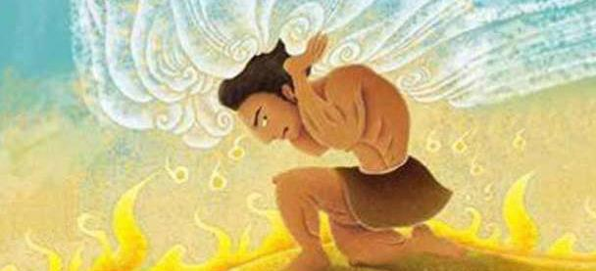
Panku
Body: giant, muscular, ninety thousand li(about thirty thousand miles)
At the beginning: empty, close to the sky
Later: the distance between sky and earth（ninety thousand li “ Nine-Layer Sky”
Time: ten years to separate
…
Changes: right eye: moon; left eye: sun; head and limbs: mountains; blood vessels: rivers and seas; flesh: fertile lands; sweat and tear: rain, voice: thunder and lightning; breath: winds and clouds,
Finally: left a beautiful landscape.

Slide 6
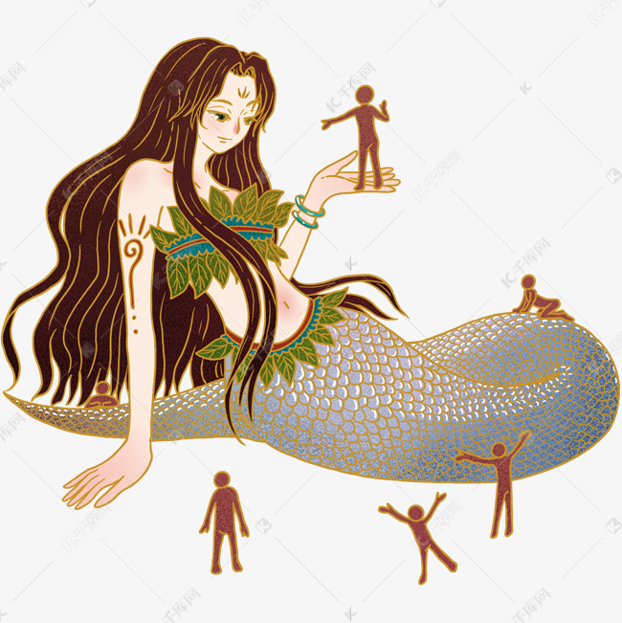
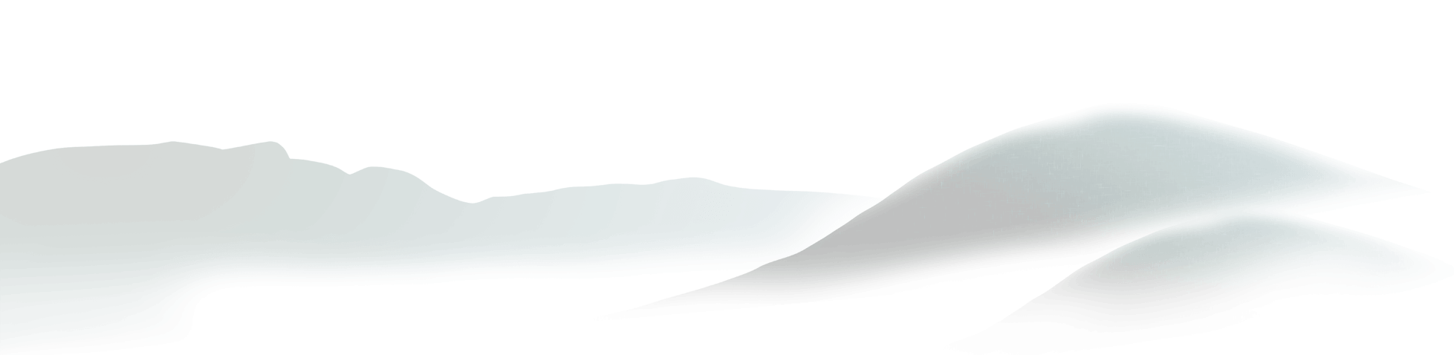
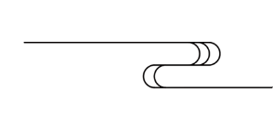
Nuwa
Goddness
Appearance: a body of snake and human face
Create human beings: after Panku’s death, felt lonely.
kneading mud with human forms alive
…
People were getting old and dying one after another
Reproduce: Men and women, marriage

Slide 7


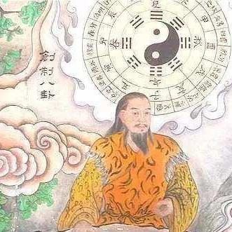
Fushi
Teach people
Lute
Reason: To live in harmony
Make musical instrument and use it (pipa=lute)
Hunting, make fire, writing, agriculture, breeding and so on

Slide 8
Part two: Water War

Slide 9


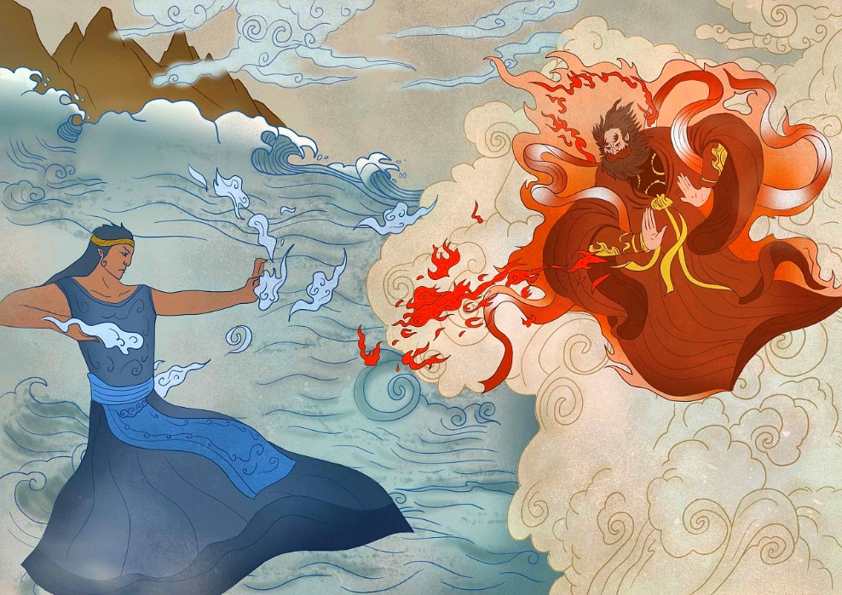
Gong
Zurong
VS
Appearance；a snake’s body and human face
Temper: bad
Actions: rain and floods
Appearance: massive human body, red skin and beard
Temper: bad
Reaction: intervene to stop
War: 1. wrestle on the sky
2. get down to the earth
Ending: Gong (god of water) was defeated

Slide 10

Thank You!

