Slide 1
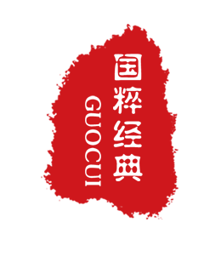
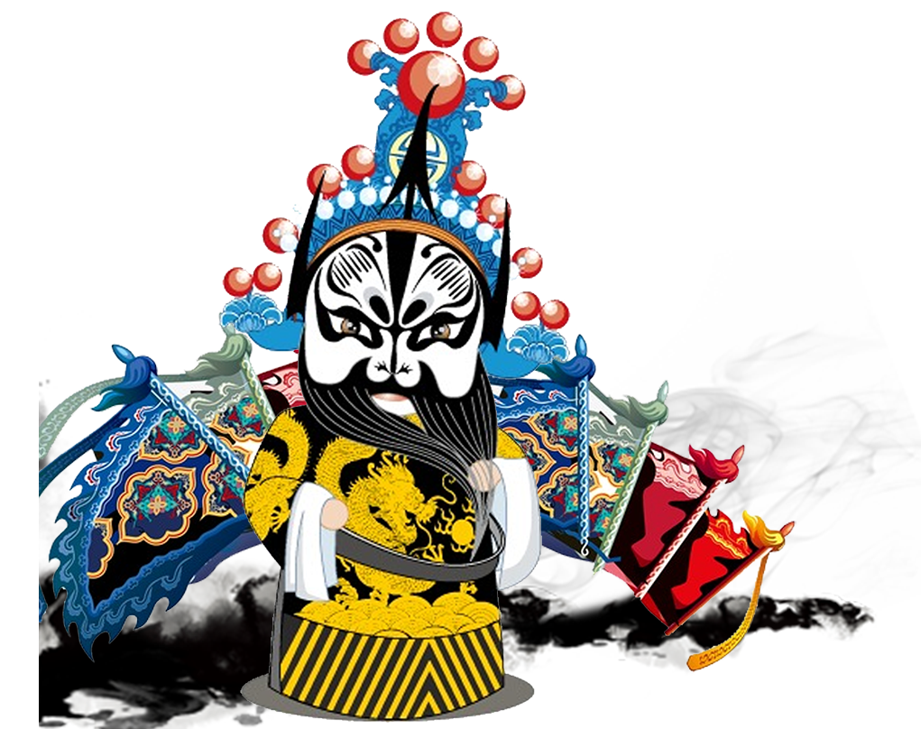
Facial Makeup
By:邹享睿

Slide 2
CONTENTS
01 origin
02 History
03 Types

Slide 3
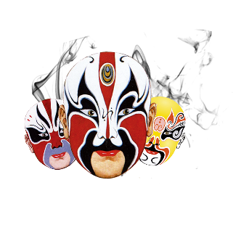
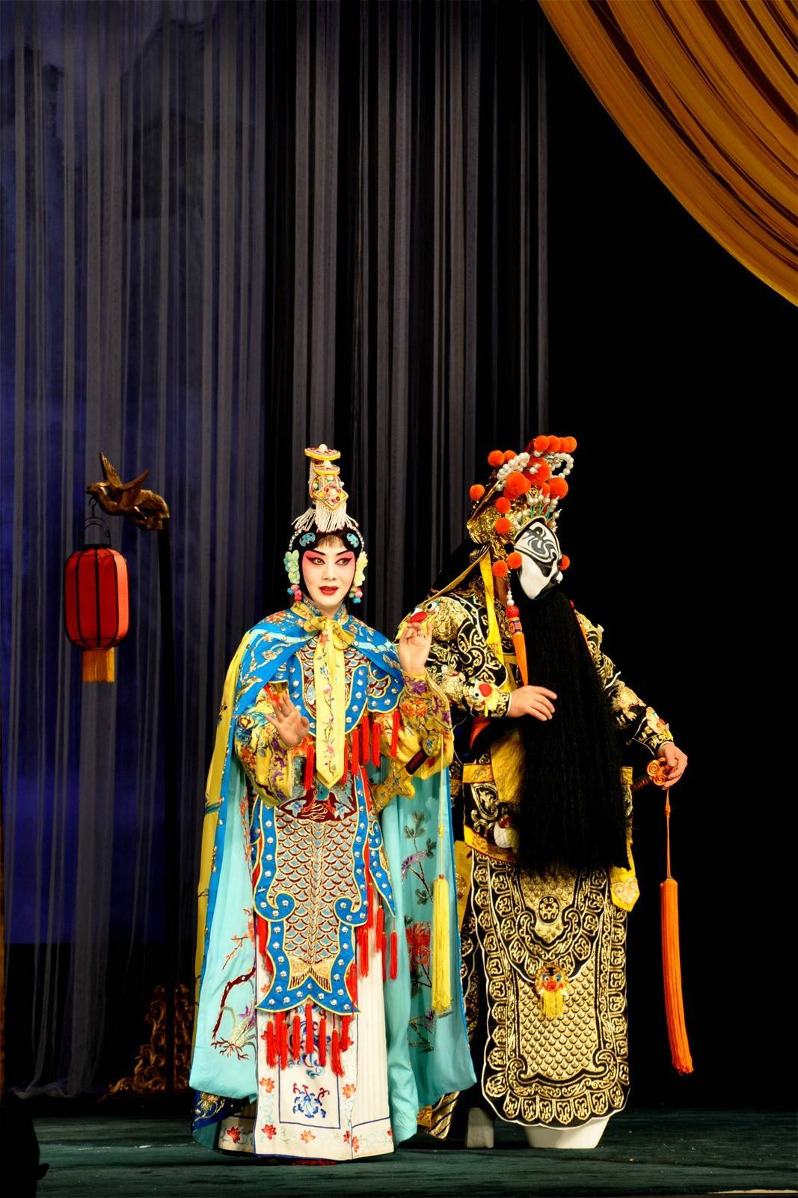
Origin
People hold different views when speaking of the origin of the facial makeup. It is said facial makeup was closely related to a kind of dance, called Damian, which appeared in the Northern and Southern Dynasties and thrived in the Tang Dynasty. It was performed by a single man aiming to extol King Lanling Gao Changgong’s outstanding military service and merits. He was courageous and good-looking and was bound to win every time he worn a mask that seemed frightening in the battlefield. As for the facial makeup used in opera, it is used to highlight the roles’ character, appearance as well as status, achieving a colorful and fantastic stage.

Slide 4
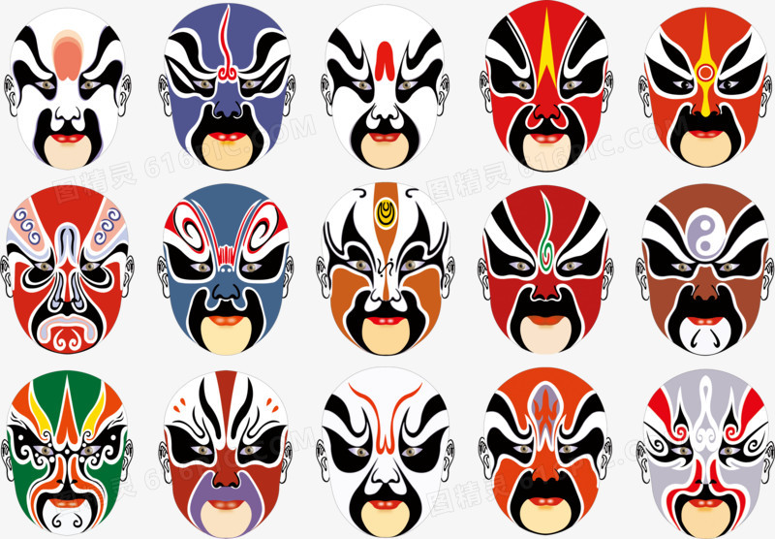
History
The legendary drama played a dominant role in Ming Dynasty, rich in content and fine in role division. Both jing and chou wear their own special facial makeup. The basic color is mostly designed based on the description in the drama literature or the singers’ personal imagination. For instance, facial makeup of Guanyu is red and that of Baozhen is black. Their brow and eyes are exaggerated in some way. The pattern ratio has changed as well. Unlike the Ming Dyansty, there are both simple and sophisticated facial makeups with the same basic color. In the Mid-Qing Dynasty, as the local drama arose, facial makeup varied greatly in different places and possessed distinct local features and folk characteristics. More than 300 kinds of dramas sprung up after the 18th century. Therefore, the drama characters mount and their division is much more finer. More colors like blue, green, yellow, grey and orange are added in jing.

Slide 5
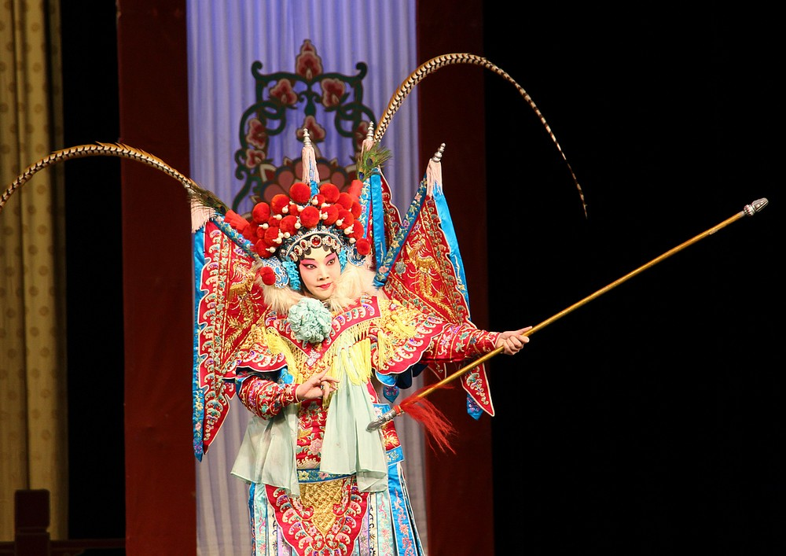
Types
The character roles in Peking opera are divided into four main types according to the sex, age, social status and profession of the character. Sheng refers to male roles and is divided into laosheng (middle-aged or old men), xiaosheng (young men) and wusheng ( men with martial skills). Dan refers to female roles and is also subdivided into various types. Qingyi is a woman with a strict moral code; and laodan is an elderly woman. Jing refers to the roles with painted faces. They are usually warriors, statesmen or even demons. Chou, clown, is a comic character and can be recognized at first sight for his special make-up.

Slide 6
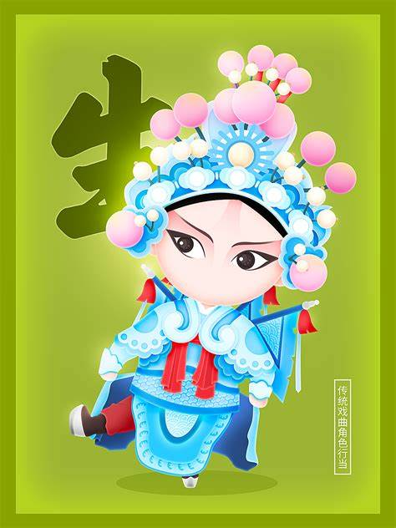
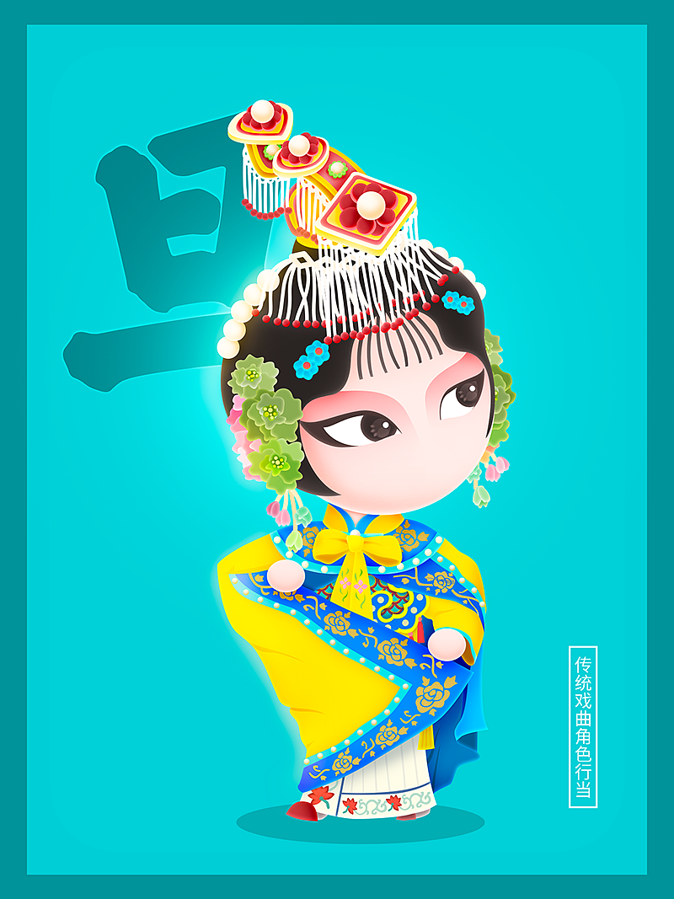
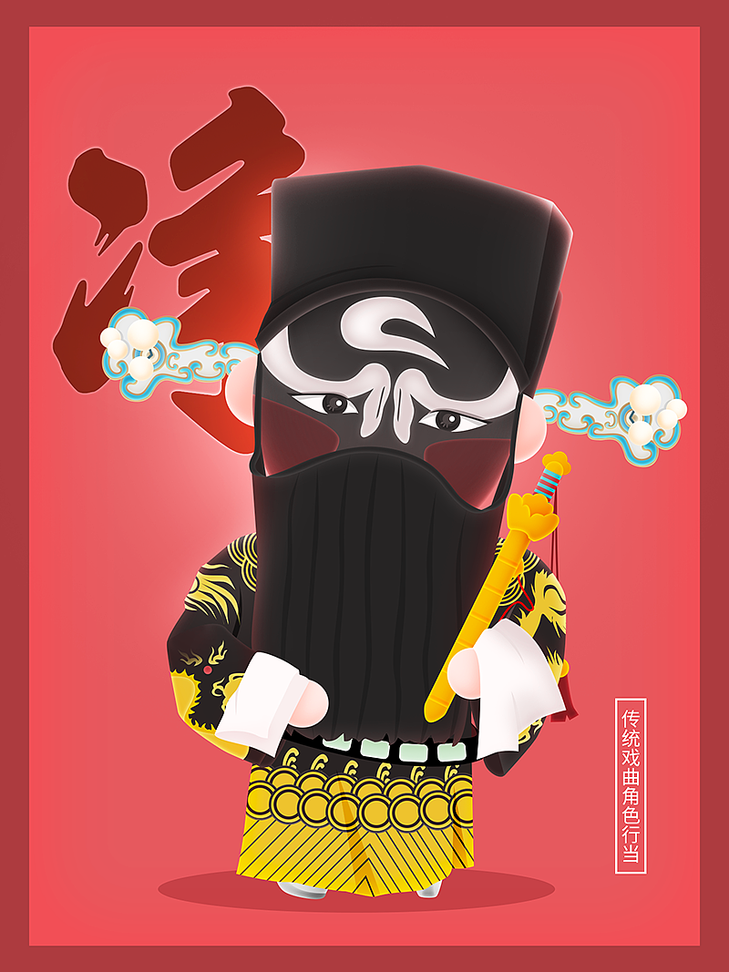
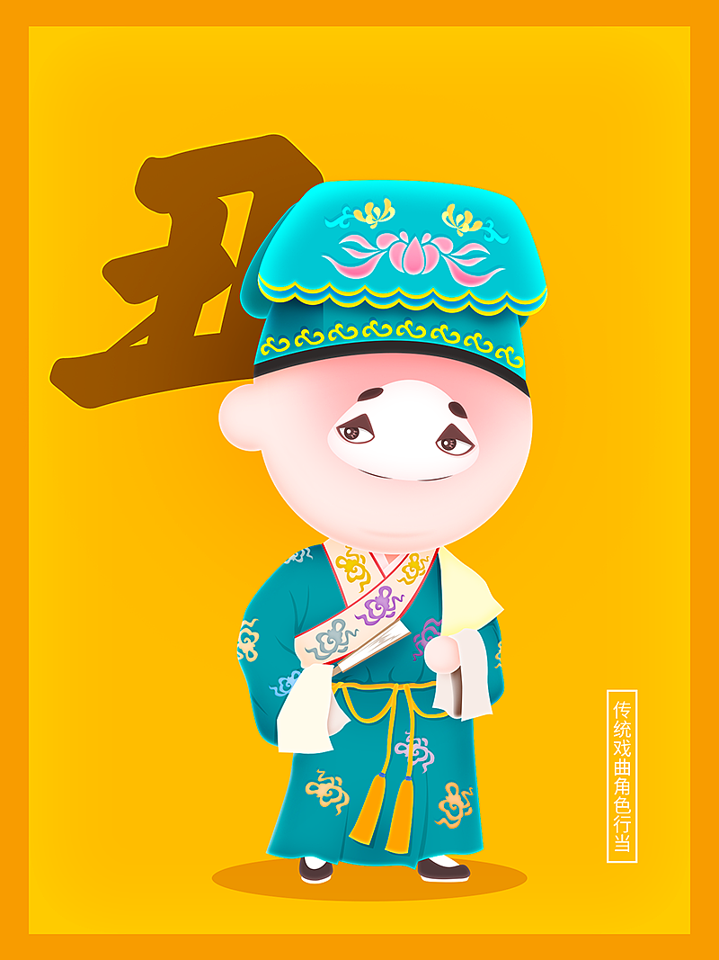
Main Types
Sheng
Dan
Jing
Chou

Slide 7
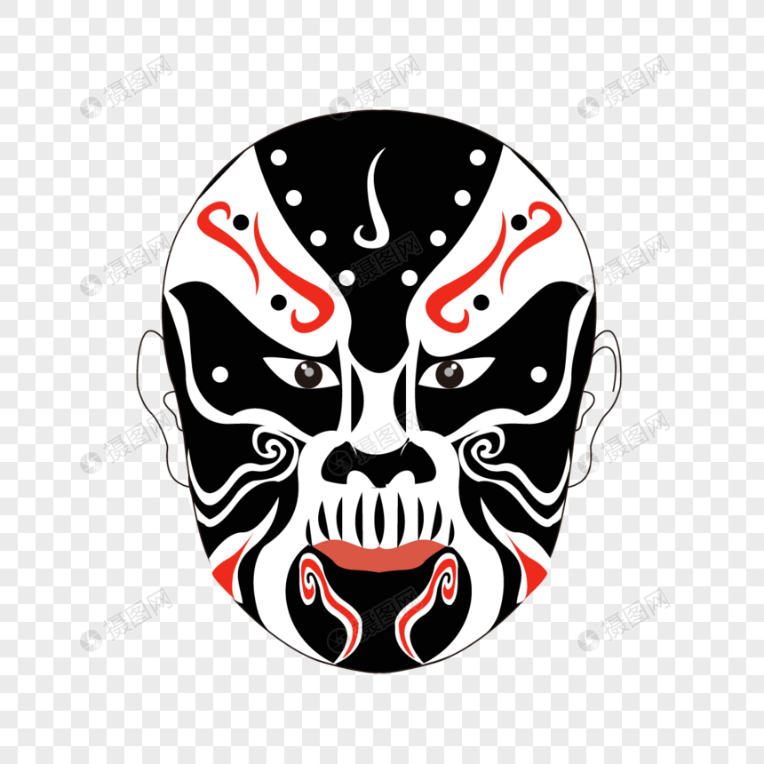
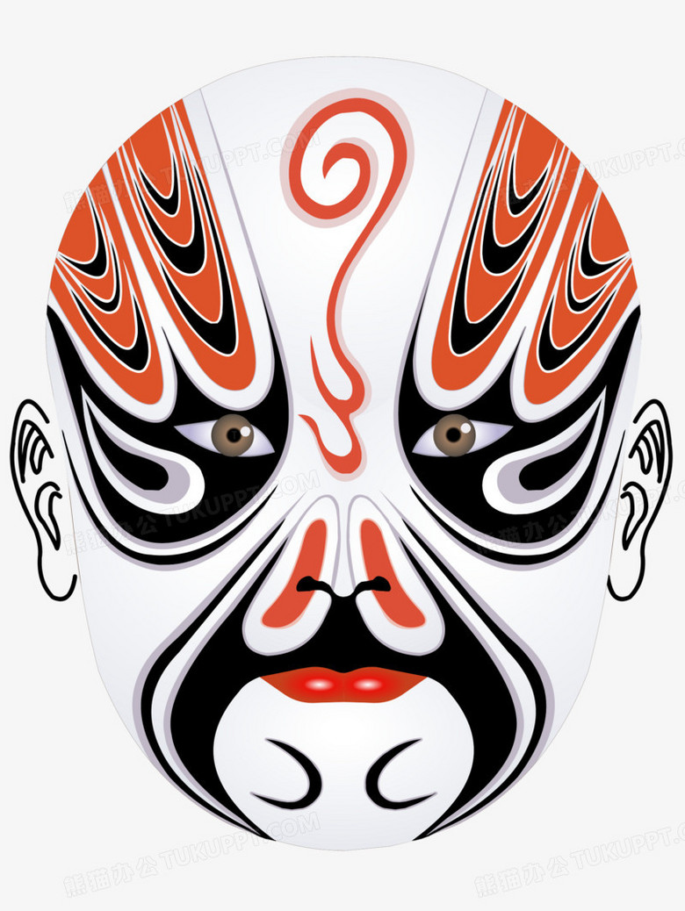
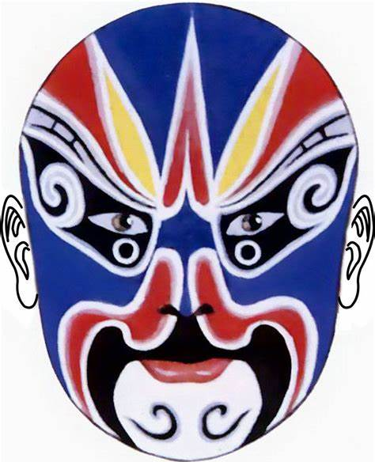
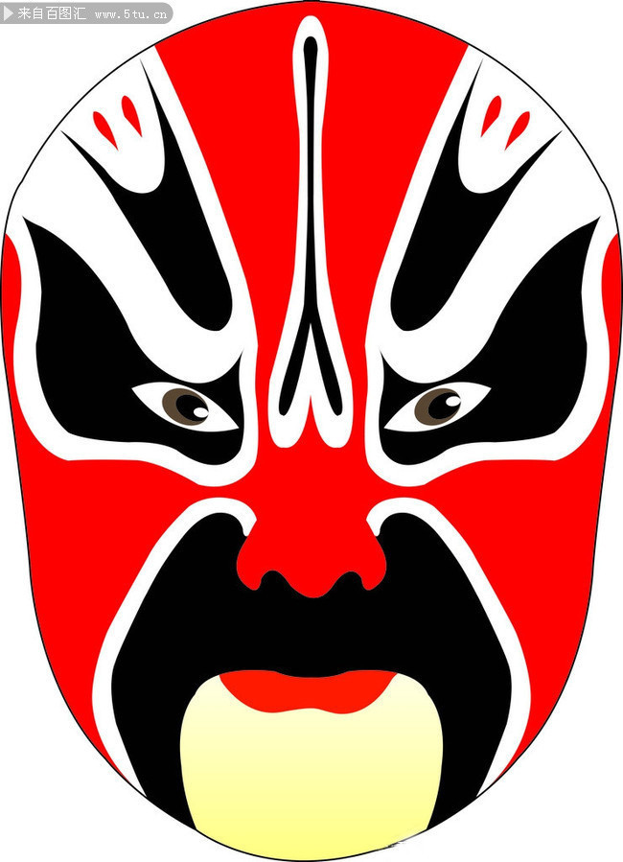
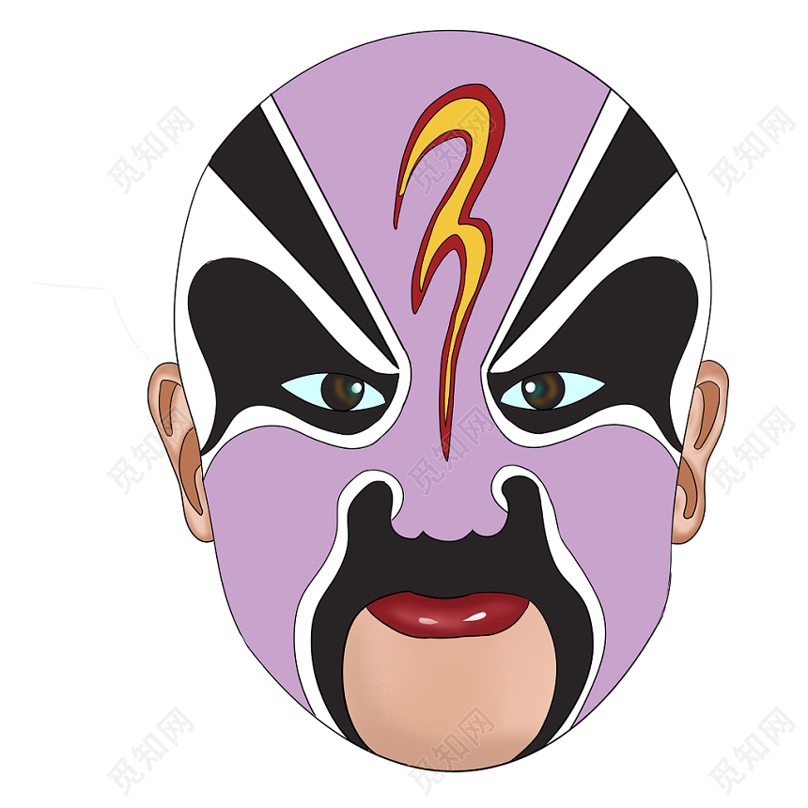
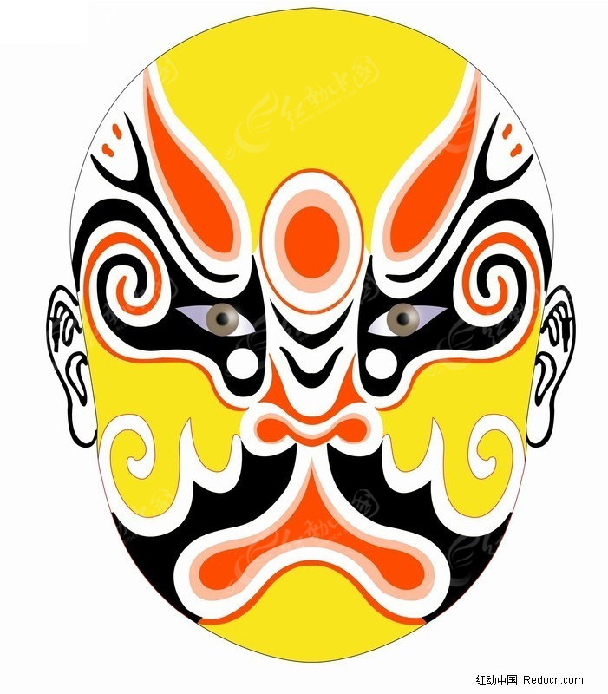
Different colors

Slide 8
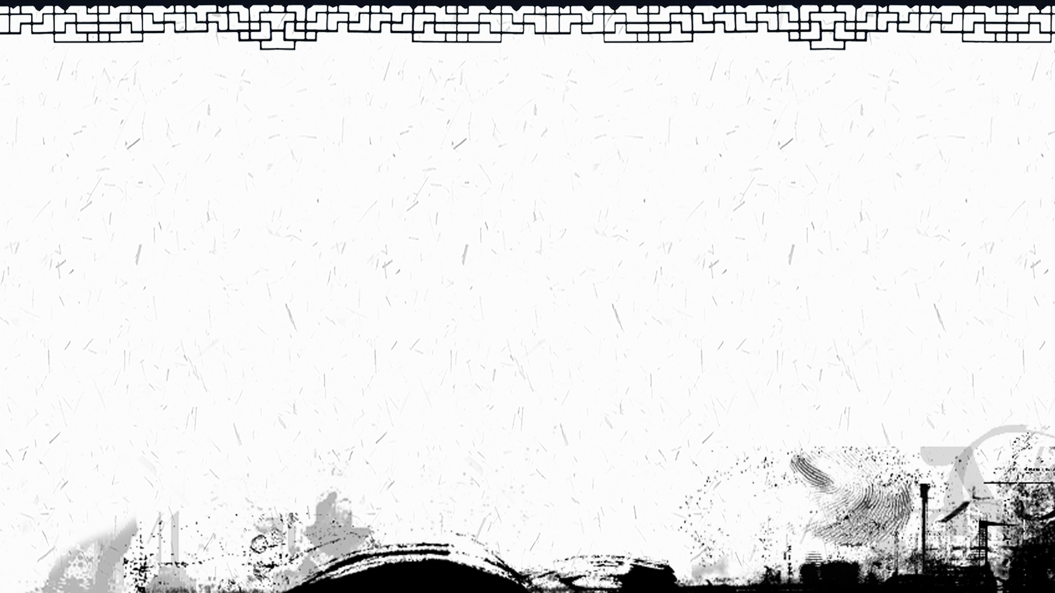
Thank You

