Slide 2
from Clash to Synergy
Nancy Adler

Slide 3
from Clash to Synergy
Nancy Adler
Avoidance
Low on my way
Low on their way

Slide 4
from Clash to Synergy
Nancy Adler
High on my way
Dominance
Avoidance
Low on my way
Low on their way

Slide 5
from Clash to Synergy
Nancy Adler
High on my way
Dominance
Avoidance |  | Accommodation
Low on my way
Low on their way
High on their way

Slide 6
from Clash to Synergy
Nancy Adler
High on my way
Dominance
 | Compromise
Avoidance |  | Accommodation
Low on my way
Low on their way
High on their way

Slide 7
from Clash to Synergy
Nancy Adler
High on my way
High on their way
High on my way
Dominance |  | Synergy
 | Compromise
Avoidance |  | Accommodation
Low on my way
Low on their way
High on their way

Slide 8
basic synergistic approach

Slide 9
basic synergistic approach
Describe the situation from all points of view

Slide 10
basic synergistic approach
Describe the situation from all points of view
Interpret the basic assumptions and values

Slide 11
basic synergistic approach
Describe the situation from all points of view
Interpret the basic assumptions and values
Find new ways, that fit all the cultures involved

Slide 12
basic synergistic approach
Describe the situation from all points of view
Interpret the basic assumptions and values
Find new ways, that fit all the cultures involved
Implement, stay sensitive for feedback, modify if necessary

Slide 13
The Growth Process in Intercultural Sensitivity
in six stages
by Milton Bennet

Slide 14
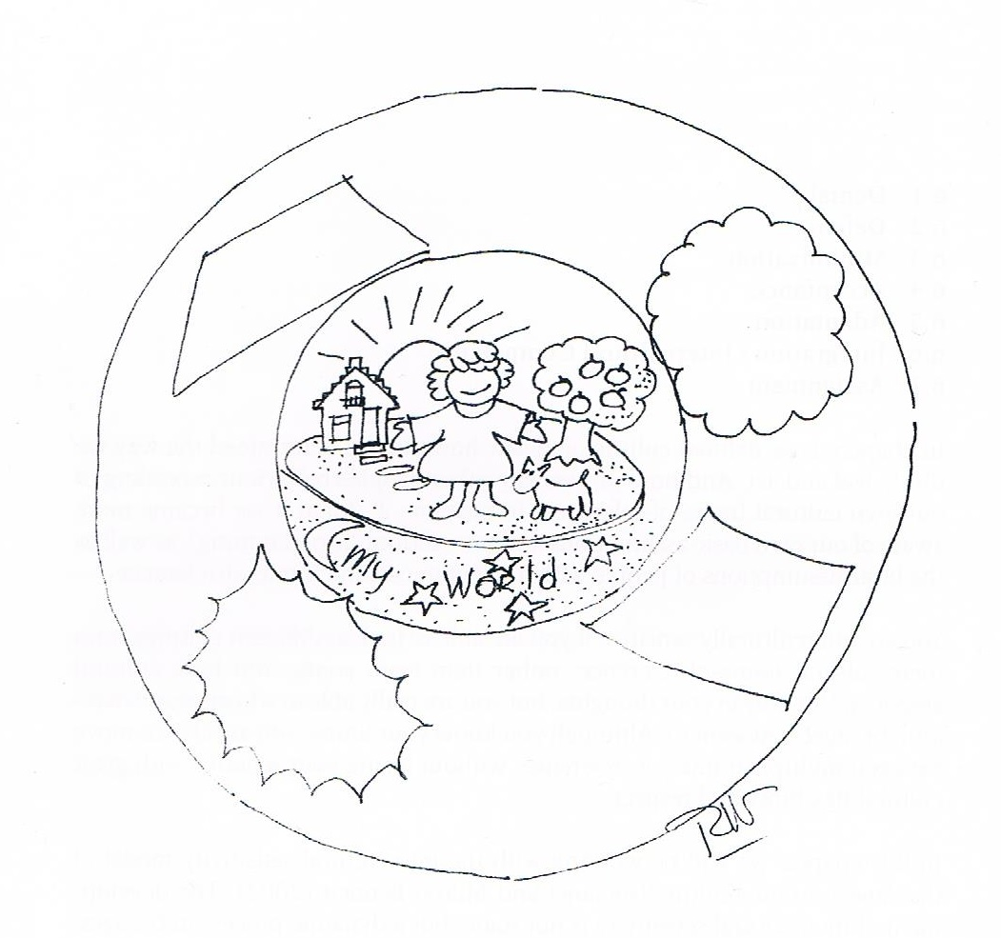
1. Denial

Slide 15
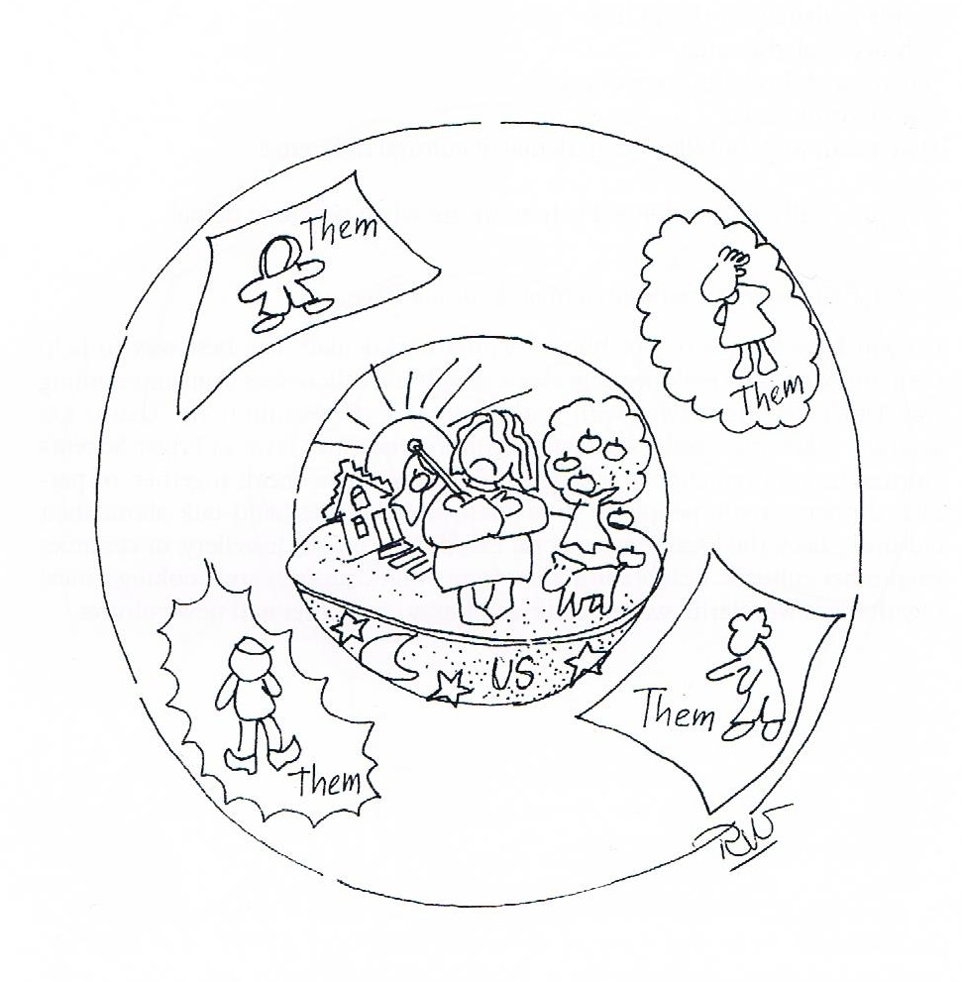
2. Defence

Slide 16
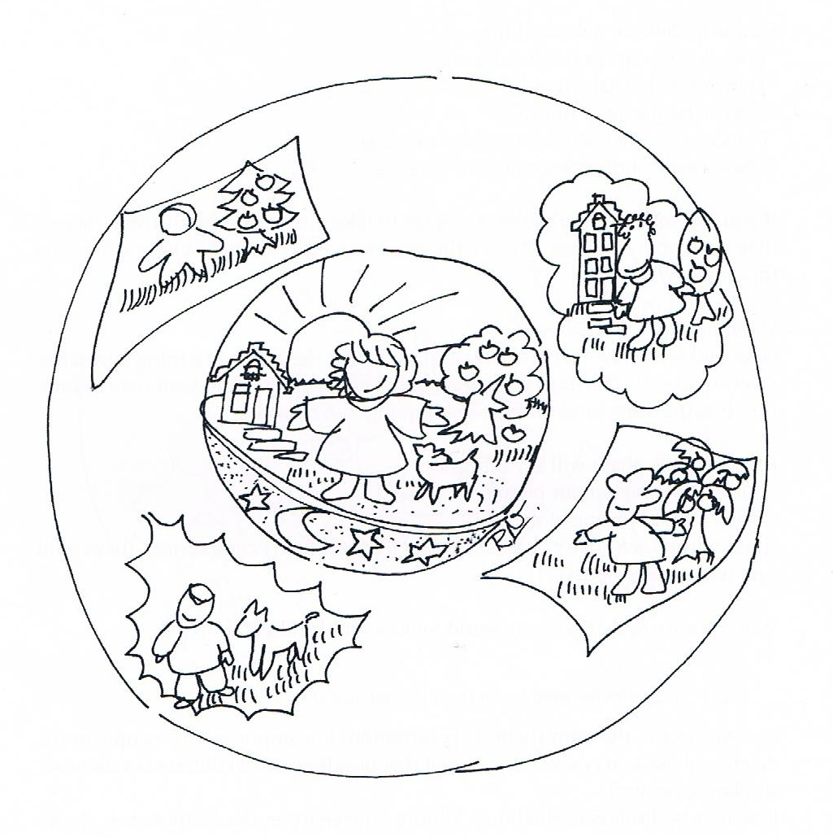
3. Minimization

Slide 17
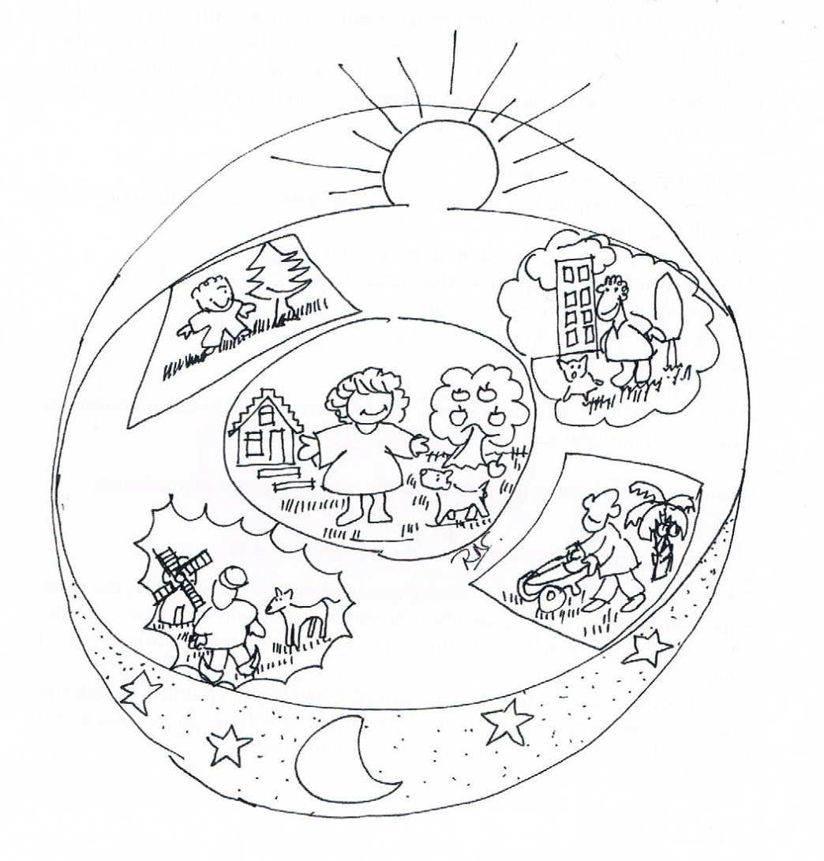
4. Acceptance

Slide 18
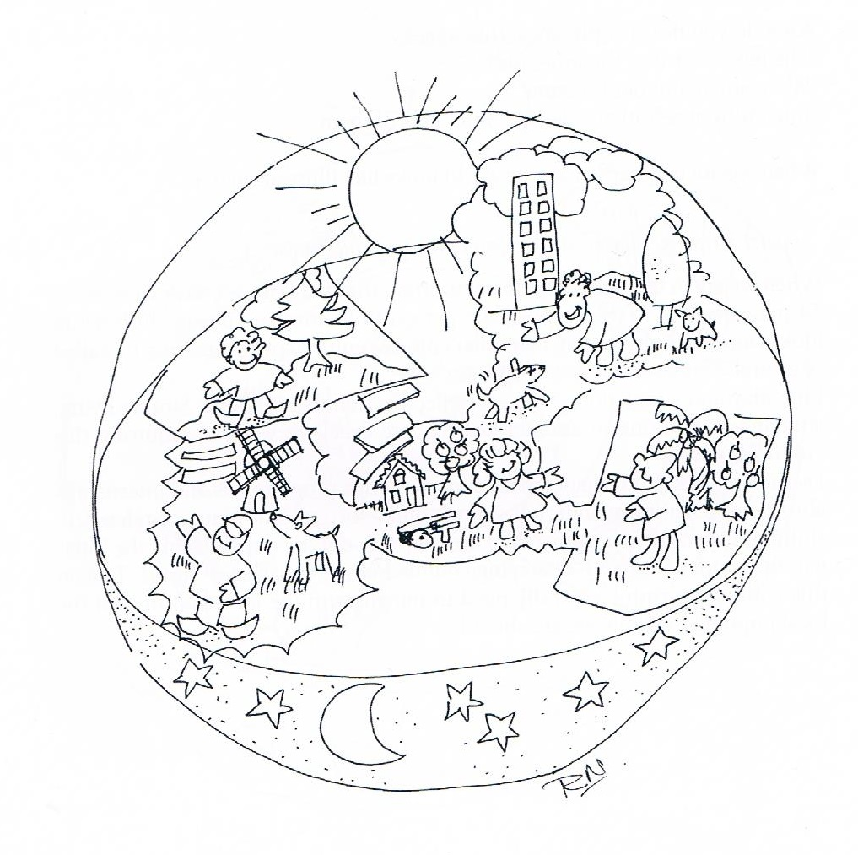
5. Adaption

Slide 19

6. Integration/Intercultural Competence

Slide 20
Sources
“Cultural Synergy: The Management of Cross-cultural Organizations”, by Nancy Adler
“Developmental Model of Intercultural Sensitivity”(DMIS), by Milton Bennett
“Intercultural Sensitivity”, by Carlos Nunez, Raya Mahdi & Laura Popma

