Slide 1
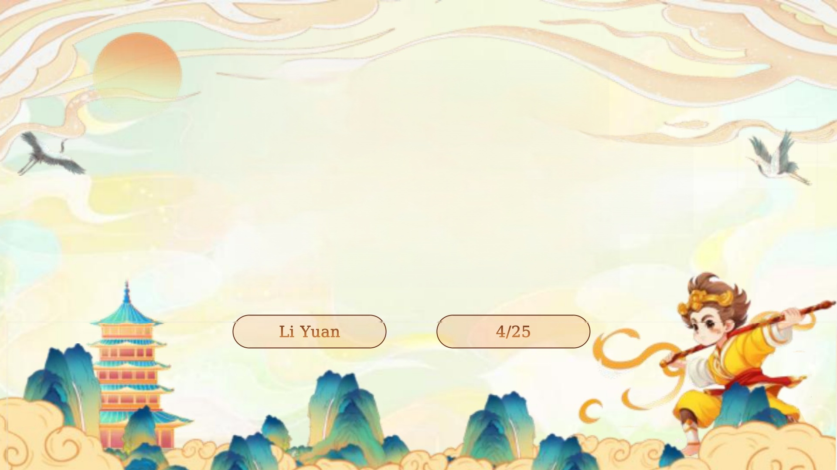
Sun Wukong:
The Monkey King in
Chinese Culture

Slide 2
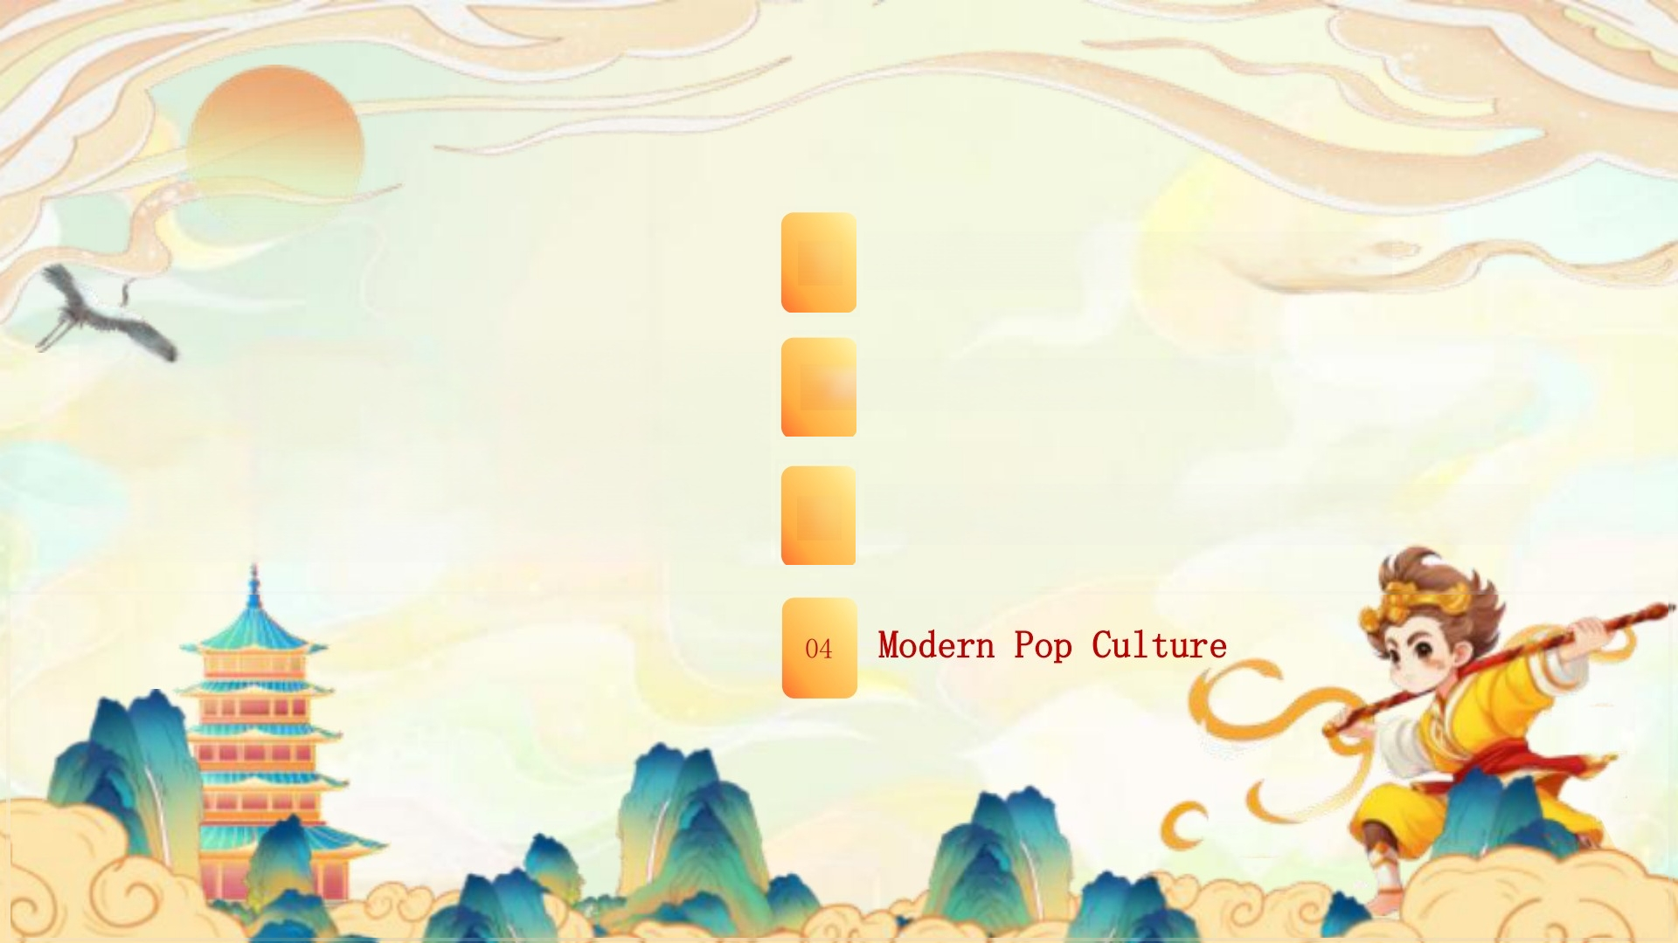
01
02
03
Origins of the Monkey King
Journey to the West
Symbolism:Rebellion &Redemption
contents

Slide 3
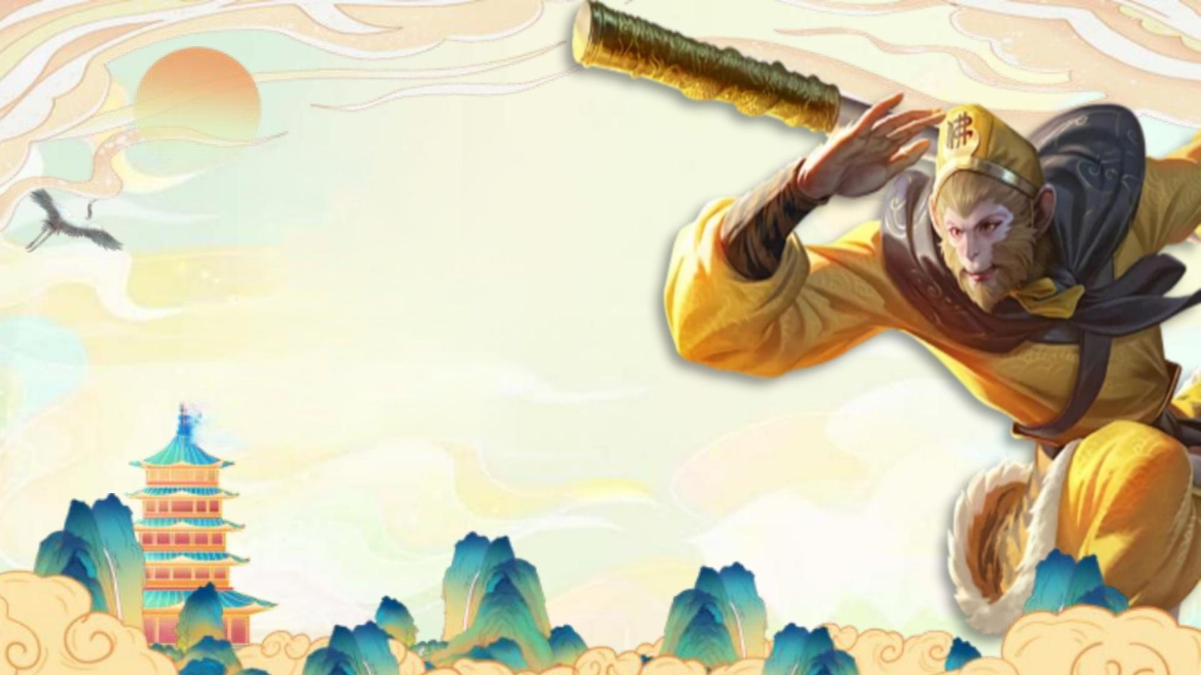
part1
Origins ofthe
Monkey King

Slide 4
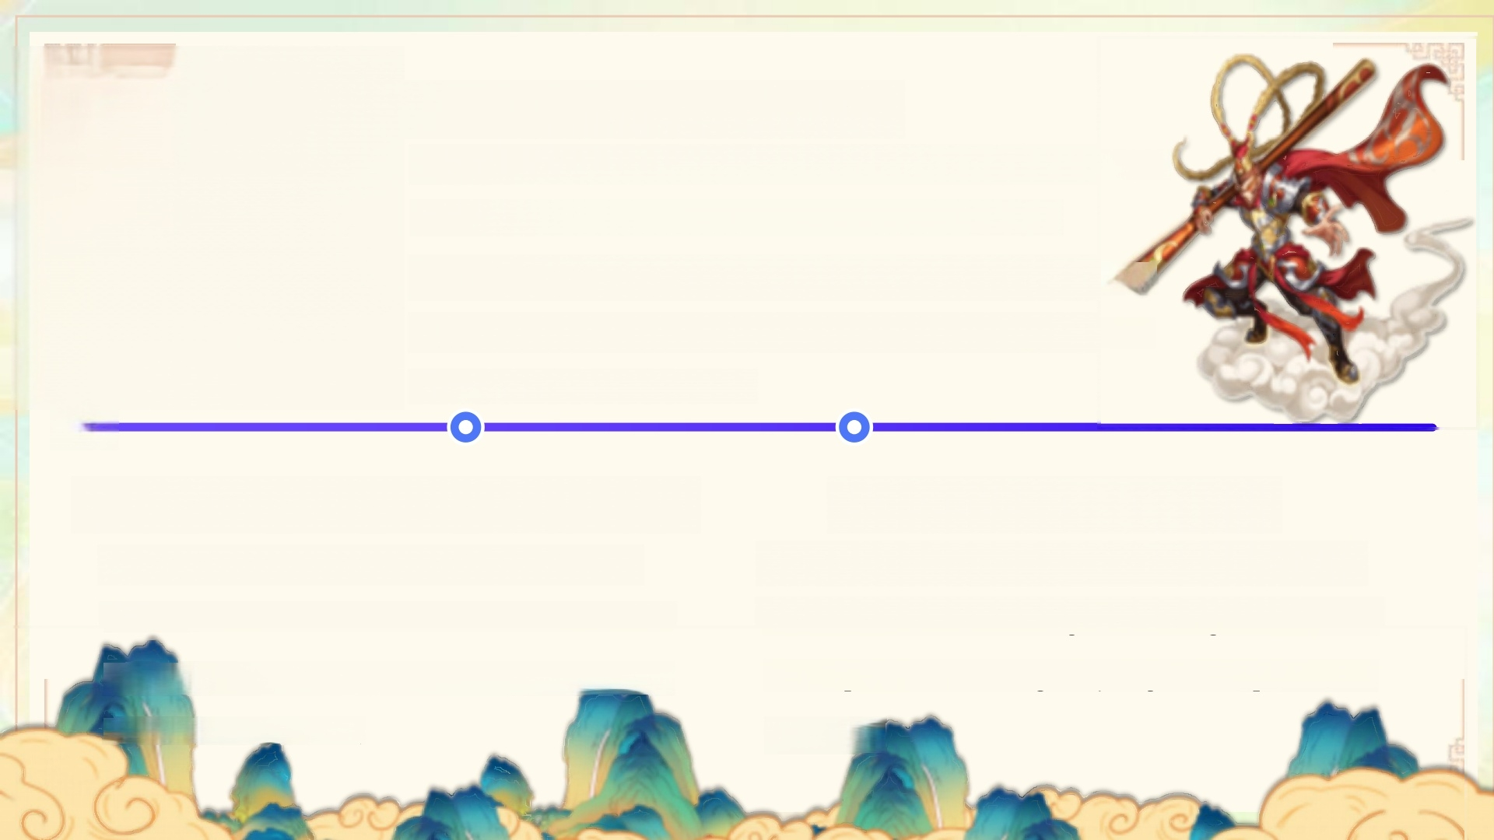
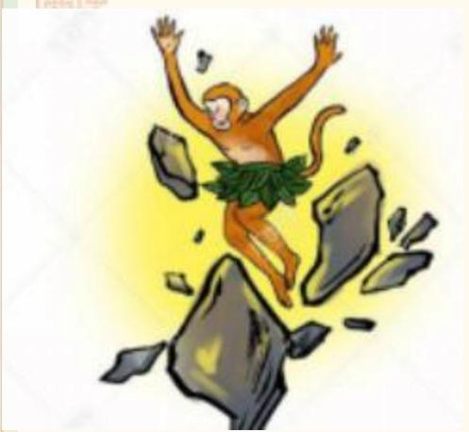
02 Seeking Immortality
To achieve immortality,Wukong find a master—— the Patriarch Subhuti.Under his master's
guidance,he learned the 72 transformations ai
the somersault cloud,laying the foundation for
his future adventures.
一O
01 Born from a Magical Stone
Sun Wukong was born from a magical
stone on the Mountain of Flowers and
Fruit,which absorbed the essence of
heaven and earth.
03 Name and Identity
The name "Sun Wukong"was given by his master,with"Wukong"meaning "awakened to emptiness,"signifying his spiritual
journey.

Slide 5
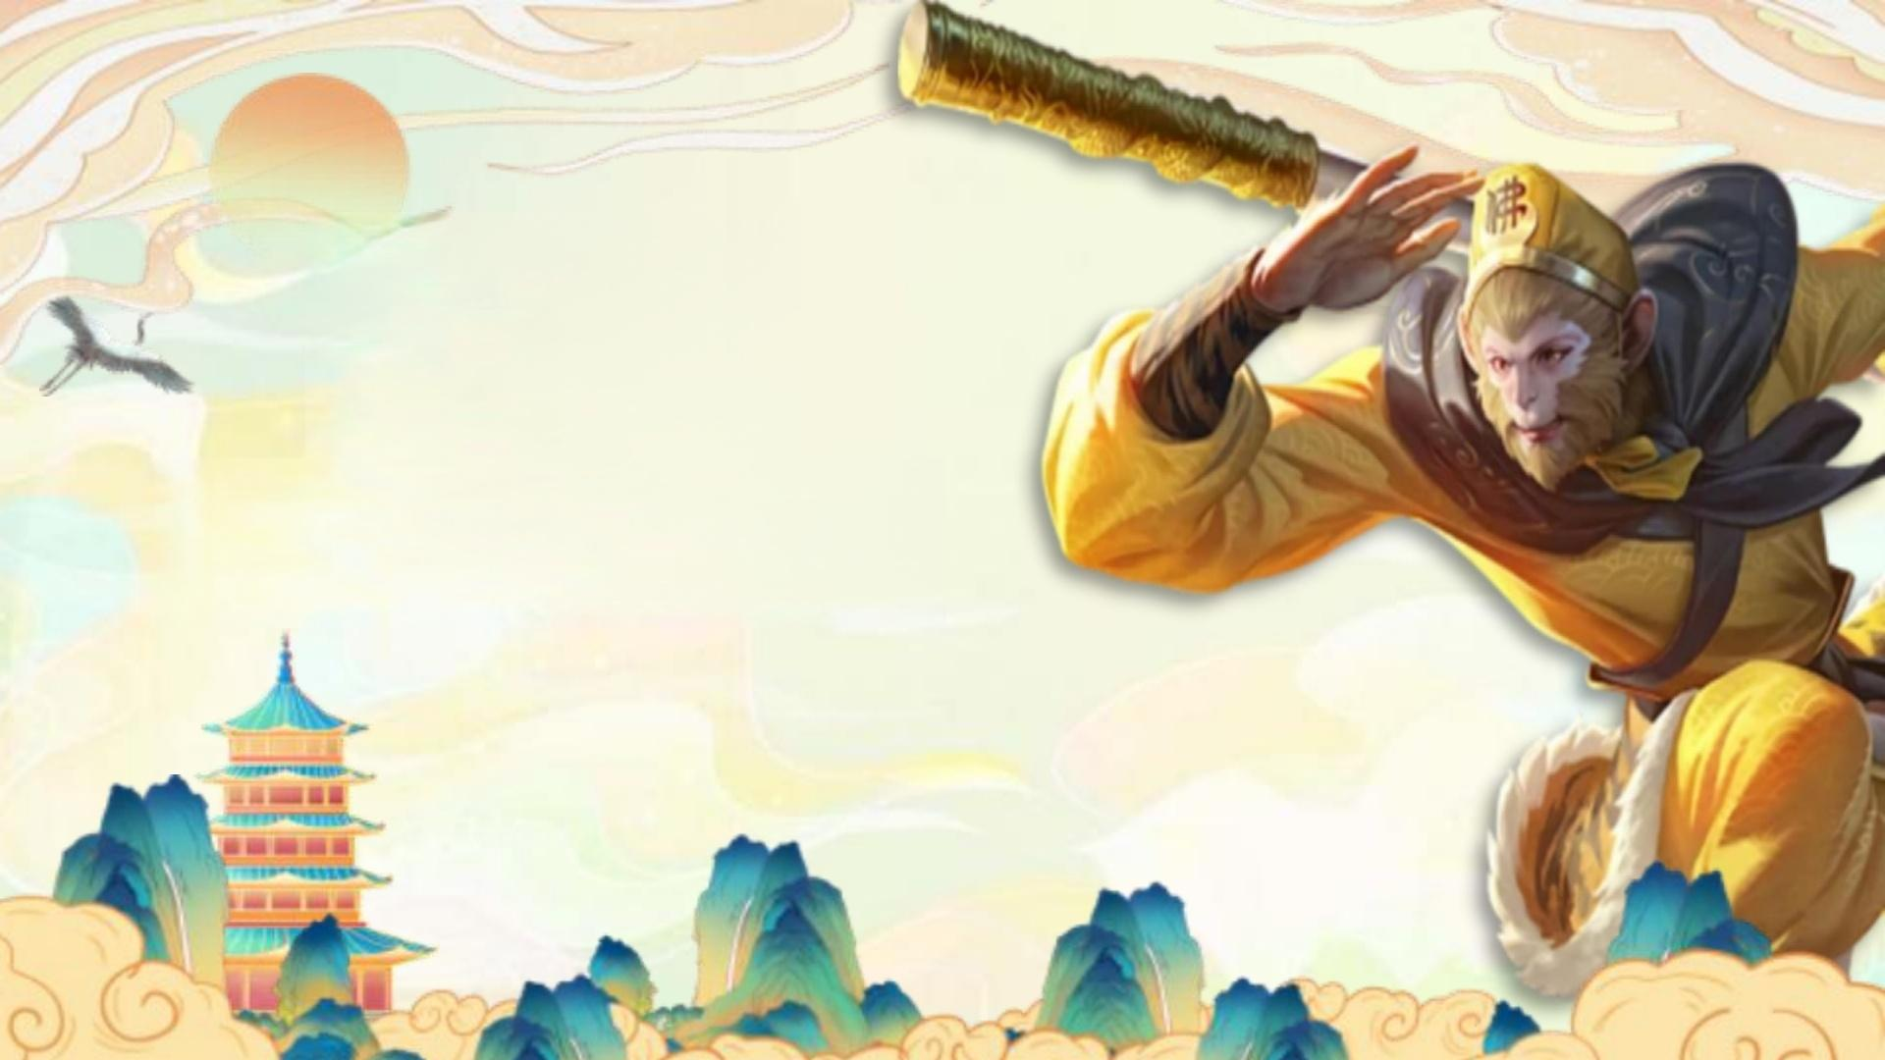
part2
Journey to the West

Slide 6
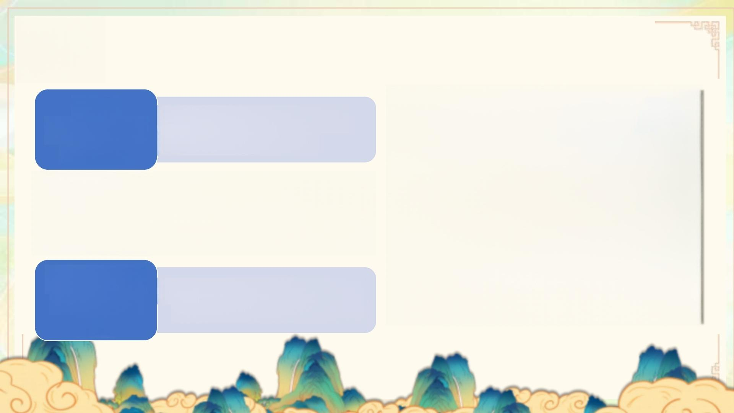
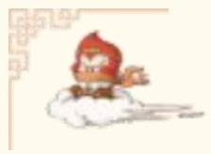
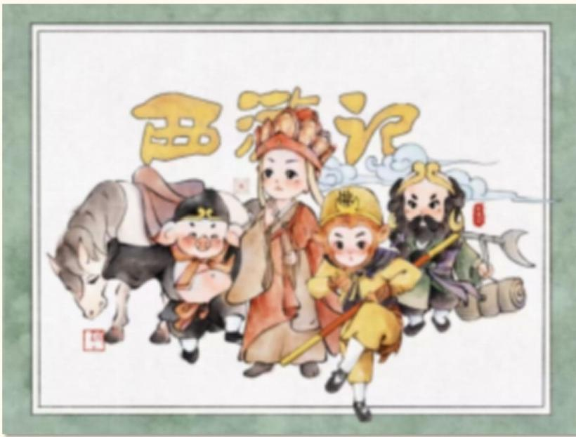

Tang
Sanzang's
Mission
·obtain sacred scriptures
·promote Buddhism
Wukong's Redemption
·protect Tang Sanzang
·a loyal guardian
Challenges
Along the
Way
·Wukong's crucial role in overcoming adversity.

Slide 7

part3
Symbolism:Rebellion &Redemption

Slide 8
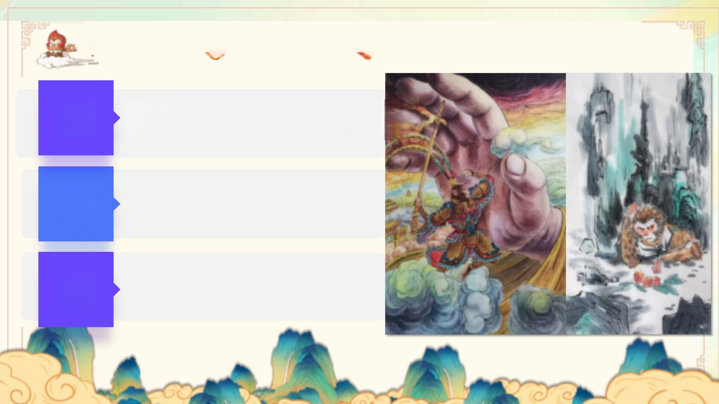
Rebellion Against Authoritu
01 Defying the Jade Emperor
₀₂ Chaos and Disorder
₀₃ The Punishment

Slide 9
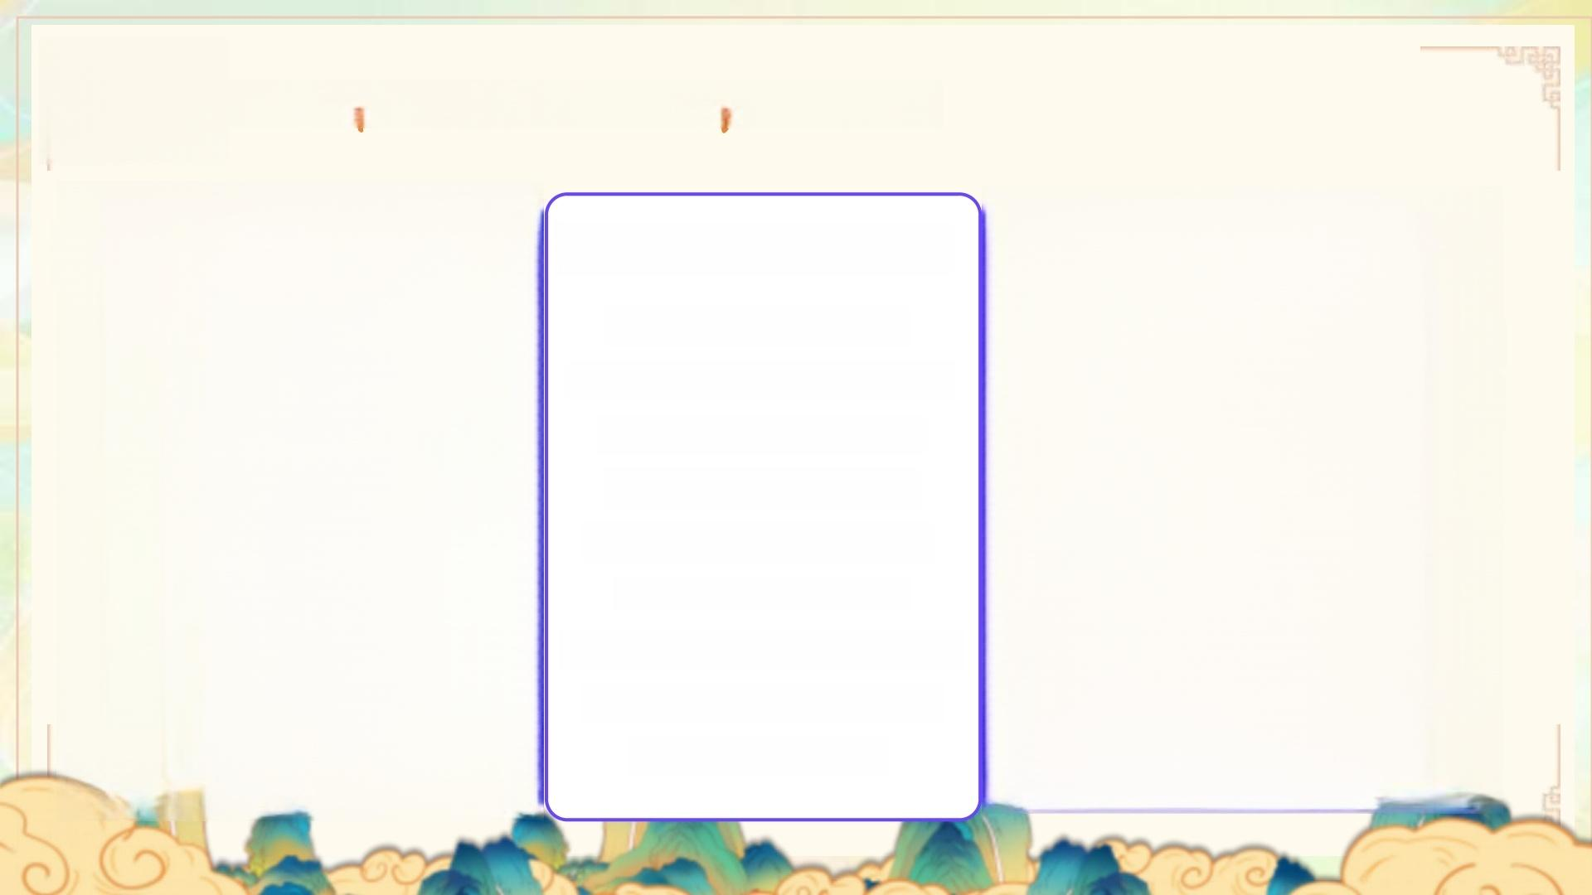
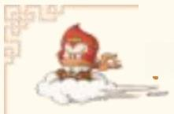


Redemption and Transformation
Protecting Tang Sanzang
Wukong's commitment to
protecting Tang Sanzang
represented his shift from
chaos to order and his
embrace of a higher purpose. His loyalty and dedication
became central to his
character.
Achieving Enlightenment
After enduring numerous trials,
Wukong achieved enlightenment
and was honored as the
"Victorious Fighting Buddha."
His journey from rebel to
enlightened being symbolizes
the potential for redemption
and spiritual evolution.
Learning Discipline
Through the journey,
Wukong learned to control
his impulsiveness and
pride,embodying the
principles of Buddhism.
This transformation
highlighted the importance of self-discipline and
spiritual growth.

Slide 10

part4
Modern Pop Culture

Slide 11
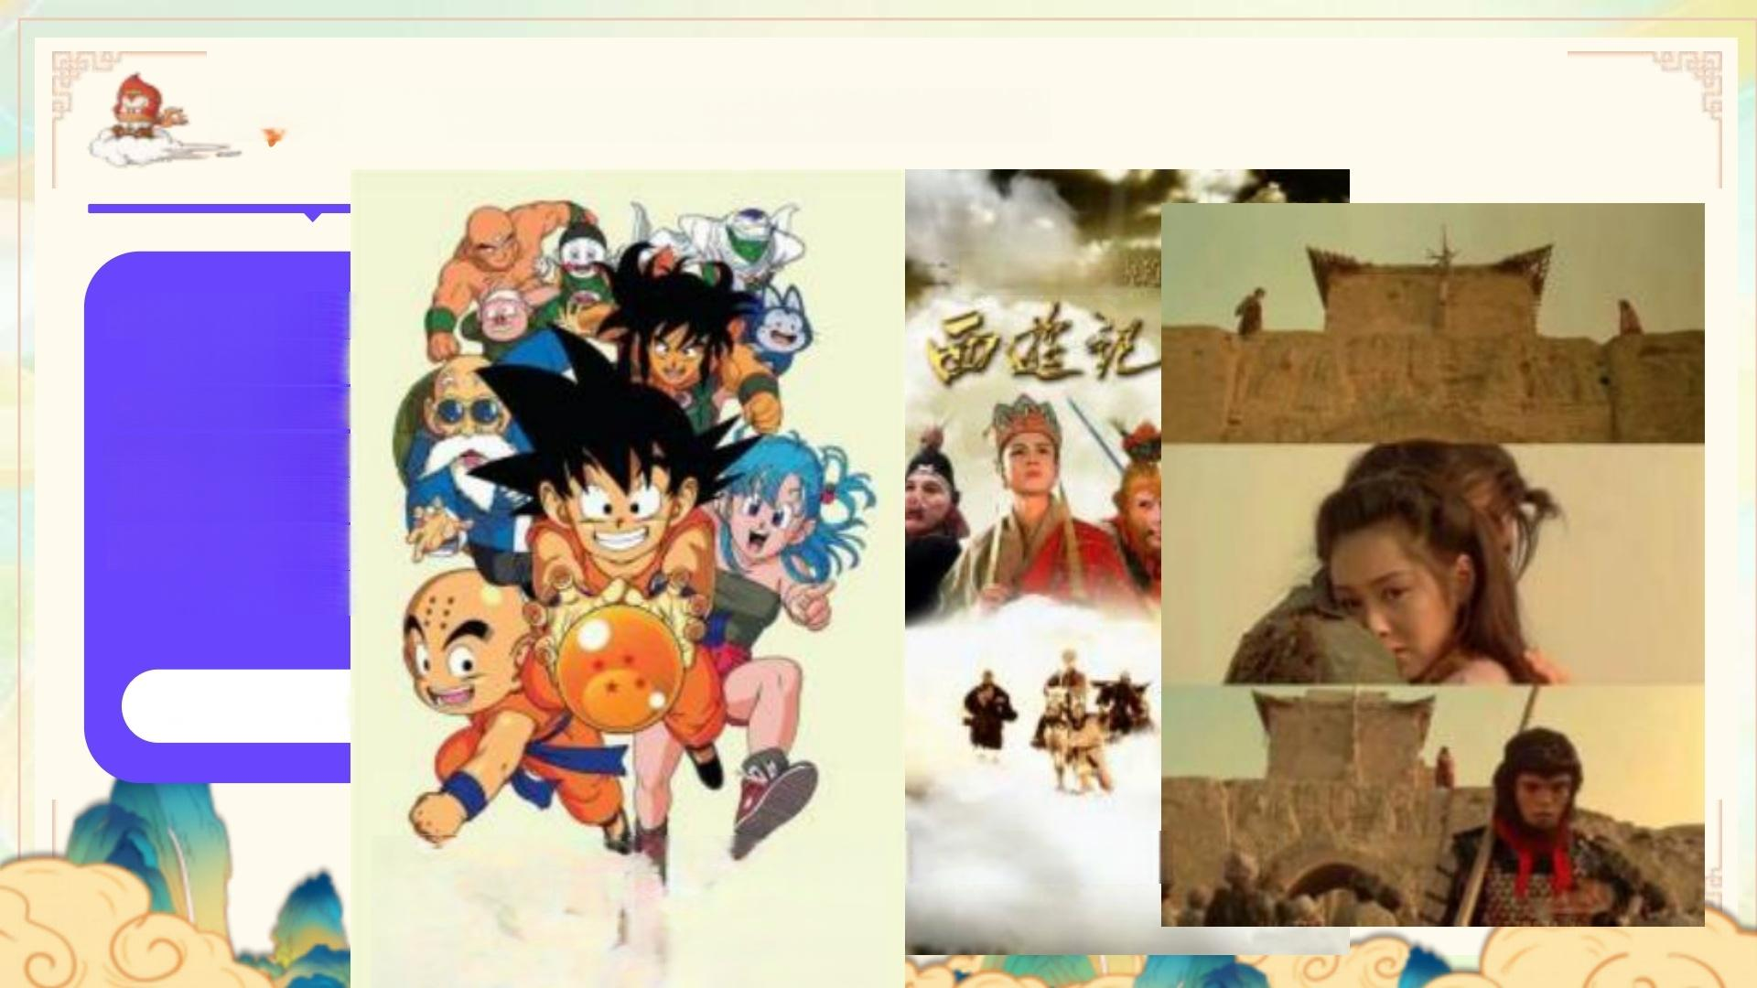
Influence on Film and Television
五集种话电
The classic 1986 T
of"Journey to
became a cultural
introducing Wukong
This version remai
classic,capturing
of the origina
Classic Adap
少小始赏还粤少华讼重动
DRAGONBAL.

Slide 12
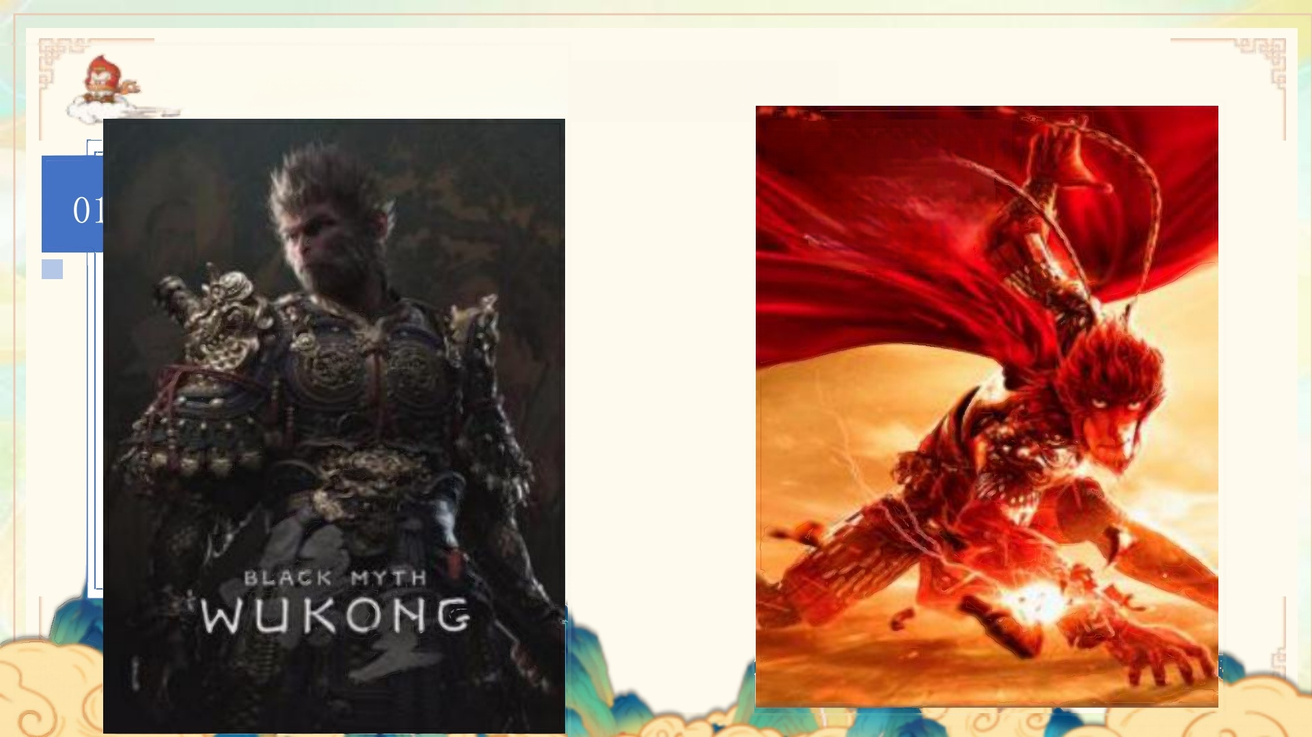
Influence on Animation and Games
MONKEY
KING
THEHERO
IS BACK

Slide 13
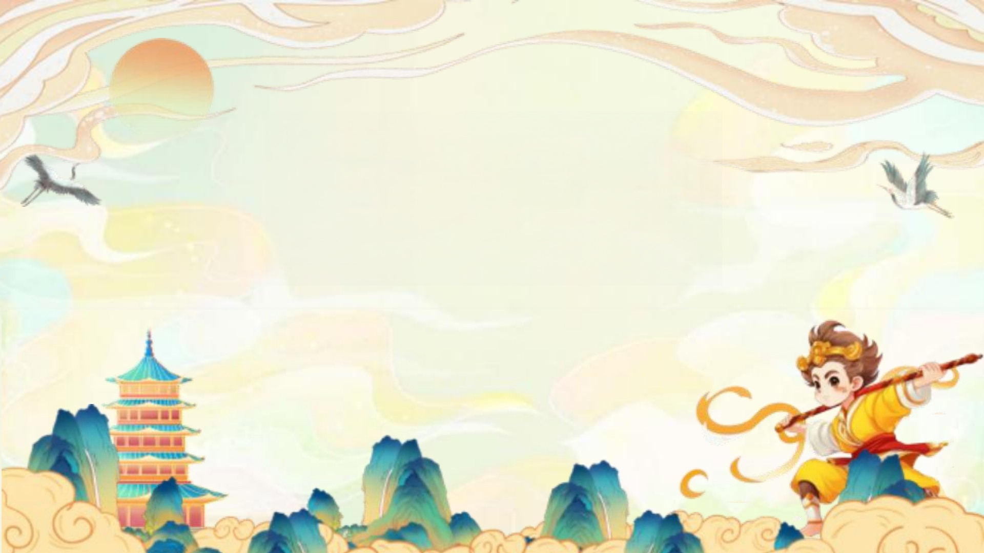
Thanks

