Slide 1
A Linguistic Theory of Translation
J.C.Catford
Wen Xiaoyi
Wei Honglang

Slide 2

Introduction
Scholar contribution
all aspects of phonetics
the theory of translation
the application of linguistic knowledge to methods of second language instruction
J.C.Catford
1917.3-2009.10
a linguist and theoretician of translation

Slide 3
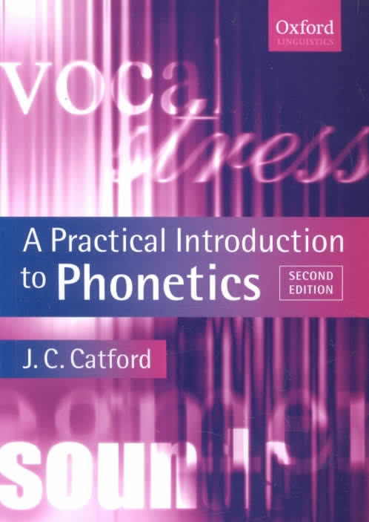
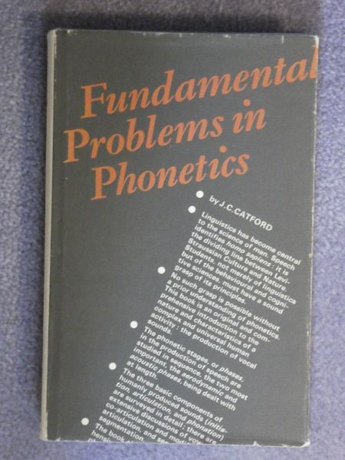
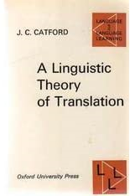

Introduction

Slide 4
Introduction
Translation
Linguistics

Slide 5

Contents
The Definition of Translation
Translation Equivalence
Translation Shifts

Slide 6
1.The Definition of Translation
Translation may be defined as follows:
the replacement of textual material in one language(SL) by equivalent textual material in another language(TL).

Slide 7
2.Translation Equivalence
Formal correspondence
A formal correspondent is any TL category (unit, class, structure, element of structure, etc. ) which can be said to occupy the same place in the economy of the TL as the given SL category occupies in the SL as nearly as possible.
Textual equivalence
A textual equivalent is any TL text or portion of text which is observed on a particular occasion to be the equivalent of a given SL text or portion of text.

Slide 8
2.Translation Equivalence
Formal correspondence
the non-specific relationship between elements in two languages
Langue
Textual equivalence
the relations that exist between elements in a specific ST and TT pair
Parole

Slide 9
3.Translation Shifts
By “shifts” we mean departures from formal correspondence in the process of going from the SL to the TL.
Two major types of “shift”: level shifts and category shifts.

Slide 10
Level shifts: a SL item at one linguistic level has a TL translation equivalent at a different level.
Eg. The rubbish is being disposed of. (有人）正在处理这些垃圾。

Slide 11
Category shifts: Category shifts are departures from formal correspondence in translation.
Structure-shifts
Class-shifts
Category shifts
Unit-shift
Intra-system shift

Slide 12
Structure-shifts:
These are among the most frequent category shifts at all ranks in translation; they occur in phonological and graphological translation as well as in total translation.
In grammar, structure-shifts can occur at all ranks.
Eg. I saw you yesterday.
我昨天看见你了。

Slide 13
Class-shifts:
A class means grouping of members of a given unit which is defined by operation in the structure of the unit next above.
Class-shift occurs when the translation equivalent of a SL item is a member of a different class from the original item.
Eg. “...and that government of the people,by the people, for the people...”
“民有、民治、民享的政府”

Slide 14
Unit-shifts:
Changes of rank or rank shift-that is departures from formal correspondence in which the translation equivalent of a unit at one rank in the SL is a unit at a different rank in the TL.
Rank: Sentence-Clause-Phrase/word group-Word-Morpheme
Eg. Surprisingly,politics is her favourite subject.
令人惊讶的是，政治课是她最喜欢的课程。

Slide 15
Intra-system shift：
The term intra-system shift occurs within a system;
In these cases where SL and TL possess systems which approximately correspond formally as to their constitution, but when translation involves selection of a non-corresponding term in the TL system.
Eg. How are you?
你好吗？/你们好吗？

Slide 16
Thank you!

