Slide 1

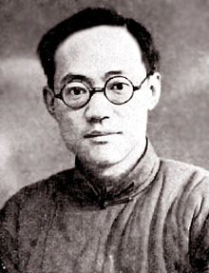
Ba Jin
1904-2005
By Philip Harding

Slide 2
Early Life
His real name is 李尧棠, (Li Yao Tang) Ba Jin is just a pseudonym he wrote under. He was born on November 25, 1904 in Chengdu, Sichuan.
Li Yao Tang’s childhood and upbringing is much like his story, “Family”. He lived in a large estate. His parents died when he was young, so most of his upbringing was arranged by his grandfather, who was the domineering head of the house, and it was not until his grandfather’s death that Ba Jin was free to start pursuing his own goals and ambitions.
When he was sixteen he enrolled in the Chengdu Foreign Language Specialist School with his older brother. There he began to broaden his horizons and started writing in the school’s literary journal, “ Crescent”, for which he wrote some free verse poetry. He also joined an anarchist group called “The Equality Society”.

Slide 3
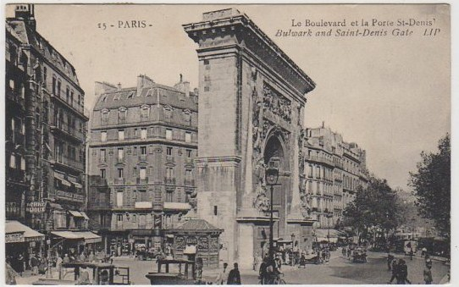
College and Studying Abroad
In the years following his studies in Chengdu, he first moved to Shanghai, and then to Nanjing to study at the Southeast University (东南大学).
While studying in Nanjing he continued to support the Equalist Society and actively voiced his opinions in writing as well as publicly demonstrating in strikes, etc.
His first and foremost reason for leaving home to study was not for education, although he did study. The primary reason was to get away from his controlling family.
In 1927 he found an opportunity to study abroad, which led him to Paris, France . Here he continued his correspondence with the anarchist movement, and branched to international correspondence to others in America. His living circumstances and a longing for home brought him back to China one year later in 1928.
Paris 1927

Slide 4
Settling down in Shanghai, or not.
Upon returning to Shanghai, he dove into his writing career, writing novels, short stories, as well as translating foreign works into Chinese.
It was at this time that he wrote his most influential novel “Family” (家) which became part of a trilogy called “The Torrents Trilogy” also including “Spring” and “Autumn”.
By 1934, some of his writing received some negative attention and was blacklisted, which forced him to flee to Japan, using a fake name. He returned to China two years later, when things had cooled down.
From 1937-1941 he moved a lot, trying to escape the conflict of the war with Japan. He slowly made his way back to his ancestral home in Chengdu. There he saw the final results of his family’s traditions fade into history.
When the war ended he moved back to Shanghai, where he continued writing.

Slide 5
Family
The novel “Family” is a story of a broken home. The family relationship is the complete opposite of what a family should be like. It makes perfectly clear the injustices of the time, and the senile traditions of the Kao family.
There are 3 main protagonists in the story. They are three brothers, Cheuh Hsin, Cheuh Hui, and Cheuh Min. They each have their own ambitions and love interests, however each is muddled up and ruined by the elders of the family, particularly the grandfather, who is the head of the house, and has the final say on everything.
The oldest brother, Cheuh Hsin, (whom I think perfectly represents Ba Jin) is very good academically, and has plans to study abroad. He also has his heart set on marrying Mei Mei. His hopes are shattered, however, when his father arranges for him to marry a complete stranger, and also his dreams of continuing his education when his father sends him to work at a local, family-owned business, to support his new family.

Slide 6
Family continued
Cheuh Hui loves Ming Feng, a servant in their house. He feels strongly about going forward with their relationship but he can’t bring himself to tell his relatives about it. Without his knowledge, the grandfather arranges for her to become a concubine to one of the grandpa’s friends. She is so dejected and frightened by the prospect, that she drowns herself. This sends Cheuh Hui into severe depression.
Chueh Min is perhaps the only character that may achieve his own ambition. He loves Chin, a cousin who has similar goals for her education. But they are equally afraid let anyone find out about any of this.
The final blow on the characters is struck when the grandfather dies. There is a tradition in this part of china, that when a corpse is in a house, and a woman is giving birth, it causes the corpse to be desecrated and spurt blood or something like that. So, Cheuh Hsin’s wife is giving birth, and in order to keep with tradition, she is forced to go somewhere else to have her baby, in the dead of winter, all to protect the dead grandpa and she dies in childbirth.

Slide 7
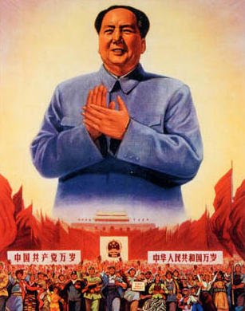
Life Under Communist Rule
When the communist party assumed power in 1949, Ba Jin was hopeful for a better future. He believed communism could be the answer to the problems China was facing, However he soon began to see that life did not improve under the communist regime.
In the 1950’s he still continued to write, but was compelled to write under the communist theme, which he conformed to. He stopped writing fiction, and strictly wrote nonfiction.
He was also forced to “edit” his past and deny all connection to the Anarchist Movement. In 1961 he said 'I am not satisfied either by the quantity or quality of my works.‘ The attention given to him, proved to be a curse, not a blessing, when he was appointed him to be vice-chairman of the official China Writers' Association.
He regretted his forced actions and when allowed to, he began expressing his true opinions and criticized the government. He even wrote a letter of support to the students of the 1989 Tiananmen protests on May 18. (before the massacre had started.)

Slide 8
The Price of Honesty
During the Cultural Revolution (1966-76). Terror was unleashed on all non-supporters of Mao Zedong. The Red Guards attacked many writers, including Ba Jin. They made a big fuss about his anarchist past. They saw his independent thinking was dangerous, and claimed he was being a traitor to his country.
For a while he was imprisoned, and was also forced to work in a Labor camp. Finally, on June 20, 1968, Ba Jin was dragged to the People's Stadium of Shanghai. It was a televised humiliating spectacle with him kneeling on broken glass, with the shouts from the crowd, accusing him of being a traitor and enemy of Mao Zedong. At the end of the demonstration Ba Jin shouted, “You have your thoughts and I have mine. This is the fact and you can't change it even if you kill me.”

Slide 9
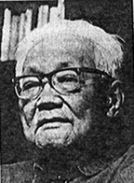
His Own Family and Old Age
He married Xiao Shan in 1944
They had two children, A daughter and a son, both of whom had the freedom filled upbringing he wanted himself to have. They each choose their own careers and their own spouses. His daughter is now a leading member of the editorial department of a big Chinese literary magazine while his son is a rising novelist.
Xiao Shan died in 1973 from cancer, which affected him deeply. He said, "When I lose my ability to work, I hope there will be several copies of fictions translated by Xiao Shan on my sickbed. After I close my eyes, please let my ashes be mixed with hers."
In 1983 he contracted Parkinson’s disease, which in his final years left him mute and unable to walk. He spent most of that time in a hospital in Shanghai, where he died in 2005 at the age of 100.

Slide 10
Inspiration
Emma Goldman, an anarchist writer, who started a correspondence with him which lasted for many years. He referred to her as his “spiritual mother.”
He chose his pen name from the Chinese transliterations of Ba in Bakunin (Mikhail), and of the last syllable of the name Kropotkin (Pyotr), two Russian anarchist writers that he admired.
It was during this time in France that he heard of two Italian men, Ferdinando Sacco and Bartolomeo Vanzetti, who were in prison, and members of the anarchist movement. He was touched by their story and the details of their imprisonment. He wrote to them, and kept correspondence with them until they were executed. In memory of them he wrote a short story called “The Electric Chair” (电椅) .

