Slide 1
Liquor Culture in China
by Liu Zhuofan

Slide 2
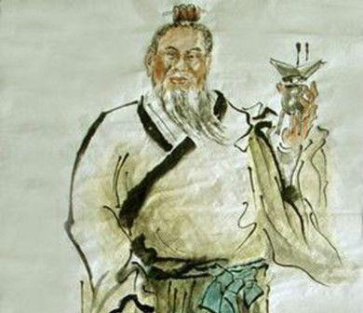
Origin
Yellow Emperor era and Xia-Shang-Zhou dynasties
Baishui, Shaanxi / Ruyang, Henan
何以解忧？
唯有杜康。
——《短歌行》曹操
What can relieve me of this sorrow?
Here is only the famous Dukang wine.
——Translation by Wu Fusheng
Du Kang

Slide 3
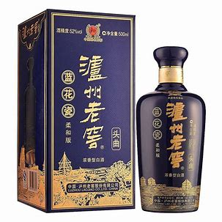
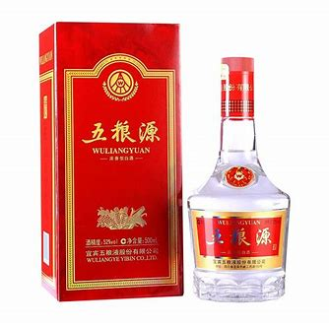
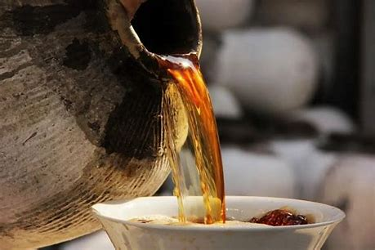
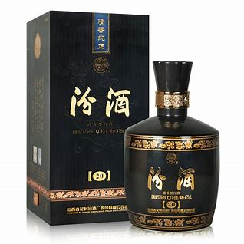
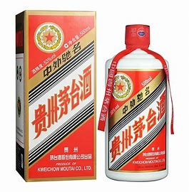
Classification
Fermented wine: Yellow rice wine
Producing techniques
E.g. Shaoxing Wine
Distilled liquor: Liquor and Spirits (Baijiu)
Strong aroma: Wuliangye, Luzhou Laojiao
Light aroma: Fenjiu
Sauce aroma: Kweichow Moutai
"prominent sauce aroma, elegant and delicate flavor, long aftertaste, and lasting fragrance in an empty cup"
…

Slide 4
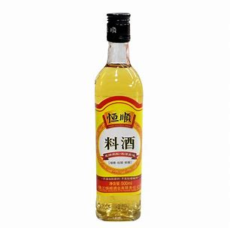
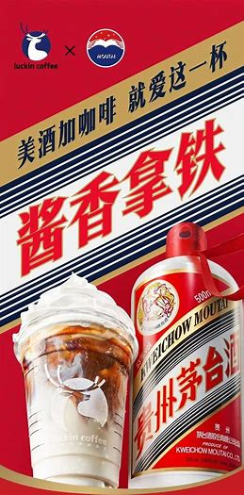
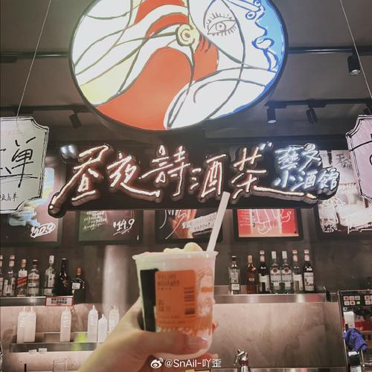
Application
1. Ingredient（dishes/beverages）
Cooking wine
Liquor-added coffee & tea

Slide 5
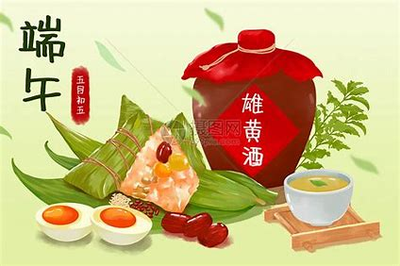
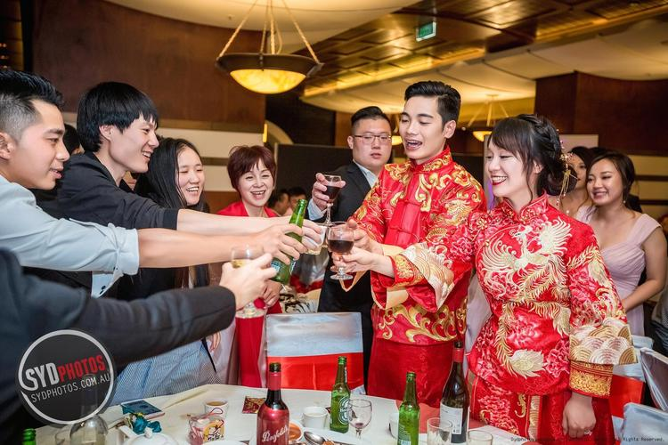
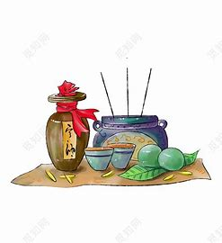
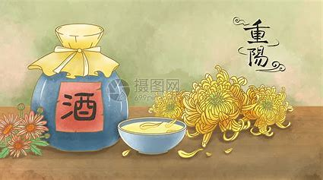
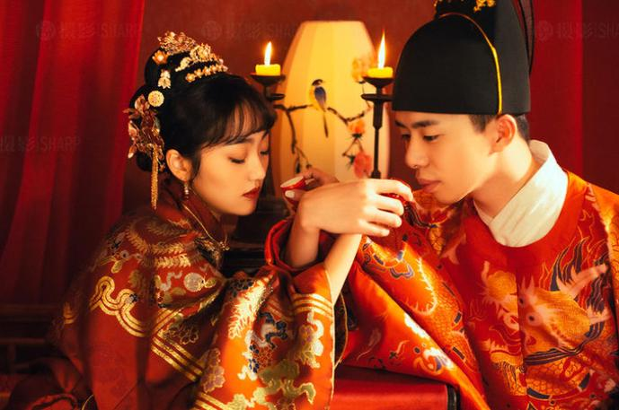
Application
2. Ceremonies & Festivals
Realgar wine in the Dragon Boat Festival;
Chrysanthemum wine in the Double Ninth Festival
Worship heaven and earth,
God, ancestors…
Traditional wedding

Slide 6
Application
3. Literature
An arbor of flowers and a kettle of wine:
Alas! In the bowers no companion is mine.
Then the moon sheds her rays on my goblet and me,
And my shadow betrays we’re a party of three!
—Translated by Herbert A. Giles
花间一壶酒，独酌无相亲。
举杯邀明月，对影成三人。
——《月下独酌》李白
明月几时有？把酒问青天。
——《水调歌头》苏轼
How long will the full moon appear？
Wine cup in hand，I ask the sky.
—Translated by Xu Yuanchong

Slide 7
Application
4. Social interaction
Farewell wine: marking the end of a relationship
Reception wine: bearing the pleasure of reunion

Slide 8
Negative influence
1. Damage to health and life
Diseases related to excessive drinking
Accidents caused by drunk driving
Alcohol-induced violence
…

Slide 9
Negative influence
2. Outdated opinions/customs at liquor table
Urge others to drink
Force others to drink beyond their capacity
Drinking competition
Discrimination against non-drinkers
…

Slide 10
Conclusion
The liquor culture in China retains some traditions but is also embracing innovation. As we honor the rich history and positive aspects of liquor, let's also be mindful of its potential negative impacts. It's about taking the essence and discarding the dregs, promoting a balanced and responsible attitude towards liquor consumption.

