Slide 1
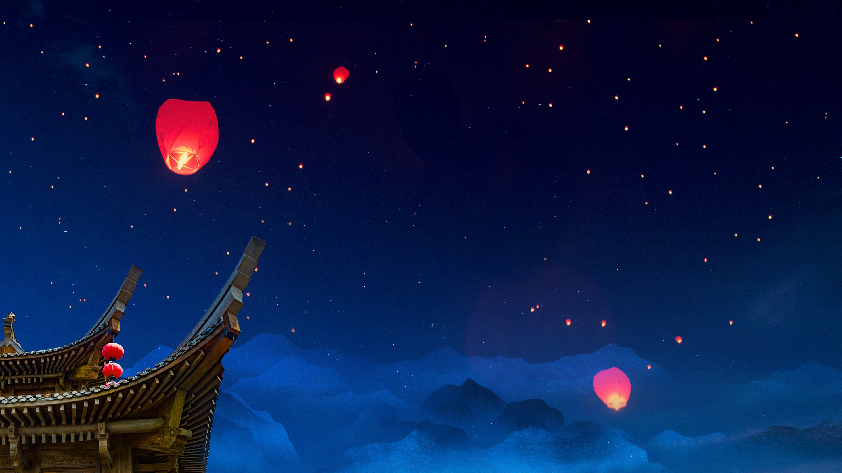

Zhongyuan
Festival
Speaker：蒋克雨
Date：2025.11.6

Slide 2

Contents
Main Traditional Customs
1
Origins
2
3
Compare to Halloween
Cultural Inheritance and Dissemination
4

Slide 3

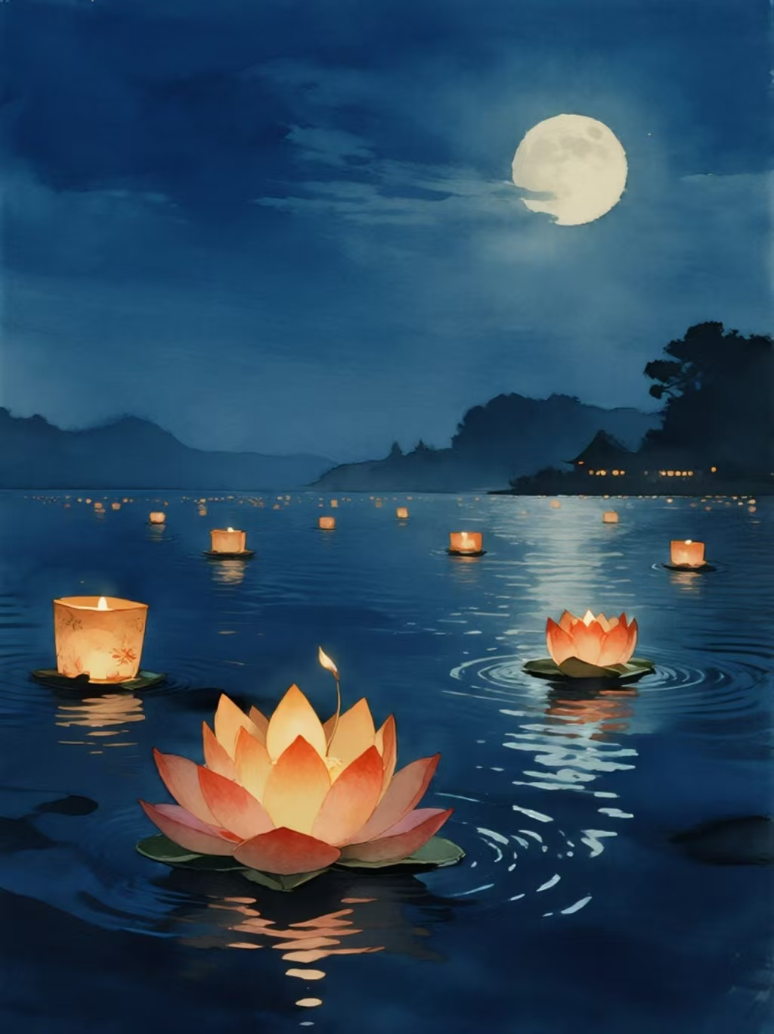
Image
Time: 14th or 15th day of the seventh lunar month
Names: Ullambana Festival
The Ghost Festival
The Festival of the dead
The Seventh Month Half Festival
俗称“七月半”

Slide 4
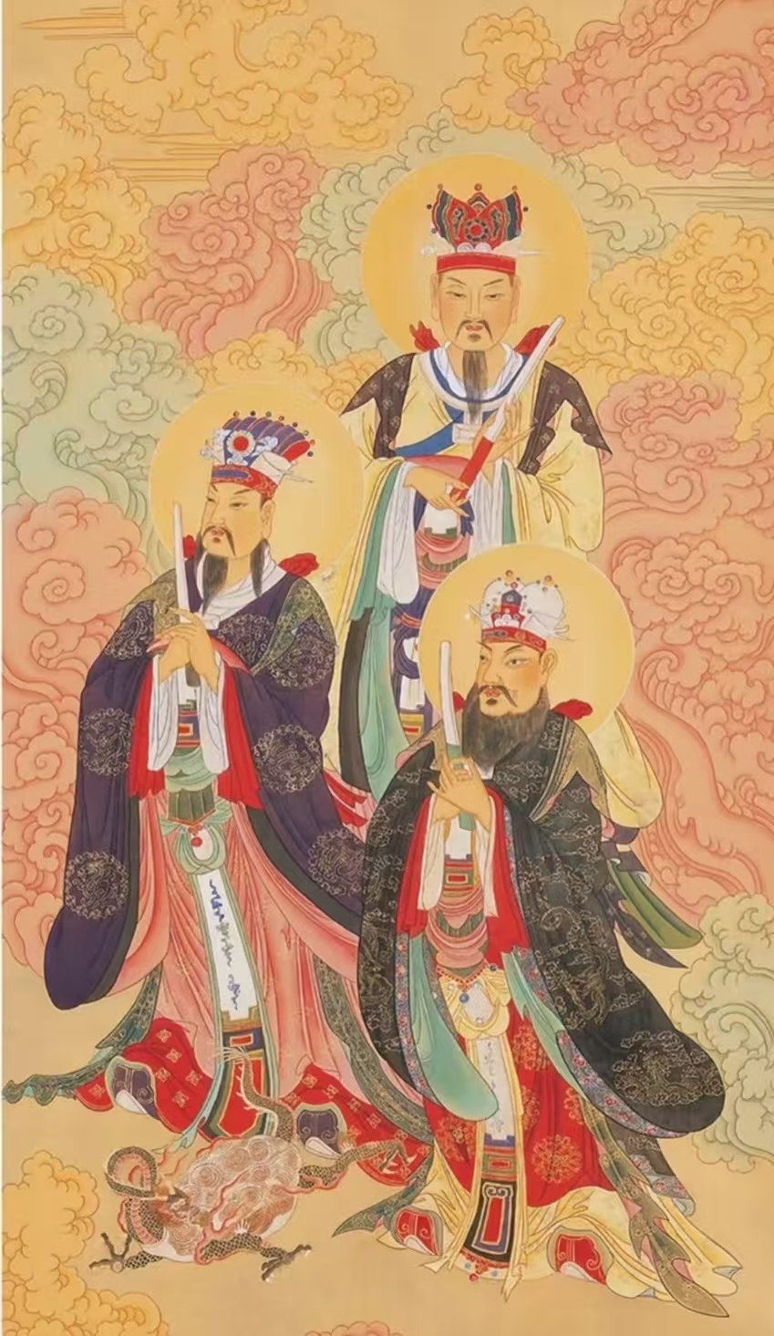
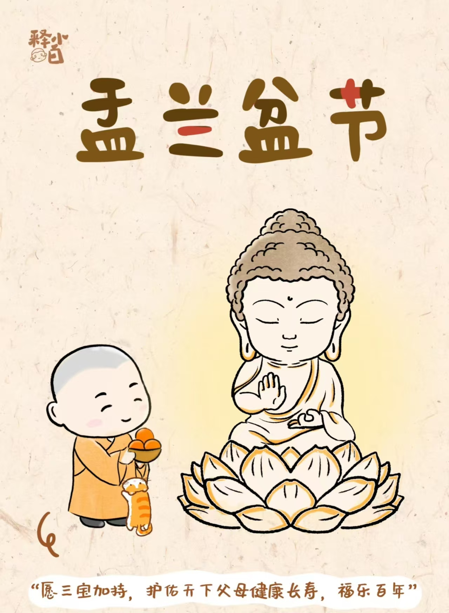
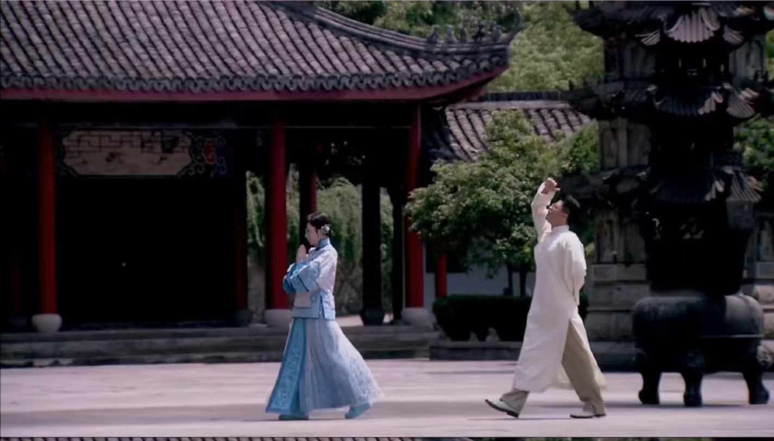
In Taoism
It’s the day when the “Earth Official” pardons sins
In Buddhism
It’s connected to the “Ullambana Assembly”
In Confucianism
It carries the idea of “respecting the deceased and remembering ancestors”

Slide 5
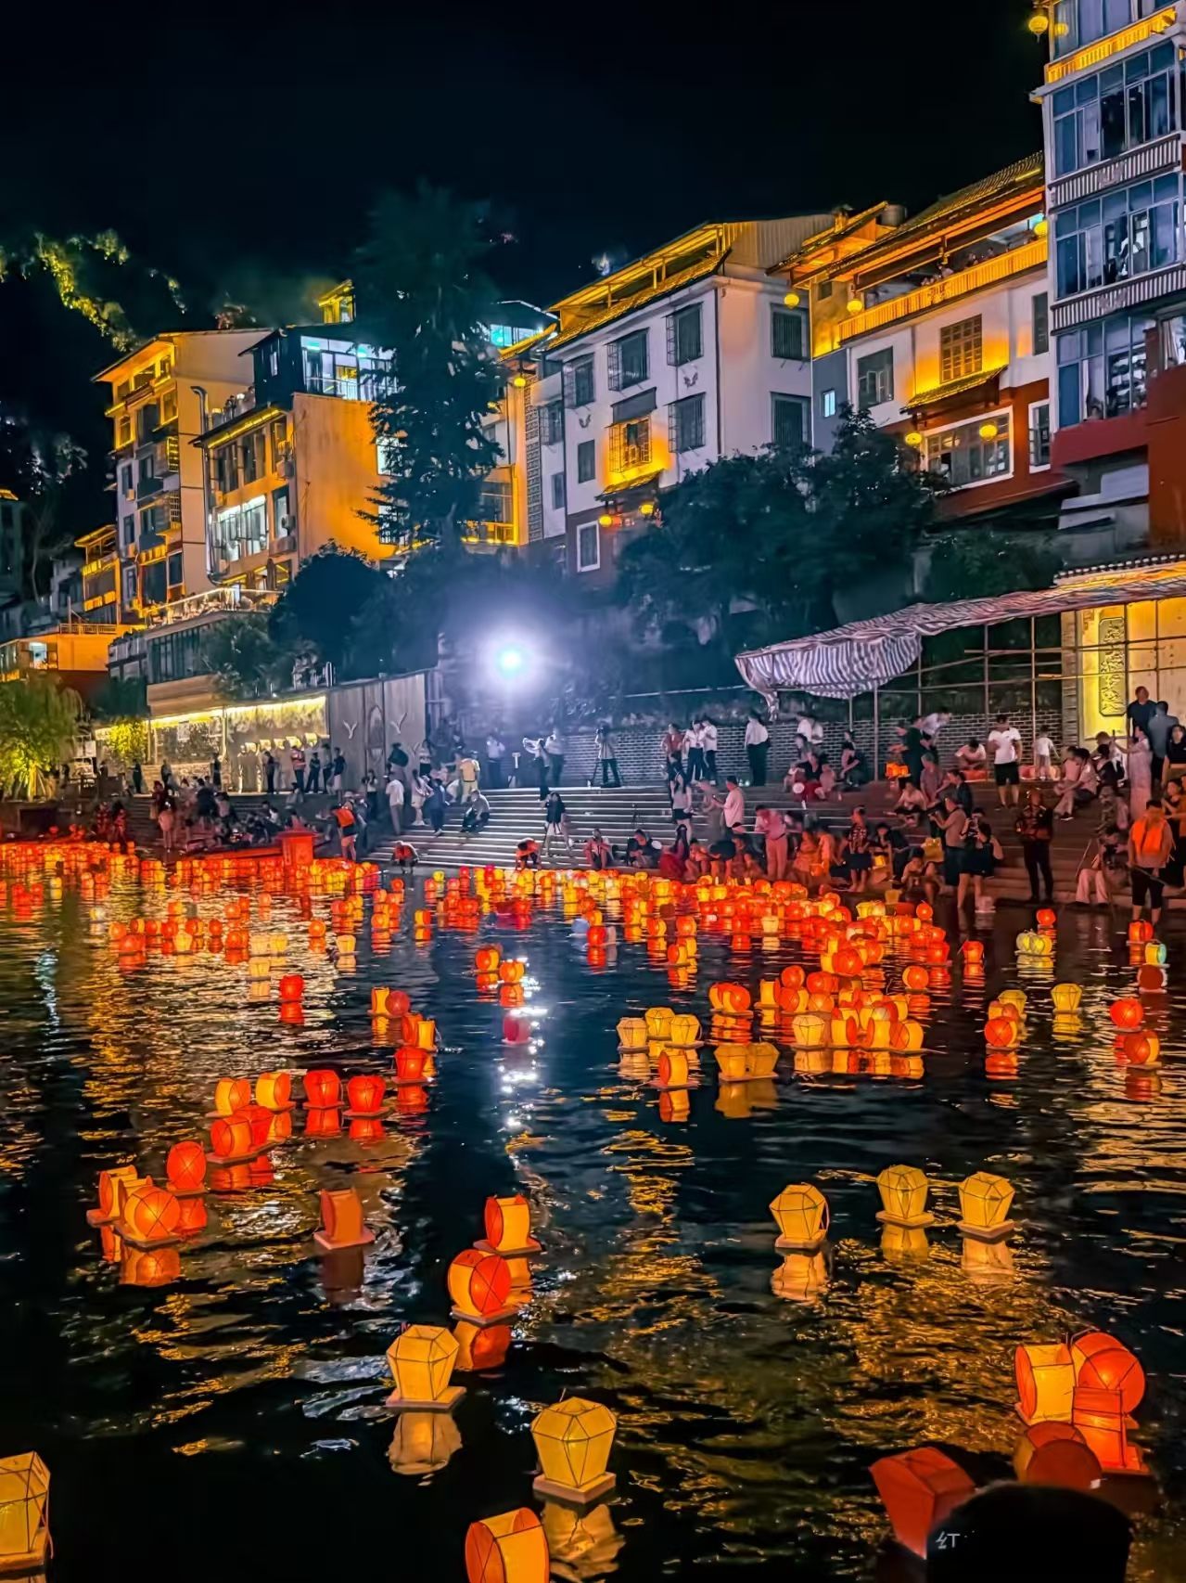
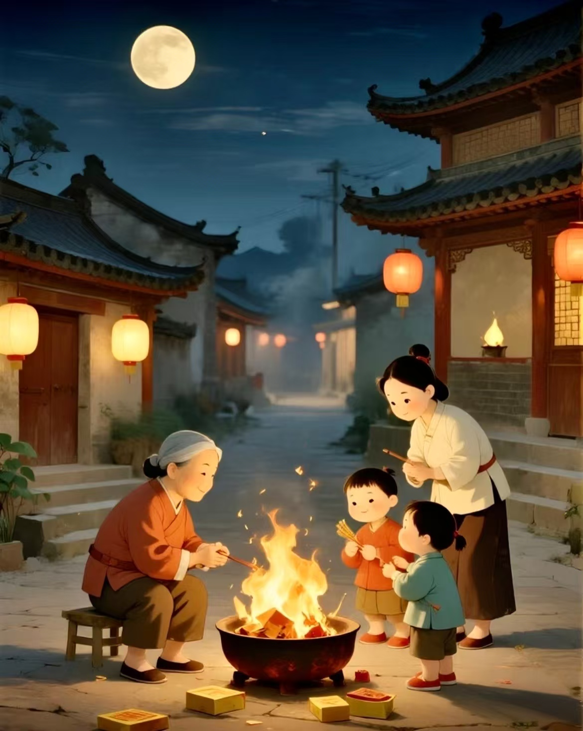
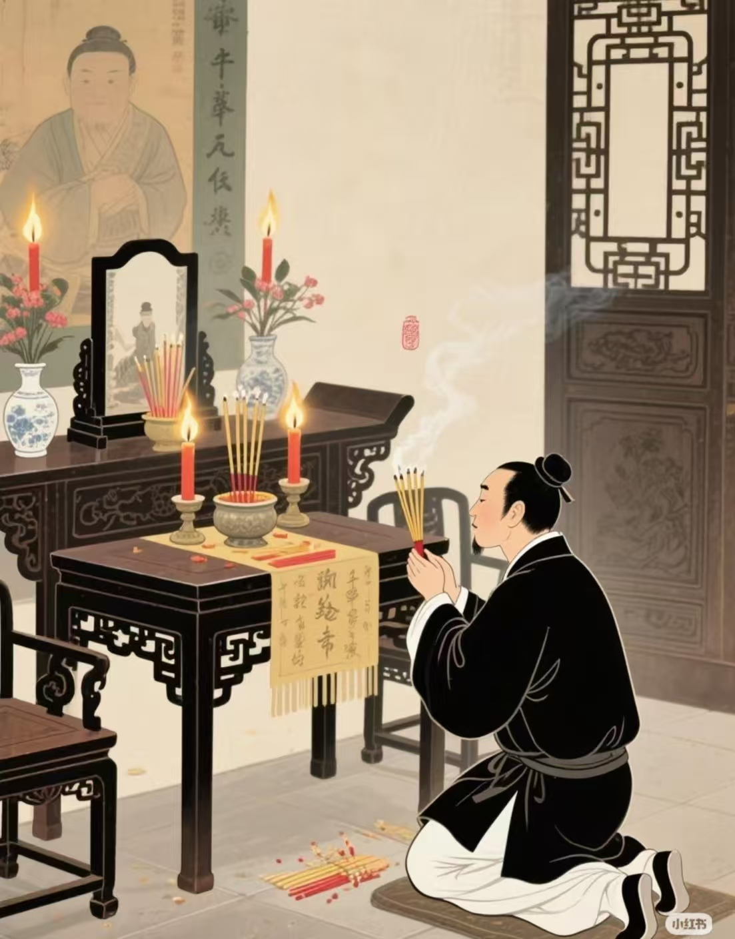
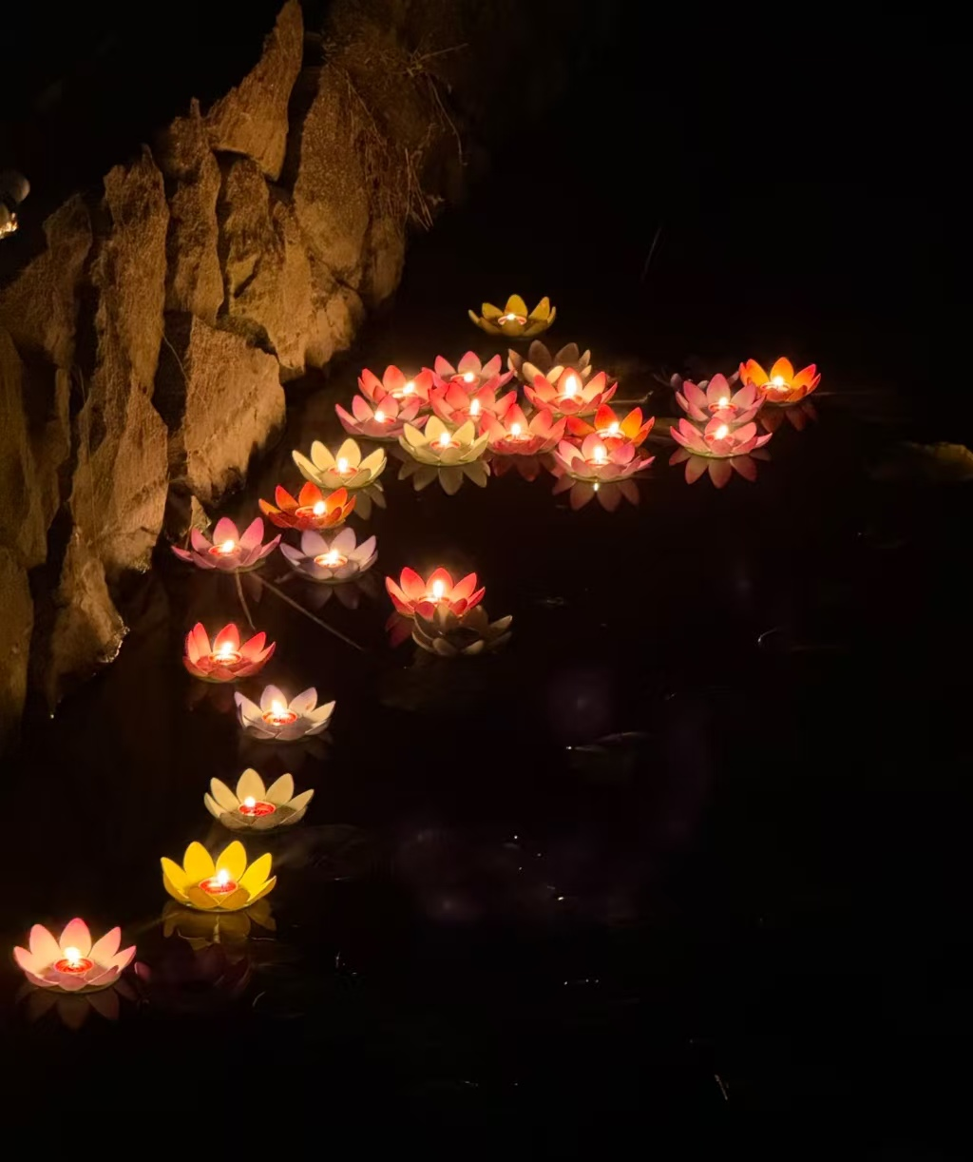
Traditional Customs
Burning Paper Money
Floating river lanterns
Worshiping ancestors

Slide 6
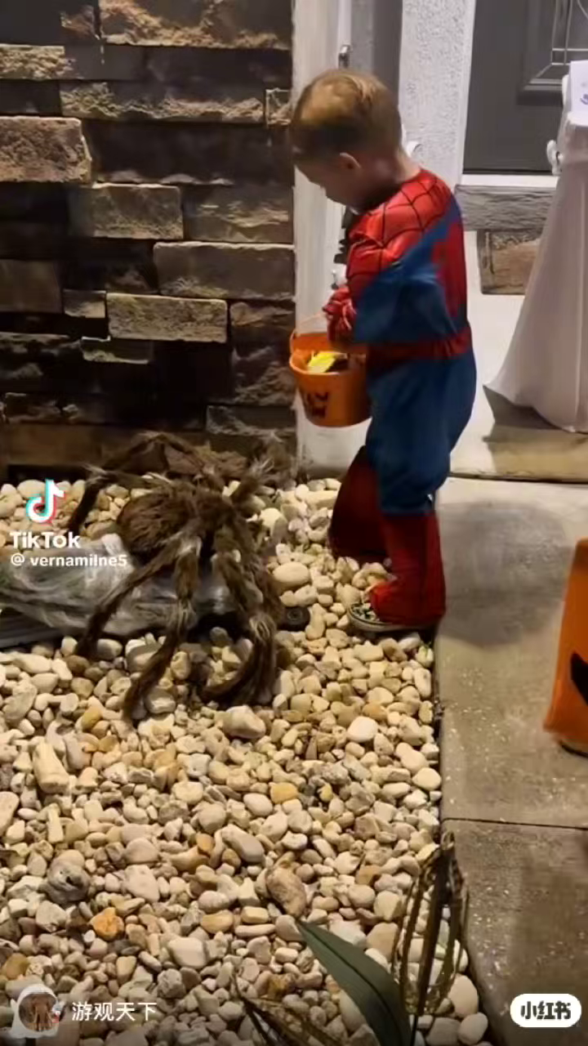
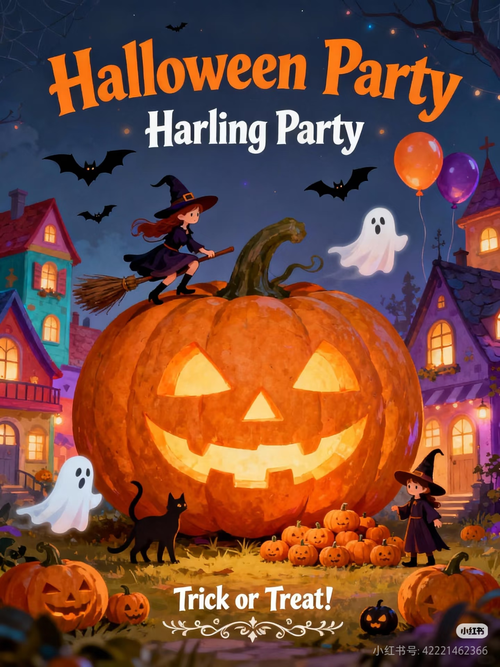
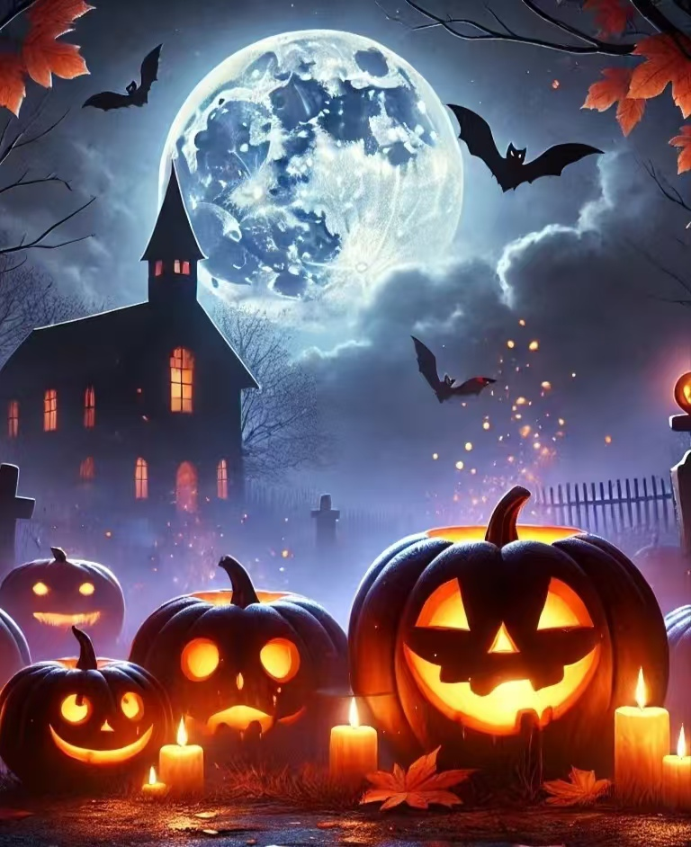
Halloween

Slide 7
Zhongyuan Festival & Halloween
Zhongyuan Festival
1
It carries a solemn and respectful atmosphere, serving to commemorate ancestors and convey remembrance.
Halloween
2
This festival, however, is lighthearted and entertaining, filled with fun as both adults and children engage in cosplay and carnival celebrations.

Slide 8
As Ghost Festival
Zhongyuan Festival:
不做亏心事，不怕鬼敲门
“No shame, no fear of ghosts”
Halloween:
只要心里有鬼，每天都是万圣节
If there’s a “ghost” in your heart, every day is Halloween.

Slide 9
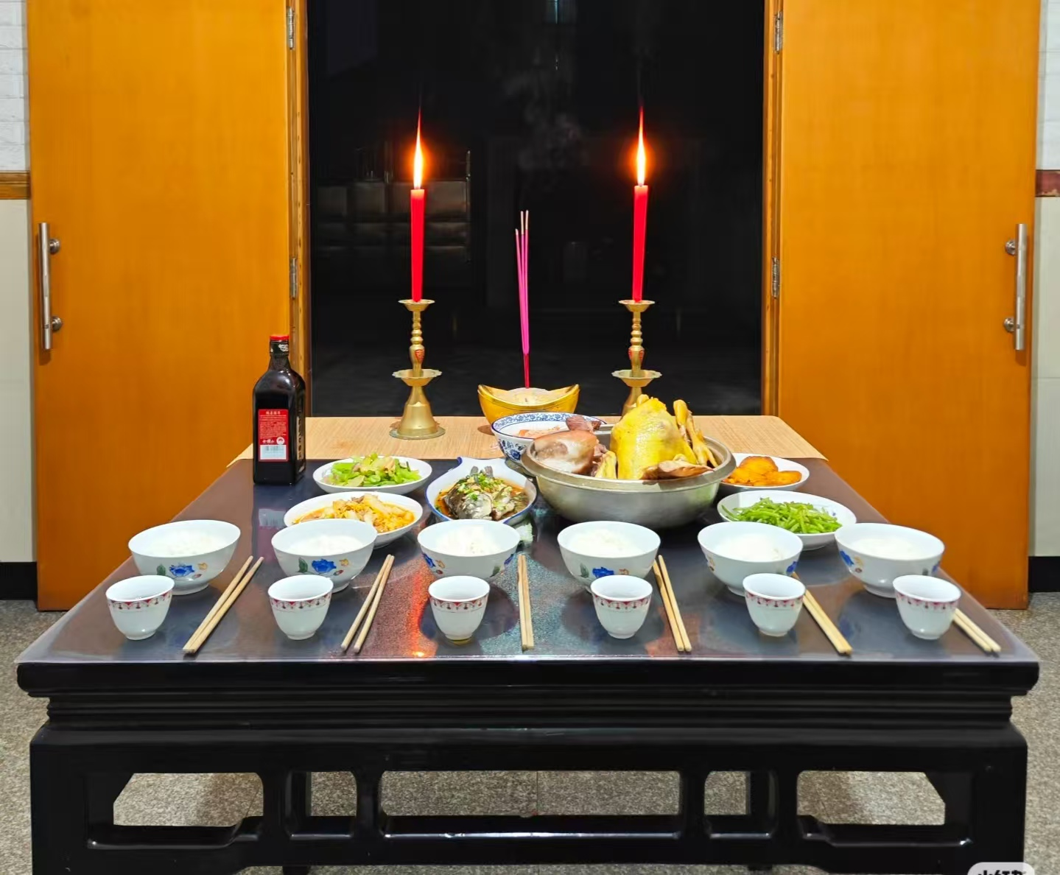
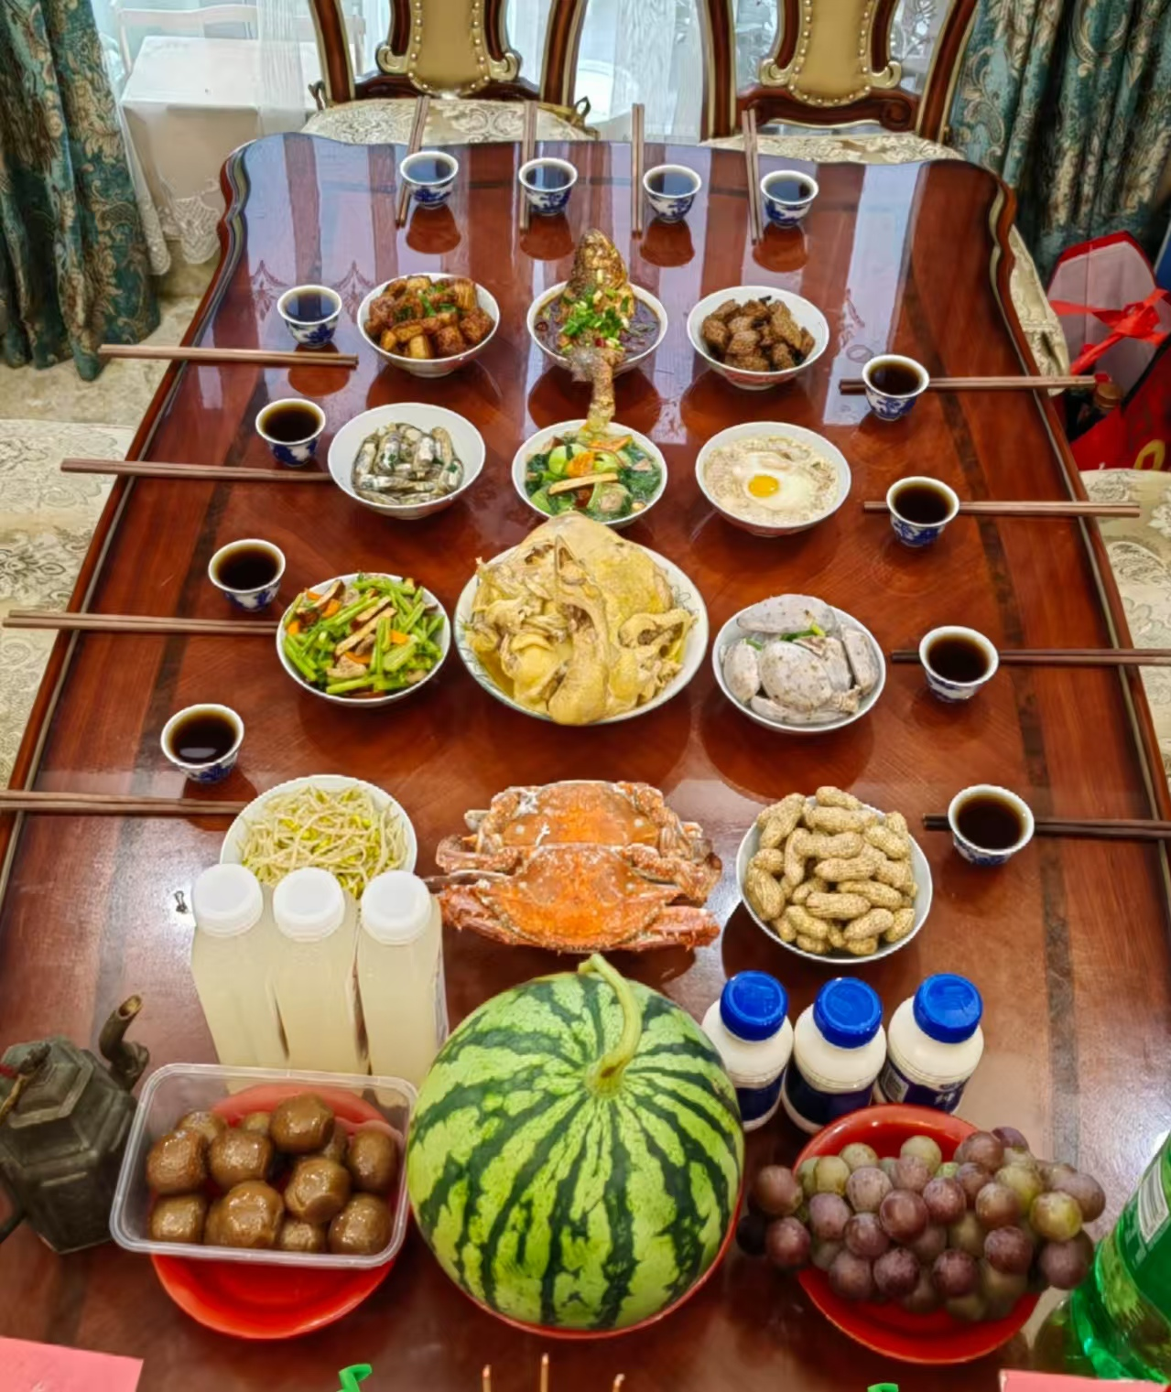
Inheritance and Dissemination
In Zhejiang and Fujian provinces, there is a custom called “shishi”(offering food to the hungry ghost).
1
In the Qidong area of Shandong province, the ancient custom of the Zhongyuan Festival is to hold a melon festival.
2

Slide 10
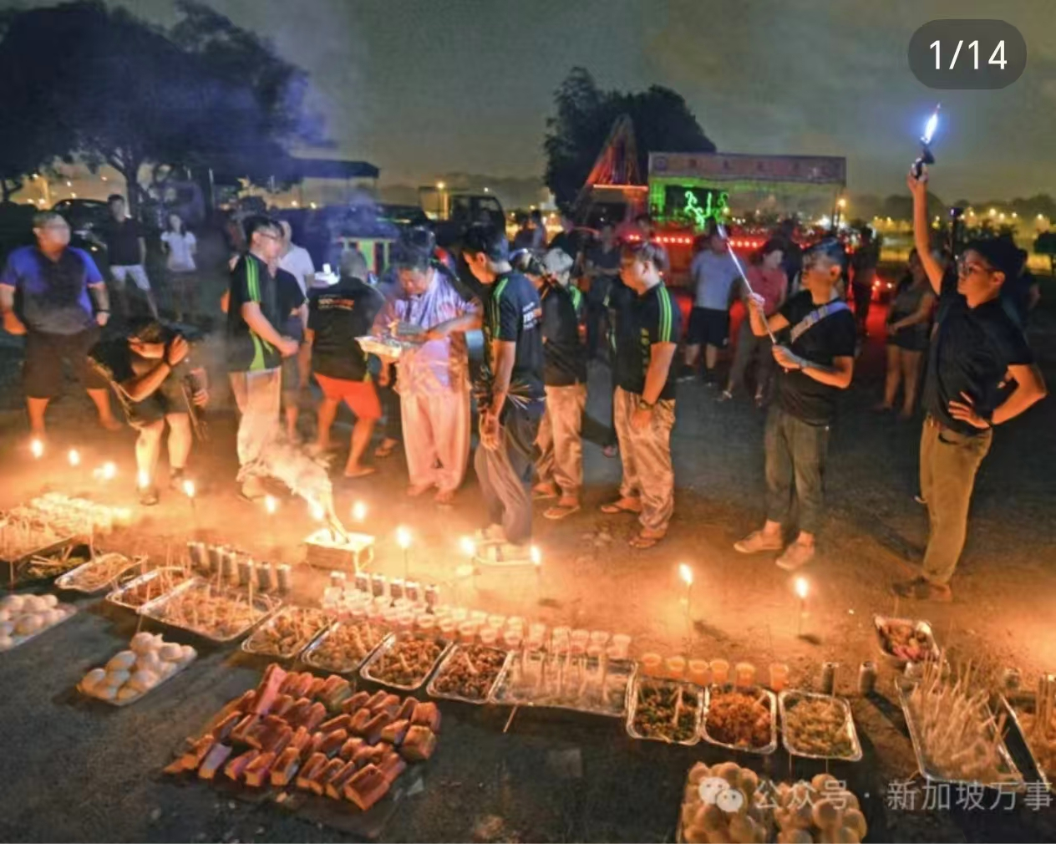
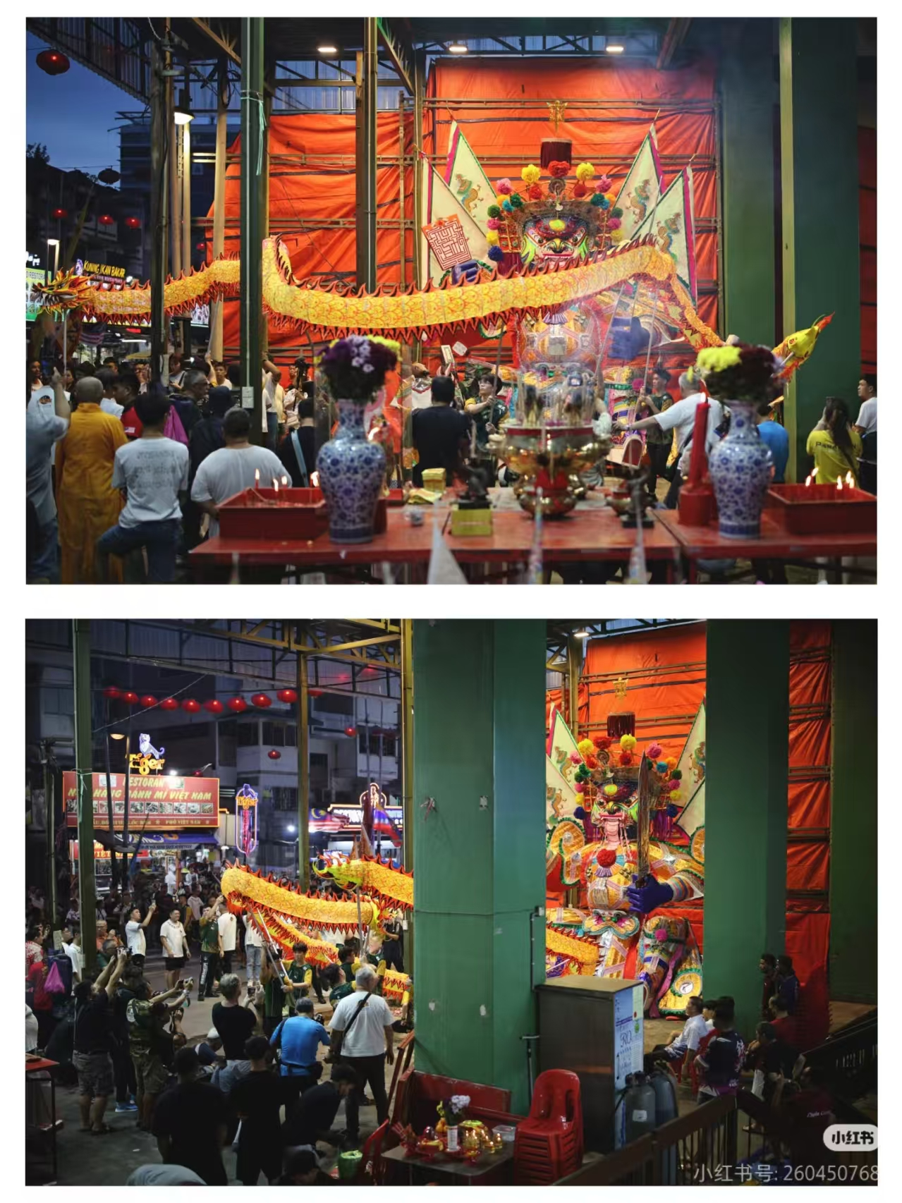
In Singapore
the “July Song Stage” is a performance activity that entertains both people and ghosts.
In Malaysia
local Chinese hold Zhongyuan Pudu activities in temples, such as worshiping the Pudu Gong (a deity related to the festival) and holding song stage performances.

Slide 11
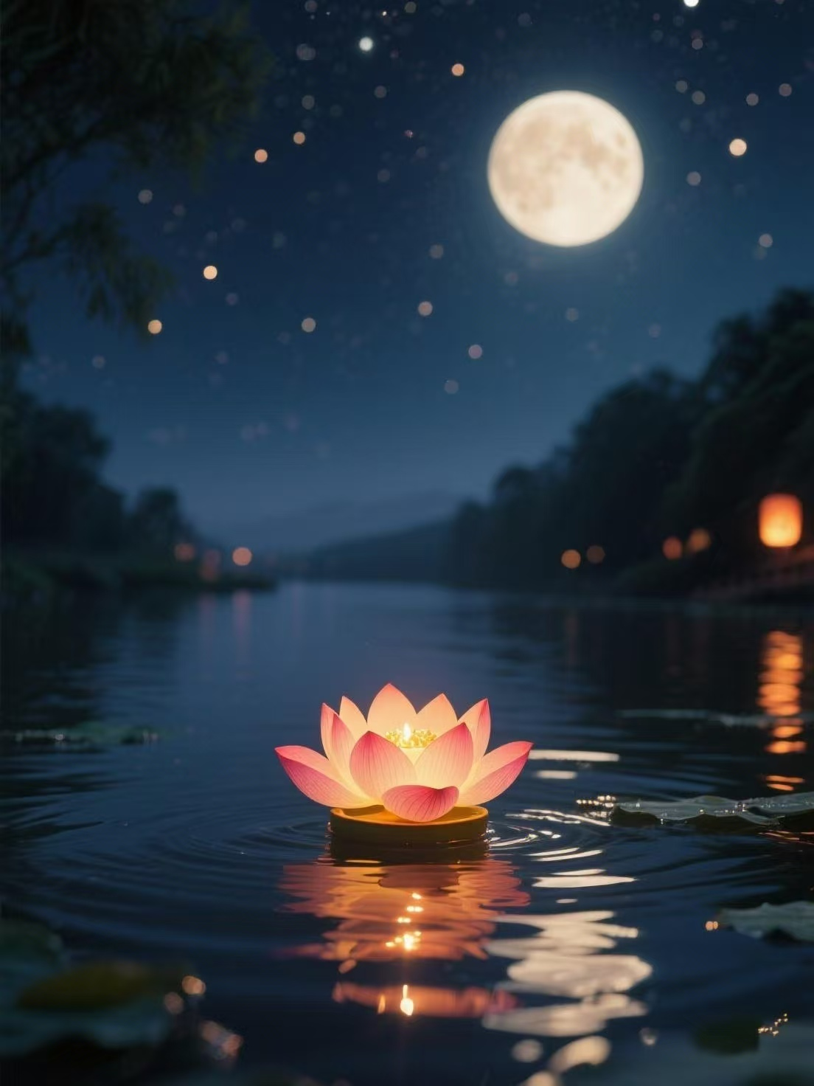
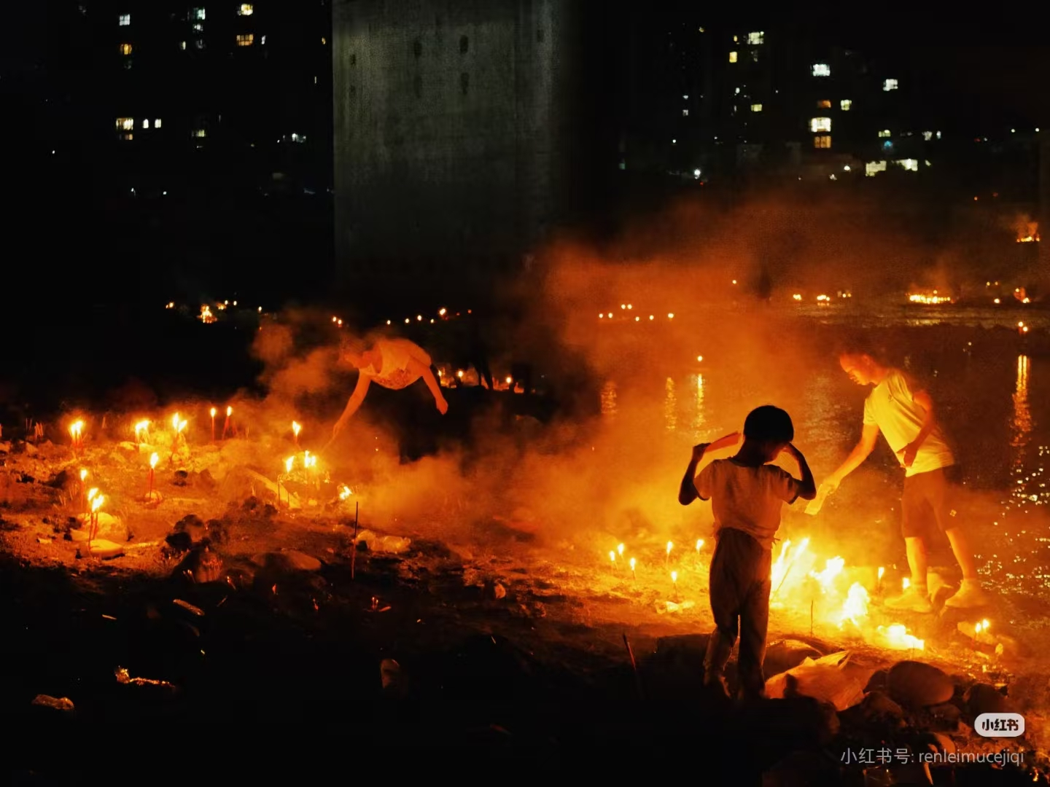
The Zhongyuan festival teaches us about love and respect. It teaches us to remember our family history and to be kind to others. It reminds people to honor ancestors, conveying missing feelings and wishes. Globally, it spreads love and cultural heritage, making it meaningful.
Significance

Slide 12
Thanks

