Slide 1
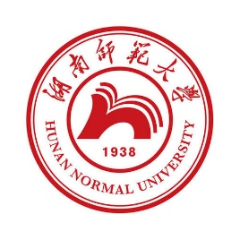
中国语言文化 Chinese Language & Culture for Master Students of Translation Studies
湖南师范大学 2022年2月25日-2021年6月10日 中国文化基础 周五第九和第十节课16:30-18:10，
上课地点：外国语学院大楼613室
助教：Lan Qi 兰綺
吴漠汀特聘教授 Distinguished Professor Dr. Martin Woesler
培高德 教授 Professor Dr. Cord Eberspächer
湖南师范大学外国学院 Foreign Studies College, Hunan Normal University

Slide 2
Schedule 学期题目
Session Rank Topic Percent
1 – Organizational Things
2 2 Literature: Ancient literature: Chinese Classical Fairy Tales 71%
2 5 Literature: Ancient literature: Chinese Mythology 67%
2 7 Literature: Ancient literature: Four Folk Stories of Ancient China 65%
3 17 Language: Chinese Language 57%
3 4 Language: Chinese Dialects 70%
3 16 Minority Languages in China 58%
3 13 Language: Chinese Folk Argot 61%
4 1 Movies: Chinese Movies 73%
5 8 Song: Celadon and the Celadon Song 《青花瓷》歌词 64%
5 18 Song: Marriage Accompanying Songs in Hunan 57%
5 12 Social Media: Douyin (Tik Tok) 61%
6 14 Literature: Ancient Literature - Four satirical novels in ancient China 60%
6 15 Literature: Ancient literature: Classical Literature 58%
6 22 Literature: Ancient Literature - Take Su Shi as an example. Relegation Literature in Ancient China 55%
6 34 Literature: Ancient Literature: The Classic of Mountains and Seas 53%
7 3 Global Impact of Chinese Culture 70%
7 6 Global Impact of Chinese Language 66%
8 25 Translation: Oral Interpreting from and into Chinese 55%
8 28 Translation: Written Translation from and into Chinese 54%
8 37 Translation: Artificial Intelligence in Translation 52%
Session Rank Topic Percent
9 35 Literature: Tang and Song - Classical Prose Movement of late Tang Dynasty and Song Dynasty 53%
9 9 Literature: Premodern literature: Strange Stories from a Chinese Studio 64%
9 21 Literature: Premodern literature: Tang-Song 56%
9 32 Literature: Premodern literature - Li Bai's “The River-Merchant's Wife: A Letter” and its translations 53%
9 11 Literature: Premodern literature - China's Four Great Classical Novels 63%
10 19 Language: How the language shapes the mind (comparison with other languages) 57%
10 24 Language Styles (official, formal, written, colloquial, slang, sociolects, dialects, regionalects etc.) 55%
10 30 Language: Ambiguity of Chinese Language (e.g. Tang poetry) 54%
10 39 Language: Rhethorics and Propaganda in China 51%
11 10 Stage entertainment: Crosstalk 相声 63%
12 26 Chinese Writing: Chinese Characters 54%
12 36 Chinese Writing: Calligraphy 53%
12 33 Traditional Festivals: Spring Festival Couplets 53%
13 20 Literature: Modern Literature: Qian Zhongshu (Ch'ien Chung-shu) 56%
13 23 Literature: Modern Literature 55%
13 29 Literature: Modern and Contemporary Literature: Literature, Science Fiction, and Fantasy 54%
13 40 Literature: Contemporary Literature 50%
14 38 Opera: Peking Opera 52%
14 41 Opera: Peking Opera Actor Mei Lanfang 50%
14 42 Opera: Hunan Flower-drum Opera (Huagu Opera) 50%
15 27 Globalization: The Westernization Movement 54%
15 31 Globalization: The Eastward Spread of Western Learning 53%

Slide 3
Session 5 第五周
Session Overview 本节概览
Preparation:
Follow WeChat Group and course website http://bit.ly/LANG2022
Read textbook texts
Answer quizzes
Translate Homework
Correct translation of fellow student
Presenting students: prepare
Ppt
Podium Discussion (Arguments need to be uploaded on Wiki)
Literature Review and Handout
Wiki Article on the topic
Online Participants: Start VooV 775-353-554. (All students need to turn on camera or will be blocked by student assistant. If Tencent does not work, here is an emergency Zoom session: https://bit.ly/ZOOMCOURSE.)
Start your final exam paper now!

Slide 4
Session 5 第五周
Session 5, Fri March 25, 2022 - Language
Rank Topic Percent
8 Song: Celadon and the Celadon Song 《青花瓷》歌词 64% 孙丽君
18 Song: Marriage Accompanying Songs in Hunan 57% 彭慧璇 Peng Huixuan
12 Social Media: Douyin (Tik Tok) 61% 向望 Xiang Wang

Slide 5
Celadon
5 2 Silk and porcelain: Celadon and Celadon Song 《青花瓷》歌词 72%喻锦博

Slide 6
Questions Concerning Section D
1. Why does celadon appear green?
2. Why was the celadon industry prosperous in Hangzhou?
3. Why was Chinese green porcelain named Celadon?
4. What do you know about crackleware?

Slide 7
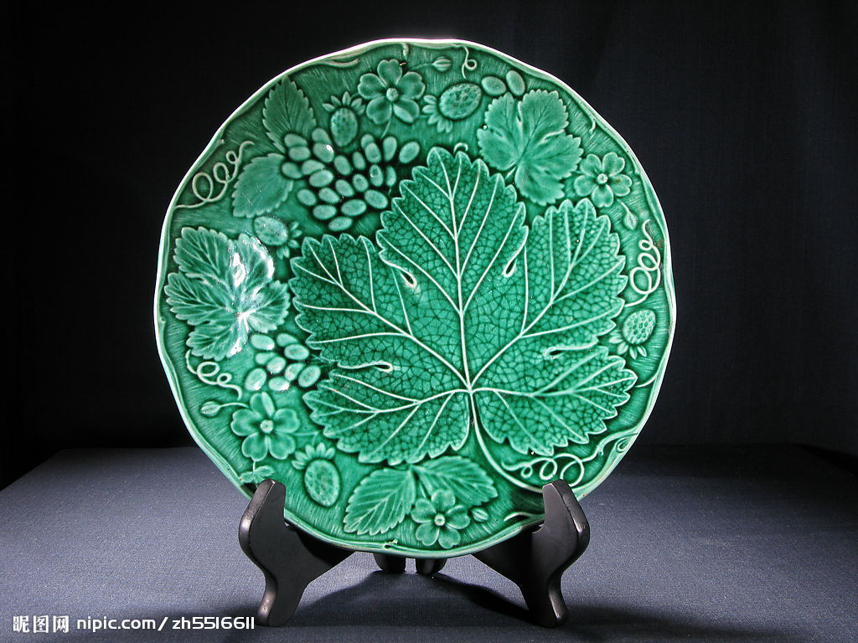
Why does celadon appear green?
Celadon plate

Slide 8
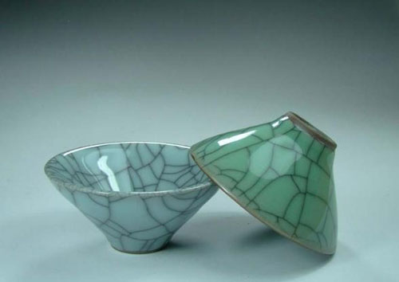
What do you know about crackleware?
Celadon crackleware

Slide 9

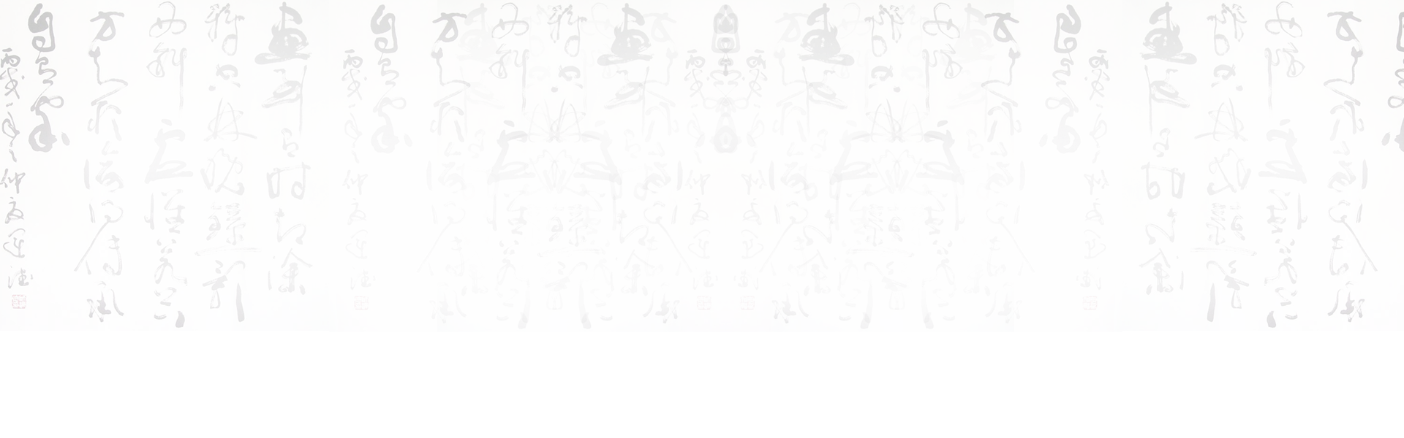
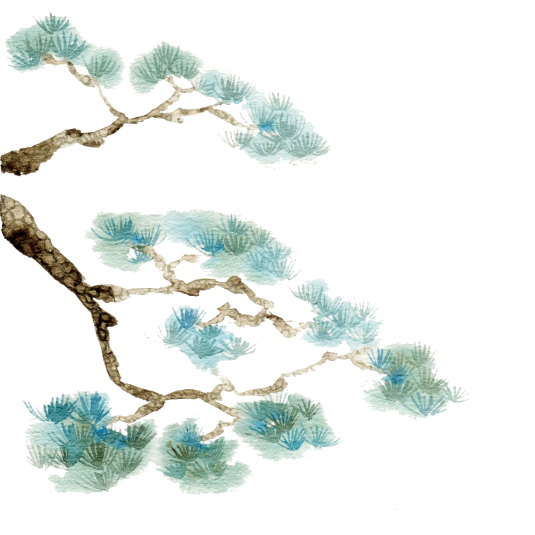

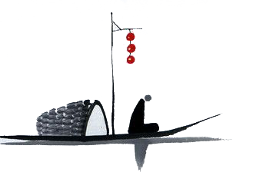
BY YUSHEN
Celadon

Slide 10
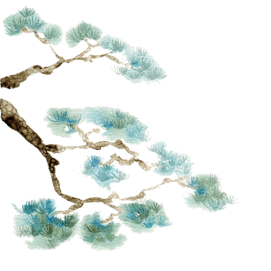
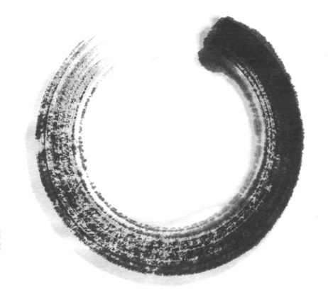

目
A brief introduction of celadon
录
CONTENTS
Longquan celadon
Translation difficulties and skills

Slide 11


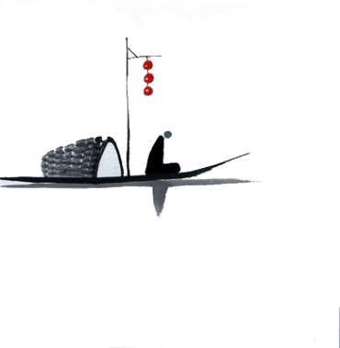
PART 01
A brief introduction of celadon

Slide 12
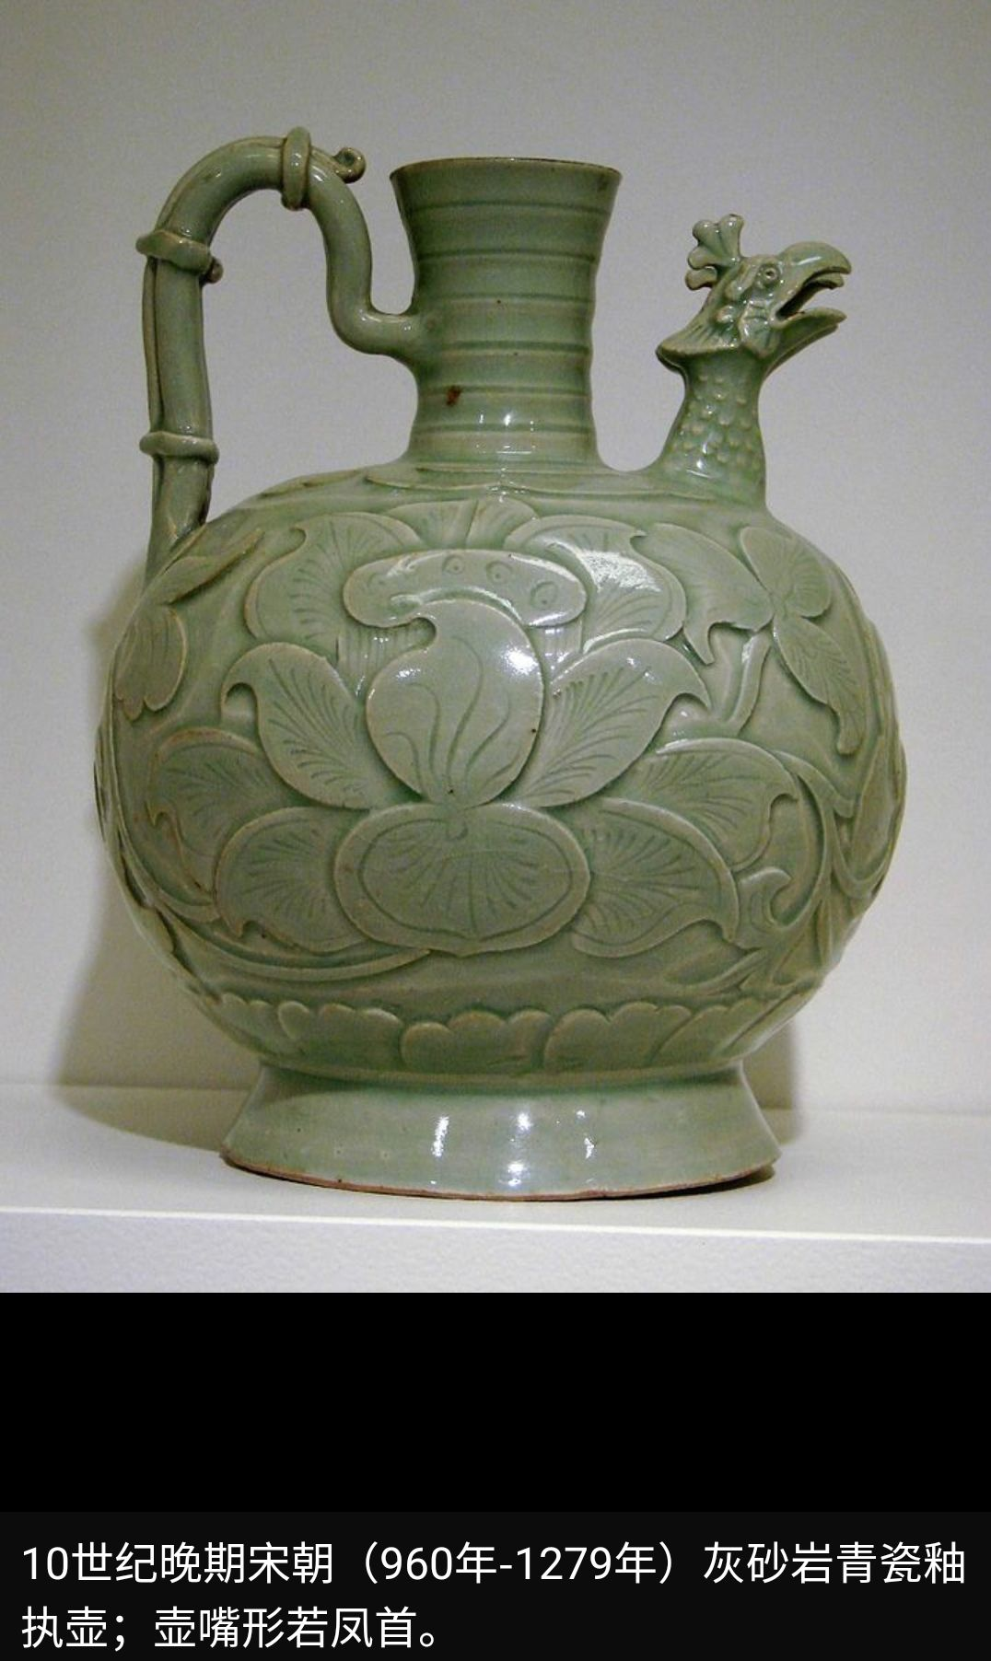
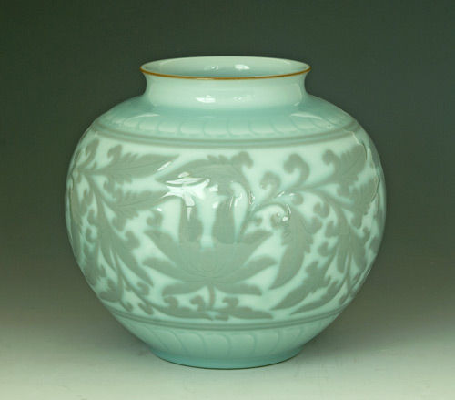
Celadon is a term for ceramics denoting both wares glazed in the jade green celadon color, also known as greenware (the term specialists tend to use) and a type of transparent glaze, often with small cracks, that was first used on greenware, but later used on other porcelains.

Slide 13
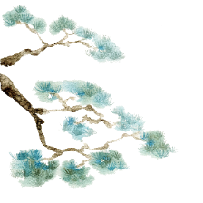

Shang and Zhou Dynasties
Three Kingdoms,Jin and Southern and Northern Dynasties
Eastern Han Dynasty
Greenwares are found in earthernware from the Shang dynasty onwards and was called primitive celadon.
The celadon firing technology in the Eastern Han Dynasty has reached a mature stage.
The celadon fired in the south and the north had their own characteristics.

Slide 14
PART 02
Longquan celadon

Slide 15
It reached its peak in the Southern Song Dynasty.
The ancient Longquan famous kiln was one of the five famous kilns of the Song Dynasty "Guan, Ge, Ru, Ding and Jun".
Longquan celadon began in the Southern Dynasty.
It flourished in the Northern Song Dynasty.
Longquan celadon
一
二

Slide 16
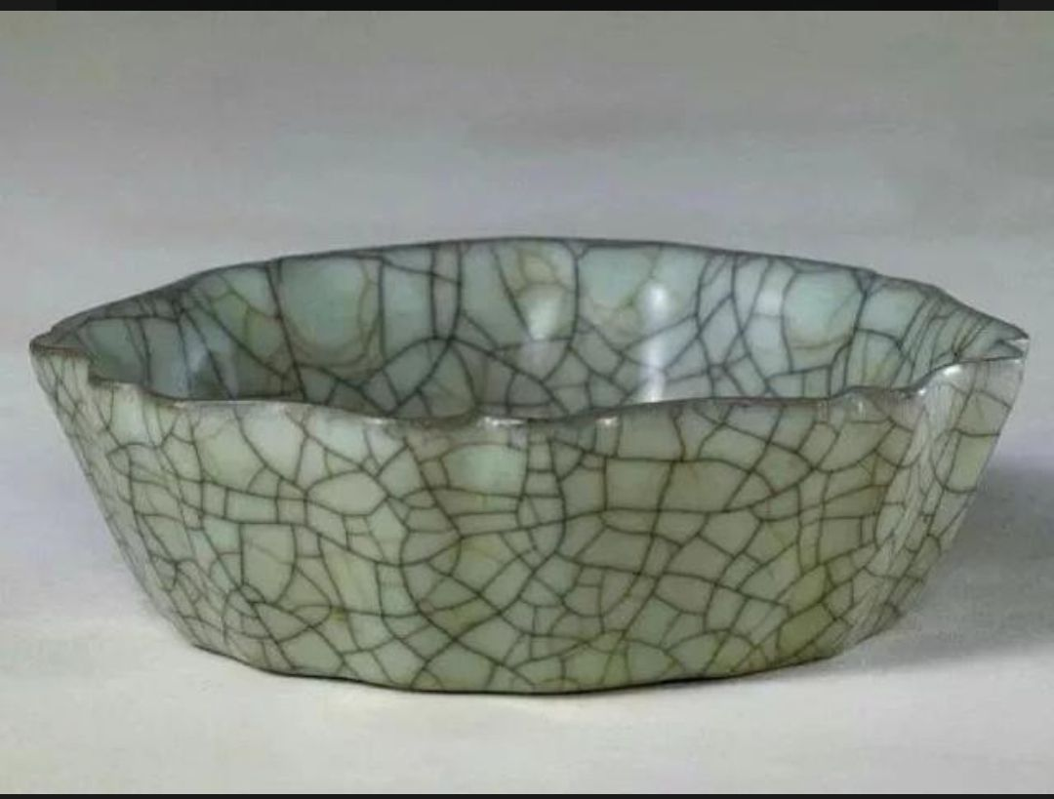
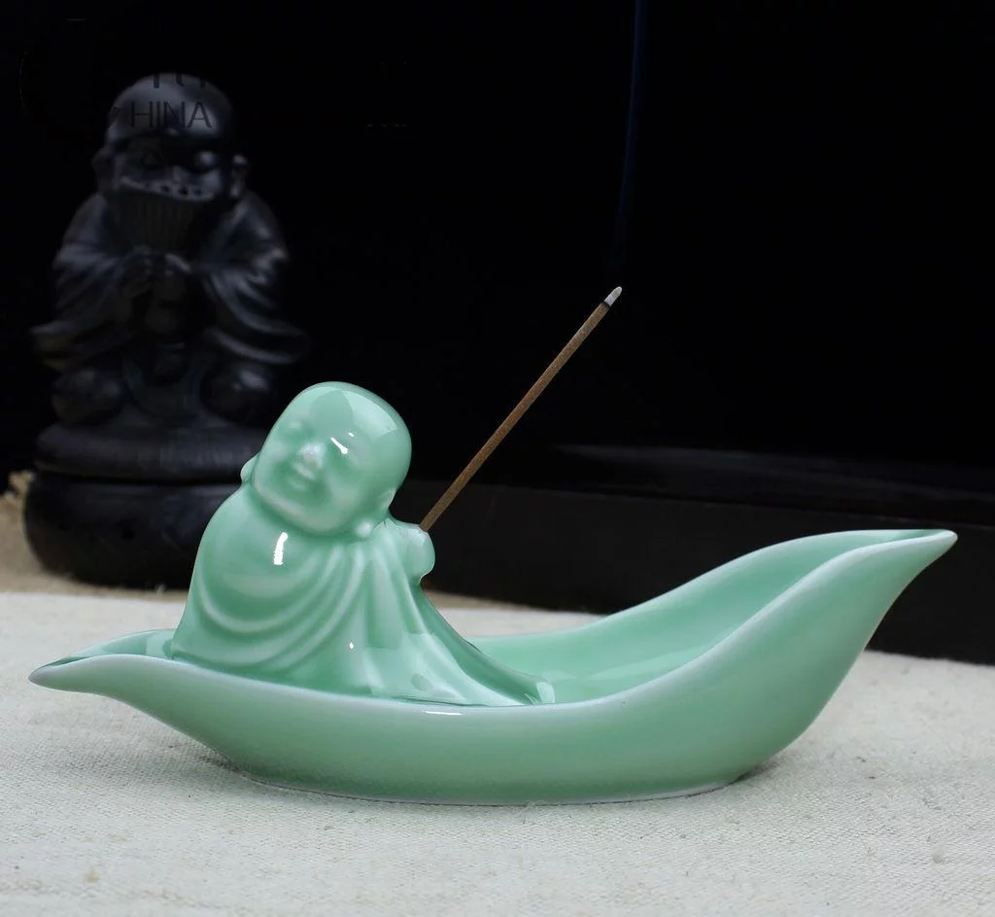



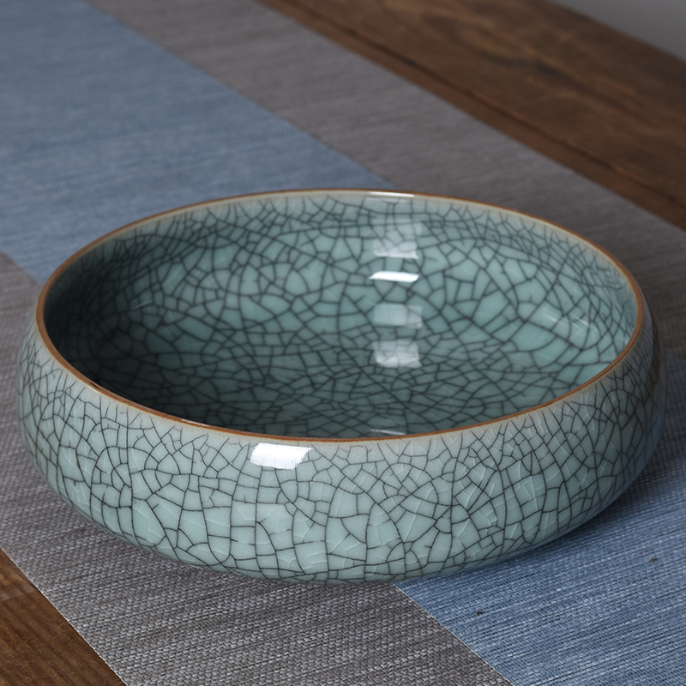
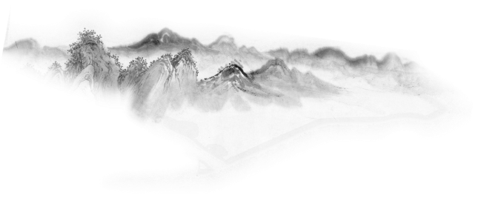
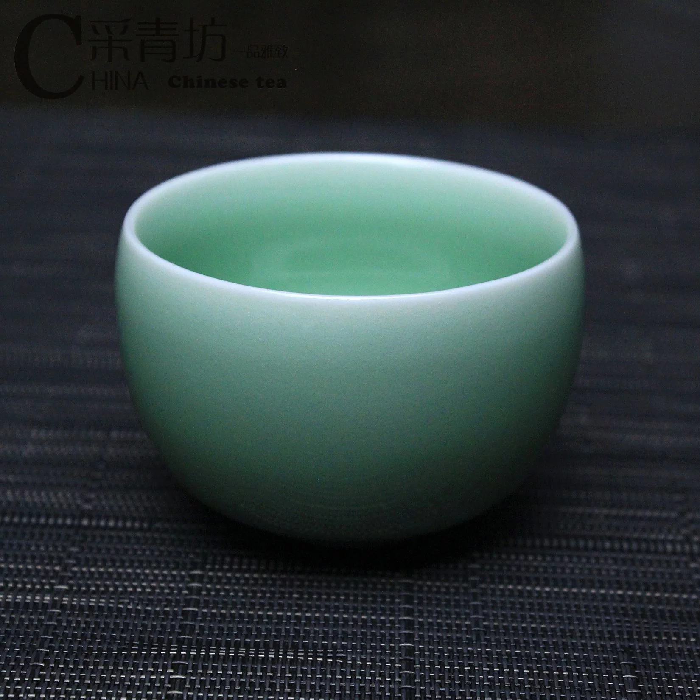
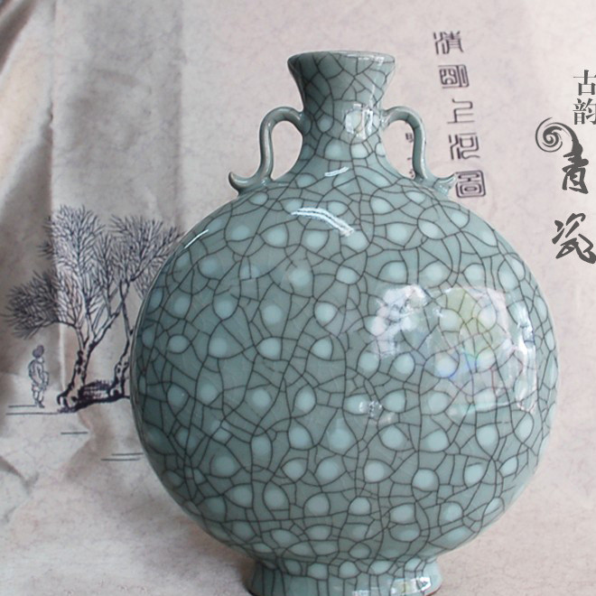
.
Di kiln
Ge kiln
.

Slide 17

“Ge kiln”
history
specialty
It appeared in the middle and late Southern Song Dynasty, together with the famous Guan, Ru, Ding, and Jun, they were called the five famous kilns in Song Dynasty.
The fetus is as thin as paper, and the glaze is as thick as jade. The glazed surface is covered with patterns, purple-mouthed iron feet, and the fetal color is gray and black.

Slide 18
“Di kiln”
specialty
history
It has white glaze green. The glaze colors are powder green and plum green.The glaze layer of the di kiln is rich, the glaze is blue, and the luster is soft, crystal, better than jade.
From the middle and late Southern Song Dynasty, especially in the Yuan Dynasty, a large number of works using exposed fetus appeared.

Slide 19
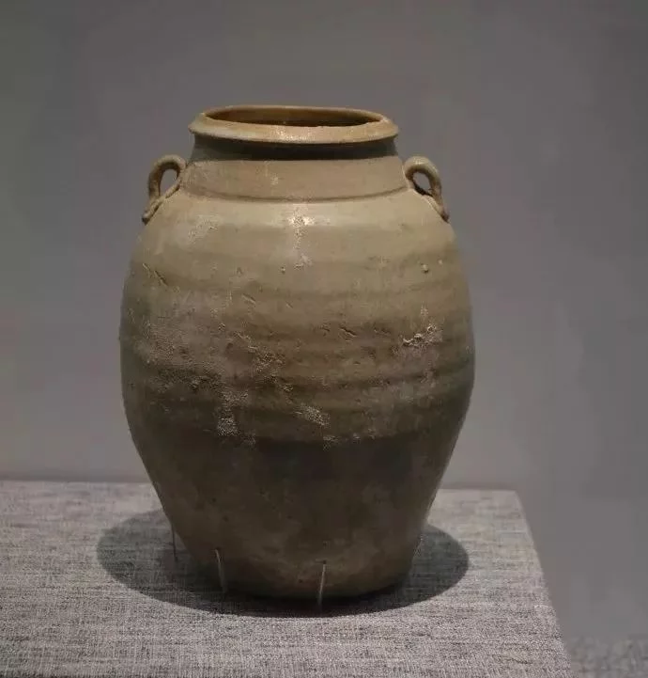
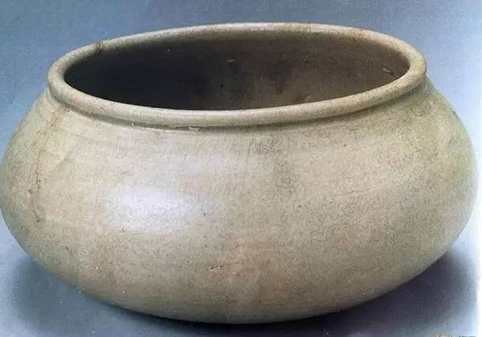
features of Longquan celadon in different periods
the Five Dynasties
light cyan glaze color
fetal bone gray-white
while a few gray-black
solid texture

Slide 20
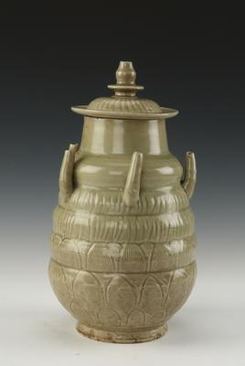
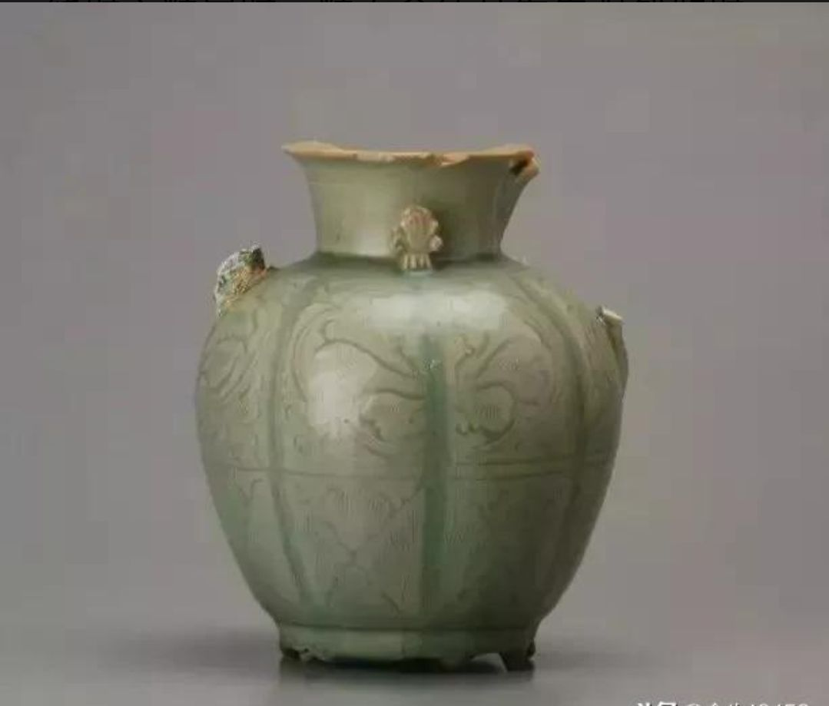
features of Longquan celadon in different periods
Patterns such as cluster flowers, waves, and burnt leaves appeared
the early Northern Song Dynasty

Slide 21
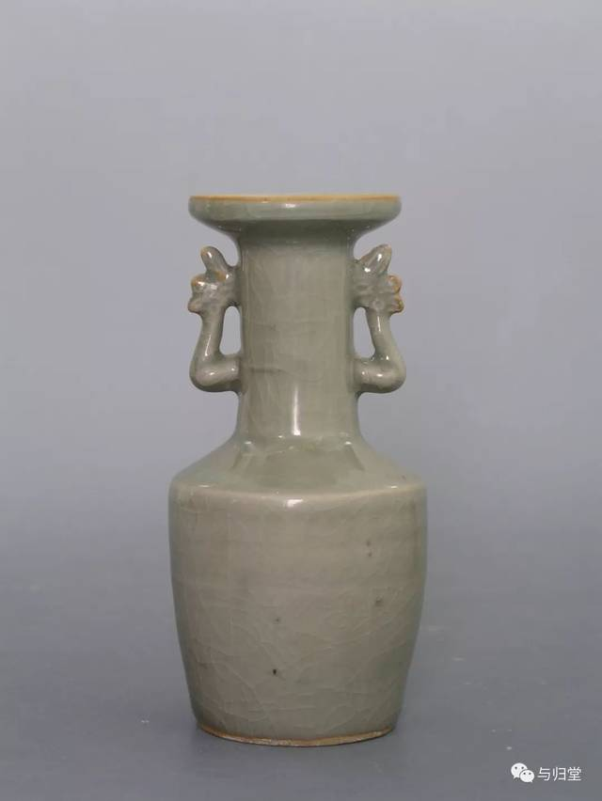
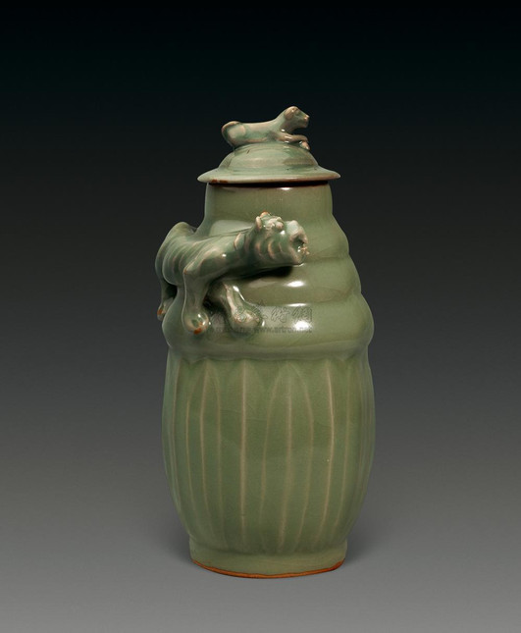
features of Longquan celadon in different periods
the Southern Song Dynasty
glaze color is like jade,
the shape is rich and varied,
the decoration is quite creative

Slide 22
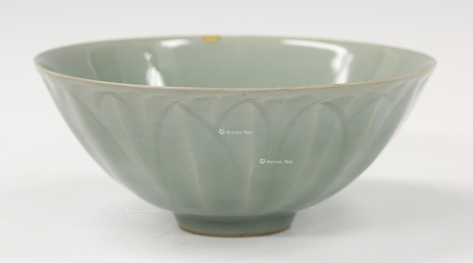
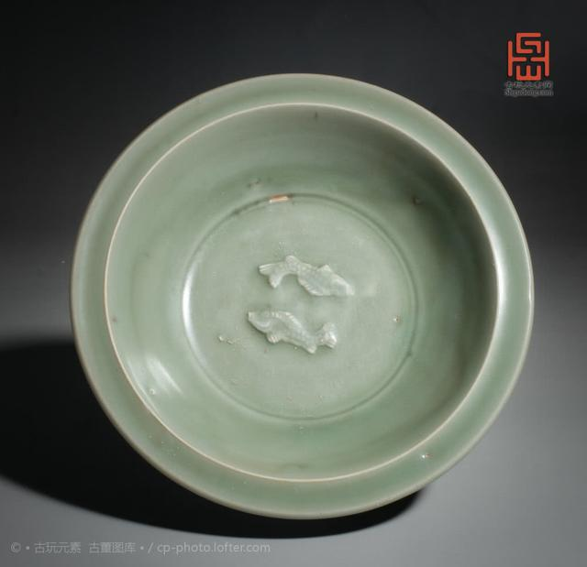
features of Longquan celadon in different periods
the Yuan Dynasty
light cyan glaze color
fetal bone gray-white
while a few gray-black
solid texture

Slide 23
PART 03
Translation difficulities and skills

Slide 24
translation of some kinds of celadons
transliteration and explanation
transliteration
一
二
龙泉窑，龙泉青瓷
Longquan kiln, Longquan celadon
尊式瓶
zun-shaped vase (a kind of vessel, means the bottom is smaller than the top

Slide 25
其中的白胎和朱砂胎青瓷釉层丰润，釉色青碧，光泽柔和，晶莹滋润，胜似翡翠，以梅子青，粉青，豆青等釉色最为珍贵。
translation of four-character words
三
..., the enam of layer of white and vermilion embryo is plump, smooth and green like jade.

Slide 26


The Name “Celadon”

Slide 27



Celadon is the most widespread type of ancient Chinese porcelain.
celadon:
1. a pale grayish green color
2. Chinese porcelain with a grayish green glaze
porcalain:
a hard white shiny substance made by baking clay and used for making delicate cups, plates and decorative objects
china:
white clay which is baked and used for making delicate cups, plates, etc.

Slide 28
The original meaning of “celadon” is “tender lover”.
“Celadon” came to mean green porcelain from China because of a 17th century drama by Honore d'Urfe that was played on the stages of Paris. The hero, named “Celadon”, was clad in delicate green.
Through the efforts of Chinese and Arab travelers and businessmen, large quantities of this high-quality celadon found its way into West Asia, Egypt and Europe. When the drama was played, the Parisians liked the green porcelain from China so much that they renamed it after the hero of Honore d'Urfe's play.
Metonymy:
the same colour
the hero - the porcelain

Slide 29
The History of Celadon

Slide 30
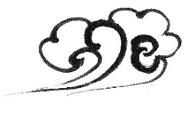
Han Dynasty
The Southern Song Dynasty
first appeared in East China
simply known as green porcelain.
After the establishment of the southern capital in Hangzhou in 1127 during the Song Dynasty, the manufacturing of the green porcelain reached new heights.
New imperial kilns (or official kilns) near Hangzhou and kilns in Longquan, southwest Zhejiang, produced a type of porcelain that was of extraordinary delicacy and purity.
Tang Dynasty
the art of making celadon matured

Slide 31
A Famous Brand of Celadon

Slide 32
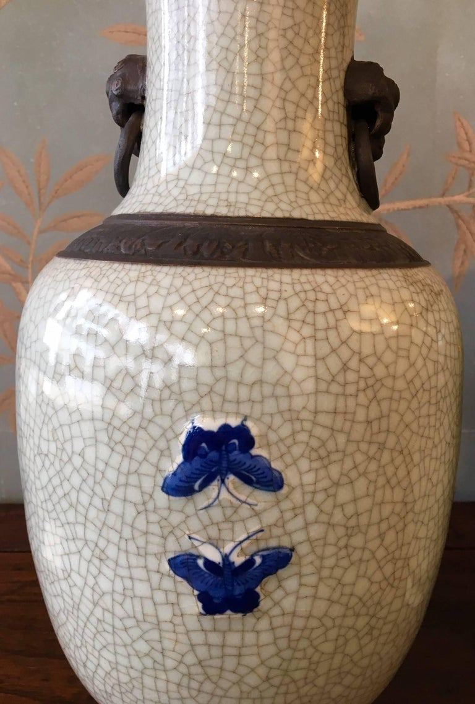

Crackleware
crackle (n. characteristic) + ware (n. object)
Crackleware has broad and fine cracks on its surface. These characteristics appear in the glaze as a result of the firing process when the glaze shrinks more than the body of the pottery. The potters from the Song Dynasty cleverly used the crackle in the glaze for a decorative effect. That is how a world-famous brand of ceramics was born in ancient China.

Slide 33
The Celadon Song

Slide 34
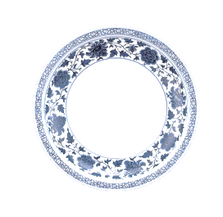
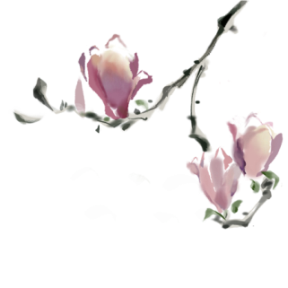
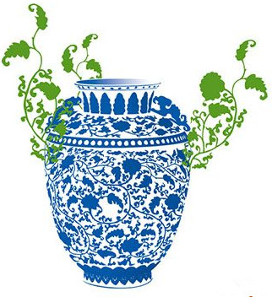
A Question
Celadon Song?
Song of the Blue-and-white Porcelain?
?
{
celadon(青瓷)
porcelain
white porcelain(白瓷)
blue and white porcelain(青花瓷)
an independent category
...

Slide 35

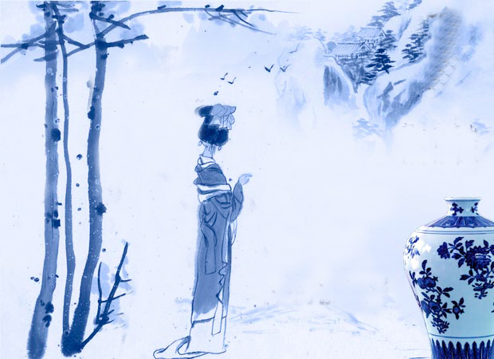

素胚勾勒出青花，笔锋浓转淡
瓶身描绘的牡丹一如你初妆
冉冉檀香透过窗，心事我了然
宣纸上走笔，至此搁一半
釉色渲染仕女图，韵味被私藏
而你嫣然的一笑如含苞待放
你的美一缕飘散，去到我去不了的地方
天青色等烟雨，而我在等你
炊烟袅袅升起，隔江千万里
在瓶底书汉隶，仿前朝的飘逸
就当我为遇见你伏笔
天青色等烟雨，而我在等你
月色被打捞起，晕开了结局
如传世的青花瓷自顾自美丽，你眼带笑意
色白花青的锦鲤跃然于碗底
临摹宋体落款时却惦记著你
你隐藏在窑烧里千年的秘密
极细腻，犹如绣花针落地
帘外芭蕉惹骤雨，门环惹铜绿
而我路过那江南小镇惹了你
在泼墨山水画里，你从墨色深处被隐去
天青色等烟雨，而我在等你
炊烟袅袅升起，隔江千万里
在瓶底书汉隶，仿前朝的飘逸
就当我为遇见你伏笔
天青色等烟雨，而我在等你
月色被打捞起，晕开了结局
如传世的青花瓷自顾自美丽，你眼带笑意

Slide 36
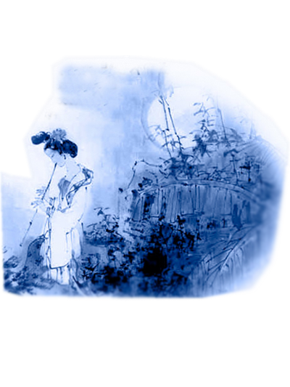
The sky is crying blue, as I wait for you
The fire in my heart burning white and true
A thousand miles the smoke is rising high both sides
I see your shadow outlined through
The sky still dark as I make my way to you
White moon light guides our way, fields of morning dew
Our world is greener on the other side so free
The time is calling.
天青色等烟雨，而我在等你
炊烟袅袅升起，隔江千万里
在瓶底书汉隶，仿前朝的飘逸
就当我为遇见你伏笔
天青色等烟雨，而我在等你
月色被打捞起，晕开了结局
如传世的青花瓷自顾自美丽，你眼带笑意

Slide 37
Marriage Songs

Slide 38
Chinese Marriage Customs

Slide 39
Introduction
China is an ancient country of rites. When it comes to the most important thing in one’s life---marriage, Chinese people have developed a set of unique and grand ceremonies. Generally speaking, weddings in ancient China needed to be approved by parents and arranged by parents.

Slide 40
Contents
1
Six Procedures
2
Customs
3
Development

Slide 41
1
Six Procedures
Na Cai
Wen Ming
Na Ji
Na Zheng
Qing Qi
Qin Ying

Slide 42
1
Na Cai

Slide 43
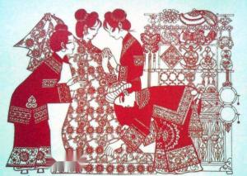
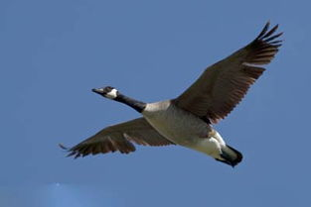
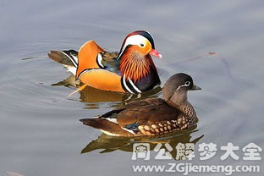
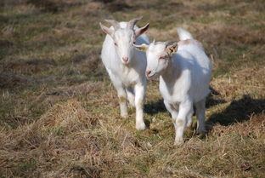
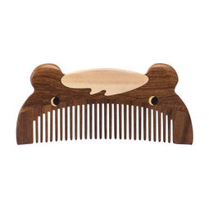
Na Cai is the begining of all the marriage processes. It refers to a practice that if a boy intends to marry a girl, firstly his family must invite a matchmaker to the girl's home to propose marriage
wild goose
mandarin ducks
wooden comb

Slide 44
2
Wen Ming

Slide 45
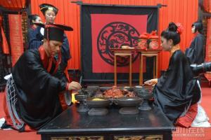
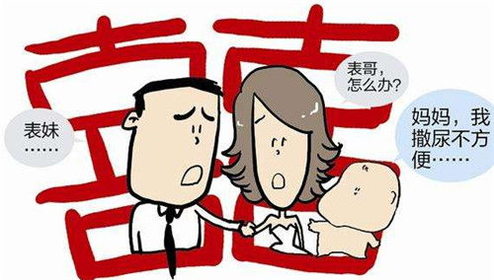
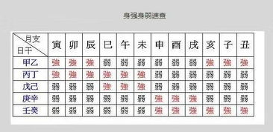
Wen Ming means that the boy's family asks the matchmaker to fetch the girl's name and date of birth.
assure the compatibility of the prospective bride and bridegroom through their “eight characters” of the birth moment.
prevent the marriage of close relatives with the same surname

Slide 46
3
Na Ji

Slide 47
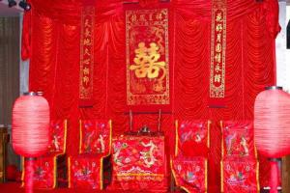
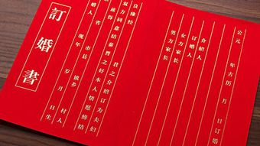
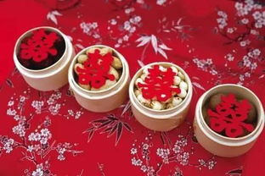
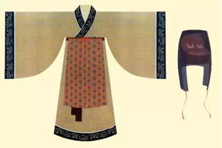
Naji happens after the matchmaker takes back the woman's name and eight characters. If divining an lucky portent, the boy's family will inform the girl’s parents and decide to engage the marriage.
What is more, Na Zheng is an important step when the boy sends engagement presents to the girl and for courtesy the girl will send back part of the presents such as food and some clothes.

Slide 48
4
Na Zheng

Slide 49
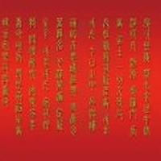
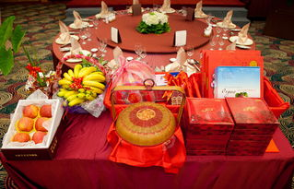
Nazheng is the ancient marriage custom of Han nationality“ The fourth of the six gifts, also known as "Nacheng", means that a man's Naji gives a bride price to a woman's.
The completion of acceptance marks the end of the engagement stage and is one of the main signs of the establishment of marriage.

Slide 50
5
Qing Qi

Slide 51
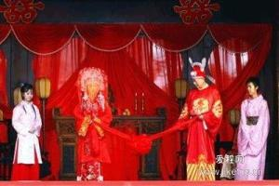
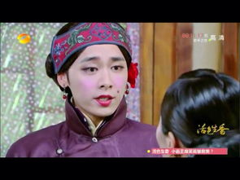
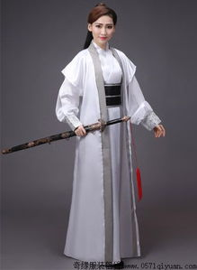


Qing Qi means that the boy's family choose a lucky day to hold the wedding ceremony and then dispatch the matchmaker to tell the girl’s family.
Qing Qi

Slide 52
6
Qin Ying

Slide 53

Qin Ying
Qin Ying is the last process of the six processes, that is, the groom goes to the bride's home to take the bride to his home.

Slide 54
2
Customs
In addition to the six steps mentioned above, there are many other customs in the traditional Chinese wedding ceremony. Generally speaking, ancient marriage was ordered by parents and matchmaker and many young people could not master their own marriage. Before wedding ceremony, men and women were not allowed to meet each other in that ancient people were very conservative and most girls were kept in boudoirs. If they met in private before marriage, it would be regarded as a kind of female infidelity and parents would also think it quite unlucky. Under this condition, newcouples could only see each other until the day of marriage.

Slide 55




After that, the following step is the most grand one among the whole ceremony --- at the dusk moment, the groom and the bride, his parents as well as all the guests will gather together at the central room to witness the kneeling steps of the couple, which consists of 4 steps
Kneel down to heaven and earth
the new couple kowtow towards each other
drink “ cross-cupped wine ”
Kneel down to parents

Slide 56




After wedding ceremony, the couple must return to the girl’s home together at the third day, which is called “Huimen” or “Guiling”. This step is indispensable. The groom should take some gifts for respect and change the way that he addresses the bride’s parents, and the latter will also prepare a good meal for the couple’s coming.
Hui Meng

Slide 57
4
Development

Slide 58



As time goes by, there are many reforms about marriage nowadays. Adults own the freedom to choose their form and they can meet each other every day if possible. Parents can’t master their “life event” any more. In addition, many couples skip the cumbersome rites in the wedding ceremony. Some of them choose to hold the ceremony in the church with some close relatives and friends and some even finish it through travel.

Slide 59



Nevertheless, most young people still adopt the main processes of the traditional Chinese customs, some of which are handed down until the present day. There still exist engagement gifts and dowries, and many couples choose to wear red costumes. The bridegroom should go to the bride’s home to escort her to the wedding and so on. Thus it can be seen that most traditional Chinese marriage customs are deeply rooted in the hearts of Chinese people and show a unique Chinese characteristics.

Slide 60
TikTok (Douyin) and Bilibili
For examples what HUNNU students post on Bilibili:
https://wiki.rub.de/uvu/index.php/Produce_a_Bilibili_or_a_Douyin_video_and_link_it_here.

Slide 61

DOU YIN (TIK TOK)
SCIENCE AND TECHNOLOGY:

Slide 62

CONTENTS
1
PART ONE Overview
2
PART TWO Comparison
3
PART THREE Popularity
4
PART FOUR Effects

Slide 63

Part One
Overview

Slide 64


# It is a platform for creating and sharing 15-second videos.#
ABOUT Tik Tok
Douyin is a short video media app developed by China’s young tech giant Bytedance.
Users
Douyin allows users to create, edit, and share short videos as well as livestreams, often featuring music in the background. In their videos, users can interact with the camera and sing at the same time, with songs provided by Douyin's extensive music library.
Contents
Contents themed on dances, comedies, babies, food, pets pranks, and stunts are most welcomed on Douyin. Showing off dance skills and comedy routines are also popular pastimes on the app.

Slide 65


Characteristics
# No ”play” or “pause” button#
# Personalized Recommendation#
Once you open the app, a video starts immediately. You scroll through a 15-second stream of videos nonstop, as does how you look through photos on Instagram. Therefore, many people can't help spending most of their spare time on the For You Page.
Unlike other popular Chinese apps like Weibo, where you have to actively follow specific accounts to be pushed toward their content, Douyin identifies users’ interests through a powerful recommendation algorithm that tracks the users’ preferences through their browser history.
It also shows content it thinks could go viral, regardless of how many followers the creator has.

Slide 66
Part Two
Comparison

Slide 67
Comparison between Tik Tok and Bilibili
Position
Short video culture community
Time Limit
21 seconds on average, less than 60 seconds mostly
Volume
DAU: 600 million
Users
Across all age group, a platform of mass culture
Tik Tok
Position
ACG culture community
Time Limit
More than 2 minutes, 8 minutes on average
Volume
DAU: 65 million
Users
Mostly generation Z, a minority of generation Y
Bilibili

Slide 68
Part Three
Popularity

Slide 69

Several reasons why Tik Tok is so popular include：
Localized content
The app often runs local contests and challenges and captures local trends using localized hashtags. Douyin also sends personalized recommendations to each of its users. This ensures that Douyin users are always updated on the latest trending videos and are never out of ideas for video creation
Easy content creation, sharing and viewing
Due to the short format, neither the video-creation nor the watching process takes much time or effort. Also, the short-form video content plays as soon as a user opens the app.
Celebrity endorsements
Several celebrities, including Angelababy from China, Jimmy Fallon from American, have helped drive Tik Tok's popularity.

Slide 70
Part Four
Effects

Slide 71
Effects
Most people scroll through the For You Page looking at videos perfectly catered to their tastes through the TikTok algorithm. The app is designed to be addictive, with an unlimited stream of videos at around 30 seconds each, making users hard to get bored. It's incredibly easy to fall down the TikTok hole and suddenly reemerge hours later only to find have lost an entire day.
.
Addiction
While the application can be used to spread positivity, it can also be used as a platform for bullying. Some people criticize other people's videos, while others create videos for deriding someone. This leads to a negative impact on the mental health of everyone involved, thus resulting in life-threatening situations and decisions.
Bullying/Mental Health
On Tik Tok, there are no restrictions as to who can join the app, so strangers can easily message children and create harmful situations.
Unsafe

Slide 72
THANKS.

Slide 73
Preparation for next week
Please prepare all texts for session 3, answer quizzes, translate, correct
Topics:
14 Literature: Ancient Literature - Four satirical novels in ancient China 60% 黄琼 Huang Qiong
15 Literature: Ancient literature: Classical Literature 58%杨紫微Yang Ziwei
32 Literature: Premodern literature - Li Bai's “The River-Merchant's Wife: A Letter” and its translations 53%张姣玲 Zhang Jiaoling
34 Literature: Ancient Literature: The Classic of Mountains and Seas 53% 何丽娜 He Lina

Slide 74
Always here for you! 随时为你们服务
Professor Dr. Martin Woesler 吴漠汀 湖南师范大学特聘教授，博士导师
Office / 办公室: 外国语学院415
国际汉学中心309
Phone / 电话: (150) 1138 8818 (德国+49 178 2073538) Email / 电子邮件: wmt@hunnu.edu.cn

Slide 75
Thank You

