Slide 1
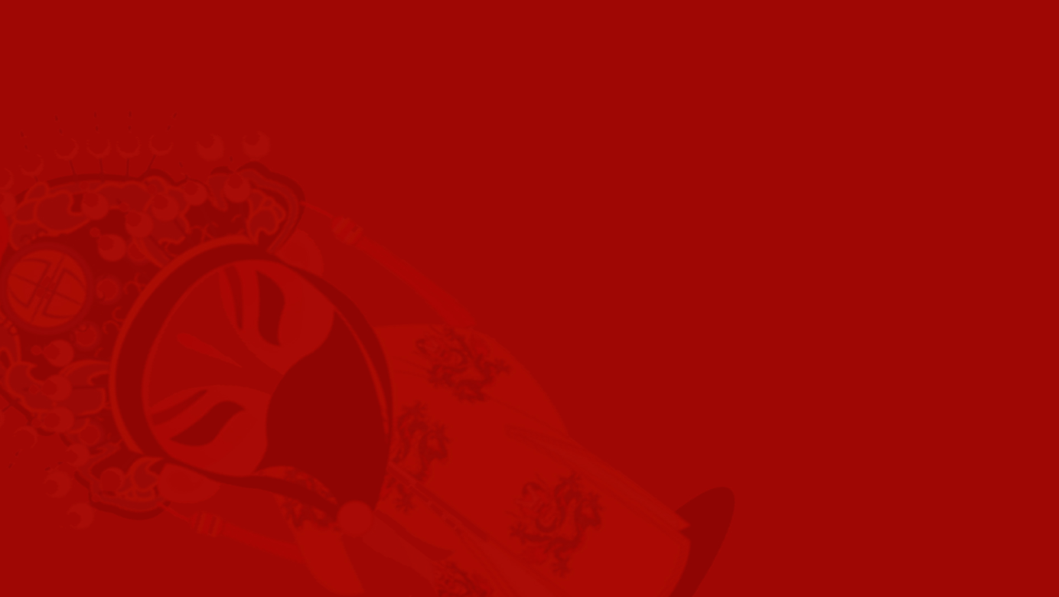

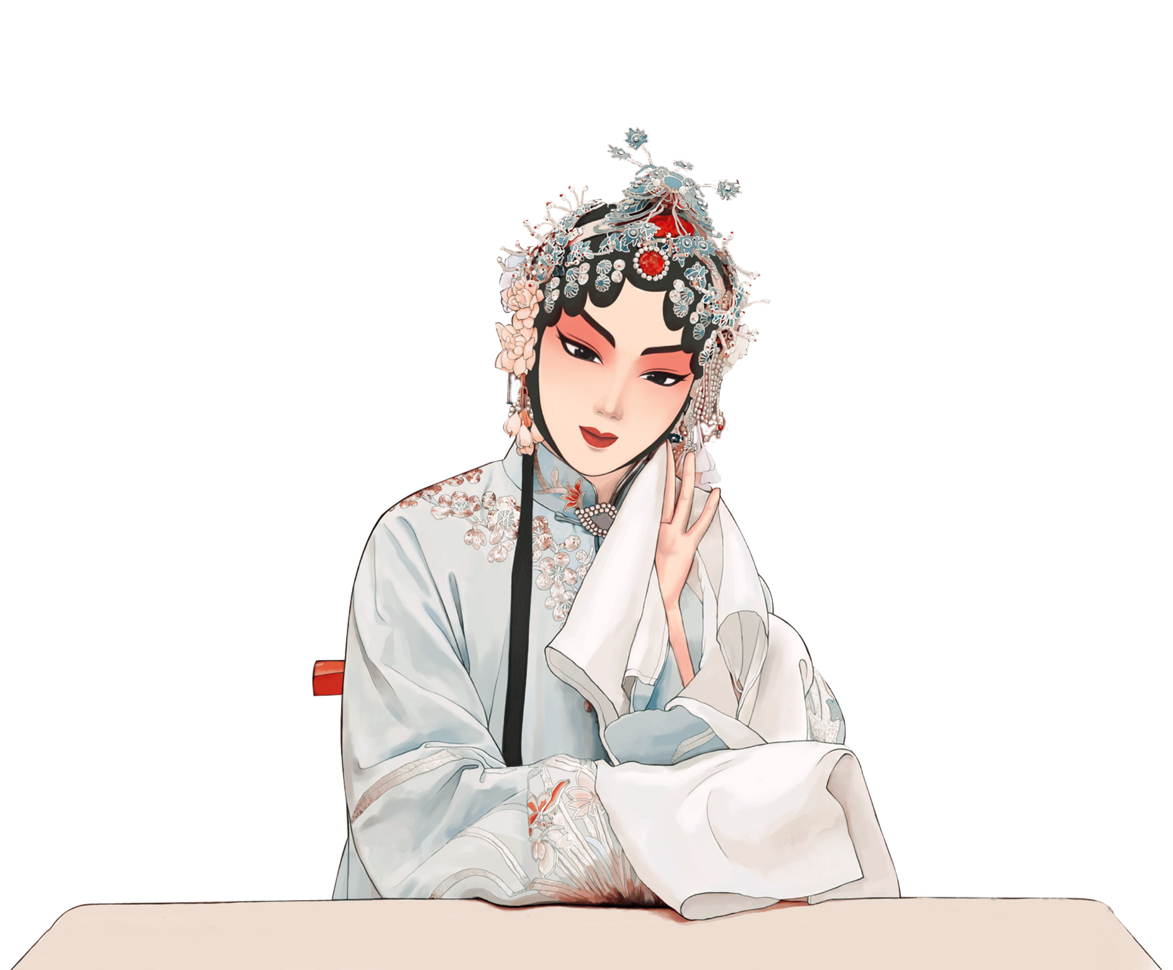
Facial
Make-up
(脸谱)
Ding Qian
202130092296

Slide 2
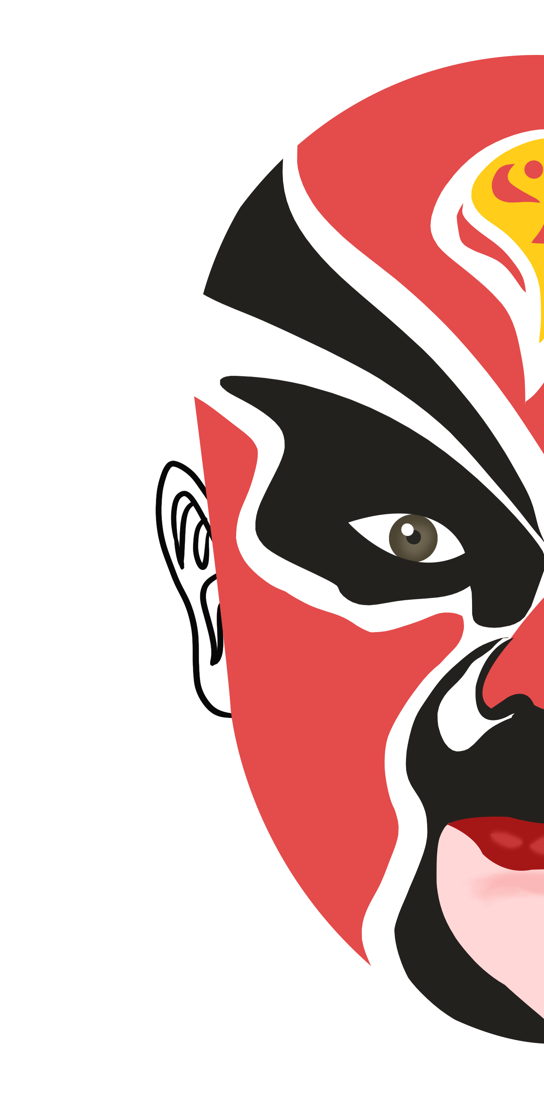
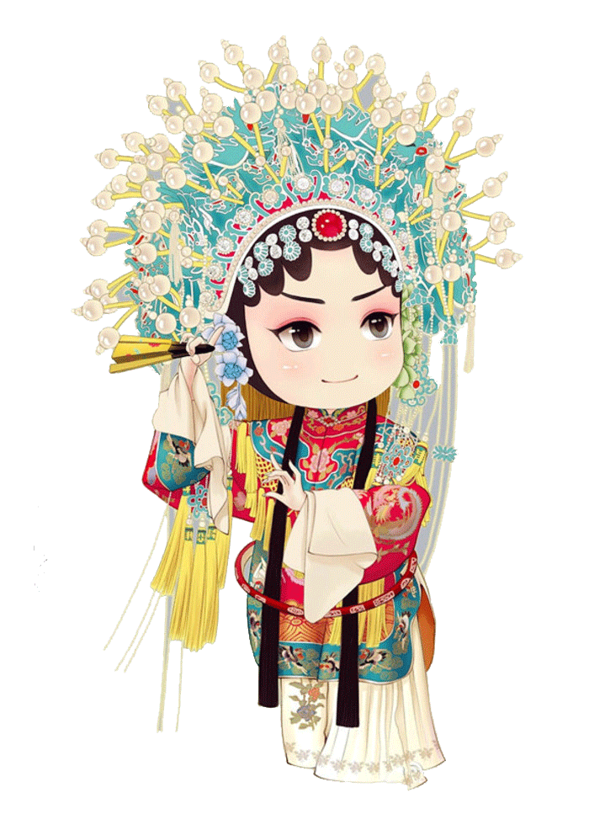
Contents
01
The Origin of Facial Make-up
02
Patterns of Facial Make-up
03
Color Culture in Facial Make-up

Slide 3
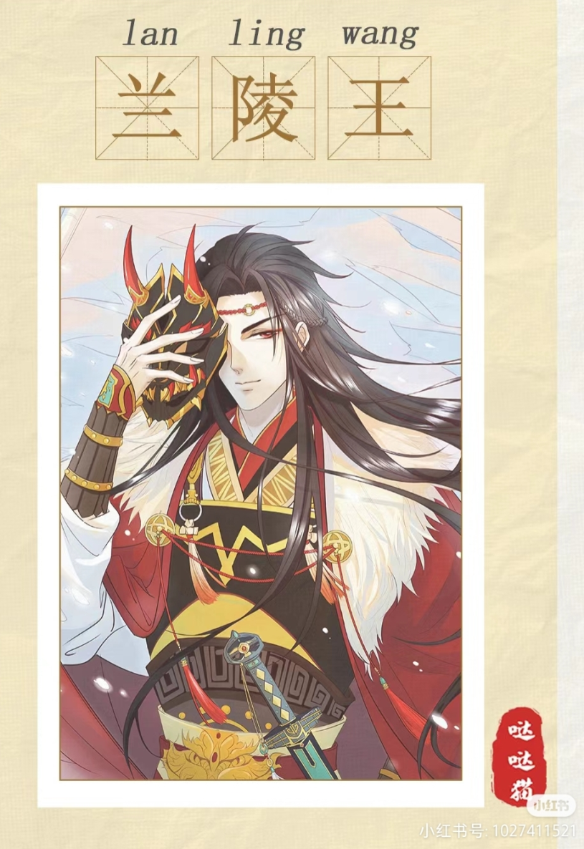
Origin
The Prince of Lanling (541-573)，Gao Changgong, had a handsome face, and every time he led his troops into battle, he was always looked down upon as an inexperienced youth, all because of his beautiful looking face.
So, in order to enhance his image as a mighty general, he made himself a mask with the image of an evil ghost. The result worked wonders in greatly intimidating his enemy troops.

Slide 4
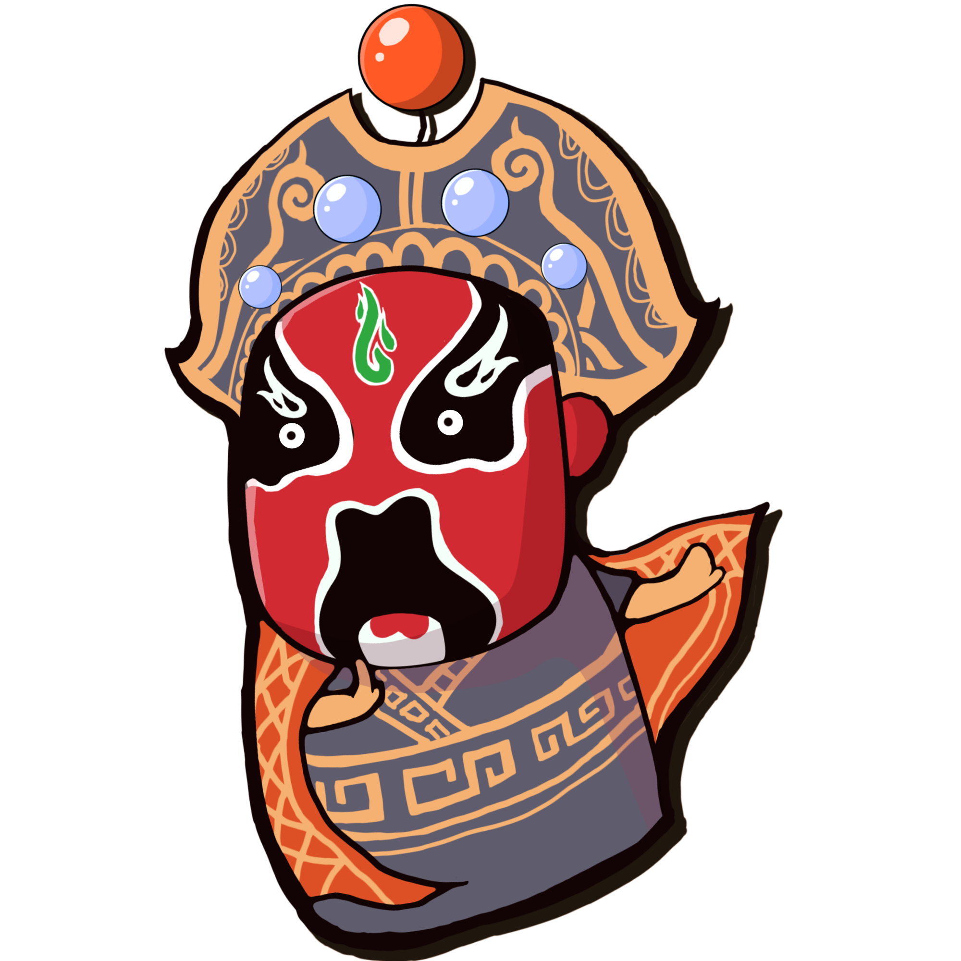
Origin
In order to praise his outstanding military achievements, people wrote a song about him . During the performance, the dancers wore masks. Later the masks, appearing in the the Northern Qi Dynasty and thriving in the Tang Dynasty, evolved into colored masks, which were the predecessors of facial makeup used in Peking Opera .

Slide 5
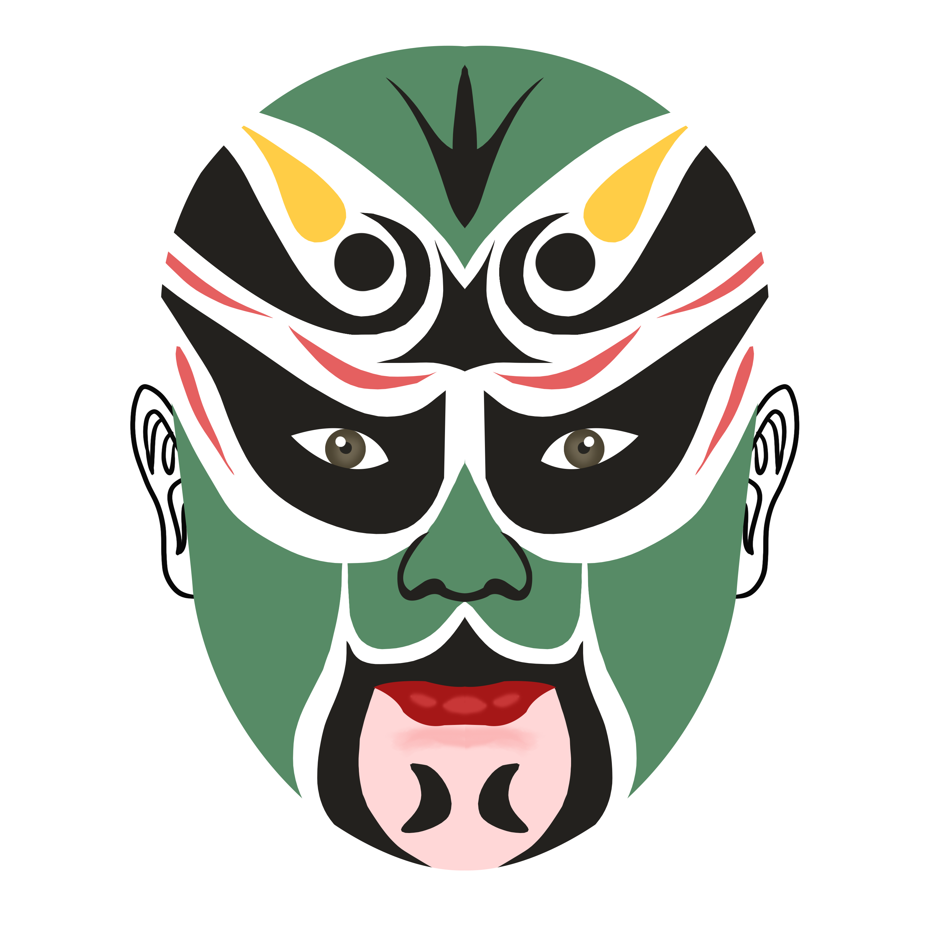
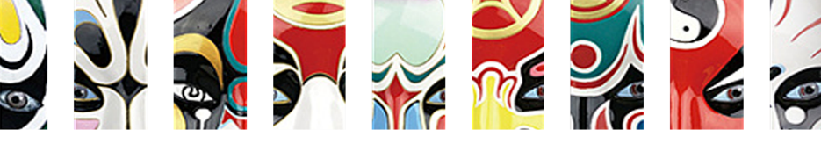
Patterns
As an impressionistic and exaggerated art, types of facial makeup in Peking Opera is featured by painting forehead, brows, eyelids, nasal fossae（鼻窝） and jowls（颌） in various patterns such as dragon, moon and weapon. The patterns of each part are varied and represent different meanings, often revealing information about the character.

Slide 6
Patterns
In facial makeup：
Bao Zheng has a white crescent on his black forehead, indicating that he is honest and unright.
Meng Liang has a red gourd（葫芦） on his forehead, indicating that this person likes to drink.
Zhao Kuangyin's dragon eyebrows indicate that he is the son of Heaven.
Xiahou Dun had an arrow wound in his eyelid, so the red dot were drawn to indicate it.
Douerdun, Dian Wei and others have their best weapon patterns on the facial makeup.
The Thunder God has a lightning streak in his face.
Sun Wukong is a monkey, naughty and witty, so we use the monkey face to show the identity.
His eyes are so sharp that we use gold or yellow circles.

Slide 7
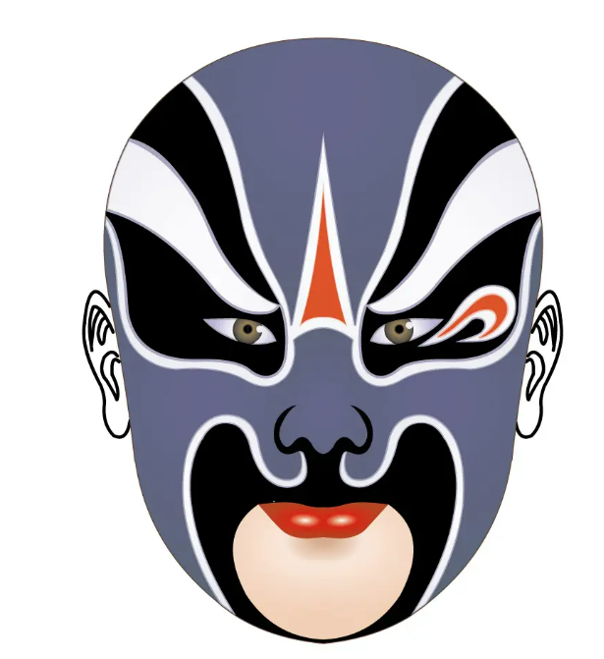
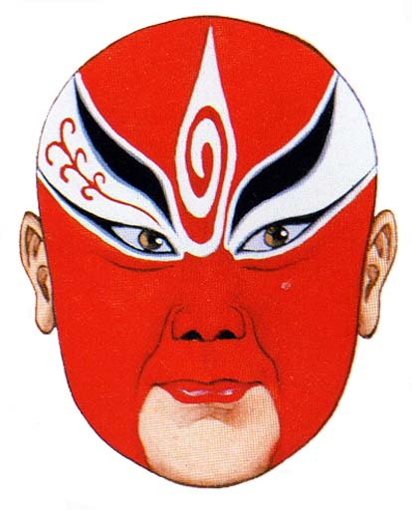
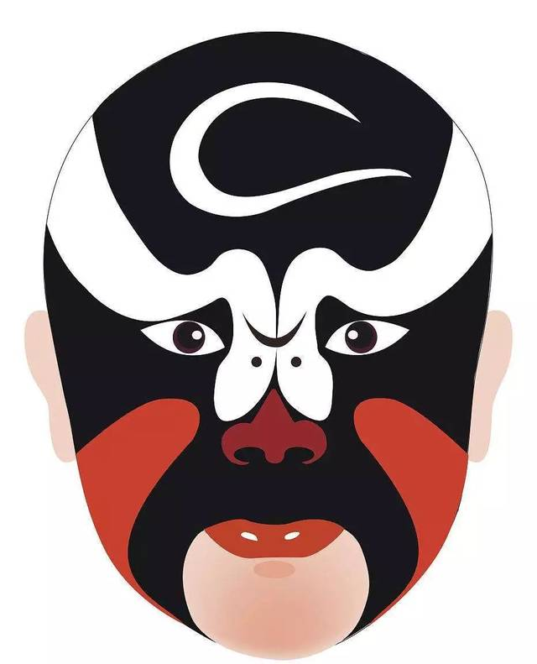
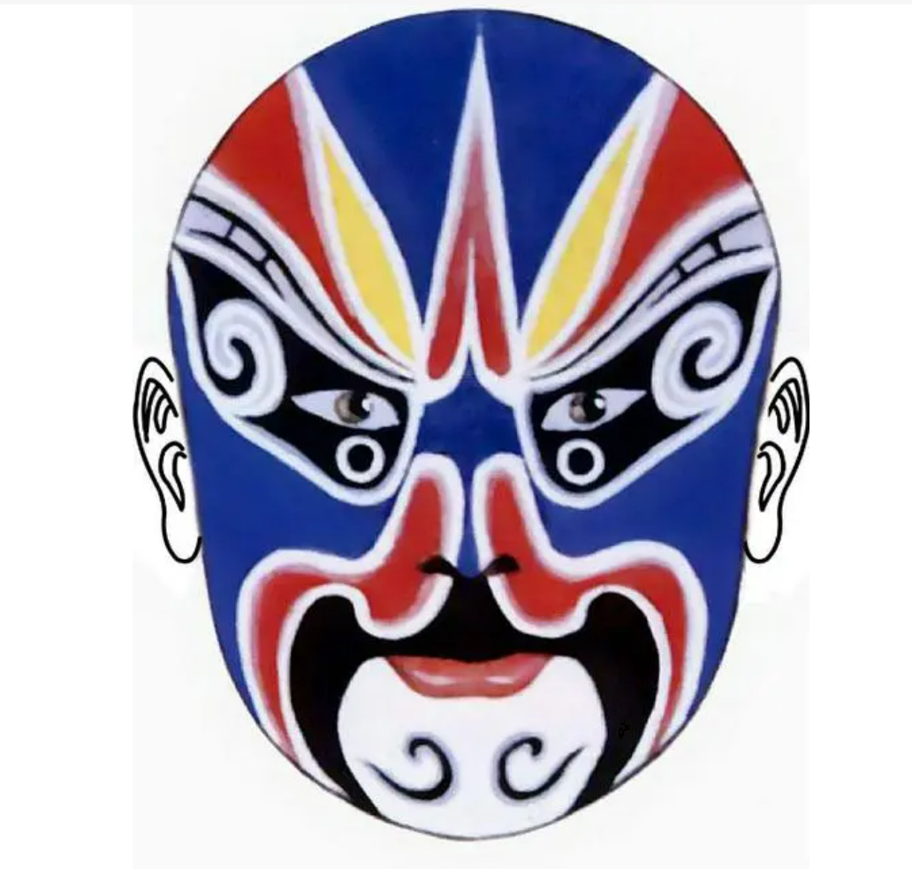
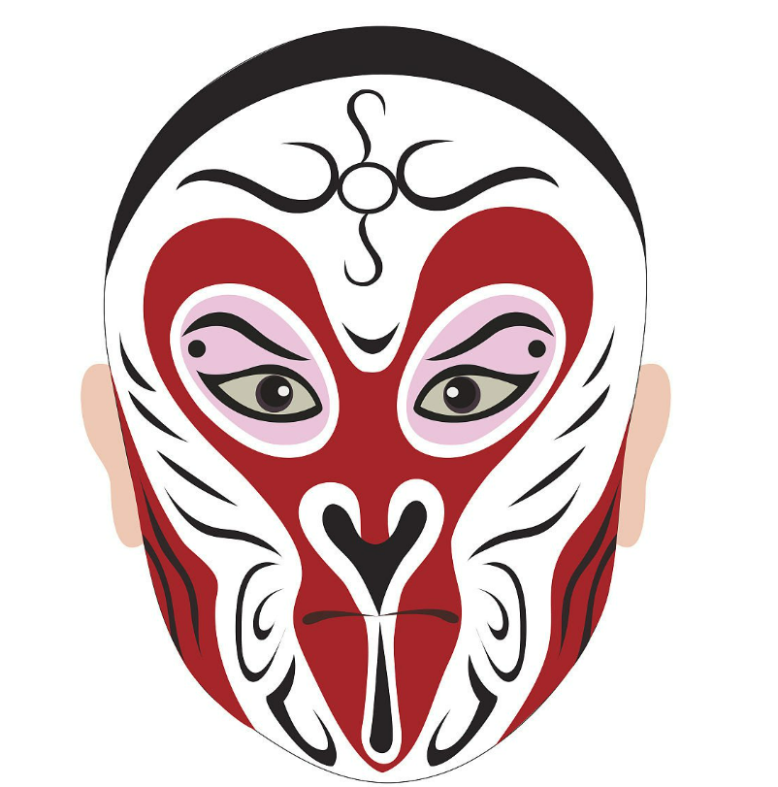
Bao Zheng
Zhao Kuangyin
Xia Houdun
Dou Erdun
Sun Wukong

Slide 8
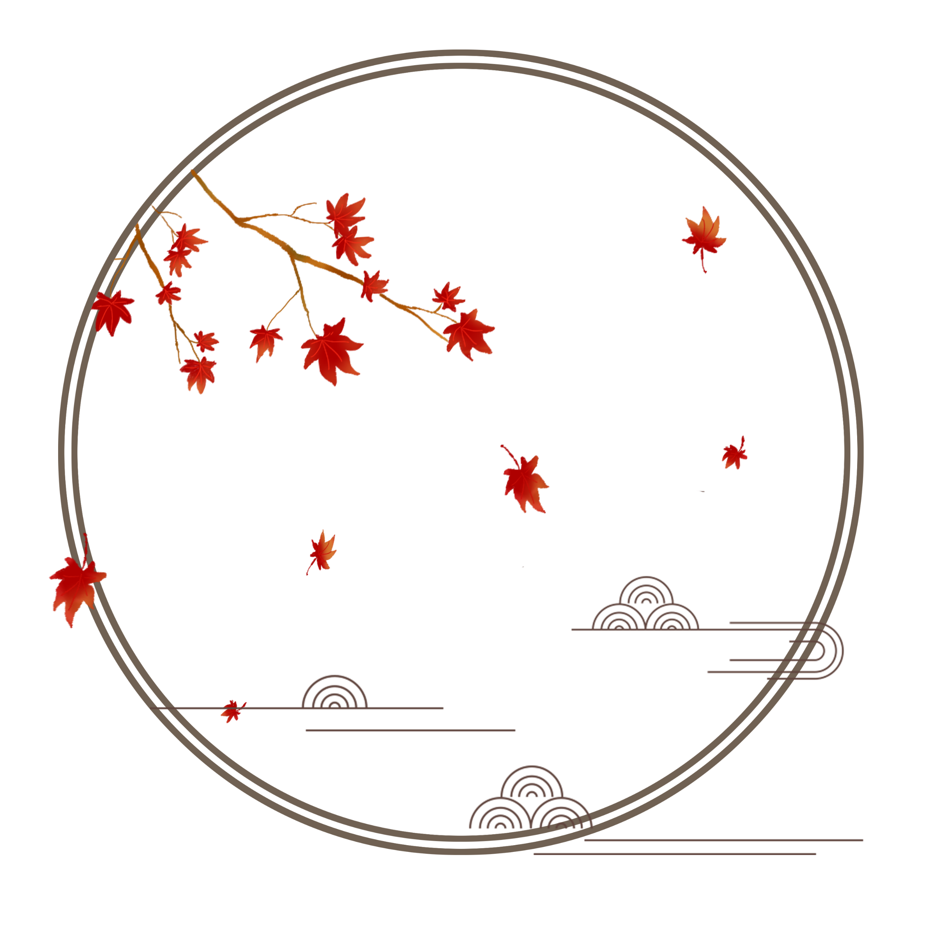
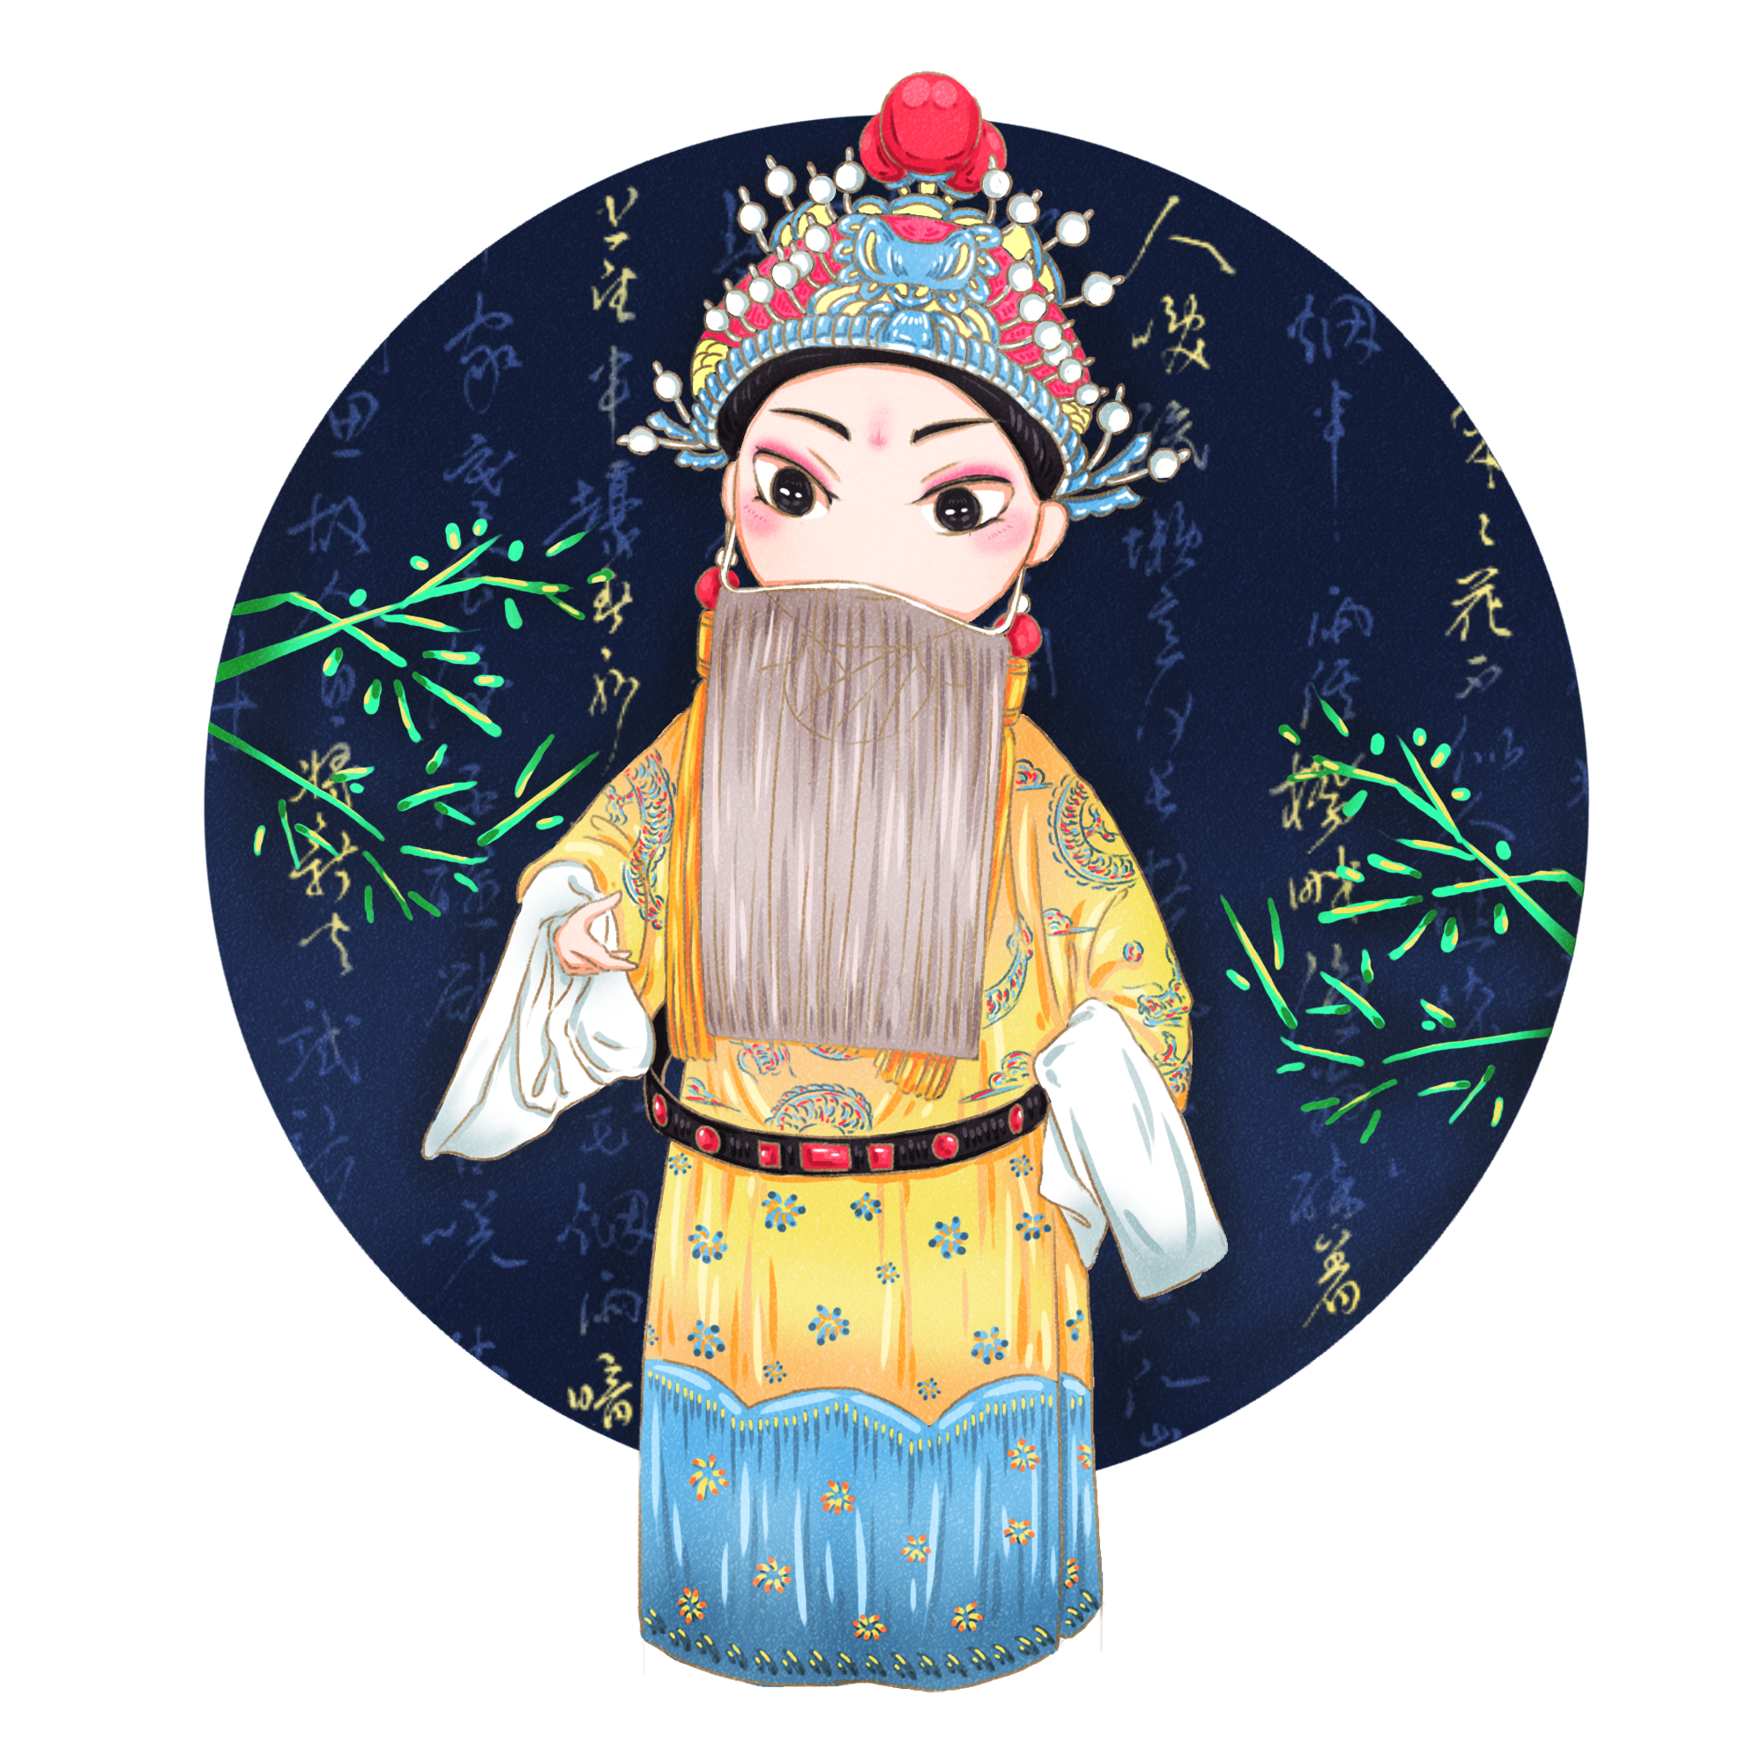
Color Culture
In order to emphasize the personality of the characters, each type of Peking Opera makeup pattern is distinguished by different colors, which as a result greatly strengthens the dramatic conflict on the stage. The color patterns of each of the facial makeup have a specific meaning. As soon as the actor enters the stage, the audience can instantly read the characteristics of the person by the pattern and colors on their face.
红忠紫孝，黑正粉老。
水白奸邪，油白狂傲。
黄狠灰贪，蓝勇绿暴。
神佛精灵，金银普照。
翁偶虹

Slide 9
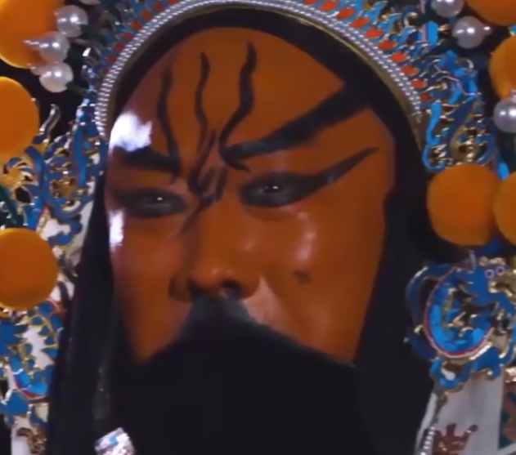
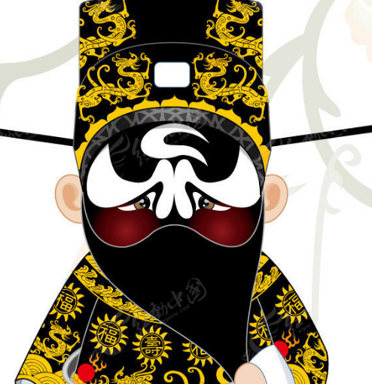
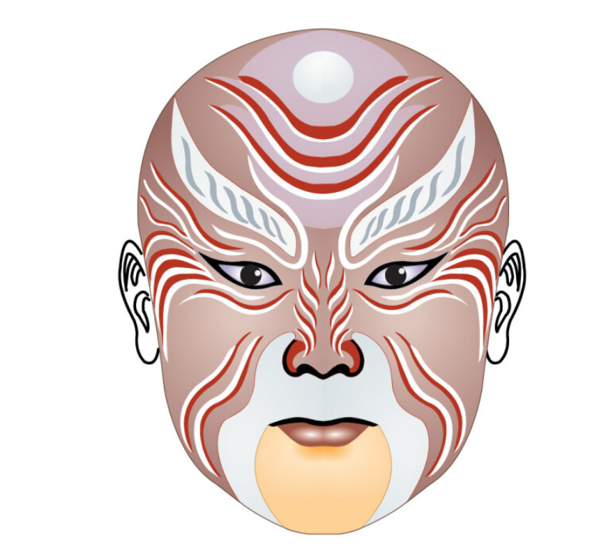
Color Culture
红忠紫孝，黑正粉老。
Red
Red facial makeup is symbolic of loyalty , upright and integrity like the characters Guan Yu
Purple
Purple facial makeup shows more calm and righteous like Zhuan Zhu .（专诸）
Black
Black facial makeup gives people the impression that the actor is serious, courageous and wise like Bao Zheng, an impartial official .
It also stands for mighty force and boldness like Zhang Fei in drama the Three Kingdoms
Pink
Pink is for older people, symbolizing the old and the weak like Jiang Ziya（姜子牙）

Slide 10
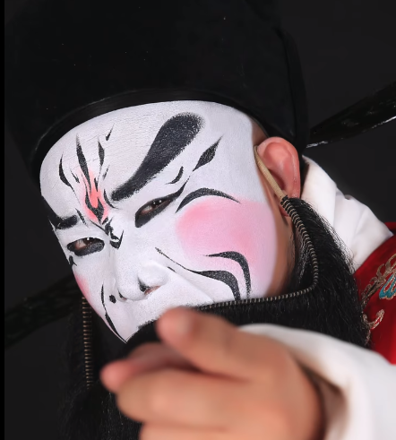
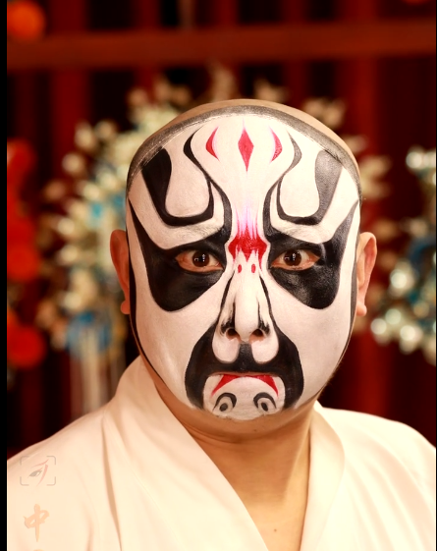
Color Culture
水白奸邪，油白狂傲。
Water white facial makeup bears a derogatory sense , indicating a deceitful and suspicious nature like Cao Cao in drama the Three Kingdoms .
Oil white stands for the headstrong like Ma Su （马谡）

Slide 11
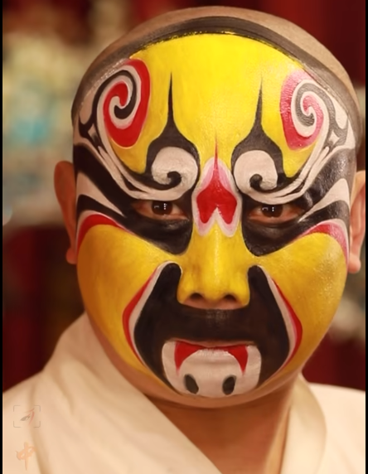
Color Culture
黄狠灰贪，蓝勇绿暴。
Yellow
Yellow means fierce and brutal
Grey
Grey is a symbol of greed
Blue
Characters wearing blue facial makeup tend to be upright, outspoken and even unruly like Dou Erdun .
Green
Green represents rudeness and recklessnes, such as Cheng Yaojin, the founding general of the Tang Dynasty

Slide 12
Color Culture
神佛精灵，金银普照。
Golden facial makeup symbolizes dignity and power like supernatural being such as Sakyamuni ( the creator of Buddhism ) and Erlang Shen ( a Chinese God with a third truth - seeing eye in the middle of his forehead ).
Silver facical makeup is usually the image of goblins and monsters

Slide 13
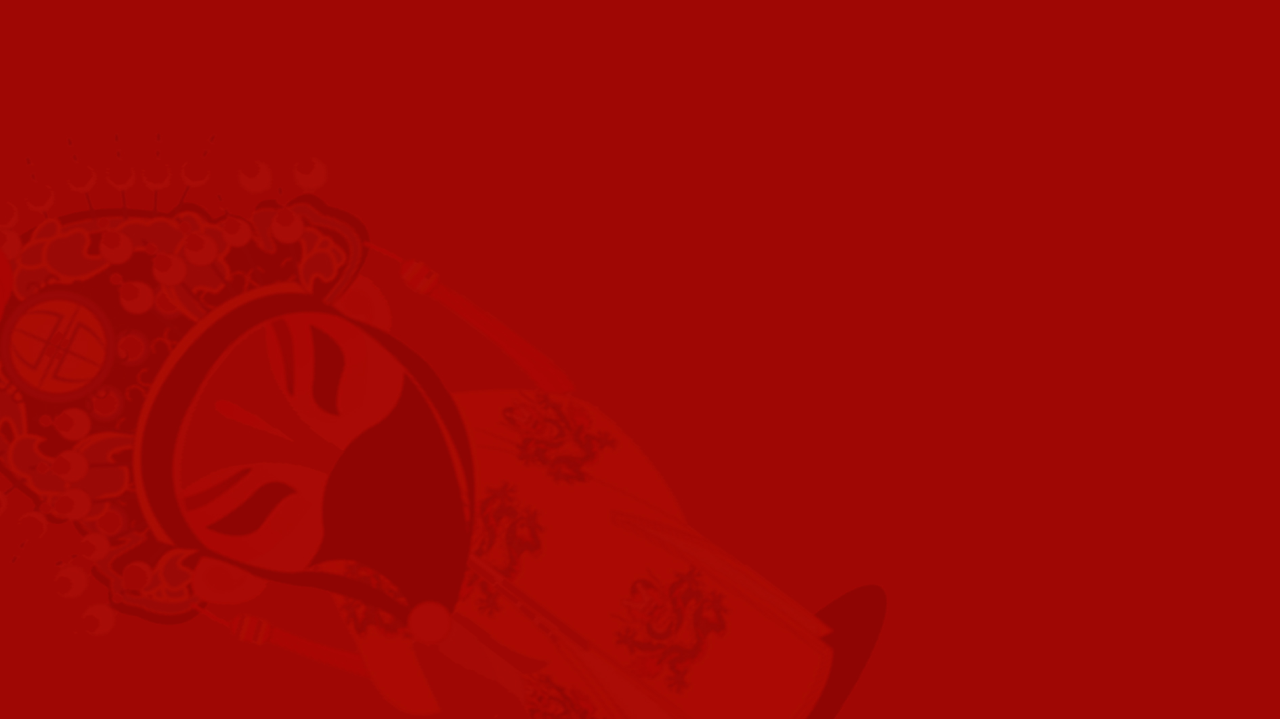
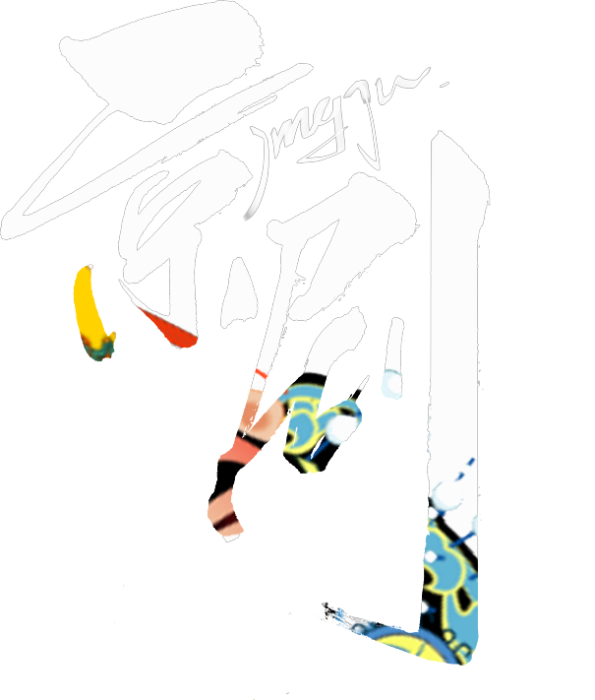
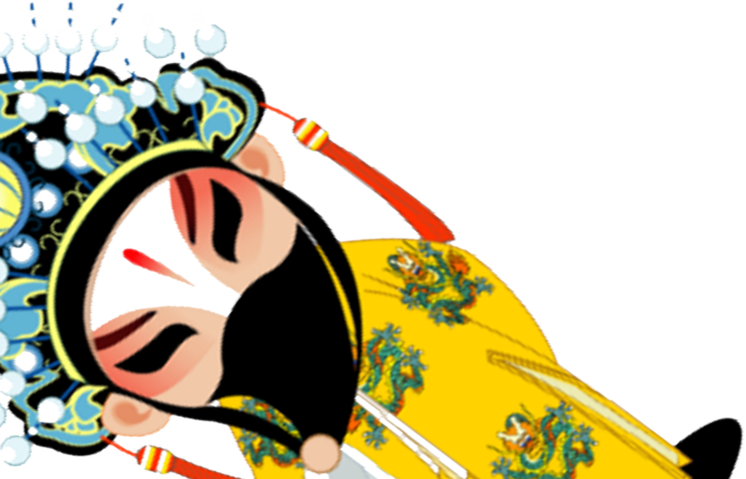
Thanks for your
listening

