Slide 1
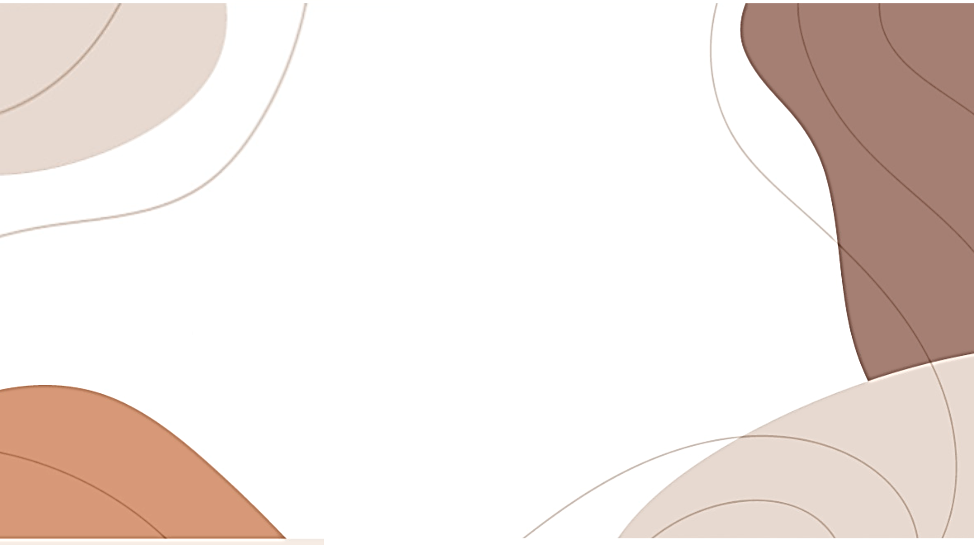
Chinese Jade Culture
英语笔译 张艳戈
（English translation Zhang Yange/Mia）

Slide 2
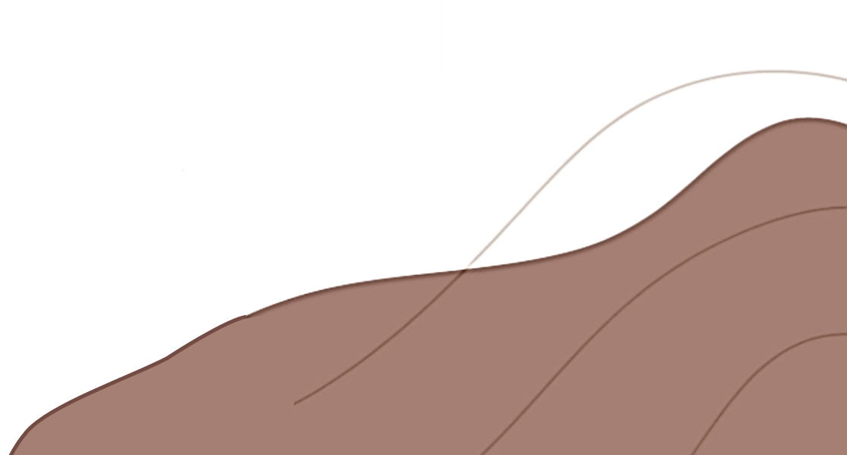
01
The origin of Chinese jade culture
02
The evolution of the function of jade
Contents
03
Basic cultural implications of jade
04
The embodiment of jade culture in Chinese language

Slide 3
The origin of Chinese jade culture
Part one

Slide 4
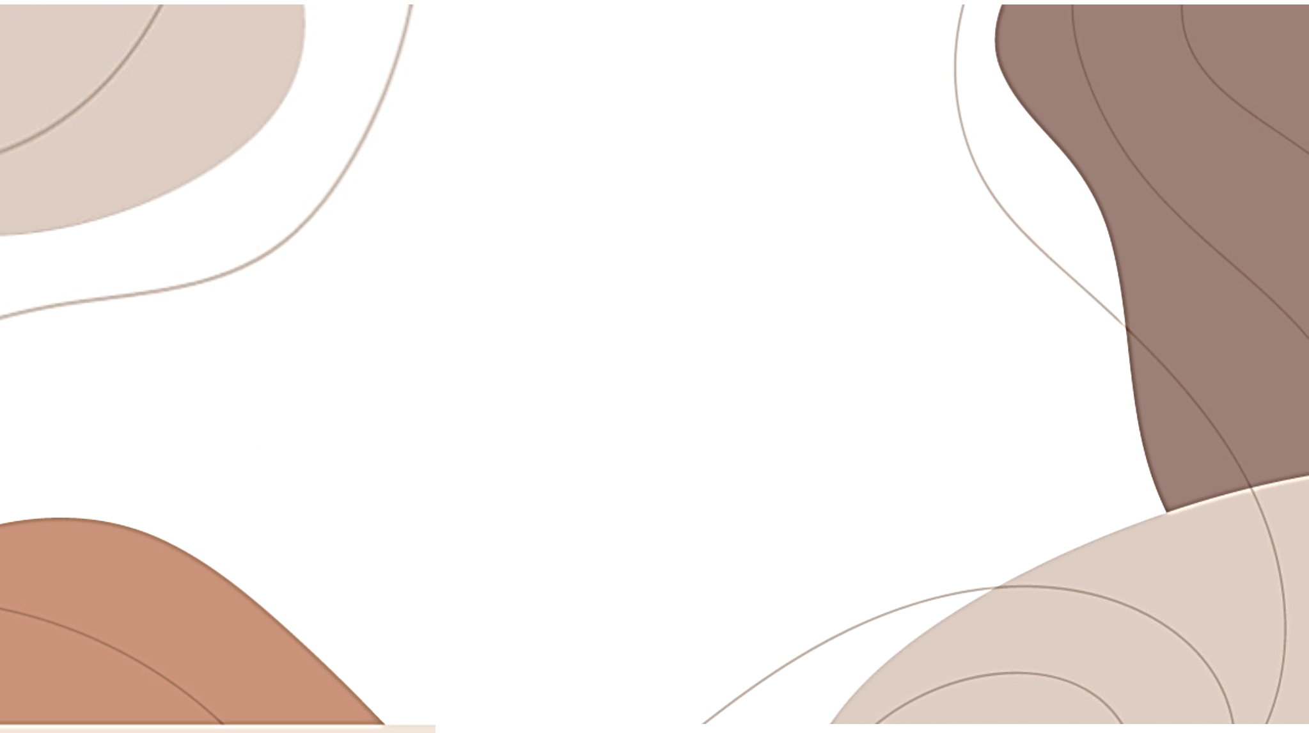
The origin of Chinese jade culture
Time: more than 18, 000 years ago
Place: In Zhoukoudian keel mountain top cave people site（周口店龙骨山顶洞穴人遗址）
Feature:
1.archaeologists found many ancient works of art as sacrificial objects.
2.the emergence of people's awareness of beauty

Slide 5
The origin of Chinese jade civilization
Time: 8200 years ago
Place: Xinglongwa cultural site in Chifeng City, Inner Mongolia（内蒙古赤峰市的兴隆洼遗址）
Feature: the excavation of a pair of white jade
Significance:
1.it marked the birth of China's jade civilization and the arrival of China's jade civilization era.
2. Chinese jade culture has gradually developed into social, economic, political, cultural, religious, artistic and moral aspects.

Slide 6
The evolution of the function of jade
Part Two

Slide 7
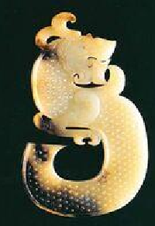
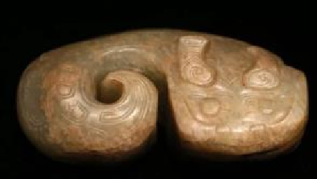
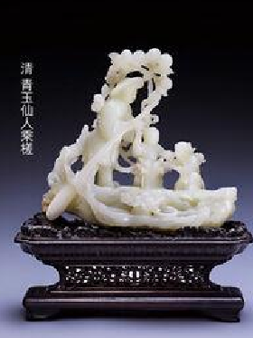
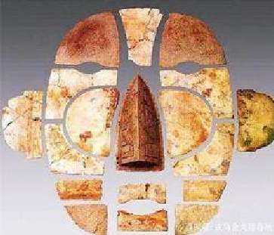
The evolution of the function of jade
Mediumistic Jade Stage（巫玉期）
Ritual Jade Stage
（礼玉期）
Burial Jade Stage（葬玉期）
Entertained Jade Stage（玩玉期）

Slide 8
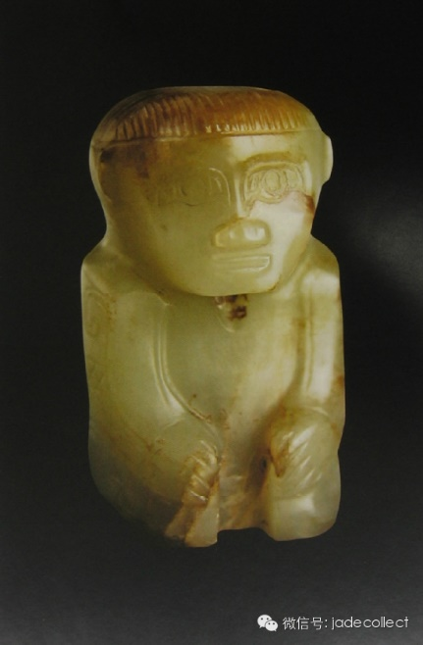
1. Mediumistic Jade Stage (From Prehistoric to Shang Dynasty)
In the prehistoric period, jade was given the spirituality of the God of Heaven. The use of jade control in the hands of the gods known as "spirits“.
In the Shang dynasty, Yin people still like divination(占卜) ,so they asked the gods for almost everything in the life.

Slide 9
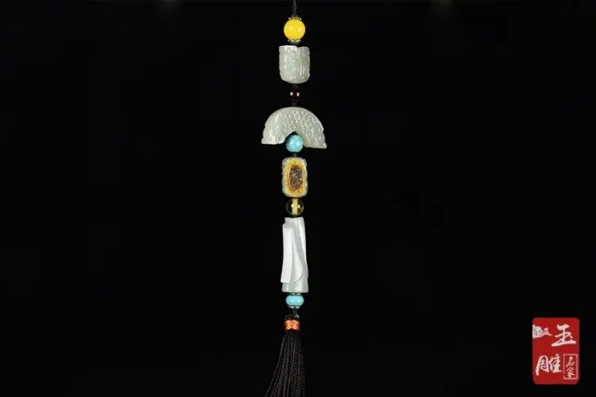
2. Ritual Jade Stage (Zhou Dynasty)
In the Zhou dynasty:
the political concept that people should be respected more than ghosts and spirits.
a whole set of ruling systems by creating rituals and music(礼乐).
In the Spring-autumn Warring period:
Confucius linked the jade with the gentleman’s good character. “gentlemen’s no reason, not body-yu”(君子无故，玉不去身).

Slide 10
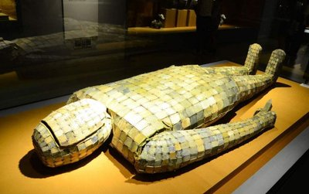
3. Burial Jade Stage (Han Dynasty)
The Han Dynasty was politically unified and economically prosperous.
In the field of ideology, the concept “Ban from hundred philosophers, venerate Confucianism”(罢黜百家，独尊儒术) was pursued.
The ruling class of the Han Dynasty advocated filial piety(孝道), and generous burial became popular.
Taoism's religious view of “immortality”.

Slide 11
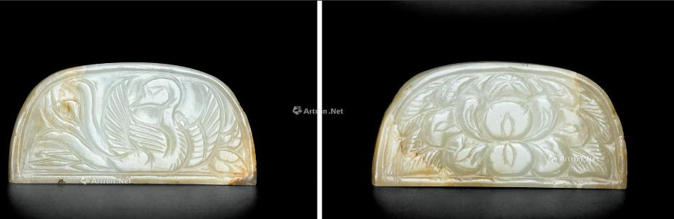
4. Entertained jade Stage (From Tang to the Qing Dynasty )
In the Tang Dynasty, jade was obviously secularized. The Tang people made great innovations, opening up a new era in decoration and shape.
In the Song Dynasty, the development of commodity economy accelerated commercialization of jade articles.
To the Qing Dynasty, jade craftsmen have been numerous, and the jade has become a popular artwork for Chinese from the emperor and the nobility to the ordinary people.

Slide 12
Basic cultural implications of jade
Part three

Slide 13
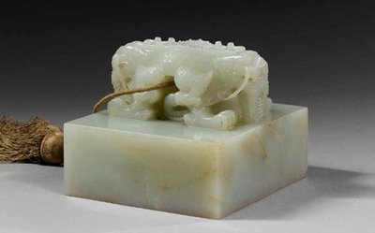
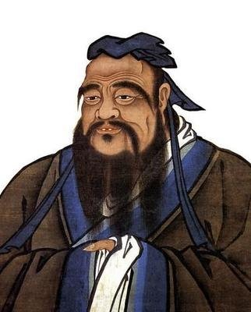
Basic cultural implications of jade
Symbol of power and wealth
On the officialdom, the different positions and ranks hold different jade. (“Jade emperor”, the “Xi” )
Symbol of Noble Morality
Confucianism combines ethical and moral values with jade symbolizing “11 virtues”

Slide 14
The embodiment of jade culture in Chinese language
Part four

Slide 15
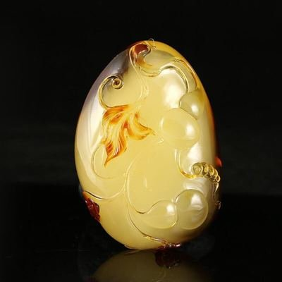
The embodiment of jade in Chinese language
“jade” symbolizes beauty, kindness and extraordinary
“jade” is a spiritual symbol of virtue.
make no distinction between jade and stone（玉石不分）
gold and jade predestined match（金玉良缘）
the house full of gold and jade（金玉满堂）
as clean as ice and as pure as jade（冰清玉洁）
It is better to die of ‘jade’ when life is a disgrace（宁为玉碎，不为瓦全）
a jade tree in the wind（玉树临风）

Slide 16
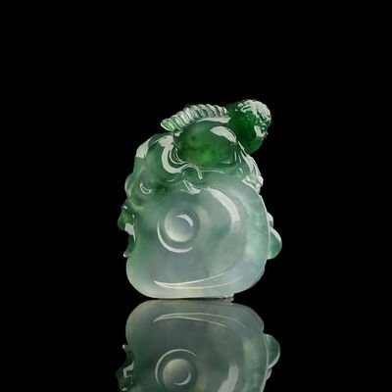
Questions
When was the Chinese jade civilization born? And what marked its birth?
How many stages did the functions of jade go through in China?
What are the two main cultural implications of jade in China?

Slide 17
Thank you
English translation
Zhang Yange/Mia
英语笔译 张艳戈

