Slide 1

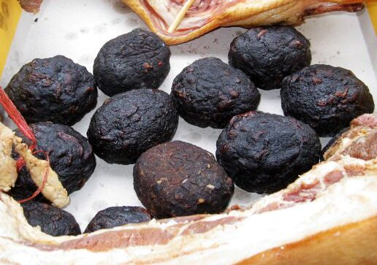
Pig Blood Balls
汇报人Li Ting
日期：2025/ 4/ 11

Slide 2

Contents
01
02
03
04
Historical Background
Process of Making Pig Blood Balls
Cooking Methods
Cultural Symbolism

Slide 3



Part
01
Historical Background

Slide 4


1. Originated in the Qing Dynasty
2. The most popular story is from the Ming Zhengde period
3. Characters: a sick poor boy ; the boy's mother;
Place： A temple in Baoqing

Slide 5

Part
02
Process of Making Pig Blood Balls

Slide 6


2.2 Step-by-Step Process
Materials: Fresh pork(meat);
Fresh pig blood;
Fresh tofu;
Baboo sieve;
salt;
clean and empty bottle;
wooden basin;
straws

Slide 7
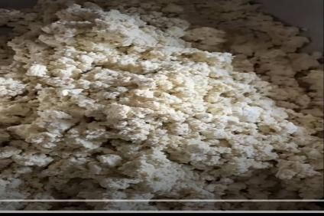
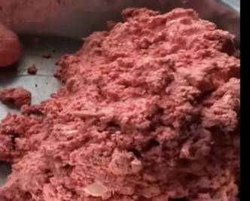
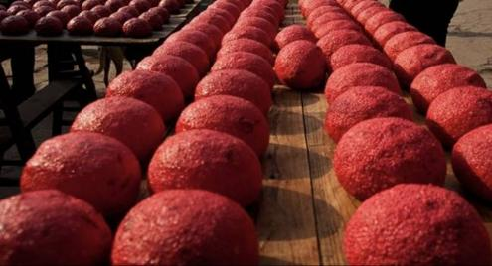
2.2 Step-by-Step Process
First, crush the tofu
pour pig blood
add some salt and minced pork meat
second, divide the materials into equal sizes and shape into elliptical balls
(mix them completely and appropriately)
Third, put balls into sieves covered with straws
(dry them in the sun or smoke them by burning wood)

Slide 8
Part
03
Cooking Methods

Slide 9

The most common ways are:
1. Steam sliced pig blood balls for 15 minutes
Steaming Time and Serving
2. Stir-fry sliced pig blood balls with peppers and garlic
3. Steamed sliced pig blood balls with other smoked meats

Slide 10
Part
04
Cultural Symbolism

Slide 11
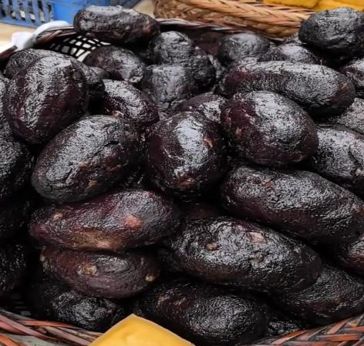

4.1 Pronunciation and Meaning
Similarities Between 丸子 and 圆子 in sound
represent reunion with family and friends;
represent pople's wish for a better life

Slide 12
Thank You

