Slide 1

Buytogether
曾锦泉

Slide 2


Buytogether
Buytogether(PDD), also called Pinduoduo in Chinese, is a mainstream e-commerce application of mobile Internet in China, and a third-party social e-commerce platform focusing on
C2M(Customer-to-Manufacturer) group shopping.

Slide 3
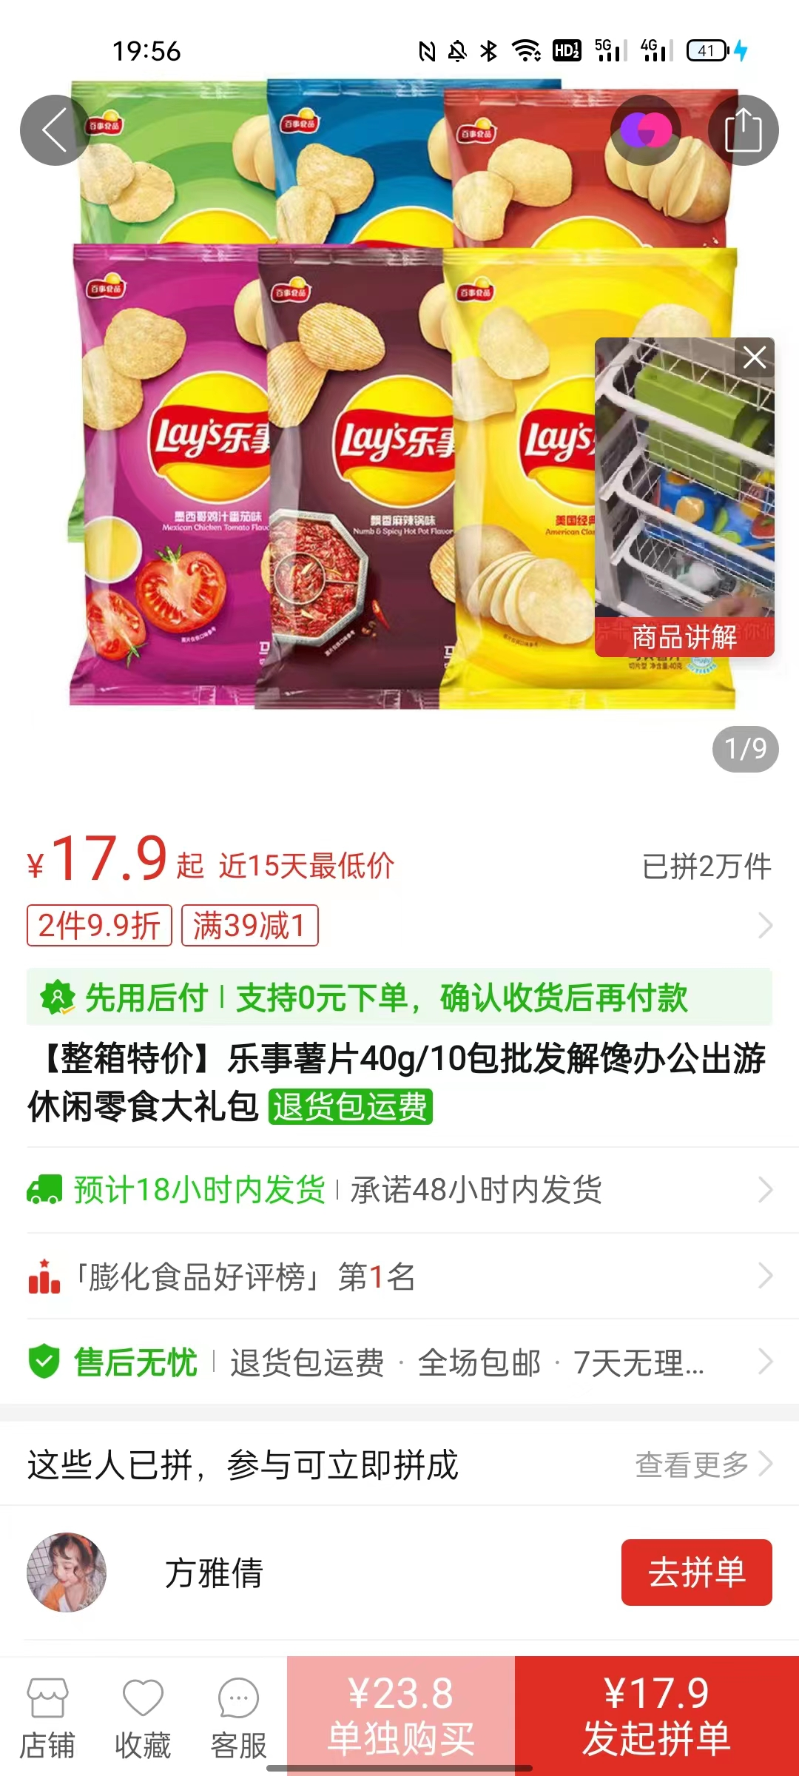
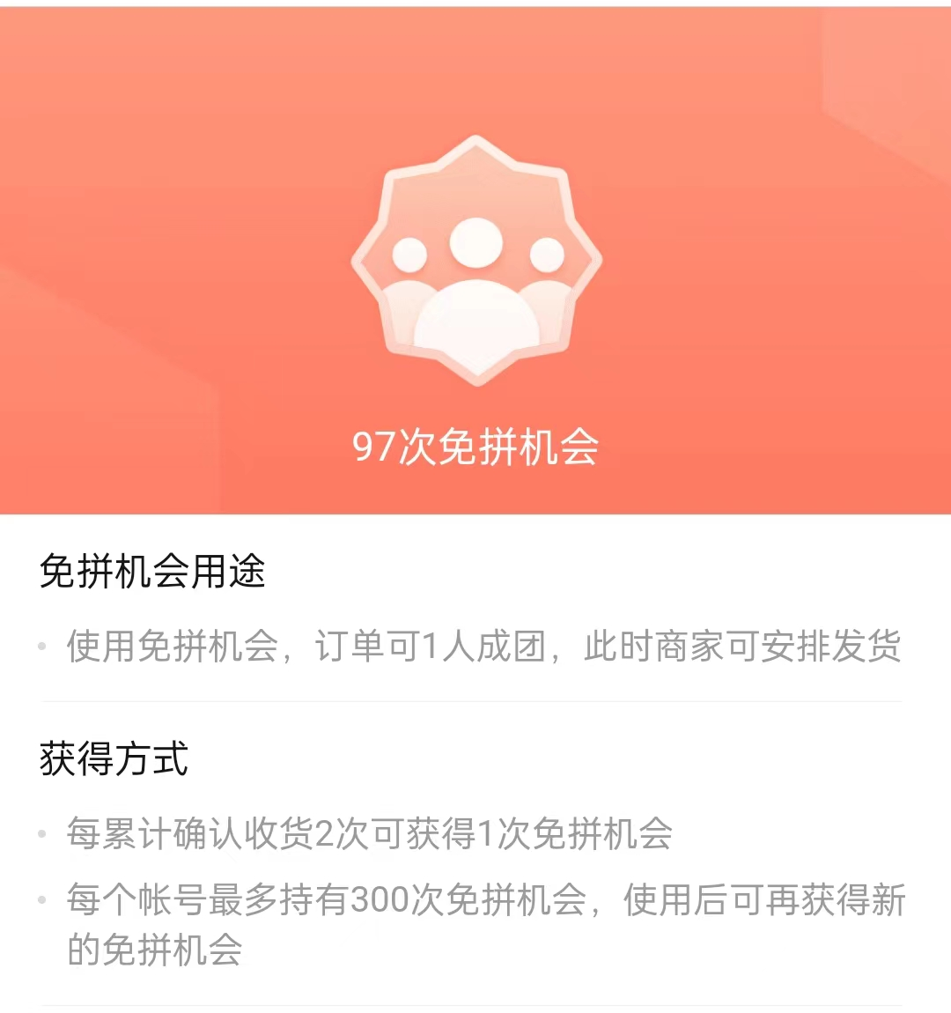
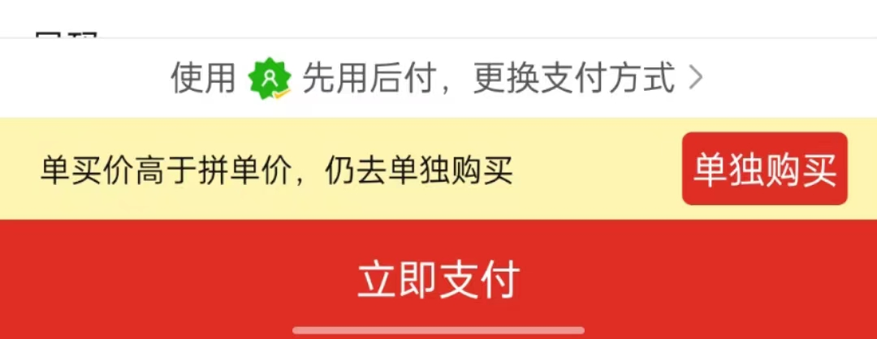
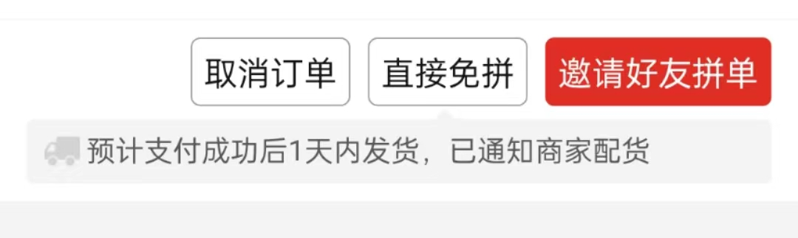

Slide 4

Buytogether aims to enable people to buy better goods at lower prices and gain more benefits and fun by gathering the strength of more people. Its idea in online shopping is unique in that it creates a brand new pattern of social e-commerce: Community E-Commerce (社区电子商务).

Slide 5
The Development Period of Buytogether

Slide 6

1.Early Developing Period (2015-2018)
In September 2015, Buytogether was officially launched.
In July 2016, Buytogether had more than 100 million users and received about $110 million financing.
In October 2017, Buytogether occupied the first place in the total number of iOS application downloads under the category of shopping for nearly one month.
Buytogether is a dark horse in the early days, constantly showing its edge.
2.Growing Period (from 2018 to now)
After three years of development, Buytogether has made remarkable achievements.
According to the 2022 annual report released by Buytogether, it achieved operating revenue of about 130.558 billion yuan in 2022, with a growing rate of 39% compared with 2021.
The achievements of Buytogether are amazing to all, creating a miracle among all the e-commerce platforms

Slide 7
The Advantages of Buytogether

Slide 8
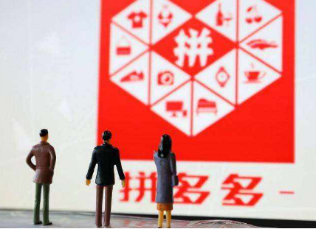
Advantages
1. Targeting customers in the sinking market.
In the early days of establishment, Buytogether effectively distinguished its main customers from those of traditional e-commerce platforms, and positioned the main customers in the sinking market to buffer competition in the industry. Buytogether supplies products at lower prices than other traditional e-commerce, shopping in group and enabling users to bargain, thus attracting a large number of consumers in the sinking market and small cities.
Consumers gain lower prices and suppliers acquire more customers; the trading system of Buytogether is gradually improved.

Slide 9
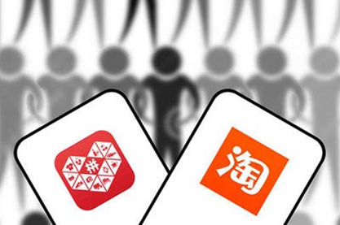
Advantages
2. Good after-sale service.
Buytogether has a very good after sale service, which is completely out of Taobao’s reach.
In Buytogether, it will be very convenient for you to refund or replace goods.
Buytogether’s after-sale period is 15 days, which is after the buyer clicks to confirm receipt (确认收货)，or the system automatically confirms (自动确认收货).
The sellers should actively cooperate with customers during this period of time.

Slide 10
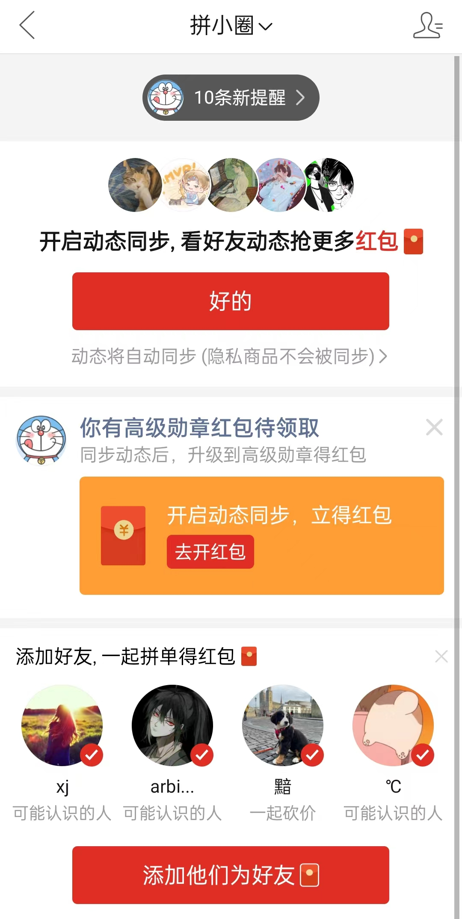
Advantages
3. Connecting users in many ways.
User connection is a significant advantage of Buytogether. Under the mode of community e-commerce, the relationship between users and sellers or other users is much closer.

Slide 11

Advantages
4. Promoting social contacts.
Buytogether utilizes the interpersonal network of community to innovate forms of discounts.
such as inviting friends to help bargain, gain free charge and group price.

Slide 12
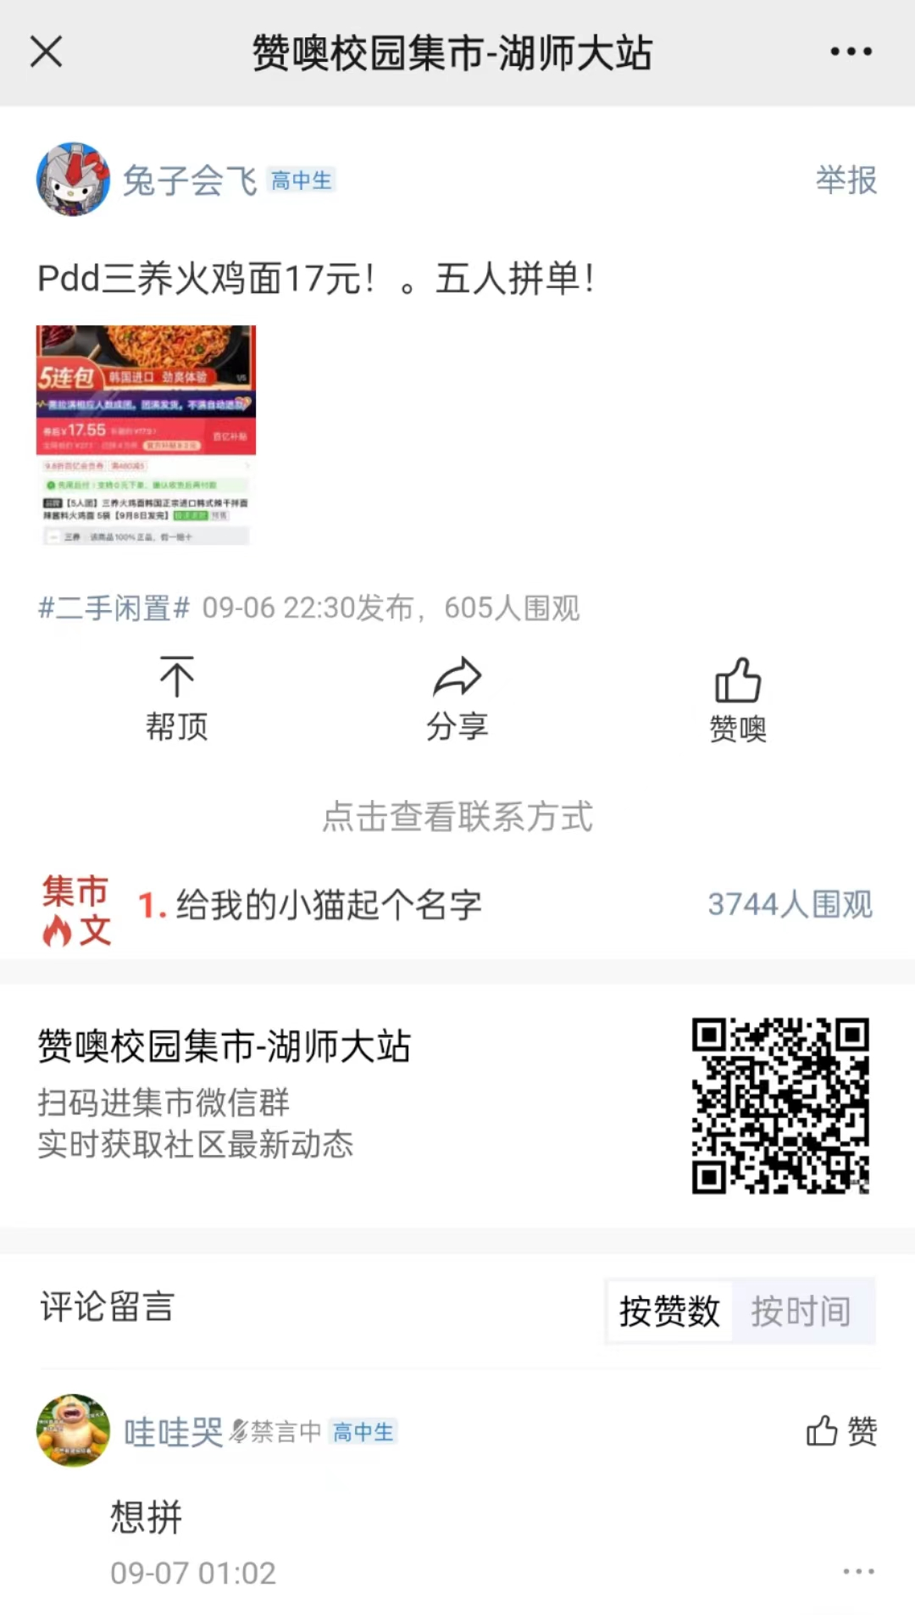
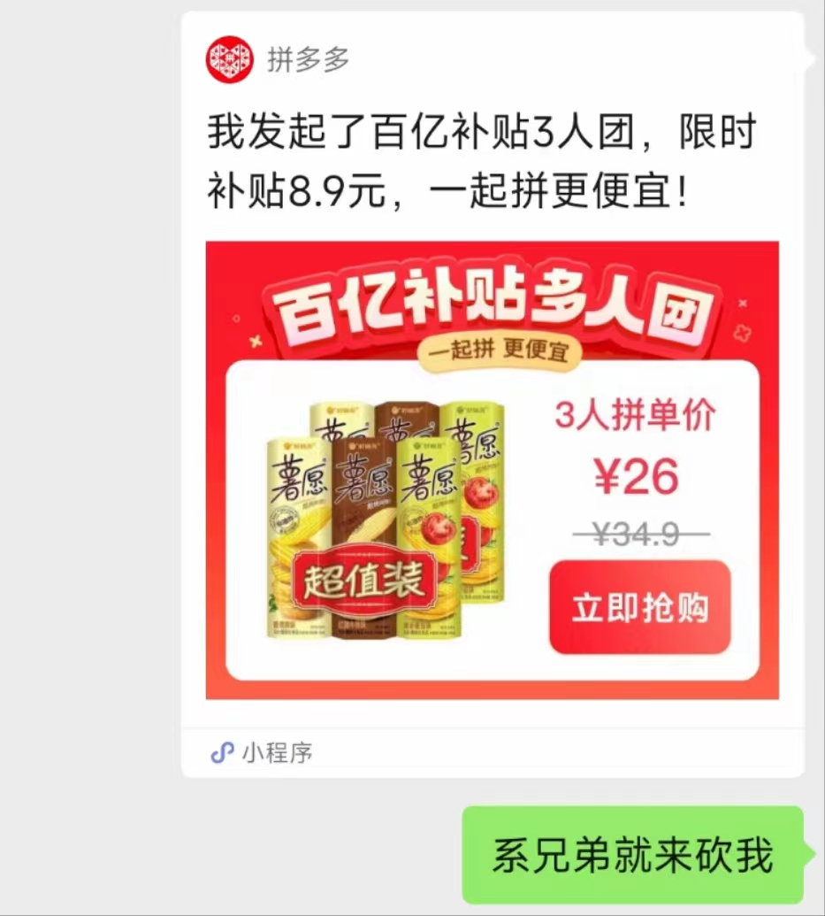
Advantages

Slide 13
The Problems of Buytogether

Slide 14
Problems
1. The problem of low quality
2.The crisis of confidence
3.The damage of corporate image （企业形象）

Slide 15

1. The problem of low quality
Problems
In order to conform with the platform's low-price strategy as much as possible, the stores have to reduce the costs of raw materials and production, thus causing quality problems.
In addition, due to Buytogether’s low entry threshold and loose supervision, the qualifications of its sellers are not all official.

Slide 16

Problems
2.The crisis of confidence (信任危机)
Buytogether has launched zero yuan purchase, cash withdrawal with friends’ help (by sharing links) and other activities that require users to invite their friends to participate in.

Slide 17

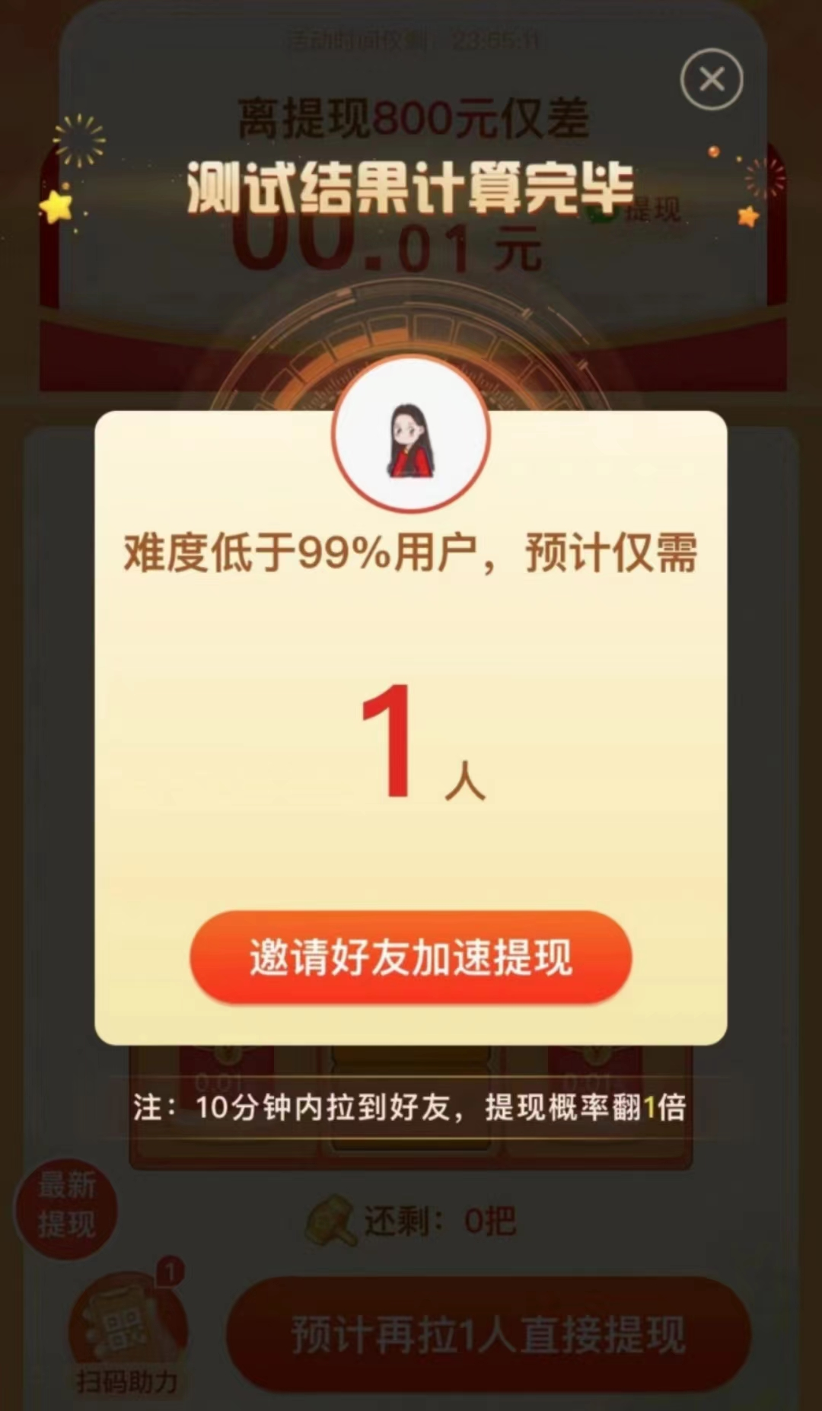
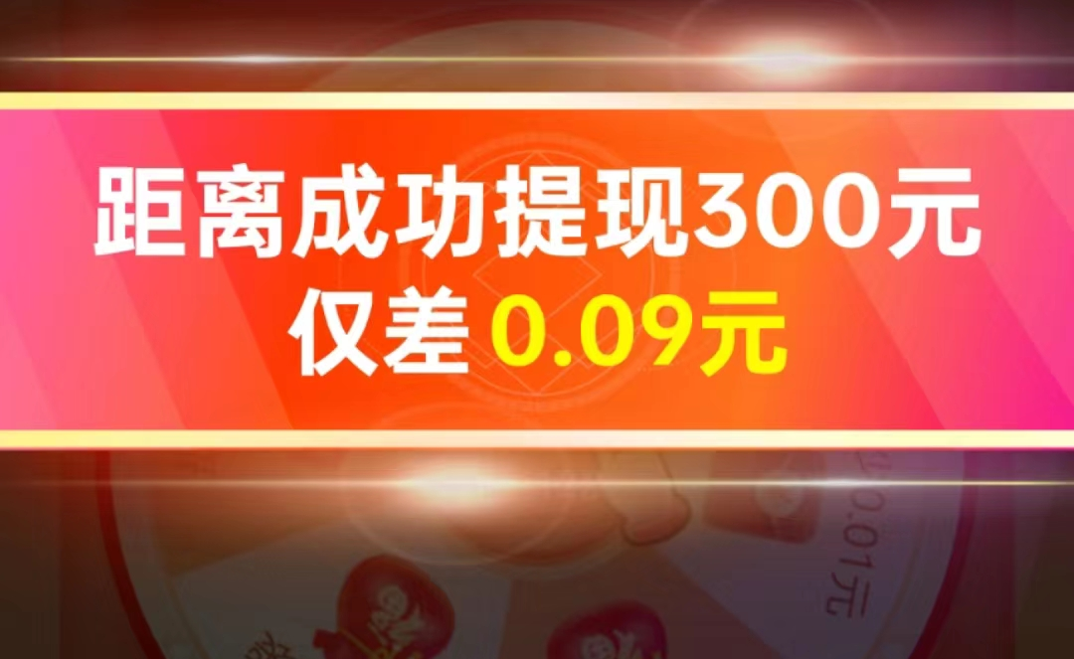
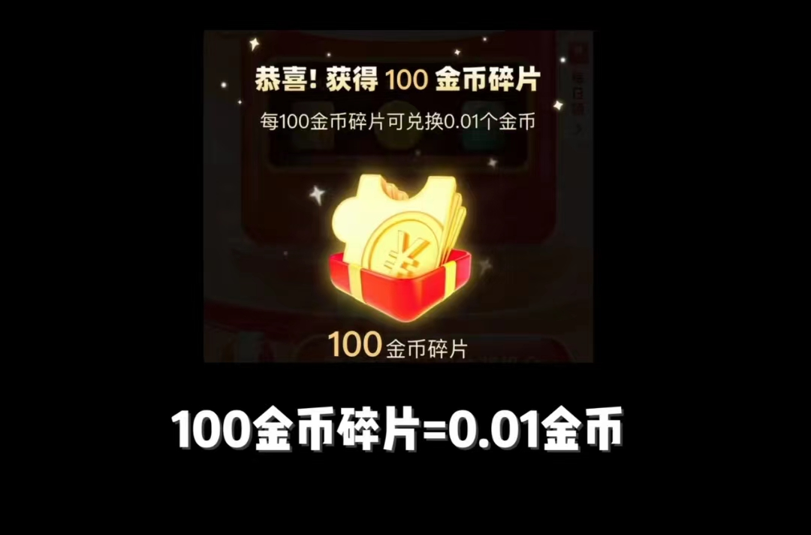

Slide 18
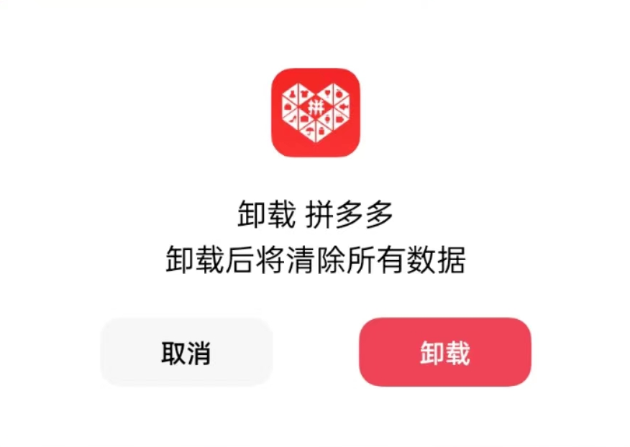
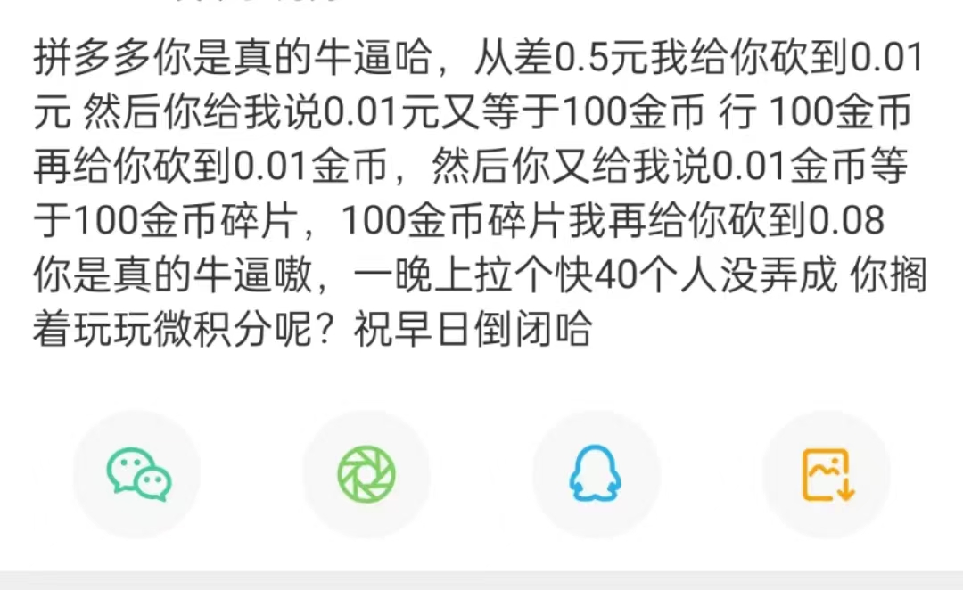



Slide 19
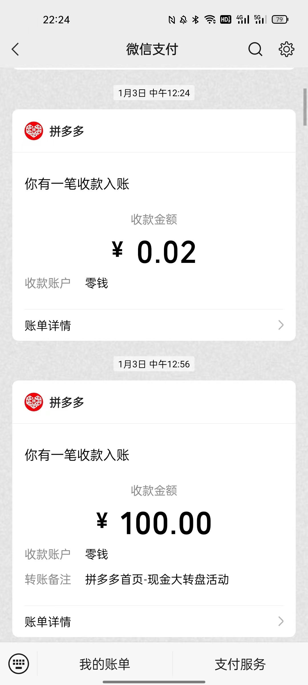
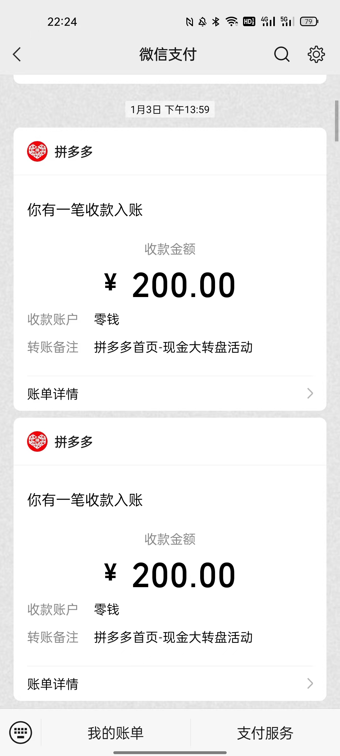

Slide 20

Nowadays, Buytogether no longer needs to rely on fission marketing methods like sharing links to expand the user scale, but needs to improve its own marketing policies, utilize social media more rationally, and formulate marketing activities from the perspective of users.
Although Buytogether's current single-user purchase level is still low, it also has the potential to improve within the system through live streaming, subsidies, and other actions to improve user stickiness, which will allow Buytogether to better cope with the competition between the Tao system and other internet e-commerce companies and continue growing and developing.

Slide 21
THANK YOU FOR WATCHING

