Slide 1

Music and Instruments: Suona Horn
汇报人：刘婕妤 Erica

Slide 2
Introduction
目录
Construction and Playing Skills
Position in Chinese Folk Music
CONTENTS
Interactive Q&A Session

Slide 3

PART
01
Introduction

Slide 4
Introduction to the Suona
1
2
3
Definition and Etymology
Historical Entry into China
Evolution Over Time

Slide 5
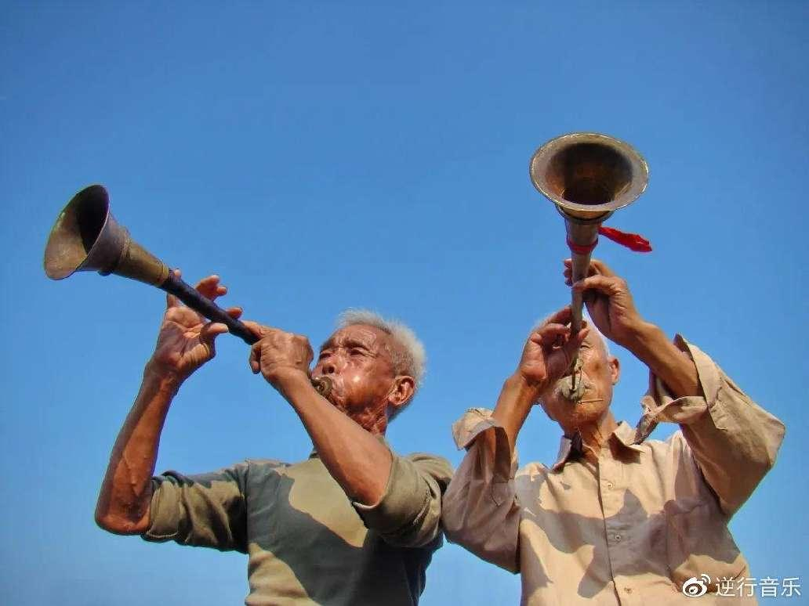
Definition and Etymology
The suona, also known as the Chinese double- reed horn, is a traditional Chinese wind instrument with a history dating back to the 3rd century. The name "suona" is derived from the Persian word "surnā," indicating its origins in Western Asia before its introduction to China.

Slide 6
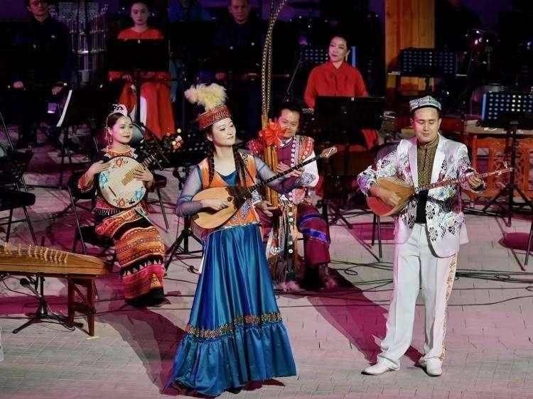
Historical Entry into China
The suona was introduced to China via the Silk Road during the 3rd century, with early depictions found in the Kizil Caves of Xinjiang. It became integrated into Chinese music culture, reflecting the country's historical connections with the wider world.

Slide 7

Evolution Over Time
Over centuries, the suona has evolved from a simple instrument used for military signaling to a complex tool for diverse musical expressions, reflecting changes in Chinese society and the development of its musical tradition.

Slide 8
PART
02
Construction and Playing Skills

Slide 9
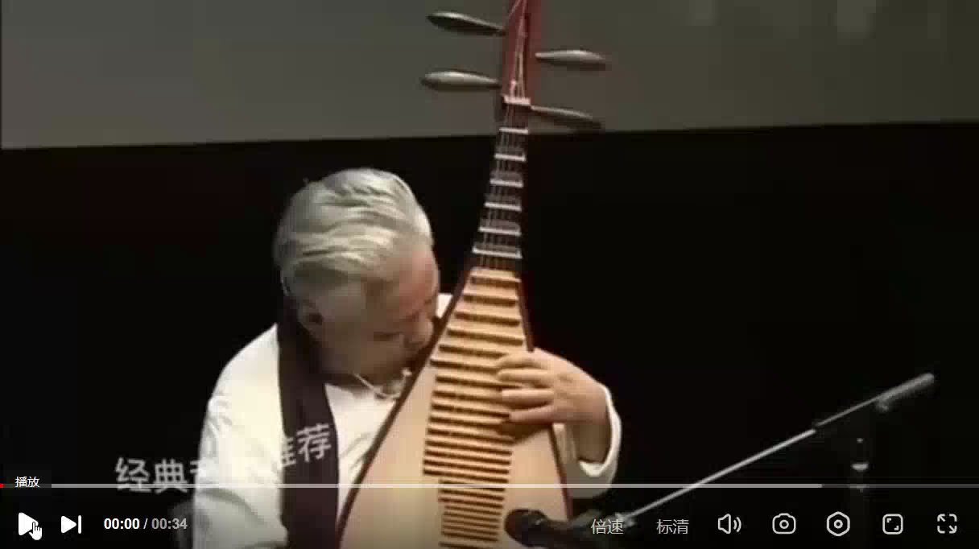
Components and Materials
The suona consists of a wooden body, a copper tube with a double- reed whistle, and a copper bawl at the bottom, which together create its unique sound. The choice of materials affects the instrument's tone and projection.
Techniques and Skills
Mastering the suona requires control over breath, lip pressure, and fingering, with players using a combination of traditional and modern techniques to produce a wide range of sounds and styles.

